Slide 1
DATE-A-SCIENTIST
An OKCupid Multiclass Classification Project by Michael Tariku

Slide 2
PROBLEM STATEMENT
Question: How well can a user’s health- and lifestyle-related attributes (e.g. body type, diet, drinking/smoking habits) predict their status on OKCupid?
Rationale: Dating apps like OKCupid almost always stress sex appeal, which can be accentuated or diminished by physical appearance and lifestyle habits. I saw no reason that these aspects could not feasibly predict or explain relationship status.

Slide 3
CHOSEN ATTRIBUTES
These following variables were selected to test whether health contains a strong enough predictive signal about relationship status:
body_type: self-reported physical description (e.g. jacked, curvy, used-up)
diet: stated dietary preference (e.g. halal, kosher, vegan)
drinks, drugs, smokes: self-reported adverse lifestyle behaviours
A person’s status can be one of four things -- single, available, seeing someone, or married.

Slide 4
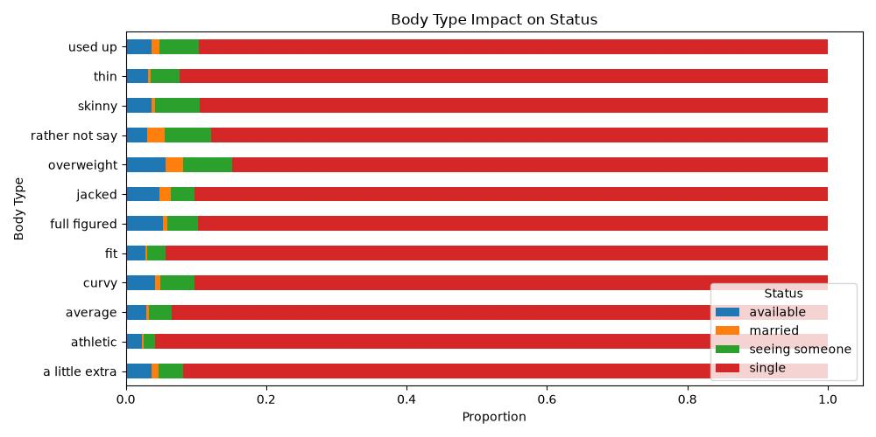
EXPLORATORY DATA ANALYSIS
The chart below offers little evidence that body type alone provides a strong predictive signal. In fact, approximately 93% of the test profiles are single. This means that the target distribution within the chosen features’ categories is skewed.

Slide 5
PREPROCESSING
Missing values: retained as a separate ‘did not answer’ category instead of discarding incomplete profiles
Training-testing split: 80% of the health dataset went into the training set and 20% into the testing set; stratification preserved the four-class status distribution in both sets
Categorical encoding: all predictors in the training set were converted into binary columns using one-hot encoding, then applied to the testing data
Model construction: stratified five-fold cross-validation was used to give minority classes more of an influence on training; balanced accuracy was the primary selection metric

Slide 6
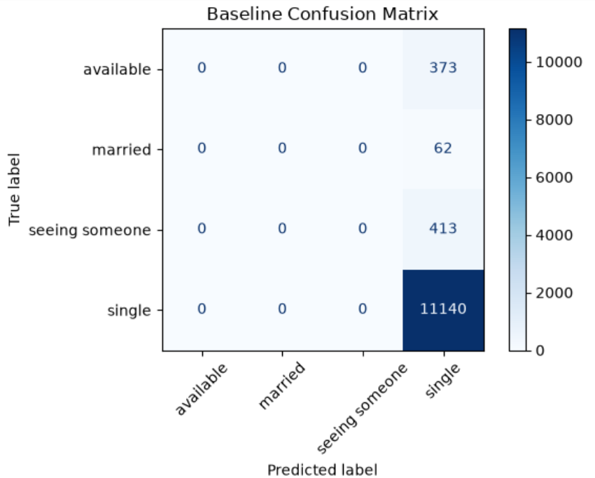
MAJORITY-CLASS (OR BASELINE) CLASSIFIER
Takeaway: Just because a model has high accuracy does not mean it can predict status. All it means is that the most prominent class is the most likely to be predicted.
Every profile is predicted as ‘single’

Slide 7
MODEL RESULTS
Model | Cross-Validation Balanced Accuracy | Test Balanced Accuracy | Macro F1-Score | Decision
Baseline | 25.0% | 93% | 24% | Heavily skewed towards the majority class
Logistic Regression | 36.4% | 34.9% | 21% | Has the best, though weak, balanced accuracy
Random Forest | 35.0% | 36.3% | 23% | Slightly worse performance
Verdict: Logistic regression was selected for diagnosis because it was the model with the highest cross-validated balanced accuracy. However, its lower macro F1 suggests that it cannot feasibly be deployed.

Slide 8
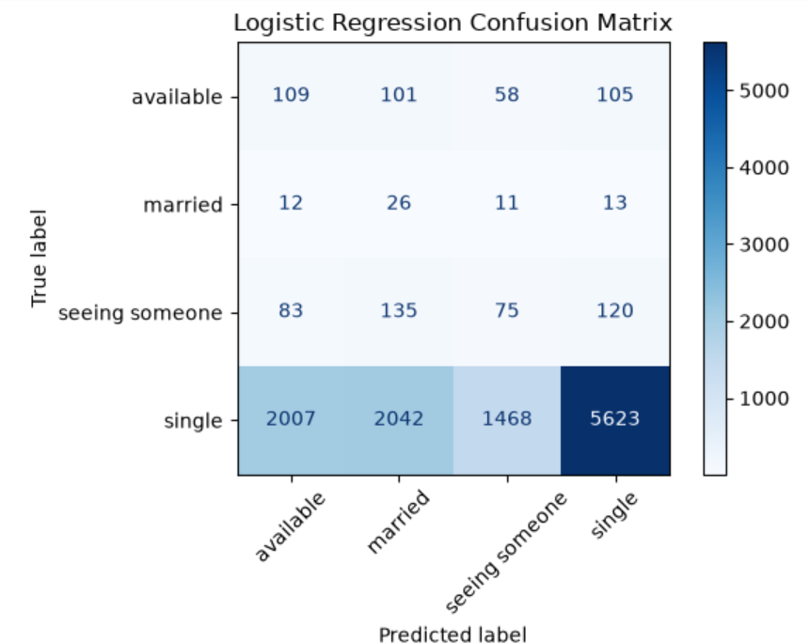
BEST-MODEL DIAGNOSIS
Minority-class recall improves
Tradeoff: More false positives; overall accuracy drops.
Takeaway: Despite the loss in bias, the above predictions are too noisy to be useful.

Slide 9
CONCLUSION
The question revisited: Is health a useful predictor of user status?
Answer: No. Because of the sheer dominance of the single status class across every health feature (body type, diet, drinking, drug use, and smoking), it is impossible to be sure that health alone sufficiently distinguishes relationship status. This, however, does not prove that lifestyle and relationship status are unrelated. It shows that these particular self-reported attributes, by themselves, provide too little signal for reliable classification.

Slide 10
NEXT STEPS
Strengthen data preparation
Measure whether missing values contain predictive information.
Packag preprocessing and modelling into one reproducible pipeline.
Address class imbalance
Compare class weighting with over- and under-sampling.
Apply resampling only within training folds to prevent leakage.
Reassess whether the rarest classes contain enough observations for reliable modelling.
Expand the predictive signal
Add age, education, location, orientation, and offspring preferences.
Use natural language processing on the offspring to separate ‘has children’ from ‘wants children’, as well as on the essay questions.

