Slide 1
GIT
Git was created by Linus Torvalds in 2005 to develop Linux Kernel

Slide 2
What is GIT ??
Git is a distributed version control system (DVCS) tool that supports distributed non-linear workflows by providing data assurance for developing quality software.
Is an open-source distributed version control system
Developed to co-ordinate the work among the developers.
The version control allows us to track and work together with our team members at the same workspace
Git can be used as private and public

Slide 3
SCM Terminologies
Server: Server is a machine which holds the collection of all the changes for every product. Server contains many repositories in it.
Repository: Folder or location under server where all the changes specific to project is stored.
Client: Client is a software which connects to the server assisting users to perform necessary actions.
Workspace: Is a folder in your local machine where we you see the files respective to a repository in the server, modify them.
Checkout: An action which helps us to fetch the files from the repository and displays in the workspace, which are later modified.
Checkin: An action where the changes made in the workspace are stored back in the repository.
Versions: References created in the repository for every checkin, which holds the transaction details of who modified, what was modified and when was it modified.

Slide 4
Version Control System (VCS)
Is a software that helps software developers to work together and maintain a complete history of their work.
Allows developers to work simultaneously.
Does not allow overwriting each other’s changes.
Maintains a history of every version.
VCS is divided into 2 Types, There are
Centralized version control system (CVCS).
Distributed/Decentralized version control system (DVCS).

Slide 5
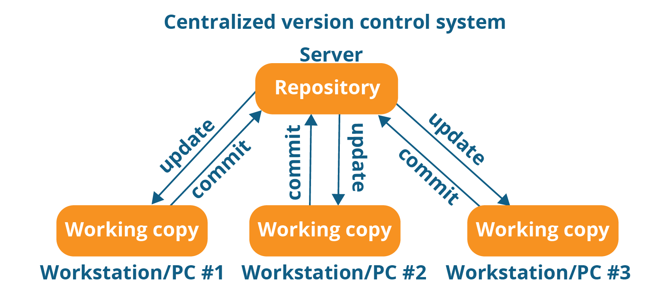
Centralized version control system (CVCS)
Uses a central server to store all files and enables team collaboration. The major drawback of CVCS is its single point of failure, i.e., Failure of central server.
Unfortunately, if the central server goes down for an hour, then during that hour, no one can collaborate at all. And even in a worst case if central server gets corrupted and proper backup has not been taken, then you will lose the entire history.
EX: SVN

Slide 6
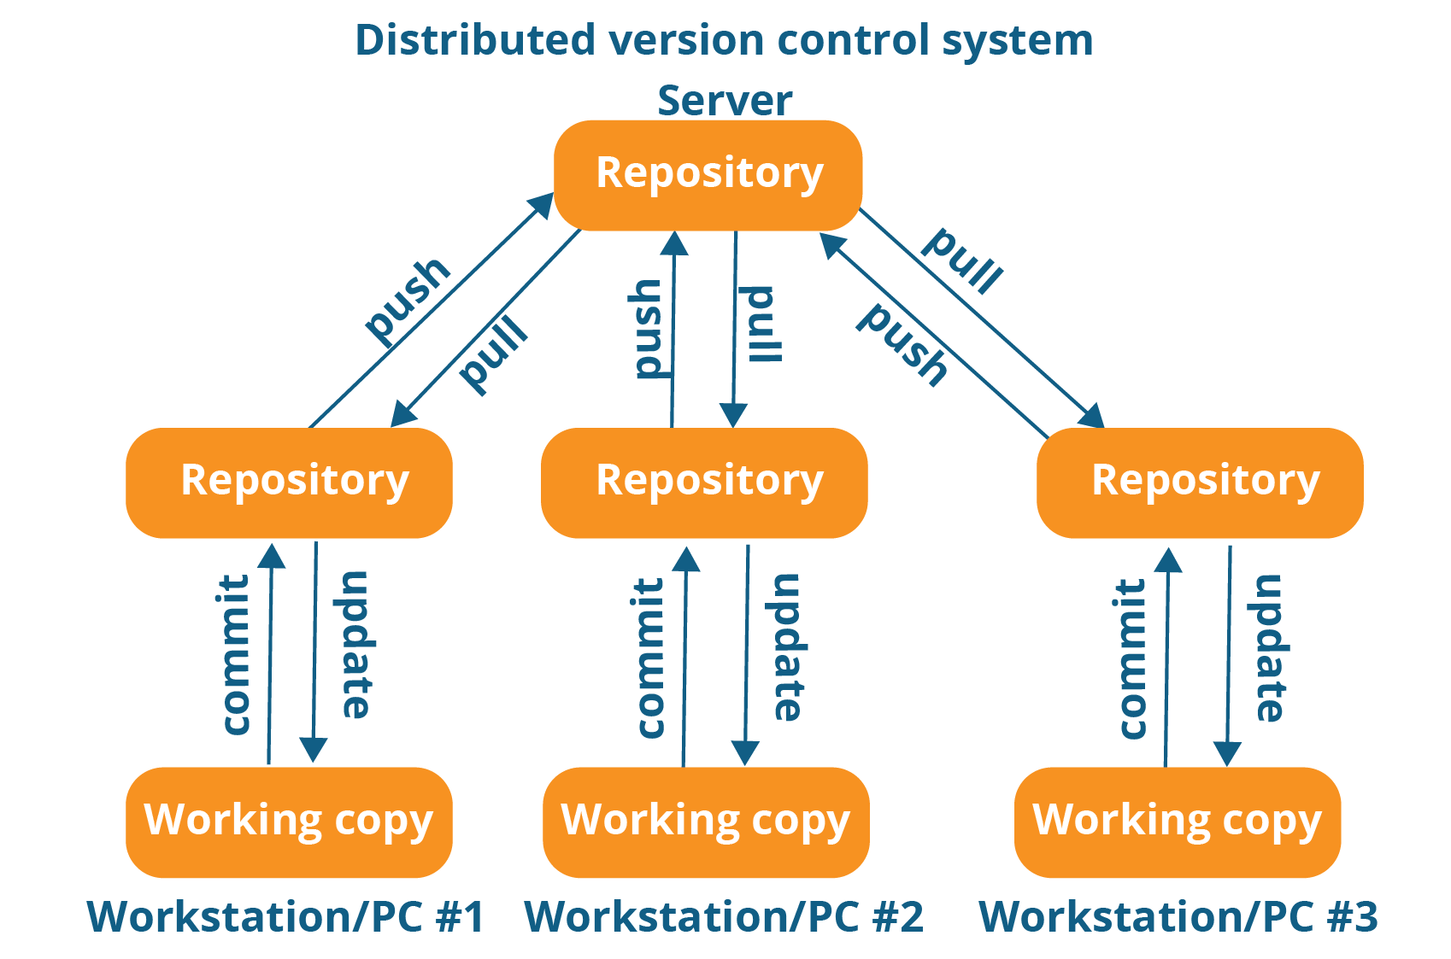
DISTRIBUTED (OR) DECENTRALIZED VCS
There is no server in DVCS and everything is a workspace. Every workspace will have a complete copy of the actual repository. If the central server/repository goes down, then the repository from any client can be copied back to the server to restore it.
Git does not rely on the central server and that is why you can perform many operations when you are offline. You can commit changes, create branches, view logs, and perform other operations when you are Offline. You require network connection only to publish your changes and take the latest changes.
EX: GIT, GITHUB, BITBUCKET, etc,

