Slide 1



PRACTICAL APPLICATIONS OF GENERATIVE AI WORKSHOP
Multi-Modal SoA GenAI Platforms
From cloud APIs to local models to agents — a hands-on session
GPT-6.1 Sol · Opus 5.5
OpenVINO GenAI
Agents · MCP · Skills
Gila Kamhi · The Academic College of Tel Aviv–Jaffa · 2026–2027

Slide 2


Today's session map
Concepts → setup → eight hands-on labs → homework
1
2
3
4
5
Platforms
Cloud lab
Local labs
Agent labs
Homework
Open vs closed,
cloud vs local
GPT-6.1 Sol &
Claude Opus 5.5
Text · vision · speech
· image with OpenVINO
LangGraph · MCP
· Skills
Reproduce, extend,
pitch your project
Bring: a laptop with Python 3.10+, the cloned sample repo, and an Azure for Students subscription (Claude API key optional).
Practical Applications of Generative AI Workshop · The Academic College of Tel Aviv–Jaffa · Gila Kamhi
2

Slide 3
Sample Student Projects – Last 2 years
Practical Applications of Generative AI Workshop · The Academic College of Tel Aviv–Jaffa · Gila Kamhi
3

Slide 4
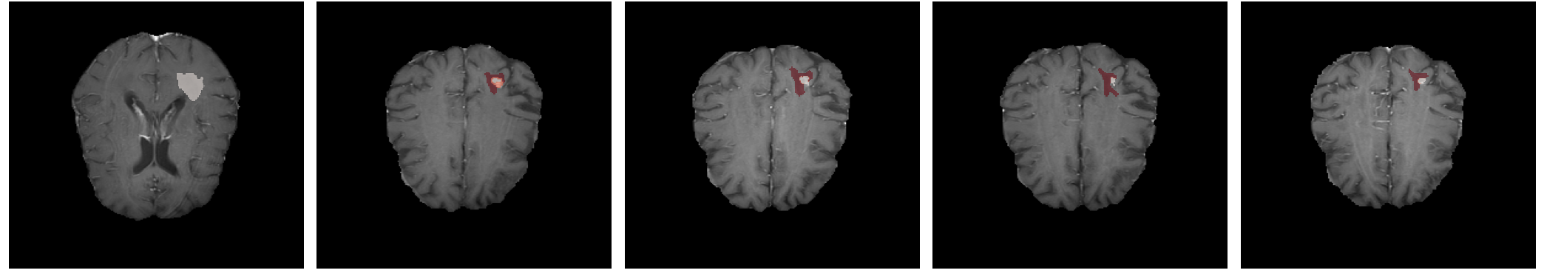



OncoFlow · 1st place, Research track
2025–2026 — automated brain-tumor tracking across MRI scans over time
Baseline
Follow-up 1
Follow-up 2
Follow-up 3
Follow-up 4
Problem
Research
System
Radiologists compare a patient's MRI scans across months by hand — slow, subjective and easy to miss a trend. Shaped with Ichilov Hospital staff.
Benchmarked tumor segmentation on BraTS follow-up scans: nnU-Net vs MedGemma vs SAM 2/3, plus ensembles (majority vote, STAPLE). Scored with Dice, HD95 and volume error.
nnU-Net segmentation → volume & RECIST change → RAG over clinical notes → multi-agent report. FastAPI · Celery · React · role-based access.
github.com/oncoflow-ai/oncoflow →
Practical Applications of Generative AI Workshop · The Academic College of Tel Aviv–Jaffa · Gila Kamhi
4

Slide 5
OncoFlow · 1st place, Research track
2025–2026 — automated brain-tumor tracking across MRI scans over time
Baseline
Follow-up 1
Follow-up 2
Follow-up 3
Follow-up 4
Problem
Research
System
Radiologists compare a patient's MRI scans across months by hand — slow, subjective and easy to miss a trend. Shaped with Ichilov Hospital staff.
Benchmarked tumor segmentation on BraTS follow-up scans: nnU-Net vs MedGemma vs SAM 2/3, plus ensembles (majority vote, STAPLE). Scored with Dice, HD95 and volume error.
nnU-Net segmentation → volume & RECIST change → RAG over clinical notes → multi-agent report. FastAPI · Celery · React · role-based access.
github.com/oncoflow-ai/oncoflow →
Practical Applications of Generative AI Workshop · The Academic College of Tel Aviv–Jaffa · Gila Kamhi
5

Slide 6
Inside OncoFlow
CODE
Four specialised agents turn scans + notes into a checked clinical report
Image agent
backend/app/modules/agents/orchestrator.py (simplified)
volumes, % change, RECIST diameters
def orchestrate(self, *, patient_id, study_id=None,
query="tumor volume interval change"):
logs = []
# 1. Image stream: segmentation metrics
image, log = self.image_agent.process(study_id=study_id)
logs.append(log)
# 2. Text stream: RAG over earlier reports
text, log = self.text_agent.process(
patient_id=patient_id, custom_query=query)
logs.append(log)
# 3. Draft the clinical summary
draft, log = self.summary_agent.process(
image_data=image, text_data=text)
logs.append(log)
# 4. Validate the draft against the image numbers
check, log = self.validation_agent.process(
summary=draft, ground_truth_image=image)
logs.append(log)
# 5. Save + re-index for the next follow-up
self._persist_and_index_summary(patient_id=patient_id, ...)
Text agent
RAG over the patient's prior notes
Summary agent
findings · impression · recommendations
Safety agent
checks the text against the image numbers
The finished report is indexed back into RAG, so the next scan is compared against it.
Exercise: run the summary agent on a local OpenVINO LLM (Lab 2) so patient data never leaves the hospital.
Practical Applications of Generative AI Workshop · The Academic College of Tel Aviv–Jaffa · Gila Kamhi
6

Slide 7

MyPrivateAI · 3rd place, Applications track
2025–2026 · Erez Pollack — cloud-level document AI that never leaves your laptop
95%
of GPT-5.1-with-perfect-context accuracy — using an 8B model running offline
3RD PLACE
Local-first desktop app
Answer correctness (RAGAS, SciRAG-QA benchmark)
Closed book
0.27
Problem
Lawyers and researchers can't upload confidential documents to cloud AI, and local tools are weak at multi-document reasoning.
Stack
Llama 3.1 8B (4-bit, MLX) · BGE embeddings + reranker · Chroma · LlamaIndex Workflows · FastAPI · React · Electron
Baseline RAG
0.55
Phase 1 · optimized retrieval
0.73
Phase 2 · agentic RAG
0.78
GPT-5.1 + perfect context
0.82
Code on GitHub →
Project post on LinkedIn →
Each step changes one variable, so every gain is attributable.
Practical Applications of Generative AI Workshop · The Academic College of Tel Aviv–Jaffa · Gila Kamhi
7

Slide 8
Inside MyPrivateAI
CODE
Hybrid retrieval + a self-critiquing agent — read the code, reuse the ideas
3-hop agent (LlamaIndex Workflow)
retrieval/hybrid_retriever.py
Hop 1
retrieve(question) → answer → critique
# Merge semantic + keyword hits: weighted
# Reciprocal Rank Fusion (RRF)
def rrf_fuse(vector_results, bm25_results, cfg):
k = cfg.rrf_k
w_vec, w_bm25 = cfg.rrf_vector_weight, cfg.rrf_bm25_weight
scores = {}
for rank, nws in enumerate(vector_results, 1):
sid = nws.node.node_id
prev, _ = scores.get(sid, (0.0, nws))
scores[sid] = (prev + w_vec / (k + rank), nws)
for rank, nws in enumerate(bm25_results, 1):
sid = nws.node.node_id
prev, n = scores.get(sid, (0.0, nws))
scores[sid] = (prev + w_bm25 / (k + rank), n)
ranked = sorted(scores.values(), key=lambda x: x[0],
reverse=True)
return [NodeWithScore(node=n.node, score=sc)
for sc, n in ranked]
# then a BGE cross-encoder reranks -> top 3
PASS → done
FAIL ↓
Hop 2
split into ≤3 sub-questions → retrieve each → answer → critique
PASS → done
FAIL ↓
Hop 3
reason over all gathered context (no new retrieval)
always answers
Exercise: the app runs on Mac (MLX). Swap its LLM for an OpenVINO LLMPipeline (Lab 2) so it runs on an Intel laptop, then re-run the benchmark and compare.
Practical Applications of Generative AI Workshop · The Academic College of Tel Aviv–Jaffa · Gila Kamhi
8

Slide 9
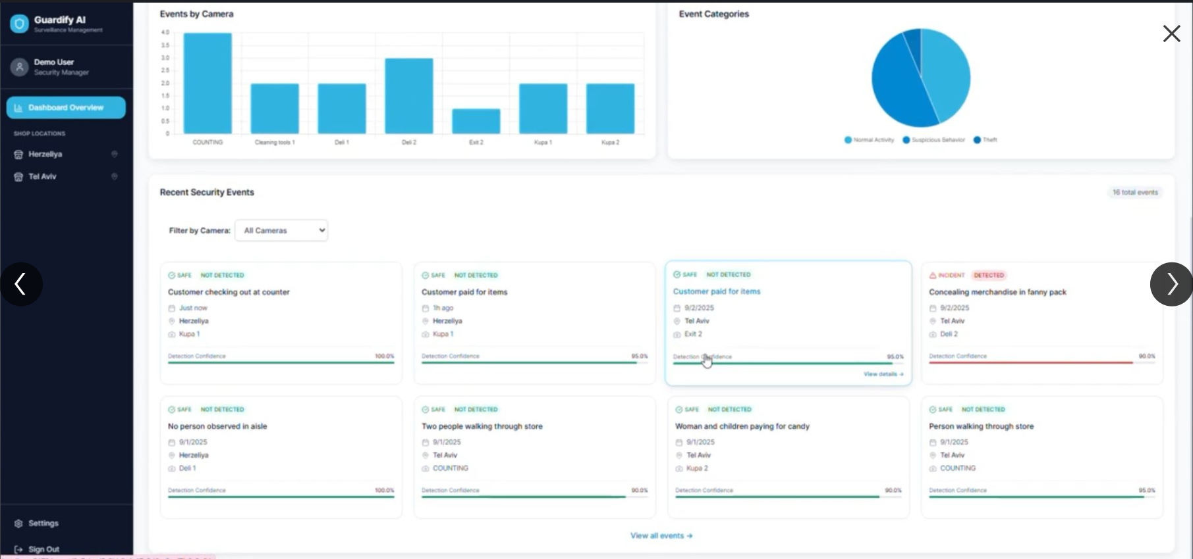


Student projects: 2024–2025
Sample projects from previous cohorts
Dialog DNA
Conversation analytics with NLP
View project post →
Guardify AI
Vision-based theft & incident detection
View project post →
Guardify AI — retail surveillance dashboard
Practical Applications of Generative AI Workshop · The Academic College of Tel Aviv–Jaffa · Gila Kamhi
9

Slide 10
GenAI Platforms
Practical Applications of Generative AI Workshop · The Academic College of Tel Aviv–Jaffa · Gila Kamhi
10

Slide 11
Closed cloud vs open local
Two ways to run GenAI — you will use both in this course
Cloud API · Microsoft Foundry
Local · OpenVINO GenAI
OpenAI, Anthropic and partner models
Open-weight models on your own hardware
Models
GPT-6.1 Sol, Claude Opus 5.5, …
Models
Qwen 3.6, Phi, Llama, Whisper, SD, …
Setup
Minutes — a key and an endpoint
Setup
Export / download, then run offline
Cost
Per token: $2–$4 in / $10–$20 out per 1M
Cost
Free after hardware
Data
Leaves the device (enterprise controls)
Data
Never leaves the device
Best for
Top quality, large context, fast prototyping
Best for
Privacy, edge, low latency, no network
Practical Applications of Generative AI Workshop · The Academic College of Tel Aviv–Jaffa · Gila Kamhi
11

Slide 12


Microsoft Foundry
Formerly Azure AI Studio / Azure OpenAI Studio — web workspace + API for Azure OpenAI and partner models
Playgrounds
Model catalog
Chat, image, audio and embeddings — try prompts and parameters without code
GPT-6.1 Sol, Claude Opus 5.5, Llama, DeepSeek and more in one catalog
Deploy & secure
v1 API
Deployment names, keys or Entra ID, content filters, role-based access
Use the standard OpenAI Python client — no api_version to manage
Portal: ai.azure.com Docs: Azure OpenAI v1 API Pricing: Azure OpenAI pricing
Practical Applications of Generative AI Workshop · The Academic College of Tel Aviv–Jaffa · Gila Kamhi
12

Slide 13
Cloud setup checklist
SETUP
Do this once — before Lab 1
1
Activate Azure for Students
.env
Free credit, no credit card
# .env (keep it out of git!)
AZURE_OPENAI_ENDPOINT=https://<resource>.openai.azure.com
AZURE_OPENAI_API_KEY=<your-azure-key>
AZURE_OPENAI_DEPLOYMENT=gpt-6.1-sol
ANTHROPIC_API_KEY=<your-claude-key>
# .gitignore
.env
2
Create a Foundry resource
Pick a region that offers your model
3
Deploy a model
e.g. gpt-6.1-sol → note the deployment name
4
Copy endpoint + key into .env
Azure key + Claude key · never commit it
Alternatives: AWS Bedrock or Google Vertex AI student programs work too — the concepts transfer.
5
Clone the samples repo
OPENVINO-GENAI-SAMPLES (lab1a / lab1b)
Practical Applications of Generative AI Workshop · The Academic College of Tel Aviv–Jaffa · Gila Kamhi
13

Slide 14
First cloud call: GPT-6.1 Sol
LAB 1a
OpenAI SDK + Responses API, pointed at your Microsoft Foundry deployment
lab1a_gpt_sol.py
Responses API
import os
from dotenv import load_dotenv
from openai import OpenAI
load_dotenv()
client = OpenAI(
api_key=os.environ["AZURE_OPENAI_API_KEY"],
base_url=os.environ["AZURE_OPENAI_ENDPOINT"] + "/openai/v1/",
)
resp = client.responses.create(
model=os.environ["AZURE_OPENAI_DEPLOYMENT"], # gpt-6.1-sol
instructions="You are a concise tutor.",
input="Explain RAG in two sentences.",
reasoning={"effort": "low"}, # low|medium|high|xhigh|max
)
print(resp.output_text)
GPT-6.x needs it for tool calling. Same code on OpenAI directly: drop base_url, use OPENAI_API_KEY.
Try it
Run effort low vs high. Compare time, resp.usage tokens and answer quality.
No temperature
Reasoning models reject temperature / top_p — steer with instructions and effort.
Practical Applications of Generative AI Workshop · The Academic College of Tel Aviv–Jaffa · Gila Kamhi
14

Slide 15
Same task on Claude Opus 5.5
LAB 1b
Anthropic SDK + Messages API — compare it with Lab 1a
lab1b_claude_opus.py
Thinking is built in
import anthropic
from dotenv import load_dotenv
load_dotenv() # reads ANTHROPIC_API_KEY
client = anthropic.Anthropic()
resp = client.beta.messages.create(
model="claude-opus-5-5",
max_tokens=16000,
system="You are a concise tutor.",
messages=[{"role": "user",
"content": "Explain RAG in two sentences."}],
output_config={"effort": "low"}, # default: medium
betas=["server-side-fallback-2026-07-01"],
fallbacks="default", # reroute if a safety check declines
)
if resp.stop_reason == "refusal":
print("Declined:", resp.stop_details.category)
else:
print(next(b.text for b in resp.content if b.type == "text"))
Opus 5.5 always reasons. Tune depth with effort (low → max), not temperature.
Try it
Same prompt on Sol and Opus 5.5: latency, cost ($2/$10 vs $4/$20 per 1M) and style.
Also in Foundry
Deploy Claude there and use anthropic.AnthropicFoundry(...); drop the fallbacks lines.
Practical Applications of Generative AI Workshop · The Academic College of Tel Aviv–Jaffa · Gila Kamhi
15

Slide 16

OpenVINO GenAI
Intel's open-source toolkit for fast, optimized inference — on the laptop you already have
One code path, many devices
openvino_genai pipelines
CPU, integrated/Arc GPU and NPU — switch with a single "device" string
LLMPipeline
Small & fast
text → text
INT4 / INT8 weight compression shrinks models to run on a laptop
VLMPipeline
image + text → text
Bring any model
WhisperPipeline
speech → text
Export from Hugging Face (PyTorch) with optimum-cli, or download pre-converted OpenVINO models
Text2ImagePipeline
text → image
Private by default
Text2SpeechPipeline
Everything runs offline — no keys, no tokens billed, no data leaves the device
text → speech
Docs · GitHub · Pre-converted models on Hugging Face
Practical Applications of Generative AI Workshop · The Academic College of Tel Aviv–Jaffa · Gila Kamhi
16

Slide 17
Local setup: environment and models
SETUP
Run once; models are cached in the repo folder
terminal (Windows)
Which device?
# 1. Get the code
git clone https://github.com/MTAGenAICourse/OPENVINO-GENAI-SAMPLES.git
cd OPENVINO-GENAI-SAMPLES
python -m venv .venv && .venv\Scripts\activate
pip install -r requirements.txt
# 2. Download pre-converted models (huggingface.co/OpenVINO)
hf download OpenVINO/TinyLlama-1.1B-Chat-v1.0-int4-ov \
--local-dir TinyLlama-1.1B-Chat-v1.0
hf download OpenVINO/Phi-3.5-vision-instruct-int4-ov \
--local-dir Phi-3.5-vision-instruct-int4-ov
hf download OpenVINO/whisper-base-fp16-ov --local-dir whisper-base
hf download OpenVINO/Qwen3-1.7B-int4-ov --local-dir Qwen3-1.7B-int4-ov
hf download OpenVINO/stable-diffusion-v1-5-int8-ov \
--local-dir stable-diffusion-v1-5-int8-ov
Start on CPU. Then try "GPU" or "NPU" and compare speed.
Disk & RAM
INT4 vision model ≈ 2–3 GB. 16 GB RAM is comfortable.
Upgrade path
Big laptop? Try Qwen3.6-35B-A3B (INT4, ~19 GB). More at huggingface.co/OpenVINO.
Practical Applications of Generative AI Workshop · The Academic College of Tel Aviv–Jaffa · Gila Kamhi
17

Slide 18
Chat with a local LLM
LAB 2
LLMPipeline — 03_text_to_text.py
03_text_to_text.py (simplified)
Exercises
import openvino_genai as ov_genai
pipe = ov_genai.LLMPipeline("./TinyLlama-1.1B-Chat-v1.0", "CPU")
config = ov_genai.GenerationConfig()
config.max_new_tokens = 128
def streamer(subword): # print tokens as they arrive
print(subword, end="", flush=True)
return False # False = keep generating
pipe.generate("Why is the sun yellow?", config, streamer)
Time CPU vs GPU: same prompt, which is faster?
Compare INT4 vs FP16 exports — quality and speed.
Turn it into a multi-turn chat with pipe.start_chat().
Ask the same question to your Lab 1 cloud model. Where does the small model fail?
$ python 03_text_to_text.py ./TinyLlama-1.1B-Chat-v1.0/ "Sun is yellow because"
Practical Applications of Generative AI Workshop · The Academic College of Tel Aviv–Jaffa · Gila Kamhi
18

Slide 19


See the world: vision-language models
LAB 3
VLMPipeline — camera and video understanding
vision_basics.py
01 Camera to Text
import numpy as np, openvino as ov, openvino_genai as ov_genai
from PIL import Image
pipe = ov_genai.VLMPipeline("./Phi-3.5-vision-instruct-int4-ov", "CPU")
cfg = pipe.get_generation_config()
cfg.stop_token_ids = {32007} # stop at <|end|>
img = Image.open("Data/Robot.jpg").convert("RGB")
tensor = ov.Tensor(np.array(img)[None]) # shape [1, H, W, 3]
print(pipe.generate("What is the robot doing?",
image=tensor, generation_config=cfg))
Snap a photo, ask questions about it
02 Video Analyzer
Describe a live webcam or video file every N seconds
$ streamlit run 01_camera_to_text.py
$ python 02_video_analyzer_cli.py --source Data/all_animals.mp4
Exercise: build a mini “Guardify” — flag frames where someone picks up an item.
Practical Applications of Generative AI Workshop · The Academic College of Tel Aviv–Jaffa · Gila Kamhi
19

Slide 20


Hear and create: speech and images
LAB 4
WhisperPipeline and Text2ImagePipeline
Speech → text
Text → image
speech_basics.py
image_gen_ov.py (simplified)
import openvino_genai as ov_genai
pipe = ov_genai.WhisperPipeline("./whisper-base", "CPU")
# raw_speech: 16 kHz mono float samples
# (from a WAV file or the microphone)
result = pipe.generate(raw_speech)
print(result)
import openvino_genai as ov_genai
from PIL import Image
pipe = ov_genai.Text2ImagePipeline(
"./stable-diffusion-v1-5-int8-ov", "CPU")
img = pipe.generate("starry night over Jaffa port",
width=512, height=512, num_inference_steps=20)
Image.fromarray(img.data[0]).save("image.bmp")
$ streamlit run 04_microphone_to_text.py
$ streamlit run image_generation_app.py
Exercise: voice-to-image — speak a prompt, transcribe it with Whisper, render it with Stable Diffusion.
Practical Applications of Generative AI Workshop · The Academic College of Tel Aviv–Jaffa · Gila Kamhi
20

Slide 21


PART 2
From models to agents
A model answers. An agent plans, calls tools, checks the result and decides what to do next.
LangGraph
MCP
Skills
Workflow
Tools
Know-how
Practical Applications of Generative AI Workshop · The Academic College of Tel Aviv–Jaffa · Gila Kamhi
21

Slide 22
Agentic workflows with LangGraph
LAB 5
05_agentic_visual_analysis_langgraph.py — a visual-inspection agent
“complete”
preprocess
_image
execute
_analysis_step
make
_decision
finalize
END
check_workflow
_complete
“continue” loop
g = StateGraph(AgentState)
g.add_node("preprocess_image", preprocess)
g.add_node("execute_analysis_step", analyze) # VLM call
g.add_edge("preprocess_image", "execute_analysis_step")
g.add_conditional_edges("execute_analysis_step", should_continue,
{"continue": "check_workflow_complete", "complete": "make_decision"})
agent = g.compile()
Exercise
Add a “safety_check” node that runs only when a person is detected.
$ streamlit run 05_agentic_visual_analysis_langgraph.py
Practical Applications of Generative AI Workshop · The Academic College of Tel Aviv–Jaffa · Gila Kamhi
22

Slide 23
Give agents tools with MCP
LAB 6
Model Context Protocol — one standard way for any agent to discover and call tools
Agent / LLM
MCP client
MCP server
12_mcp_skills_server.py
Opus 5.5 · GPT-6.1 Sol · local
13_mcp_skills_client.py
12_mcp_skills_server.py
server = Server("course-tools")
@server.list_tools()
async def list_tools():
return [Tool(name="calculator",
description="Evaluate a math expression",
inputSchema={"type": "object",
"properties": {"expression":
{"type": "string"}},
"required": ["expression"]})]
@server.call_tool()
async def call_tool(name, arguments):
expr = arguments["expression"]
r = calculator_execute(expr)
return [TextContent(type="text",
text=json.dumps(r))]
tools/list — the server advertises tools with JSON schemas
tools/call — the agent picks a tool and passes arguments
stdio — server runs as a local subprocess
Run it
$ streamlit run 07_mcp_agentic_tutorial.py
$ streamlit run 13_mcp_skills_client.py
Practical Applications of Generative AI Workshop · The Academic College of Tel Aviv–Jaffa · Gila Kamhi
23

Slide 24
Composable skills
LAB 7
08–11: package know-how as reusable, chainable skills
08_skills_agentic_tutorial.py
 | MCP tool | Skill
Unit | One function | Capability + logic
State | Stateless | Shared context
Routing | LLM via schema | Triggers / LLM
Chaining | By the agent | Built in
class WeatherSkill(Skill):
def __init__(self):
super().__init__(name="weather",
description="Current weather for any city",
category=SkillCategory.INFORMATION)
self.triggers = ["weather", "forecast", "rain"]
def can_execute(self, ctx):
return any(t in ctx.user_input.lower()
for t in self.triggers)
def execute(self, ctx, **kw):
result = get_weather(self._extract_location(ctx.user_input))
ctx.set_variable("current_weather", result) # for chaining
return result
Run with streamlit run …
08_skills_agentic_tutorial.py
09_skills_agentic_tutorial_langgraph.py
09 lets you switch the brain: Azure OpenAI ↔ local Qwen3-1.7B (OpenVINO).
Exercise: write a TranslateSkill and chain it after TextAnalysisSkill.
Practical Applications of Generative AI Workshop · The Academic College of Tel Aviv–Jaffa · Gila Kamhi
24

Slide 25
Put it together: the multimodal agent
LAB 8
06 covers See, 11 covers Act. The other stages are in Labs 1 and 4: your team wires the full chain.
Hear
See
Reason
Act
Create
Whisper · Lab 4
VLM · 06 demo
Opus 5.5 / Sol · Lab 1
MCP tools · 11–13
Image gen · Lab 4
$ streamlit run 06_agentic_multimodal_demo.py
$ streamlit run 11_skills_agentic_demo.py
Design challenge (teams): pick one real user and one pain point, then wire at least two of these stages into one app. Decide what runs in the cloud and what runs locally — and justify it with cost, latency and privacy.
Practical Applications of Generative AI Workshop · The Academic College of Tel Aviv–Jaffa · Gila Kamhi
25

Slide 26
Lab map: every sample in the repo
OPENVINO-GENAI-SAMPLES — run in order, each builds on the last
Lab | Sample | What you learn | Run
2 | 03_text_to_text.py | Local LLM, streaming | python
3 | 01_camera_to_text.py | Vision-language Q&A | streamlit
3 | 02_video_analyzer_cli.py | Video frame analysis | python
4 | 04_microphone_to_text.py | Live speech recognition | streamlit
4 | image_generation_app.py | Text → image, styles | streamlit
5 | 05_agentic_visual_analysis_langgraph.py | LangGraph state machine | streamlit
6 | 07_mcp_agentic_tutorial.py · 12/13 | MCP tools, client/server | streamlit
7 | 08 / 09 / 10 _skills_*.py | Skills, chaining, LLM routing | streamlit
8 | 06 / 11 _demo.py | End-to-end multimodal agent | streamlit
Repo: github.com/MTAGenAICourse/OPENVINO-GENAI-SAMPLES
Practical Applications of Generative AI Workshop · The Academic College of Tel Aviv–Jaffa · Gila Kamhi
26

Slide 27

Homework
Due before next session
1 · Cloud access
2 · Reproduce locally
Activate Azure for Students, deploy GPT-6.1 Sol, and run Labs 1a + 1b. Compare the two answers.
Run Labs 2–4 on your laptop. Record tokens/sec on CPU vs GPU in a short table.
Open the README →
Open the README →
3 · Extend an agent
4 · Project pitch
Add one new MCP tool or one new Skill and show it being called from the demo app.
Teams of 3–4: one slide — user, problem, modalities, cloud-vs-local choice.
Practical Applications of Generative AI Workshop · The Academic College of Tel Aviv–Jaffa · Gila Kamhi
27

Slide 28

Resources
Everything you need after class
Course repos
Cloud models
OPENVINO-GENAI-SAMPLES
AzureOpenAISamples
MyPrivateAI (student project)
OncoFlow (student project)
Foundry portal
Azure OpenAI v1 API
Azure for Students
GPT-6.1 Sol model page
Claude API docs
OpenVINO
Agents
OpenVINO docs
openvino.genai on GitHub
Optimum Intel export guide
LangGraph docs
Model Context Protocol
Practical Applications of Generative AI Workshop · The Academic College of Tel Aviv–Jaffa · Gila Kamhi
28

Slide 29
Questions?
Next session: retrieval-augmented generation — grounding models in your own data.
github.com/MTAGenAICourse/OPENVINO-GENAI-SAMPLES
Practical Applications of Generative AI Workshop · The Academic College of Tel Aviv–Jaffa · Gila Kamhi
29

Slide 30
Backup
Reference material from the previous edition
Practical Applications of Generative AI Workshop · The Academic College of Tel Aviv–Jaffa · Gila Kamhi
30

Slide 31
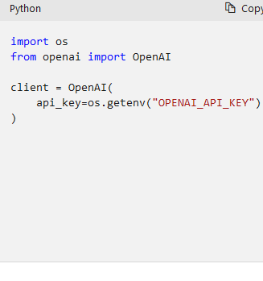
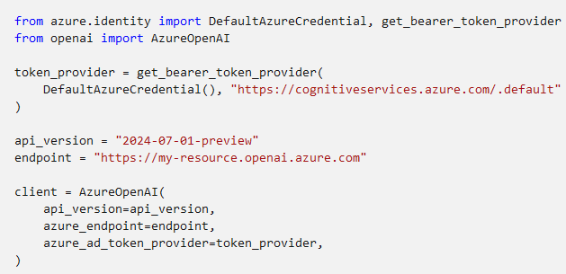
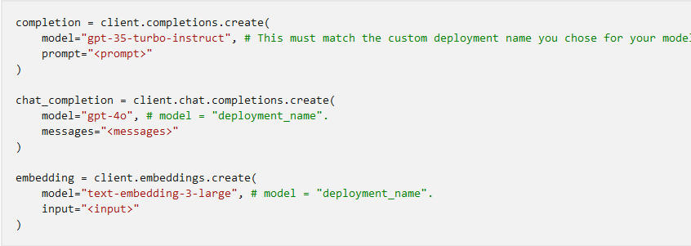
OpenAI vs Azure OpenAI clients
Legacy AzureOpenAI pattern (left: OpenAI, right: Azure with Entra ID)
Azure OpenAI docs →
Practical Applications of Generative AI Workshop · The Academic College of Tel Aviv–Jaffa · Gila Kamhi
31

