Slide 1
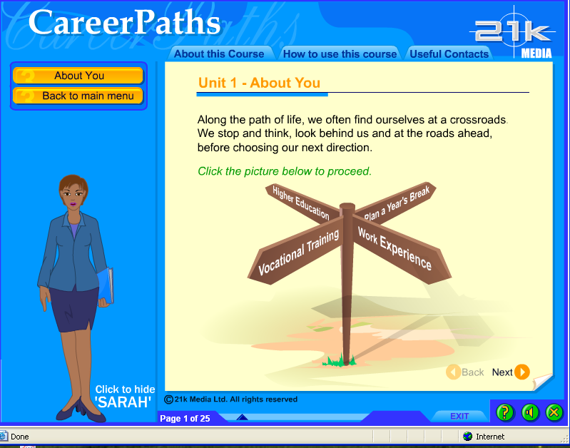
How to Use This Course
Congratulation on taking the first step towards building a successful career!
The presentation that follows will take you through the navigation of this course. It will help you get through this course smoothly and ensure an enjoyable experience for you.
So “Get Set Go!”
Click next to continue.
NEXT »

Slide 2
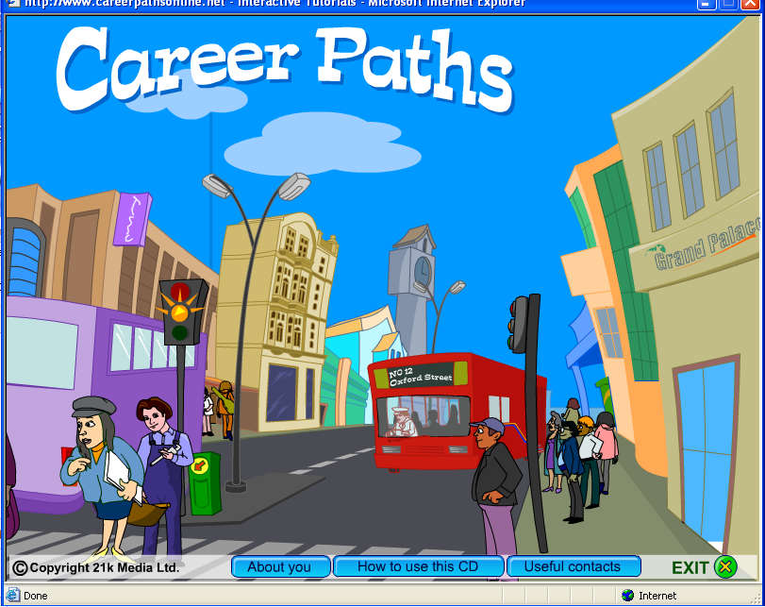
This is the home page of your course. You can choose any of the links below.
Click next to continue.
NEXT »
Notes:
Animate the Call out

Slide 3
This button will take you straight to the course content.
Click next to continue.
NEXT »
Notes:
Animate the Call out

Slide 4
This button will show you the tour you are taking just now.
Click next to continue.
NEXT »
Notes:
Animate the Call out

Slide 5
This button will display all the contacts that you might have to refer to further you career development quest.
Click next to continue.
NEXT »
Notes:
Animate the Call out

Slide 6
After you select the button relevant to you. The following page will open.
Click next to continue.
NEXT »
Notes:
Animate the Call out

Slide 7
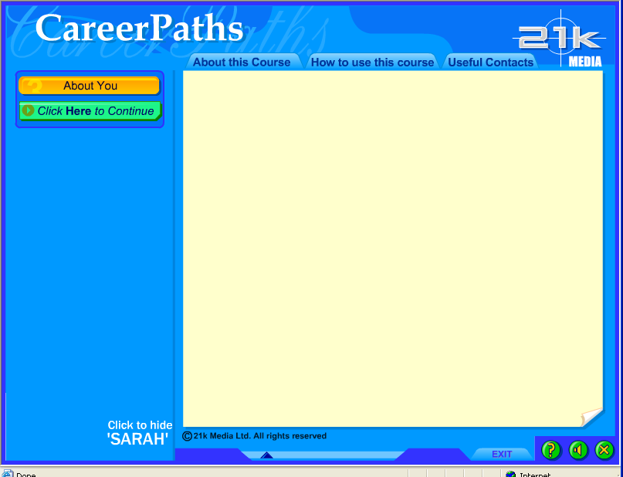
This page will provide you another opportunity to choose the information you’d like to view.
Click next to continue.
Welcome to this course!
To begin please click the green button to your left.
You could learn a little more about this course by choosing the "About this Course" Tab on the top.
For help on using this course, click the "How to Use This Course" Tab.
To view references for additional information, click "Useful Contact" Tab."
NEXT »
Notes:
Animate the Call out

Slide 8
To begin the course please click this button.
Click next to continue.
Welcome to this course!
To begin please click the green button to your left.
You could learn a little more about this course by choosing the "About this Course" Tab on the top.
For help on using this course, click the "How to Use This Course" Tab.
To view references for additional information, click "Useful Contact" Tab."
NEXT »
Notes:
Animate the Call out

Slide 9
To learn more about this course, click this Tab on the top.
Click next to continue.
Welcome to this course!
To begin please click the green button to your left.
You could learn a little more about this course by choosing the "About this Course" Tab on the top.
For help on using this course, click the "How to Use This Course" Tab.
To view references for additional information, click "Useful Contact" Tab."
NEXT »
Notes:
Animate the Call out

Slide 10
This Tab will show you the tour you are taking just now.
Click next to continue.
Welcome to this course!
To begin please click the green button to your left.
You could learn a little more about this course by choosing the "About this Course" Tab on the top.
For help on using this course, click the "How to Use This Course" Tab.
To view references for additional information, click "Useful Contact" Tab."
Animate the Call out
NEXT »
Notes:
Animate the Call out

Slide 11
This button will display all the contacts that you might have to refer to further you career development quest.
Click next to continue.
Welcome to this course!
To begin please click the green button to your left.
You could learn a little more about this course by choosing the "About this Course" Tab on the top.
For help on using this course, click the "How to Use This Course" Tab.
To view references for additional information, click "Useful Contact" Tab."
NEXT »
Notes:
Animate the Call out

Slide 12
This button will display all the contacts that you might have to refer to further you career development quest.
Click next to continue.
Welcome to this course!
To begin please click the green button to your left.
You could learn a little more about this course by choosing the "About this Course" Tab on the top.
For help on using this course, click the "How to Use This Course" Tab.
To view references for additional information, click "Useful Contact" Tab."
NEXT »
Notes:
Animate the Call out

Slide 13
After you make a selection the content presentation will begin. The following page will open.
Click next to continue.
Welcome to this course!
To begin please click the green button to your left.
You could learn a little more about this course by choosing the "About this Course" Tab on the top.
For help on using this course, click the "How to Use This Course" Tab.
To view references for additional information, click "Useful Contact" Tab."
NEXT »
Notes:
Animate the Call out

Slide 14
This is the stage where the content will be presented.
Click next to continue.
NEXT »
Notes:
Animate the Call out

Slide 15
These buttons on the stage will help you navigate back and forth in the course.
Click next to continue.
NEXT »
Notes:
Animate the Call out

Slide 16
This will indicate your progress through the course.
Click next to continue.
NEXT »
Notes:
Animate the Call out

Slide 17
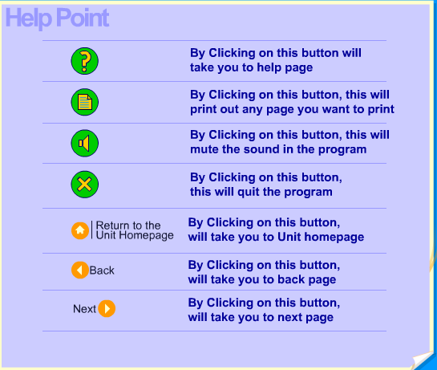
NEXT »
A guide for navigation will open on clicking this button.
Click next to continue.
Notes:
Animate the Call out

Slide 18
You can switch the voice on or off using this button
Click next to continue.
NEXT »
Notes:
Animate the Call out

Slide 19
To quit this course, click here.
Click next to continue.
NEXT »
Notes:
Animate the Call out

Slide 20
How to Use This Course
You have reached the end of this presentation.
It is very simple to go through this course. Take your time and enjoy the experience of planning your career.
All the Best!
END SHOW »
Notes:
Animate the Text

