Slide 1
DIJKSTRA'S ALGORITHM

Slide 2

THE AUTHOR: EDSGER WYBE DIJKSTRA
"Computer Science is no more about computers than astronomy is about telescopes."
http://www.cs.utexas.edu/~EWD/

Slide 3
SINGLE-SOURCE SHORTEST PATH PROBLEM
distance(v, u) = length of the shortest path from v to u
Single-Source Shortest Path Problem - The problem of finding shortest paths from a source vertex v to all other vertices in a weighted graph G
Dijkstra’s Algorithm – greedy method
similar to Prim’s Algorithm of MST.
D[u] = length of the best path found so far from v ( a vertex in the cloud/visited) to vertex outside u.
Edge Relaxation : ( u is a visited vertex, z is unvisited)
if D[u] + w(u,z) < D[z] then
D[z] = D[u] + w(u,z)

Slide 4
DIJKSTRA'S ALGORITHM
Dijkstra's algorithm - is a solution to the single-source shortest path problem in graph theory.
Works on both directed and undirected graphs. However, all edges must have nonnegative weights.
Approach: Greedy
Input: Weighted graph G={E,V} and source vertex v∈V, such that all edge weights are nonnegative
Output: Lengths of shortest paths (or the shortest paths themselves) from a given source vertex v∈V to all other vertices

Slide 5
DIJKSTRA'S ALGORITHM - PSEUDOCODE
Algorithm DijkstraShortestPaths(G,v):
Input : A simple undirected weighted graph G with nonnegative
edge weights and a distinguished vertex v of G
Output : A label D[u], for each vertex u of G, such that D[u] is the
distance from v to u in G.
D[v] = 0
For each vertex u ≠ v of G do
D[u] = ∞.
Let a priority queue Q contain all vertices of G using the D labels as
keys.
While Q is not empty do
{pull a new vertex v into the cloud}
u = Q.removeMin()
For each vertex z adjacent to u such that z is in Q do
{perform the relaxation procedure on edge (u, z)}
if D[u] + w(u, z) < D[z] then
D[u] + w(u, z) < D[z]
change the key D[z] of vertex z in Q.
return the label D[u] of each vertex u.

Slide 6
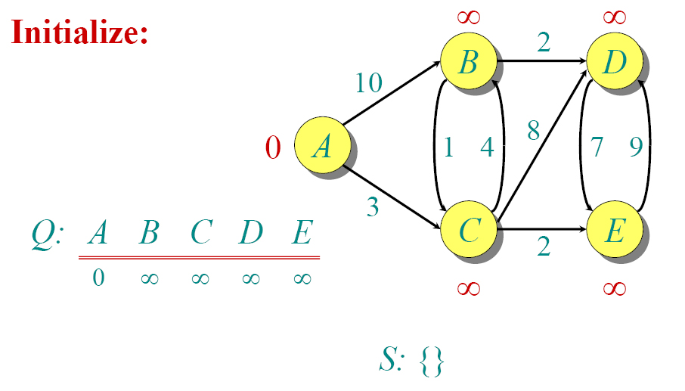
DIJKSTRA ANIMATED EXAMPLE

Slide 7

DIJKSTRA ANIMATED EXAMPLE

Slide 8

DIJKSTRA ANIMATED EXAMPLE

Slide 9

DIJKSTRA ANIMATED EXAMPLE

Slide 10

DIJKSTRA ANIMATED EXAMPLE

Slide 11

DIJKSTRA ANIMATED EXAMPLE

Slide 12

DIJKSTRA ANIMATED EXAMPLE

Slide 13

DIJKSTRA ANIMATED EXAMPLE

Slide 14

DIJKSTRA ANIMATED EXAMPLE

Slide 15

DIJKSTRA ANIMATED EXAMPLE

Slide 16
IMPLEMENTATIONS AND RUNNING TIMES
.This will produce a running time of
O((n + m) log n)
n = no. of vertices m = no. of edges.

Slide 17
DIJKSTRA'S ALGORITHM - WHY IT WORKS
As with all greedy algorithms, we need to make sure that it is a correct algorithm (e.g., it always returns the right solution if it is given correct input).
A formal proof would take longer than this presentation, but we can understand how the argument works intuitively.
If you can’t sleep unless you see a proof, see the second reference or ask us where you can find it.

Slide 18
DIJKSTRA'S ALGORITHM - WHY IT WORKS
To understand how it works, we’ll go over the previous example again. However, we need two mathematical results first:
Lemma 1: Triangle inequality
If δ(u,v) is the shortest path length between u and v,
δ(u,v) ≤ δ(u,x) + δ(x,v)
Lemma 2:
The subpath of any shortest path is itself a shortest path.
The key is to understand why we can claim that anytime we put a new vertex in S, we can say that we already know the shortest path to it.
Now, back to the example…

Slide 19
DIJKSTRA'S ALGORITHM - WHY USE IT?
As mentioned, Dijkstra’s algorithm calculates the shortest path to every vertex.
However, it is about as computationally expensive to calculate the shortest path from vertex u to every vertex using Dijkstra’s as it is to calculate the shortest path to some particular vertex v.
Therefore, anytime we want to know the optimal path to some other vertex from a determined origin, we can use Dijkstra’s algorithm.

Slide 20


APPLICATIONS OF DIJKSTRA'S ALGORITHM
- Traffic Information Systems are most prominent use
- Mapping (Map Quest, Google Maps)
- Routing Systems

Slide 21
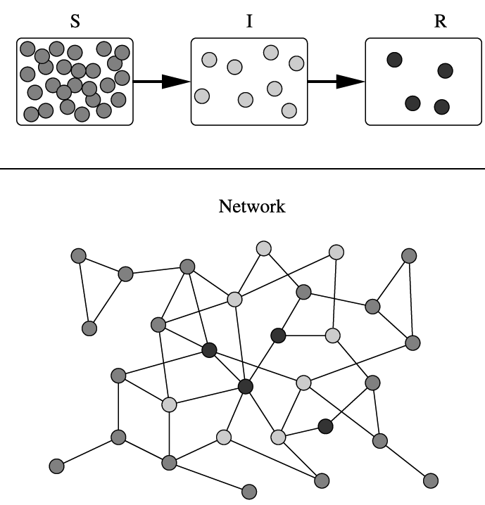
APPLICATIONS OF DIJKSTRA'S ALGORITHM
One particularly relevant this week: epidemiology
Prof. Lauren Meyers (Biology Dept.) uses networks to model the spread of infectious diseases and design prevention and response strategies.
Vertices represent individuals, and edges their possible contacts. It is useful to calculate how a particular individual is connected to others.
Knowing the shortest path lengths to other individuals can be a relevant indicator of the potential of a particular individual to infect others.

Slide 22
REFERENCES
Dijkstra’s original paper:
E. W. Dijkstra. (1959) A Note on Two Problems in Connection with Graphs. Numerische Mathematik, 1. 269-271.
MIT OpenCourseware, 6.046J Introduction to Algorithms.
< http://ocw.mit.edu/OcwWeb/Electrical-Engineering-and-Computer-Science/6-046JFall-2005/CourseHome/> Accessed 4/25/09
Meyers, L.A. (2007) Contact network epidemiology: Bond percolation applied to infectious disease prediction and control. Bulletin of the American Mathematical Society 44: 63-86.
Department of Mathematics, University of Melbourne. Dijkstra’s Algorithm.
<http://www.ms.unimelb.edu.au/~moshe/620-261/dijkstra/dijkstra.html > Accessed 4/25/09

