Slide 1
TURKOISE: a Mechanical Turk-based
Tailor-made Metric for Spoken Language Translation Systems in the Medical Domain
Workshop on Automatic and Manual Metrics for Operational Translation Evaluation, LREC 2014
Marianne.Starlander@unige.ch

Slide 2
Goal
Test crowdsourcing to evaluate our spoken language translation system MedSLT
  ENG-SPA language combination
Comparing effort (time-cost) using Amazon Mechanical Turk
  vs classic in-house human evaluation
  vs BLEU (no high correlation in previous work, time to produce references)
Notes:
Using AMT, which is defined by Chris Callison-Burch as an online labor market that is designed to pay people small sums of money to complete human intelligence tasks (HIT) – task that are difficult for computers but easy for people.
Our goal is to show that through using AMT for our specific evaluation task we can achieve equivalent results than human experts evaluators
AND THIS Within a reasonable effort in time and cost but preserving the evaluator’s reliability
We would like to show that using TURKoise would be a viable alternative to BLEU but that could provide real information concerning the usability of the provided translations in our specific safety-critical domain. We thus set up this experiment in 3 stages…
→ Il faudrait donc que je calcule la corrélation entre AMT et human vs BLEU et human et que je rajoute fluency et adequacy pour toutes les données?

Slide 3
Experiment in 3 stages
Tailor-made metric by in-house evaluators
Amazon Mechanical Turk – pilot study:
  Feasibility
  Time
  Cost
  Achieving inter-rater agreement comparable to expert evaluators ?
AMT application phase 2: how many evaluations needed

Slide 4
Tailor-made metric - TURKoise
CCOR (4): The translation is completely correct. All the meaning from the source is present in the target sentence.
MEAN (3): The translation is not completely correct. The meaning is slightly different but it represents no danger of miscommunication between doctor and patient.
NONS (2): This translation doesn't make any sense, it is gibberish. This translation is not correct in the target language.
DANG (1): This translation is incorrect and the meaning in the target and source are very different. It is a false sense, dangerous for communication between doctor and patient.
Notes:
In short: a 4 if the sentence is completely preserving the meaning
3- if the meaning is slightly different but no danger of miscommunicatio implied
2 : makes no sense – the translation can easily be identified as false
The translation seems totally correct but the meaning is altered and represents a danger for the communication between the docter and his patient
→ Not an easy scale to apply in a coherent manner by experts, can it be applied my AMT workers ? Bilingual skills needed !

Slide 5
AMT evaluation - facts
Set-up
  Creating evaluation interface
  Preparing data
  Selection phase
Response time and costs
  Cost per HIT (20 sentences) = 0.25 $ → approx. 50 $
  Time – 3 days (pilot)
Notes:
= 4052 sentences + 600 selection

Slide 6
AMT Tasks
  Selection task : subset of fluency
  Fluency
  Adequacy
  TURKoise
    Total amount of 145 HITS - 20 sentences each -> every 222 sentences of the corpus evaluated
    5 times for each task

Slide 7
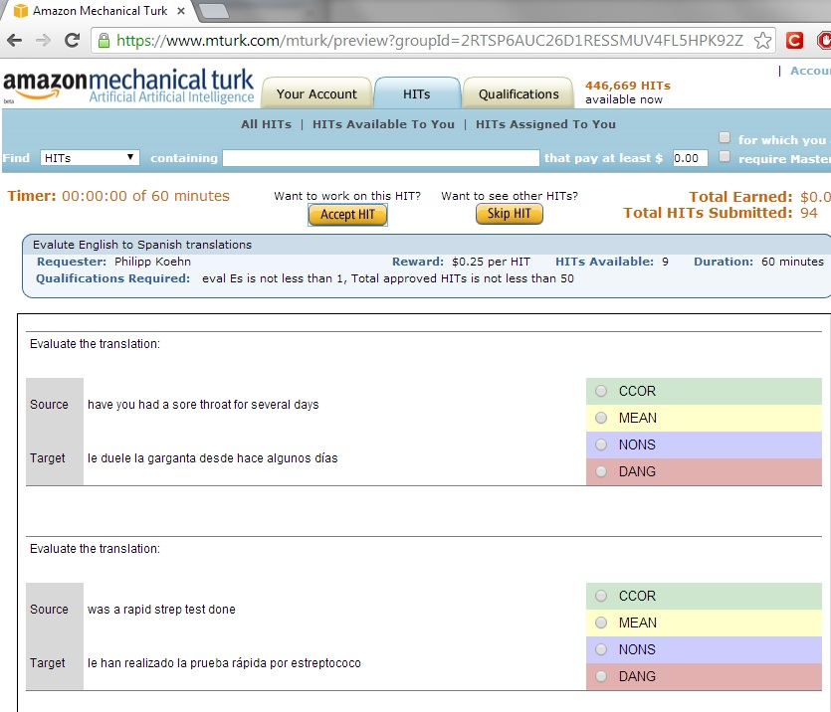
Interface for the AMT worker

Slide 8
Crowd selection
Selection task:
  HIT of 20 sentences for which in house evaluators achieved 100% agreement -> gold standard
    Qualification assignment
Time to recruit:
  within 24h. = 20 workers were selected
Accept rate: 23/30 qualified workers
Most of the final HITS achieved by 5 workers
Notes:
The AMT workers obtaining a minimum of 75% of agreement on the selection HIT were attributed a qualification, and given access to the three real tasks divided into a total of 29 HITS. Very rapidly (within 24 hours) we had assigned the qualification to 20 “suitable” workers, and within three days, our five assignments for all the proposed hits where completed.

Slide 9
Pilot results for TURKoise
In-house vs AMT
TURKoise | In-house | AMT
Unanimous | 15% | 32%
4 agree | 35% | 26%
3 agree | 42% | 37%
majority | 92% | 95%
Fleiss Kappa | 0.199 | 0.232
Notes:
Here are the results for TURKOISE in terms of percentage of agreement and for the fleiss kappa: , as expected the percentages and KAPPA is not very high since the scale is quite complex but I would like to point out that the percentages achieved by the AMT workers is quite comparable to the inhouse experts.
In the full paper you will find the results for all task, including fluency and adequacy-> fluency was the task with the worse agreement. Which could point out that the TURKoise scale is somewhat less subjective than fluency. ???

Slide 10
Phase 2 : Does more equal better
How many evaluations needed ? Compared in terms of Fleiss Kappa
Number of eval. | Fluency | Adequacy | TURKoise
3-times AMT | -0.052 | 0.135 | 0.181
5-times AMT | 0.164 | 0.236 | 0.232
8-times AMT | 0.134 | 0.226 | 0.227
5-inhouse | 0.174 | 0.121 | 0.199
Notes:
One could be tempted since it is now not a problem any more to find human evaluators, unlike the classic human method, to multiply the number of evaluations for every single translation… with this second phase we wanted to determine what would be the critical number of evaluations, if 15 AMT workers are need to achieve equivalent agreement to in-house, than we would not gain that much in time and cost. It turns out that the highest kappa is achieved with a total number of evaluation for each sentence of the corpus with 5 times.

Slide 11
Conclusion
Success in setting-up AMT based evaluation in terms of:
  time and cost
  number of recruited AMT workers in a short time
  recruitment of reliable evaluators for a bilingual task
  agreement achieved by AMT workers comparable to in-house evaluators → without recruiting a huge crowd

Slide 12
Further discussion
Difficult to assess agreement:
  Percentage of agreement
  Kappa
    Not easy to interpret
    Not best suited for multi-rater and prevalence in data
  Interclass correlation coefficient – ICC (Hallgren, 2012)
AMT – not globally accessible
  Any experience with Crowdflower ?
Notes:
Aspects to be discussed in this research…

Slide 13
References
Callison-Burch, C. (2009). Fast, Cheap, and Creative: Evaluating Translation Quality Using Amazon's Mechanical Turk. Proceedings of the 2009 Empirical Methods in Natural Language Processing (EMNLP), Singapore, pp. 286--295.
Hallgren, K. A. (2012). Computing inter-rater reliability for observational data: An overview and tutorial. Tutorials in Quantitative Methods for Psychology, 8, pp. 23–34.

