Slide 1
GPU Programming
Lecture-13

Slide 2
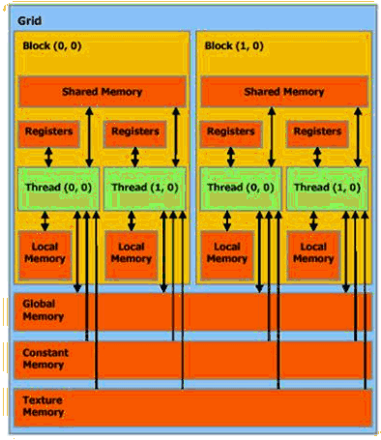
Memory Hierarchy
Shared memory much much faster than global
Local memory is not sufficient
Global, Constant, and Texture memory available to both host and cpu

Slide 3
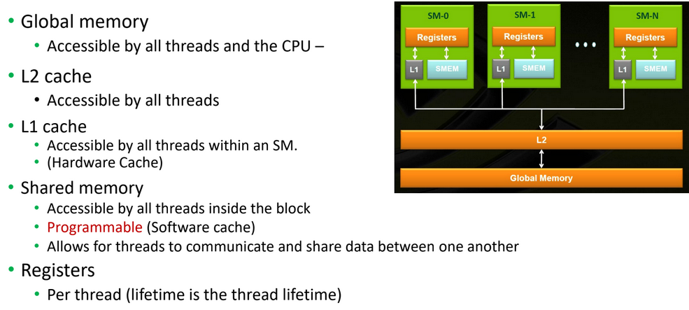
GPU Memory Hierarchy

Slide 4
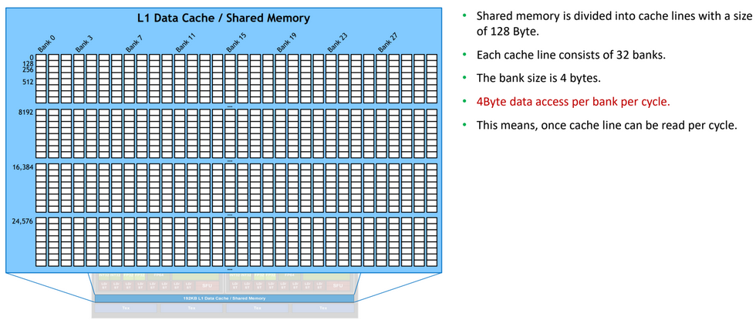
Shared Memory Architecture

Slide 5
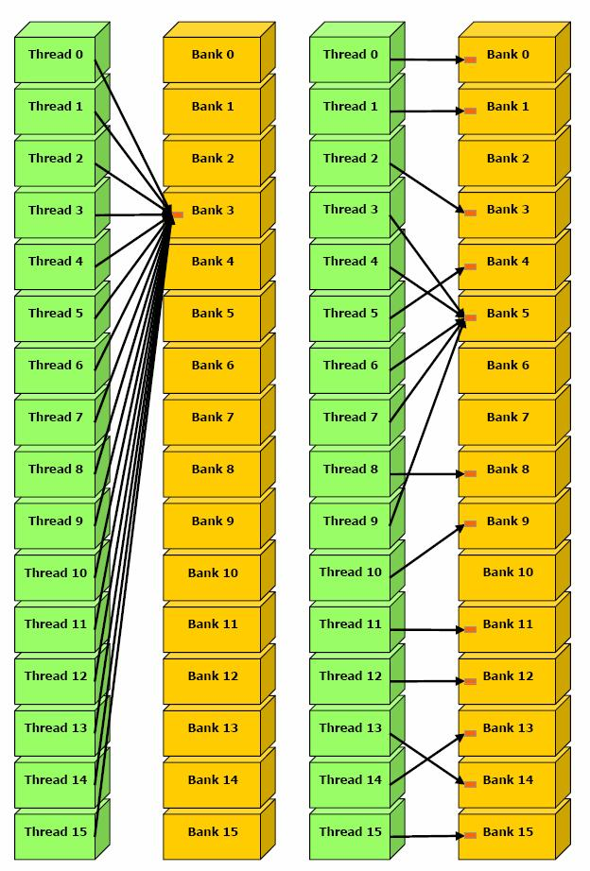
Bank Conflicts
Shared memory is divided into banks
Each bank has serial read/write access
Bank addresses are striped
If more than one thread attempts to access the same bank at the same time, they’re accesses are serialized
This is a bank conflict

Slide 6
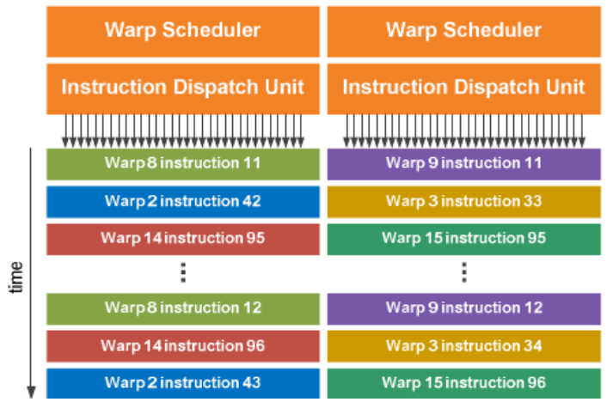
Single-Instruction, Multiple-Thread warp execution on Fermi

Slide 7
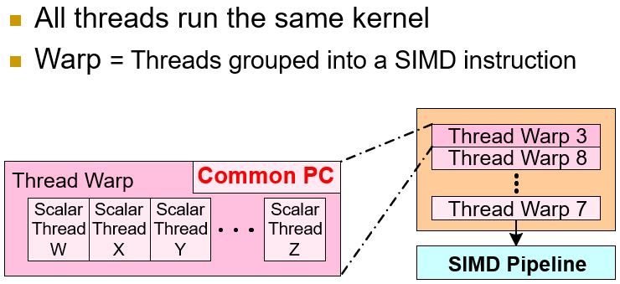
SIMD Execution of Scalar Threads

Slide 8
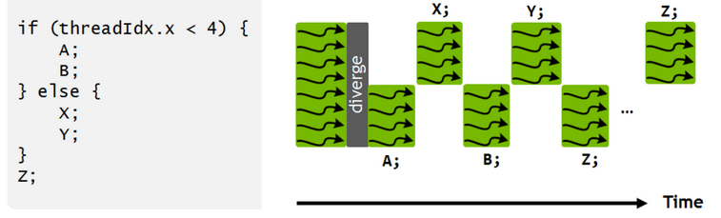
Single Instruction Multiple Threads (SIMT)
selected threads can be activated or deactivated, so that instructions and data are processed only on the active threads, while the local data remain unchanged on inactive threads.

Slide 9
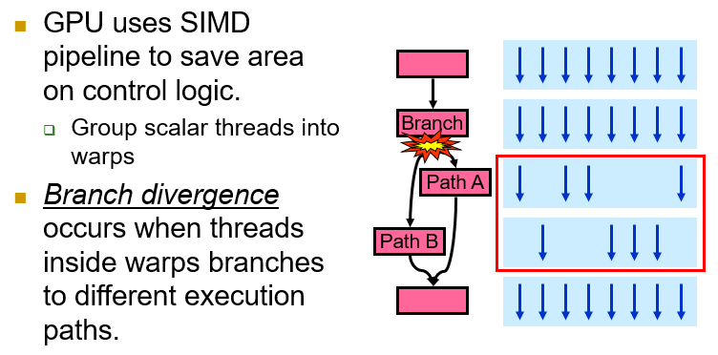
Problem with Thread Execution
GPU can’t execute both paths simultaneously — it must serialize them.

Slide 10
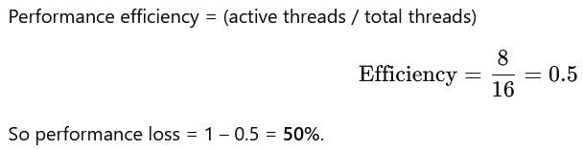
Impact of Branch Divergence
Suppose we have a SIMD width (warp size) = 16.
If half the threads take Path A and half take Path B, then:
The GPU first executes Path A for 8 threads, while 8 are idle.
Then executes Path B for the other 8 threads, while the first 8 are idle.
So only 8 out of 16 threads are active at a time.
That’s 50% utilization of SIMD lanes.

Slide 11
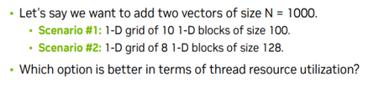
Quick quiz

Slide 12
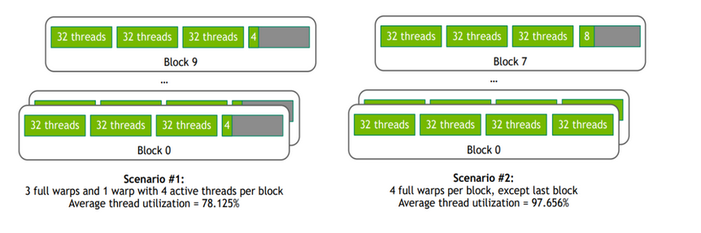
Solution

Slide 13
Some solutions to branch divergence
Profile and identify the branches.
For small branches, try branchless transforms → cheap & fast.
If divergence is data-driven, reorder/group inputs → big wins.
If work varies, use persistent threads / work queues.
Use warp intrinsics for fine-grained optimization.
Typical outcomes:
Branchless fixes: small → moderate speedup.
Data reordering: large speedup (can eliminate most divergence).
Work queues + warp compaction: good for skewed workloads.

Slide 14
Persistent threads idea
Instead of launching many short-lived threads, we launch a small, fixed number of threads (usually one block per SM) that stay alive throughout the entire computation.
These threads keep fetching new work dynamically from a global work queue, until everything is done.
Threads don’t terminate after one task — they persist.
When one finishes, it immediately grabs another task.
This keeps all SMs busy until all work is done.
__global__ void persistentKernel(Task *tasks, int totalTasks) {
__shared__ int index;
while (true) {
int taskId = atomicAdd(&index, 1);
if (taskId >= totalTasks) break; // no more work
process(tasks[taskId]); // execute task
}
}

Slide 15
Warp Divergence
Let’s say you launch 64 threads and each warp has 32 threads.
if (threadIdx.x < 16)
do_A();
else
do_B();
Threads 0–15 → take Path A
Threads 16–31 → take Path B
Threads 32–47 → Path A
Threads 48–63 → Path B
Branch divergence exists globally (different threads take different paths) But warp divergence happens twice (inside each warp: half do A, half do B)
If we had organized data differently so that:
Warp 0 → threads 0–31 → all take Path A
Warp 1 → threads 32–63 → all take Path B

Slide 16
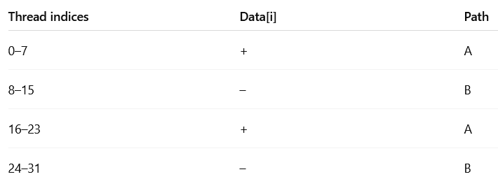
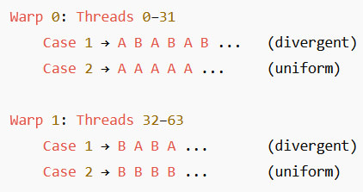
Example Code
Let’s say we launch 64 threads total (2 warps × 32 threads/warp).
if (data[i] > 0)
result[i] = computeA(data[i]);
else
result[i] = computeB(data[i]);
Clearly, this has branch divergence — two possible execution paths (A and B).
Now, whether it causes warp divergence depends on how data[i] values are distributed among threads.
Ideal Situation:

Slide 17
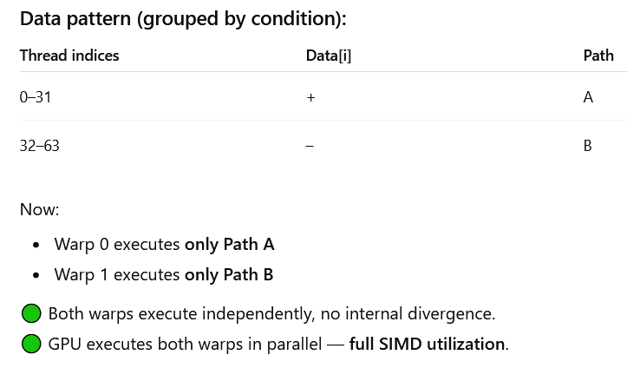
if (data[i] > 0)
result[i] = computeA(data[i]);
else
result[i] = computeB(data[i]);
Threads in the same warp should ideally make the same control-flow decisions.
You can have branching in code, but keep it warp-aligned.

