Slide 1
GPU Programming
Lecture 04

Slide 2
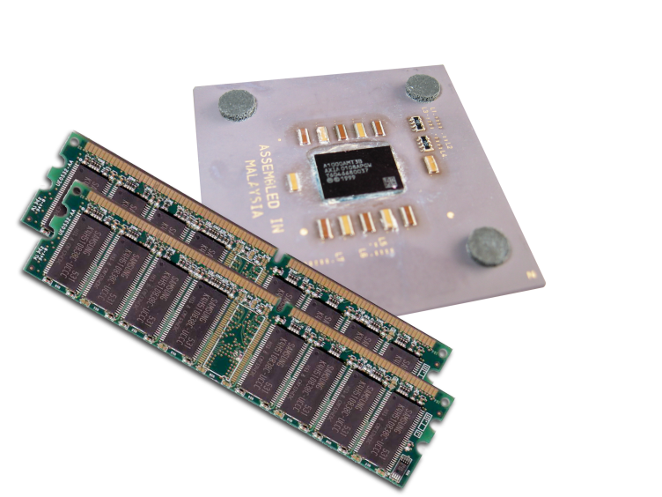
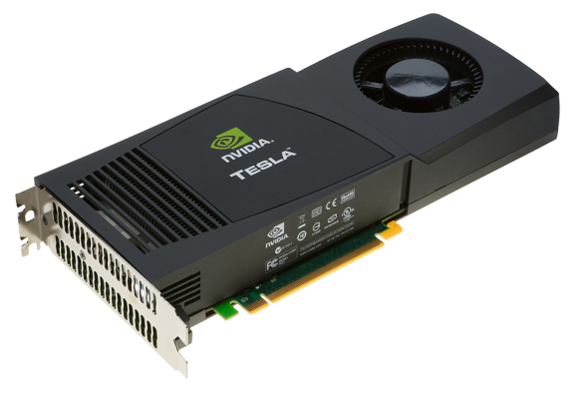
Heterogeneous Computing
Terminology:
Host The CPU and its memory (host memory)
Device The GPU and its memory (device memory)
Host
Device

Slide 3
Heterogeneous Computing
#include <iostream>
#include <algorithm>
using namespace std;
#define N 1024
#define RADIUS 3
#define BLOCK_SIZE 16
__global__ void stencil_1d(int *in, int *out) {
__shared__ int temp[BLOCK_SIZE + 2 * RADIUS];
int gindex = threadIdx.x + blockIdx.x * blockDim.x;
int lindex = threadIdx.x + RADIUS;
// Read input elements into shared memory
temp[lindex] = in[gindex];
if (threadIdx.x < RADIUS) {
temp[lindex - RADIUS] = in[gindex - RADIUS];
temp[lindex + BLOCK_SIZE] = in[gindex + BLOCK_SIZE];
}
// Synchronize (ensure all the data is available)
__syncthreads();
// Apply the stencil
int result = 0;
for (int offset = -RADIUS ; offset <= RADIUS ; offset++)
result += temp[lindex + offset];
// Store the result
out[gindex] = result;
}
void fill_ints(int *x, int n) {
fill_n(x, n, 1);
}
int main(void) {
int *in, *out; // host copies of a, b, c
int *d_in, *d_out; // device copies of a, b, c
int size = (N + 2*RADIUS) * sizeof(int);
// Alloc space for host copies and setup values
in = (int *)malloc(size); fill_ints(in, N + 2*RADIUS);
out = (int *)malloc(size); fill_ints(out, N + 2*RADIUS);
// Alloc space for device copies
cudaMalloc((void **)&d_in, size);
cudaMalloc((void **)&d_out, size);
// Copy to device
cudaMemcpy(d_in, in, size, cudaMemcpyHostToDevice);
cudaMemcpy(d_out, out, size, cudaMemcpyHostToDevice);
// Launch stencil_1d() kernel on GPU
stencil_1d<<<N/BLOCK_SIZE,BLOCK_SIZE>>>(d_in + RADIUS, d_out + RADIUS);
// Copy result back to host
cudaMemcpy(out, d_out, size, cudaMemcpyDeviceToHost);
// Cleanup
free(in); free(out);
cudaFree(d_in); cudaFree(d_out);
return 0;
}
parallel fn
serial code
parallel code
serial code

Slide 4
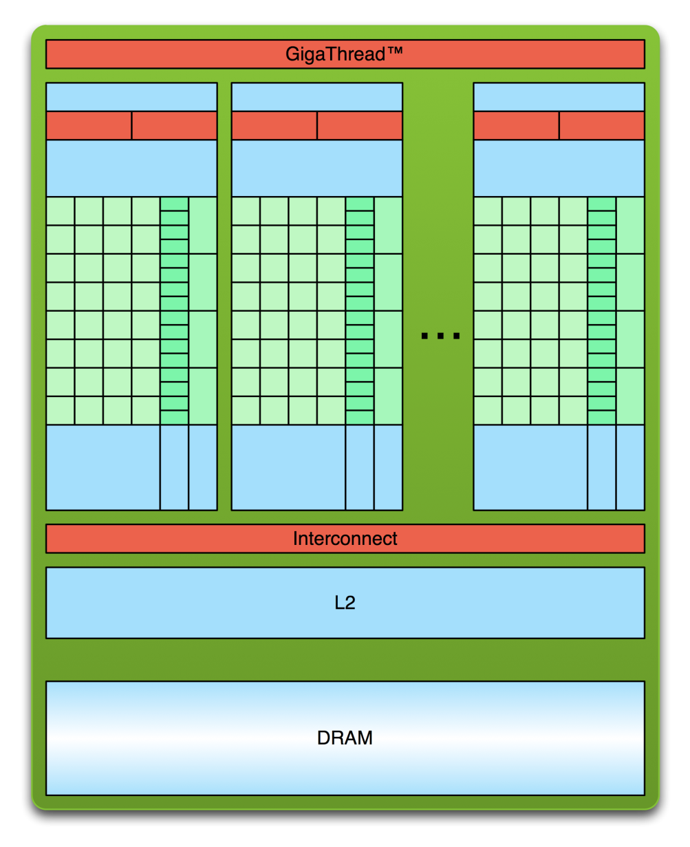
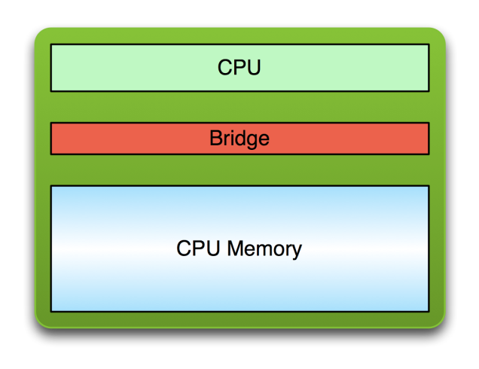
Simple Processing Flow
PCI Bus
Copy input data from CPU memory to GPU memory

Slide 5
Simple Processing Flow
PCI Bus
Copy input data from CPU memory to GPU memory
Load GPU program and execute, caching data on chip for performance

Slide 6
Simple Processing Flow
PCI Bus
Copy input data from CPU memory to GPU memory
Load GPU program and execute, caching data on chip for performance
Copy results from GPU memory to CPU memory

Slide 7
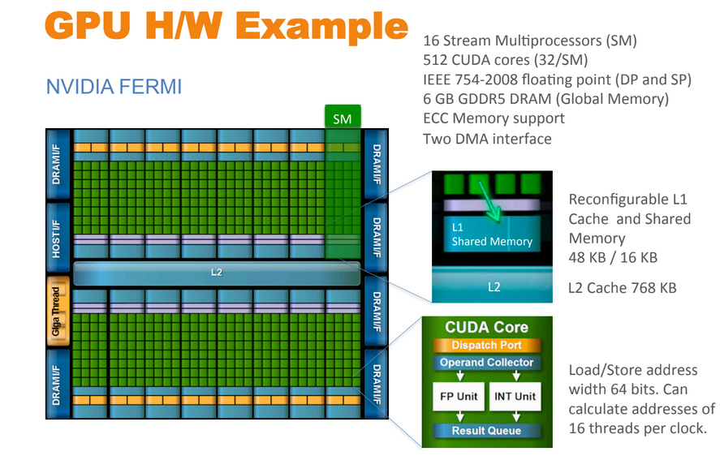

Slide 8
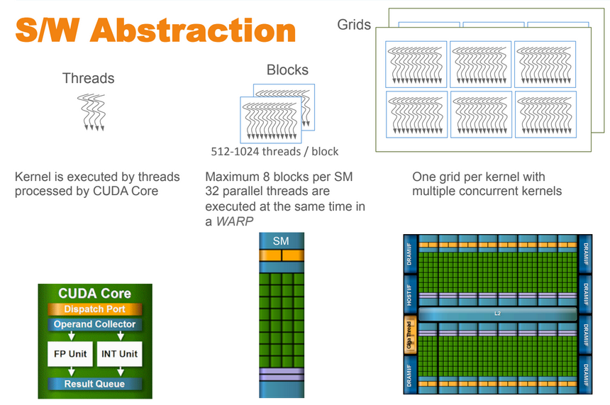

Slide 9
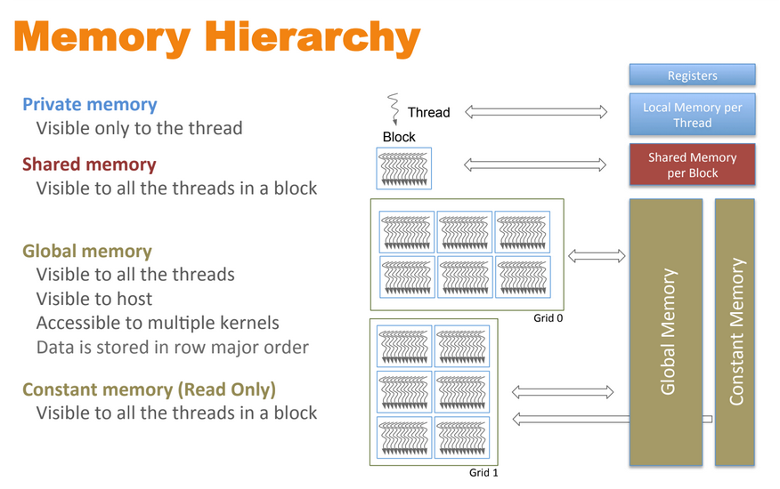

Slide 10
Moving to Parallel
GPU computing is about massive parallelism
So how do we run code in parallel on the device?
add<<< 1, 1 >>>();
add<<< N, 1 >>>();
Instead of executing add() once, execute N times in parallel

Slide 11
Vector Addition on Device(GPU)
With add() running in parallel we can do vector addition
Terminology: each parallel invocation of add() is referred to as a block
The set of blocks is referred to as a grid
Each invocation can refer to its block index using blockIdx.x
__global__ void add(int *a, int *b, int *c) {
c[blockIdx.x] = a[blockIdx.x] + b[blockIdx.x];
}
By using blockIdx.x to index into the array, each block handles a different index

Slide 12
Vector Addition on the Device
__global__ void add(int *a, int *b, int *c) {
c[blockIdx.x] = a[blockIdx.x] + b[blockIdx.x];
}
On the device, each block can execute in parallel:
Block 0
Block 1
Block 2
Block 3
c[0] = a[0] + b[0];
c[1] = a[1] + b[1];
c[2] = a[2] + b[2];
c[3] = a[3] + b[3];

Slide 13
Indexing Arrays with Blocks and Threads
No longer as simple as using blockIdx.x and threadIdx.x
Consider indexing an array with one element per thread (8 threads/block)
threadIdx.x
threadIdx.x
threadIdx.x
threadIdx.x
0
1
2
3
4
5
6
7
0
1
2
3
4
5
6
7
0
1
2
3
4
5
6
7
0
1
2
3
4
5
6
7
blockIdx.x = 0
blockIdx.x = 1
blockIdx.x = 2
blockIdx.x = 3
With M threads/block a unique index for each thread is given by:
int index = threadIdx.x + blockIdx.x * M;
Notes:
Identical to finding offset in 1-dimensional storage of a 2-dimensional matrix:
int index = x + width * y;

Slide 14
Indexing Arrays: Example
Which thread will operate on the red element?
0
1
2
3
4
5
6
7
8
9
10
11
12
13
14
15
16
17
18
19
20
21
22
23
24
25
26
27
28
29
30
31
M = 8
threadIdx.x = 5
0
1
2
3
4
5
6
7
0
1
2
3
4
5
6
7
0
1
2
3
4
5
6
7
0
1
2
3
4
5
6
7
blockIdx.x = 2
int index = threadIdx.x + blockIdx.x * M;
= 5 + 2 * 8;
= 21;

Slide 15
Vector Addition with Blocks and Threads
Use the built-in variable blockDim.x for threads per block
int index = threadIdx.x + blockIdx.x * blockDim.x;
Combined version of add() to use parallel threads and parallel blocks
__global__ void add(int *a, int *b, int *c) {
int index = threadIdx.x + blockIdx.x * blockDim.x;
c[index] = a[index] + b[index];
}
What changes need to be made in main()?

Slide 16
Addition with Blocks and Threads: main()
#define N (2048*2048)
#define THREADS_PER_BLOCK 512
int main(void) {
int *a, *b, *c; // host copies of a, b, c
int *d_a, *d_b, *d_c; // device copies of a, b, c
int size = N * sizeof(int);
// Alloc space for device copies of a, b, c
cudaMalloc((void **)&d_a, size);
cudaMalloc((void **)&d_b, size);
cudaMalloc((void **)&d_c, size);
// Alloc space for host copies of a, b, c and setup input values
a = (int *)malloc(size); random_ints(a, N);
b = (int *)malloc(size); random_ints(b, N);
c = (int *)malloc(size);

Slide 17
Addition with Blocks and Threads: main()
// Copy inputs to device
cudaMemcpy(d_a, a, size, cudaMemcpyHostToDevice);
cudaMemcpy(d_b, b, size, cudaMemcpyHostToDevice);
// Launch add() kernel on GPU
add<<<N/THREADS_PER_BLOCK,THREADS_PER_BLOCK>>>(d_a, d_b, d_c);
// Copy result back to host
cudaMemcpy(c, d_c, size, cudaMemcpyDeviceToHost);
// Cleanup
free(a); free(b); free(c);
cudaFree(d_a); cudaFree(d_b); cudaFree(d_c);
return 0;
}

Slide 18
Handling Arbitrary Vector Sizes
Typical problems are not friendly multiples of blockDim.x
Avoid accessing beyond the end of the arrays:
__global__ void add(int *a, int *b, int *c, int n) {
int index = threadIdx.x + blockIdx.x * blockDim.x;
if (index < n)
c[index] = a[index] + b[index];
}
Update the kernel launch:
add<<<(N + M-1) / M,M>>>(d_a, d_b, d_c, N);

Slide 19
Coordinating Host & Device
Kernel launches are asynchronous
Control returns to the CPU immediately
CPU needs to synchronize before consuming the results
cudaMemcpy() | Blocks the CPU until the copy is complete Copy begins when all preceding CUDA calls have completed
cudaMemcpyAsync() | Asynchronous, does not block the CPU
cudaDeviceSynchronize() | Blocks the CPU until all preceding CUDA calls have completed

Slide 20
Just-In-Time (JIT)
Just-in-time (JIT) compilation for Python with CUDA enables the dynamic compilation of Python code into machine code optimized for NVIDIA GPUs at runtime.
Numba: Numba is a widely used open-source JIT compiler that translates a subset of Python and NumPy code into fast machine code for both CPUs and GPUs. For CUDA, Numba provides the @cuda.jit decorator, allowing developers to write GPU kernels in Python and have them compiled and executed on the fly. This eliminates the need to write C/C++ CUDA code directly.
CuPy: CuPy is a NumPy-compatible array library for GPU-accelerated computing. It provides a familiar interface for performing numerical operations on GPUs, often relying on CUDA under the hood. CuPy also offers low-level CUDA support and can integrate with JIT-compiled Python functions, similar to Numba.
PyCUDA: PyCUDA provides a more fine-grained control over the CUDA API within Python. It allows developers to manage CUDA contexts, memory, and kernel execution directly, offering greater flexibility but also requiring a deeper understanding of CUDA programming.

Slide 21
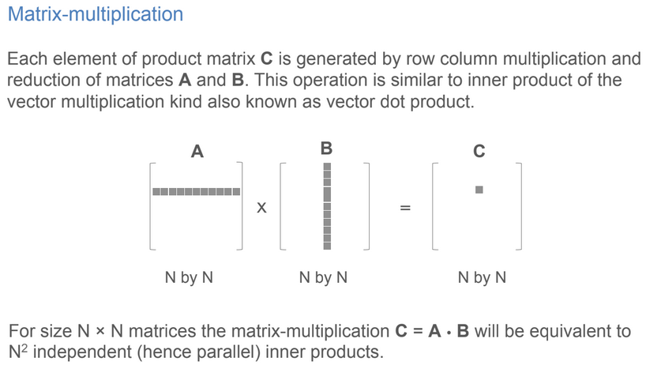
Next Example

Slide 22
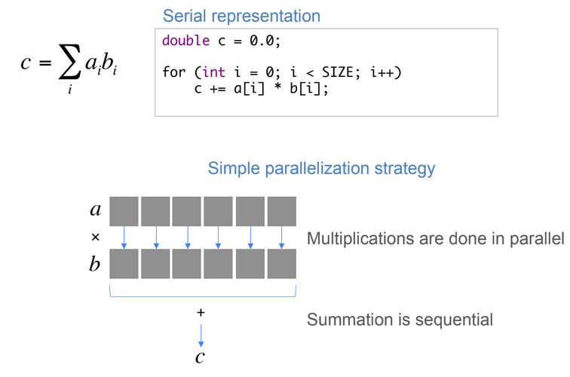
Next Example

Slide 23
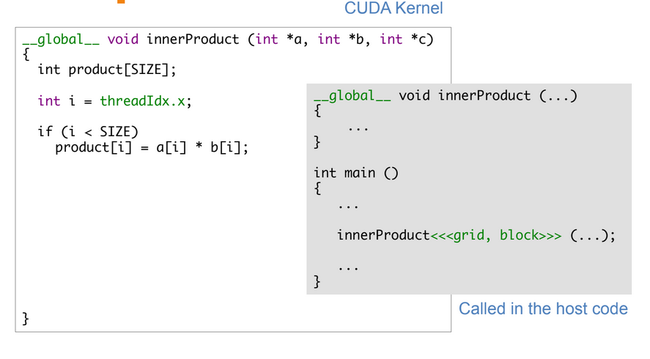
Next Example

Slide 24
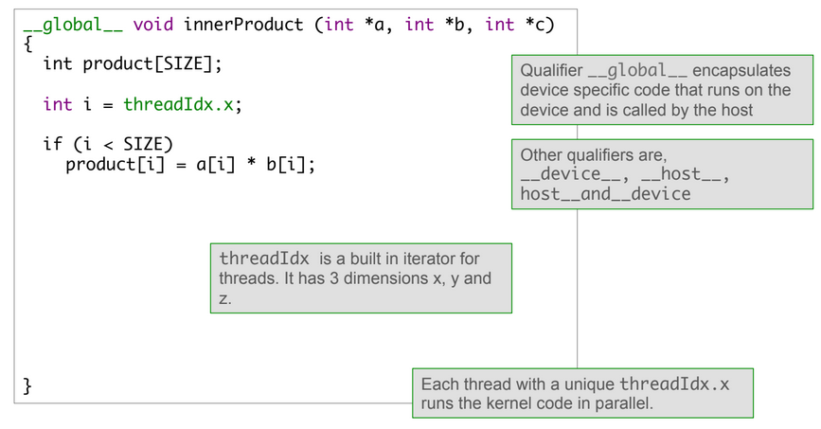
Next Example

Slide 25
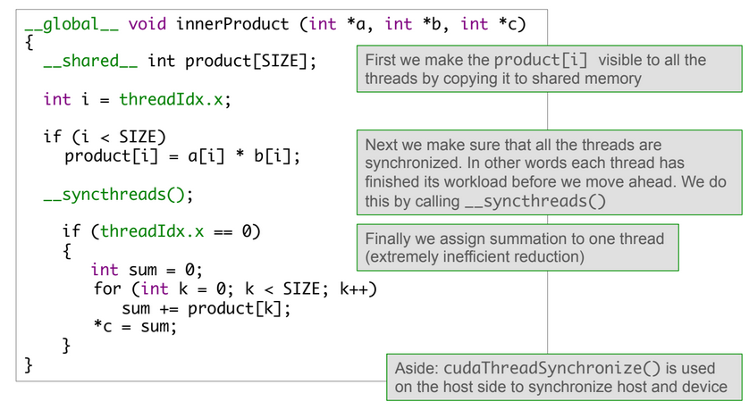
Next Example

