Slide 1
GPU Programming
Lecture 05

Slide 2

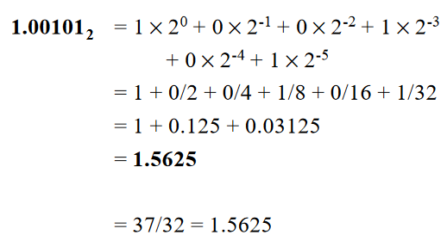
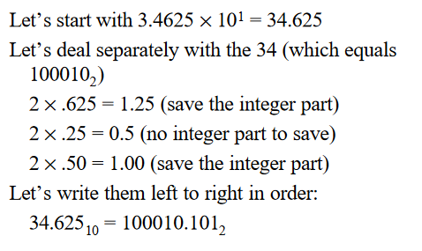
Unit of CPU Performance Measurement: FLOPs
Floating-point operations per second (FLOPs)
Instead of field lengths of 1, 8, and 23 as in single precision, have field lengths of 1, 11, and 52 in double-precision
Example: 5.6 = 101.100110011001100110011
Homework: Revise floating-point addition, floating-point subtraction etc.

Slide 3
CPU Performance Model (FLOPS)
It is a simple measurement standing for floating point operations per second. This is essentially the number of mathematical operations (i.e. +, *, …) that the computer does per second on a given algorithm.
double mul_add(double a, double b) {
double x = 0.0;
for (int i = 0; i < 50; i++) {
x = a * x + b; // (a)
}
return x;
}
One call of mul_add will execute line (a) 50 times. This involves 2 floating-point operations: *, +
Mul_add has 100 FLOP. If mul_add takes 1 second on a CPU, so this CPU performance is 100 FLOPs

Slide 4
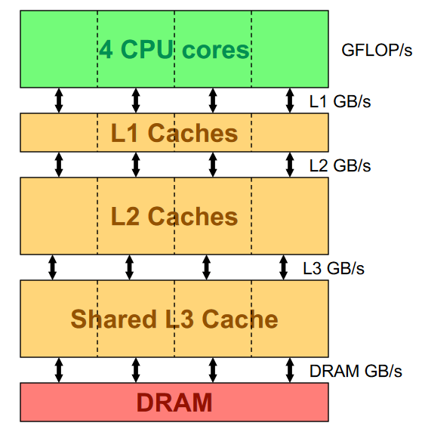
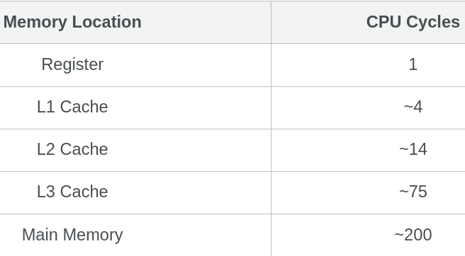
FLOPs: Computation & Communication
Since memory operations are so slow it is important to try and do as many operations with a piece of loaded data as possible before the next data is loaded. How to measure this?
The answer is Arithmetic Intensity (AI) metric.

Slide 5
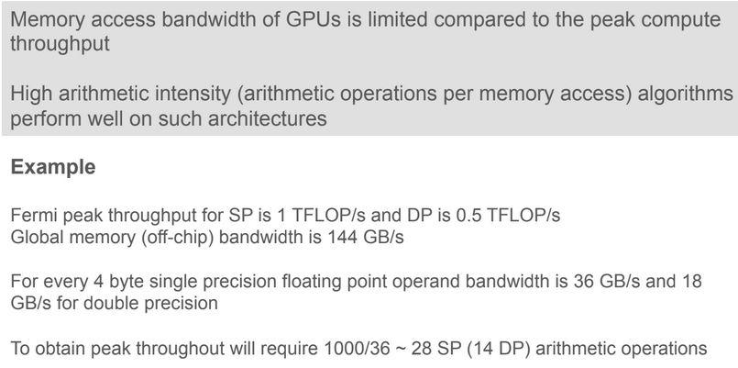
Arithmetic Intensity
Memory bandwidth – rate at which the data is transferred – is a valuable metric to gauge the performance of an application
Bandwidth (GB/s) = [(bytes read + bytes written) / 10^9 ] / execution time

Slide 6

Calculation of Arithmetic Intensity (CPUs)
Let’s take this example:
void arraymul_add(size_t n, double a, const double *x, double *y) {
size_t i;
for (i = 0; i < n; i++) {
y[i] = a * x[i] + y[i];
}
}
Arithmetic Intensity (AI) is the measure of how many operations are done per bytes loaded or stored from memory.
Arithmetic Intensity = (Total number of computations)/(Total amount of data transfer)
size_t is an unsigned integer data type

Slide 7

Calculation of Arithmetic Intensity (CPUs)
void arraymul_add(size_t n, double a, const double *x, double *y) {
size_t i;
for (i = 0; i < n; i++) {
y[i] = a * x[i] + y[i];
}
}
traffic=[(2 loads)(8bytes/load)+(1 store)(8bytes/store)]⋅n=[(2 loads)(8load/bytes​)+(1 store)(8store/bytes​)]⋅n=24n.
Arithmetic Intensity = (Total number of computations)/(Total amount of data transfer)

Slide 8
Home-work
void dgemm(size_t n, const double *A, const double *B, const double *C) {
size_t i, j, k;
double sum;
for (i = 0; i < n; i++) {
for (j = 0; j < n; j++) {
sum = 0.0;
for (k = 0; k < n; k++) {
sum = sum + A[i*n+k] * B[k*n+j];
}
C[i*n+j] = sum;
}
}
}
Answer: Arithmetic Intensity=n/16
Solution: https://dando18.github.io/posts/2020/04/02/roofline-model

Slide 9
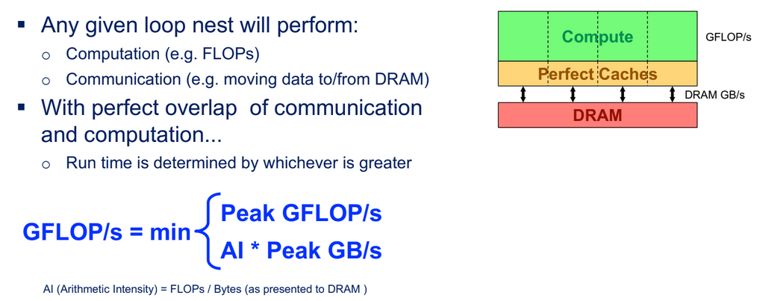
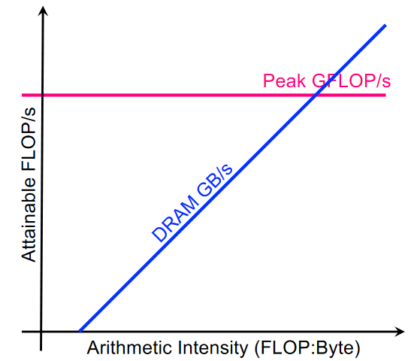
CPU Performance Model

Slide 10
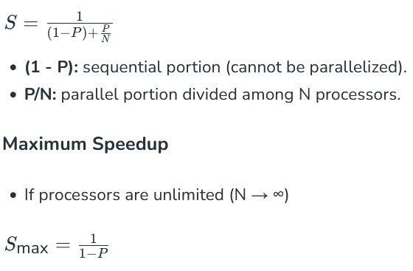
Amdahl's law
This law explains the theoretical speedup of a program when part of it is improved or parallelized. The main idea is that the speedup of a system is limited by the portion of the program that cannot be parallelized (the sequential part).

Slide 11
Quick Quiz
Assume 1% of the runtime of a program is not parallelizable. This program is run on 61 cores of a Intel Xeon Phi. Under the assumption that the program runs at the same speed on all of those cores, and there are no additional overheads, what is the parallel speedup?
Answer = 38.125

Slide 12
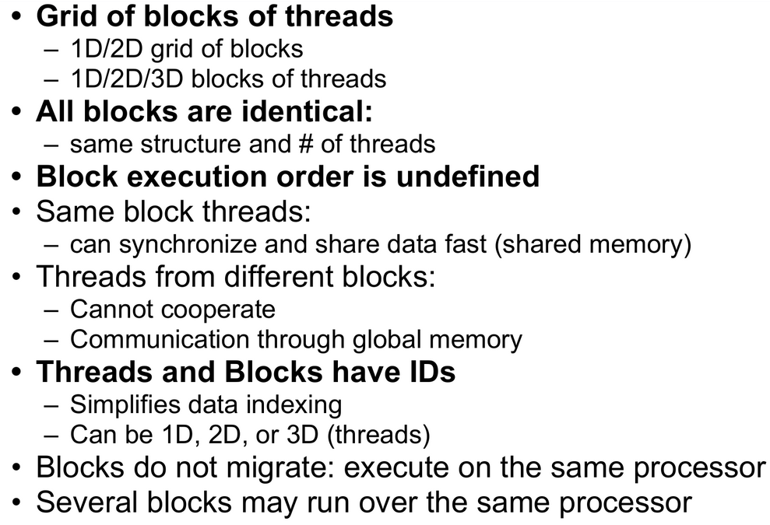
Summary for Execution on GPU

Slide 13
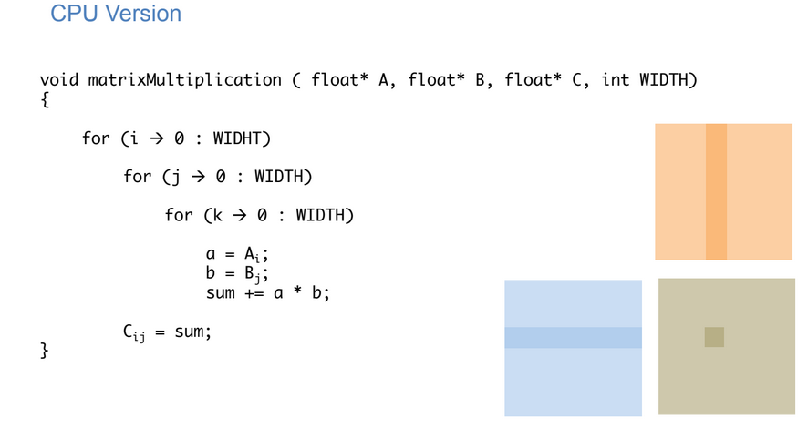
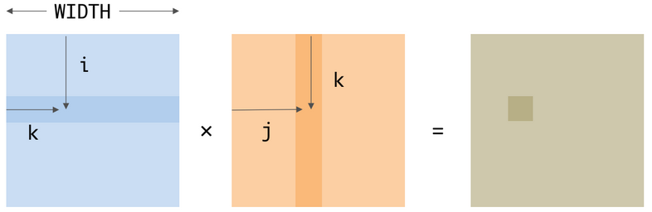
Matrix Multiplication...

Slide 14
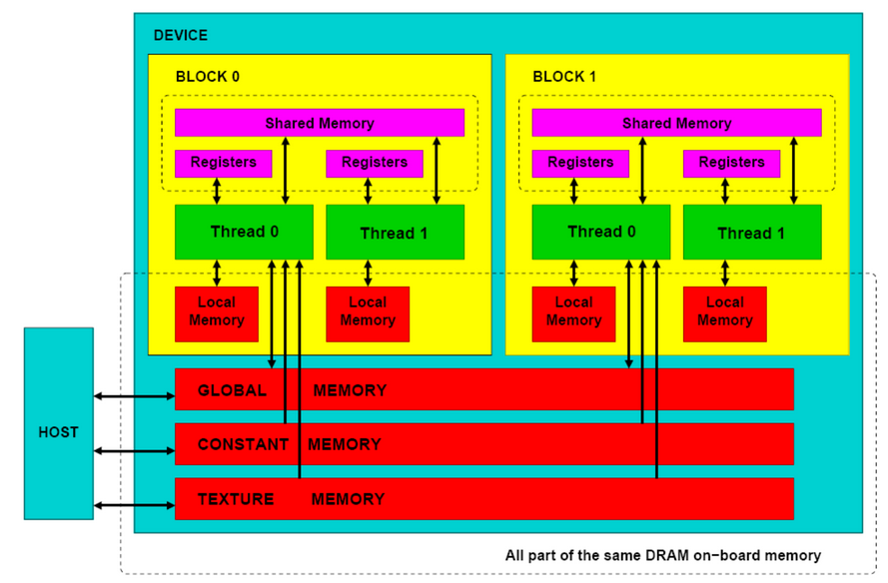
Programmer’s view: Memory Model

Slide 15
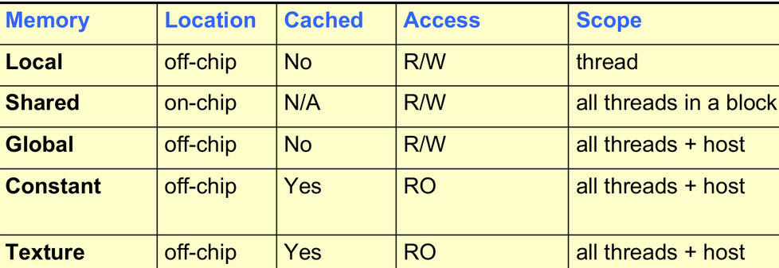
Programmer’s View: Memory Detail – Thread and Host
Each thread can:
R/W per-thread registers
R/W per-thread local memory
R/W per-block shared memory
R/W per-grid global memory
Read only per-grid constant memory
Read only per-grid texture memory
The host can R/W:
global, constant, and texture memories

Slide 16
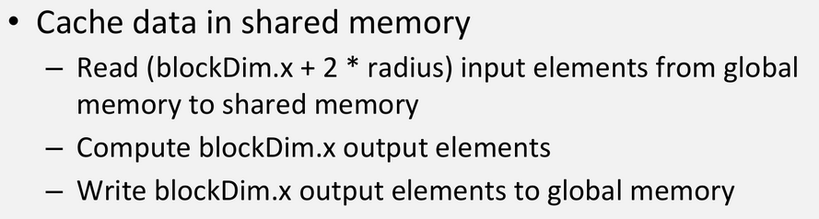
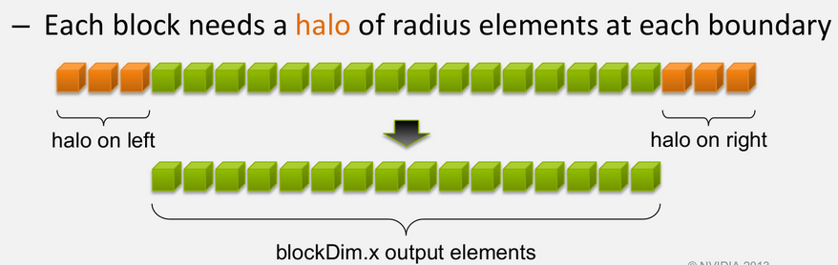
Sharing Data Between Threads
Terminology: within a block, threads share data via shared memory
Extremely fast on-chip memory, user-managed
Declare using __shared__, allocated per block
Data is not visible to threads in other blocks

Slide 17
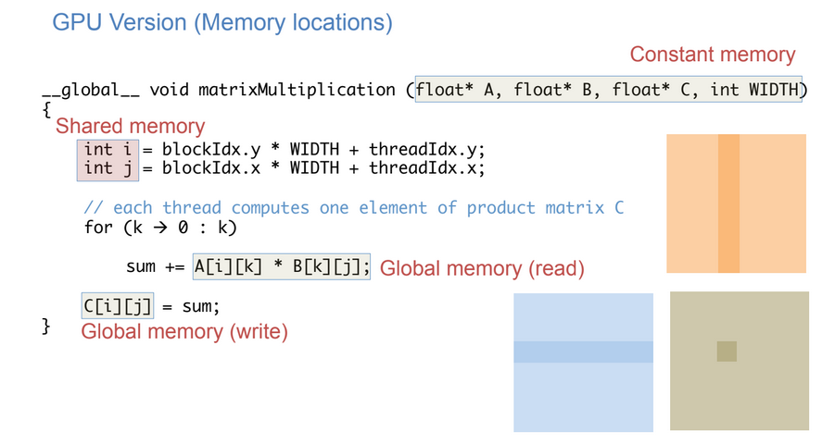
Matrix Multiplication...

Slide 18
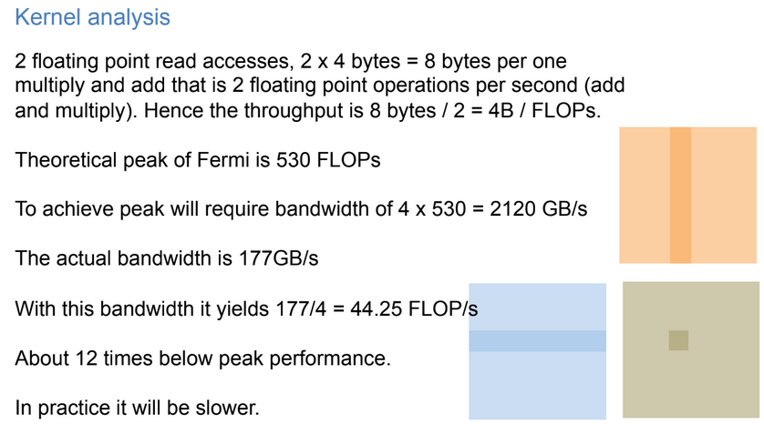
Matrix Multiplication...

Slide 19
Matrix Multiplication...
Promote fine grain parallelism, Consider minimal data movement, Exploit parallel memory access patterns, Data layout, Data Blocking/Tiling
Identify block/tile of global memory data to be accessed by threads.
Load the data into the fast memory (Shared, register)
Get the multi-threads to use the data
How to speed up?
BLOCKING
I) Load data into shared memory and reuse
II) Since the Shared memory size is small it helps to partition the
data in equal sized blocks that fit into the shared memory and
reuse.

Slide 20
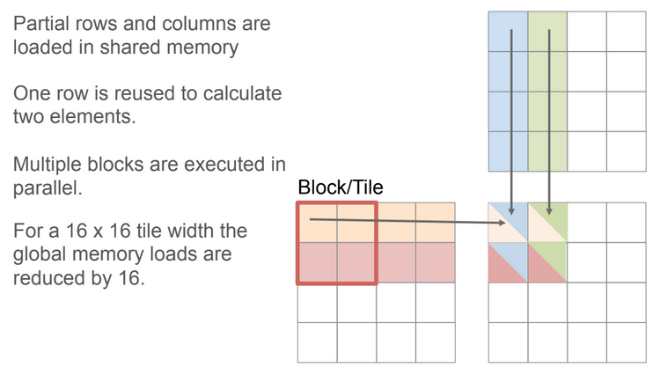
Matrix Multiplication...

Slide 21
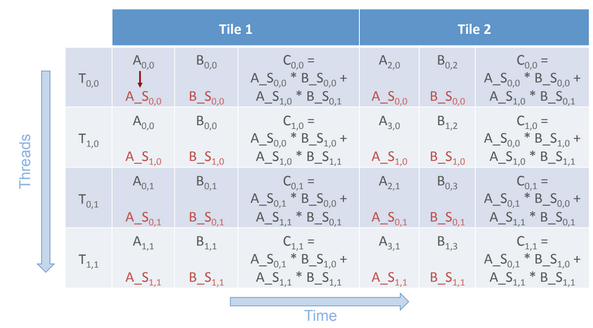
Matrix Multiplication...

Slide 22
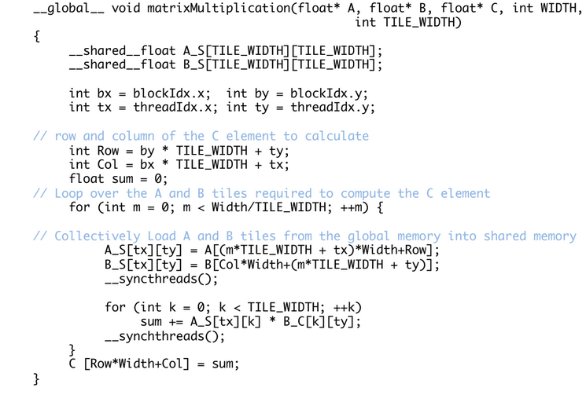
Matrix Multiplication...

Slide 23
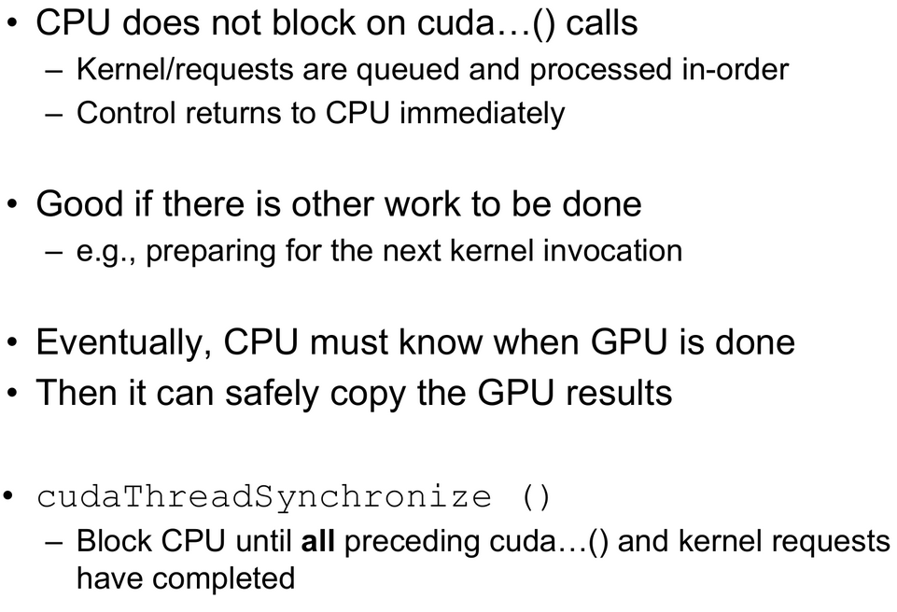
CPU/GPU Synchronization

