Slide 1
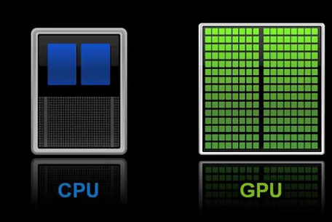
GPU Programming
Lecture-2

Slide 2
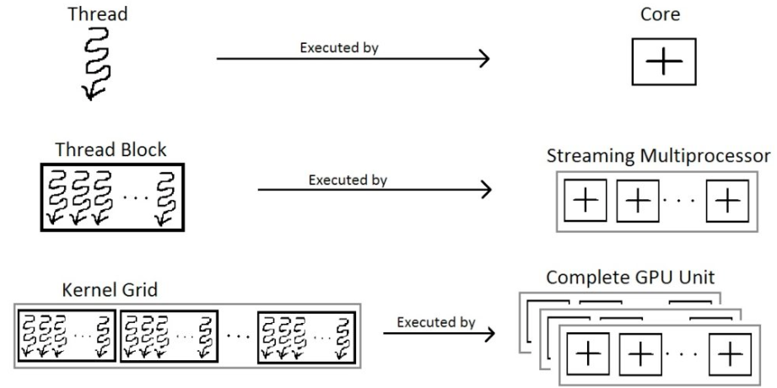
Program Execution illustration

Slide 3
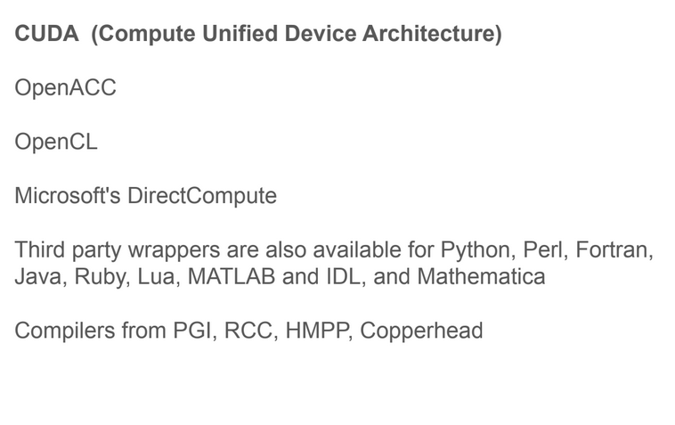
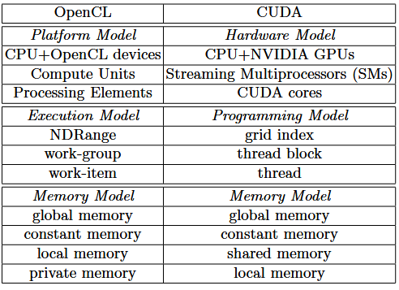
Programming Models

Slide 4
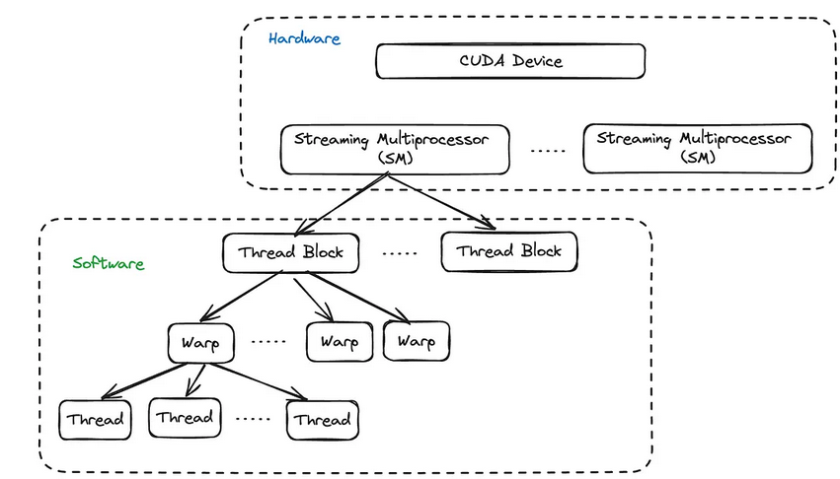
Program Execution illustration
CUDA: Compute Unified Device Architecture

Slide 5
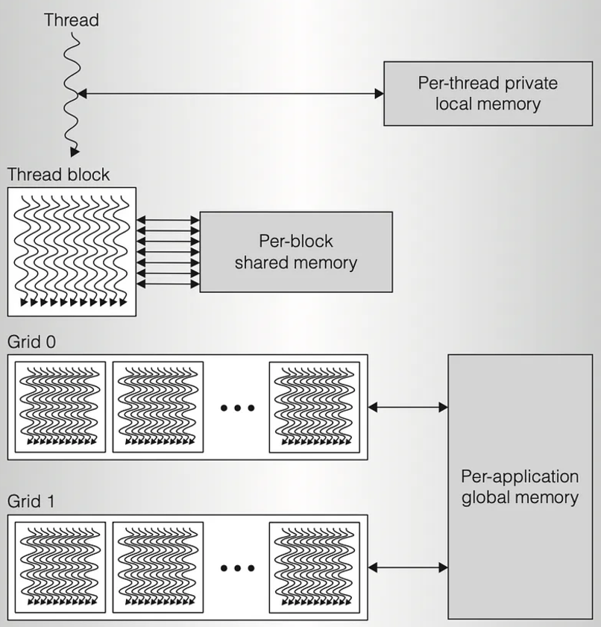
Program Execution illustration
A program consists of one or more sequential threads running on a host, and one or more parallel kernels suitable for execution on a parallel computing GPU.
Only one kernel is executed at a time, and that kernel is executed on a set of lightweight parallel threads.
Threads are grouped into thread blocks. A thread block is a programming abstraction that represents a group of threads that can be executed serially or in parallel.
Multiple thread blocks are grouped to form a grid.

Slide 6
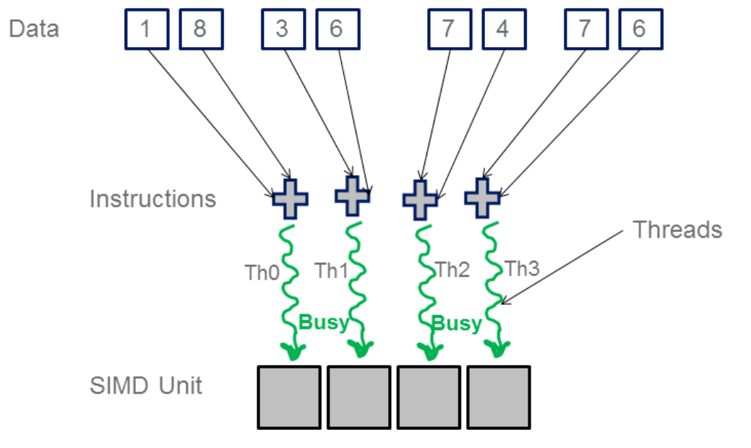
SIMT: Single Instruction, Multiple Threads
SIMD: Single Instruction, Multiple Data

Slide 7
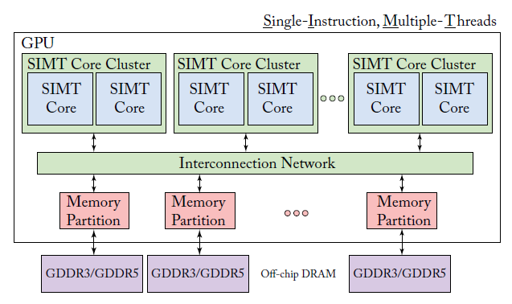
GPU Microarchitecture
GDDR= Graphics Dual-Data Rate

Slide 8

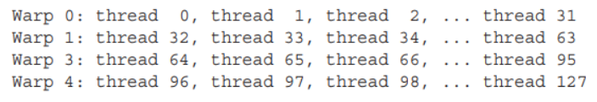
Warp
A thread block is composed of warps.
A warp is a set of 32 threads within a thread block such that all the threads in a warp execute the same instruction. These threads are selected serially by the SM.
Each warp is executed in a SIMD fashion (i.e. all threads within a warp must execute the same instruction at any given time).
32 in number

Slide 9
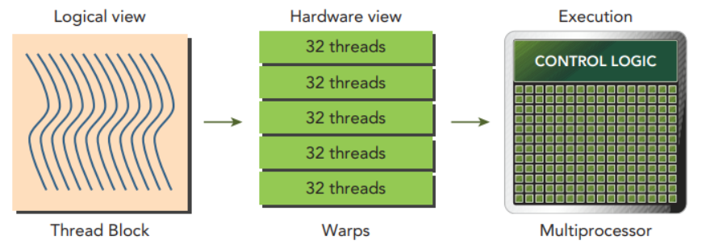
Scheduling Decisions
A 16×16 thread block gives 256 threads/block. With a maximum thread limit per SM of 1024, we get 1024/256 = 4 blocks/SM.
This is within the 8 block limit so 4 blocks, each of 256 threads can be scheduled on one SM.
With 4 blocks each with 256 threads, we get a total of 1024 threads. The threads are further split into warps of 32 threads each for a total of 32 warps.
Since the device can support 32 warps/SM we have achieved 100% occupancy.

Slide 10
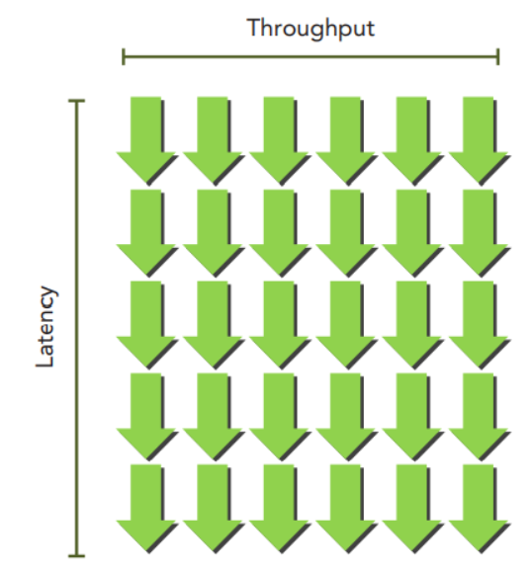
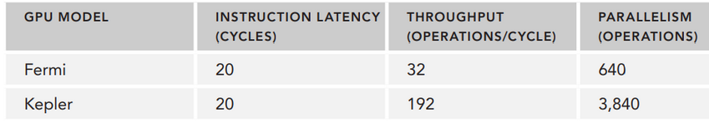
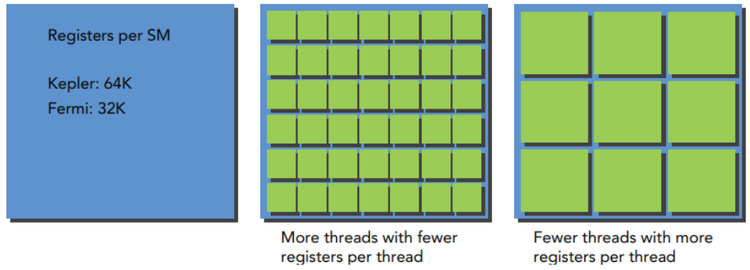
Scheduling Decisions
Number of Required Warps = Latency X Throughput

Slide 11
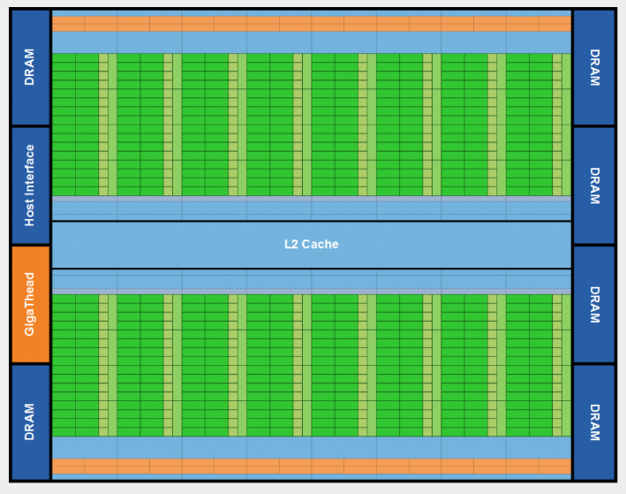
Nvidia Fermi Architecture

Slide 12
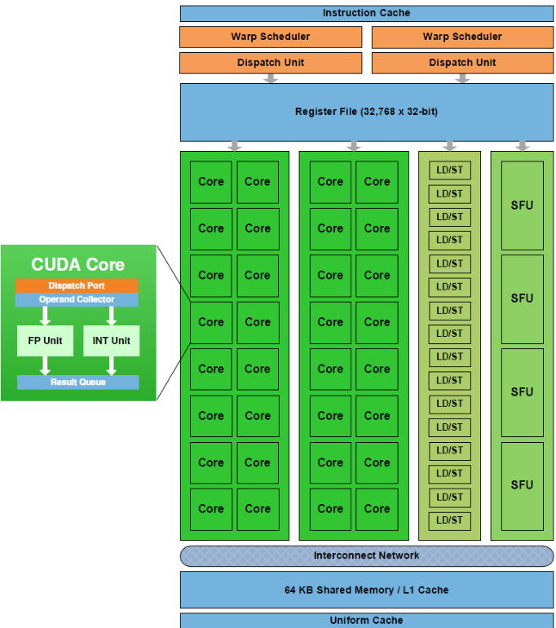
Fermi Streaming Multiprocessor (SM)
The SM has 16 load/store units allowing source and destination addresses to be calculated for sixteen threads per clock.
Each SM also has four Special Function Units (SFU) that execute transcendental instructions such as sin, cosine, reciprocal, and square root.

Slide 13
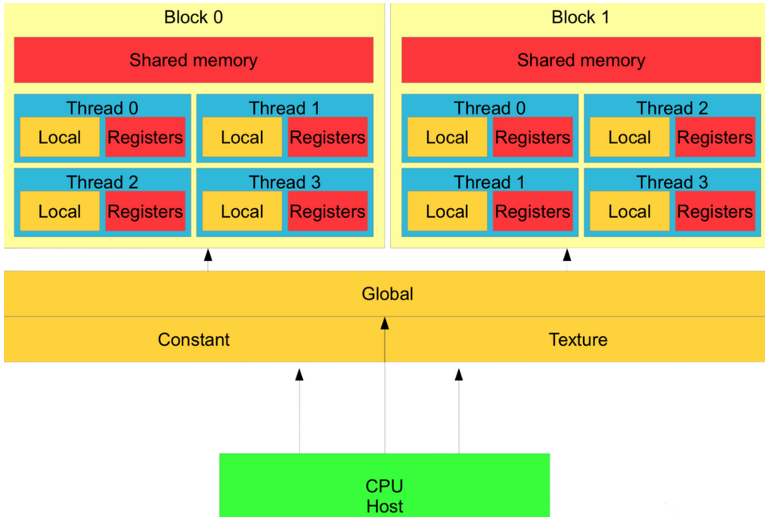
GPU Memory Hierarchy

Slide 14
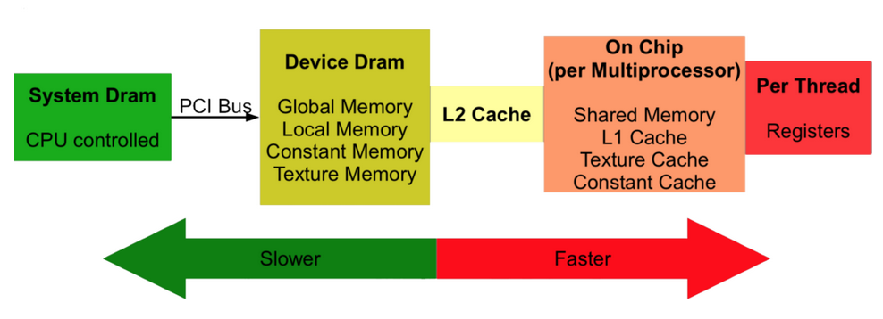
GPU Memory Hierarchy: complete picture
Texture memory on a GPU is a dedicated memory system for storing texture data, which are typically 2D or 3D images and patterns, used to render detailed 3D scenes. It's read-only, features hardware caching for efficient spatial access, and supports specialized addressing modes like clamping and interpolation.

Slide 15
Execution of a workload
From the top, a GPU workload:
starts on a CPU
CPU launches CUDA kernels on a GPU
For each CUDA kernel, data is moved (copied) from CPU (host) memory to GPU (device) memory over PCIe
The threads of each kernel compute on the data in blocks until the grid runs out.
Useful data is moved back to the CPU memory for further processing

Slide 16
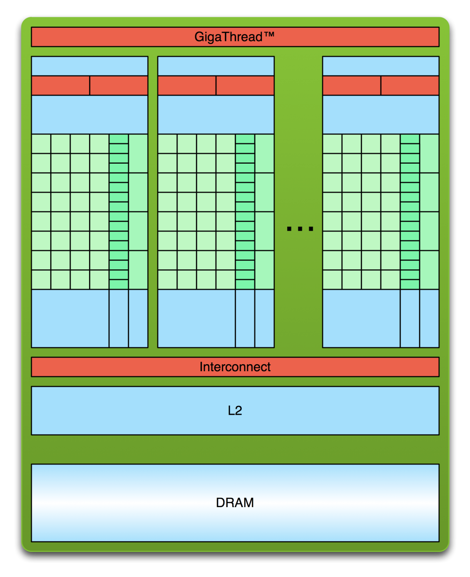
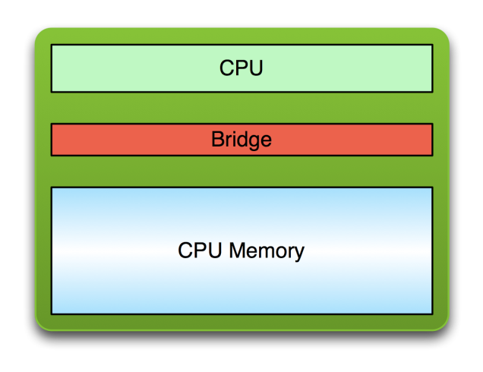
Simple Processing Flow
PCI Bus
Copy input data from CPU memory to GPU memory

Slide 17
Simple Processing Flow
PCI Bus
Copy input data from CPU memory to GPU memory
Load GPU program and execute, caching data on chip for performance

Slide 18
Simple Processing Flow
PCI Bus
Copy input data from CPU memory to GPU memory
Load GPU program and execute, caching data on chip for performance
Copy results from GPU memory to CPU memory

Slide 19
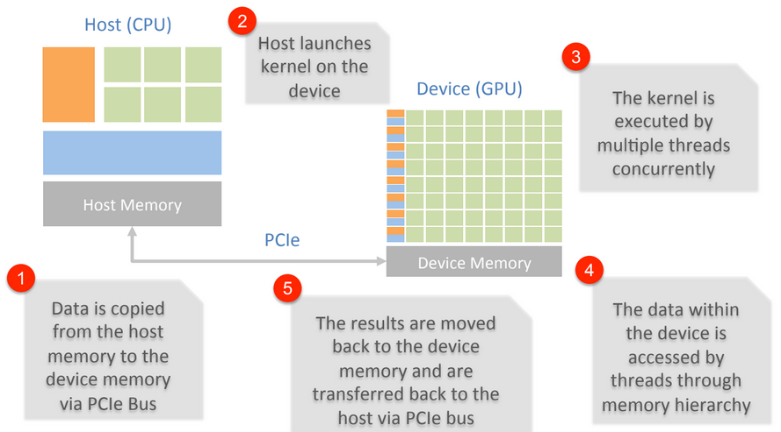
DataFlow

