Slide 1
GPU Programming
Lecture 03

Slide 2
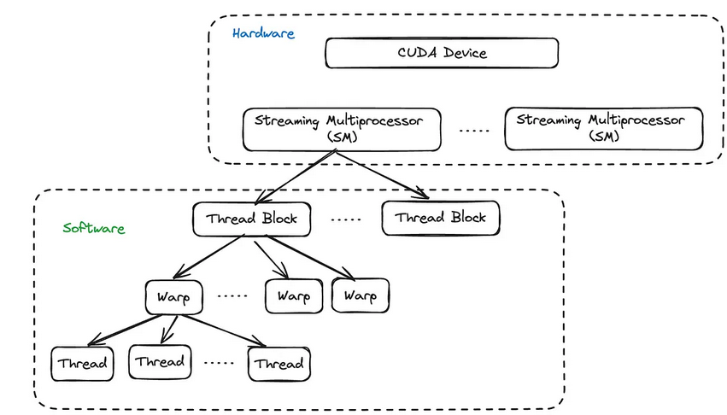
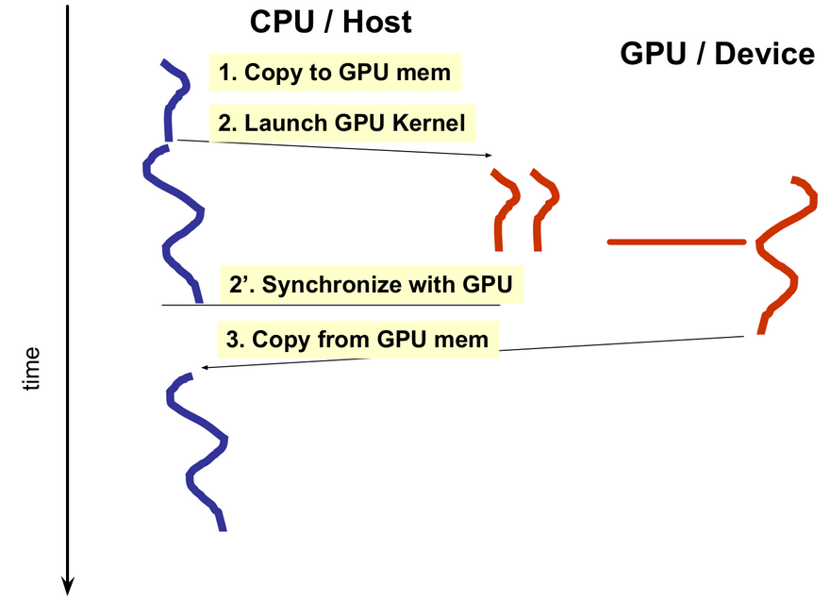
Program Execution: Recap

Slide 3
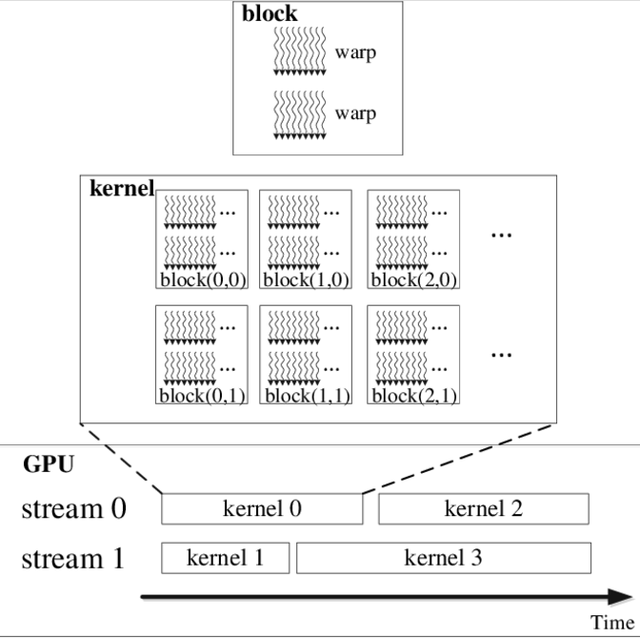
Hierarchy of kernel, block, warp and thread
The host calls a kernel using a triple chevron <<< >>>. In the chevrons we place the number of blocks and the number of threads per block.
Kernel1<<<100, 256>>> would launch 100 blocks of 256 threads each (total of 25600 threads).
Kernel2<<<50, 1024>>> would launch 50 blocks of 1024 threads each (51200 threads in total).

Slide 4
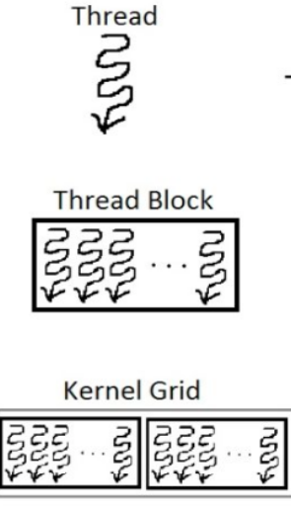
Organization of thread blocks
It is convenient to organize thread blocks into 1D, 2D or 3D arrays of threads.
The blocks in a grid must be able to be executed independently, as communication or cooperation between blocks in a grid is not possible.
When a kernel is launched the number of threads per thread block, and the number of thread blocks is specified, this, in turn, defines the total number of CUDA threads launched.
The limitation on the number of threads in a block is actually imposed because the number of registers that can be allocated across all threads is limited.
http://thebeardsage.com/cuda-dimensions-mapping-and-indexing/

Slide 5
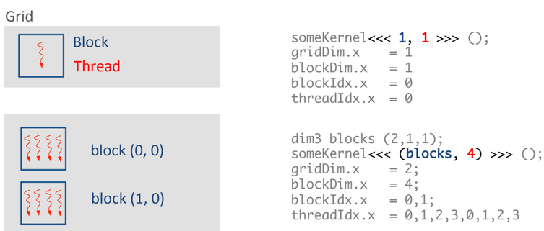
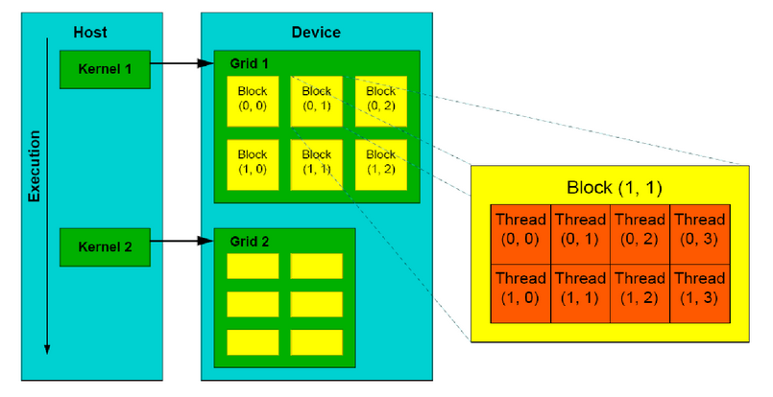
Grids Blocks of Threads

Slide 6
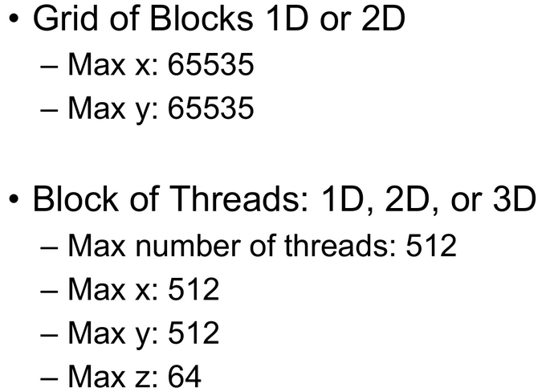
Grids of Blocks of Threads: Dimension Limits

Slide 7
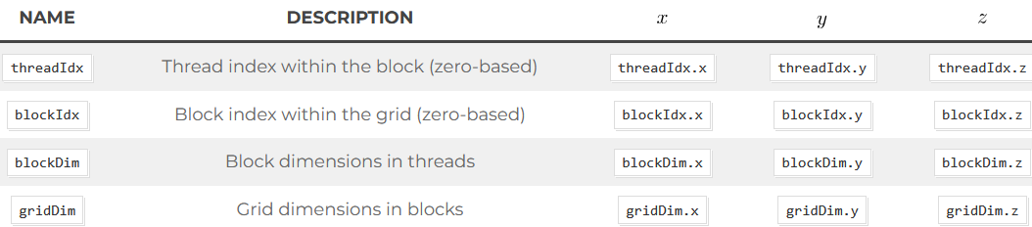
Programming Basics: Example
dim3 is a 3d structure or vector type with three integers x, y, and z. One can initialise as many of the three coordinates as they like
dim3 threads(256); // Initialise with x as 256, y and z will both be 1
dim3 blocks(100, 100); // Initialise x and y, z will be 1
dim3 anotherOne(10, 54, 32); // Initialises all three values, x will be 10, y gets 54 and z will be 32.

Slide 8
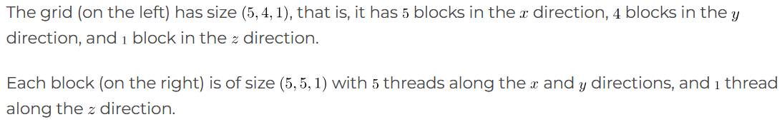
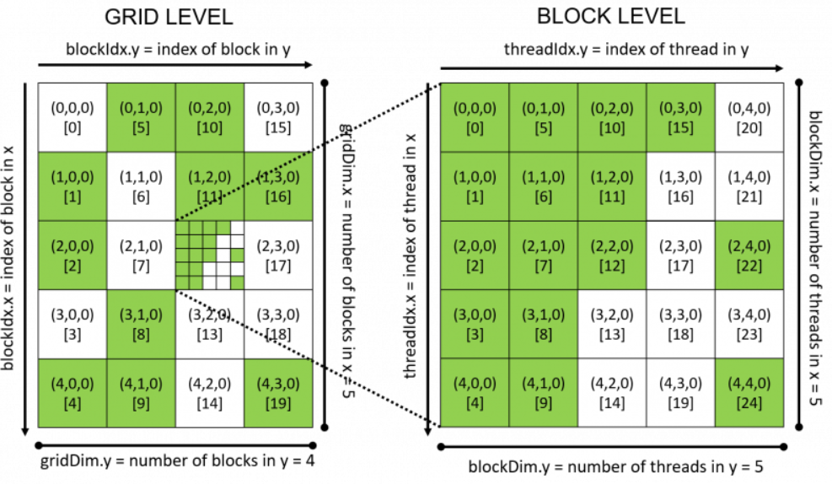
Programming Basics-Example
During execution, the CUDA threads are mapped to the problem in an undefined manner. Randomly completed threads and blocks are shown as green to highlight the fact that the order of execution for threads is undefined.

Slide 9
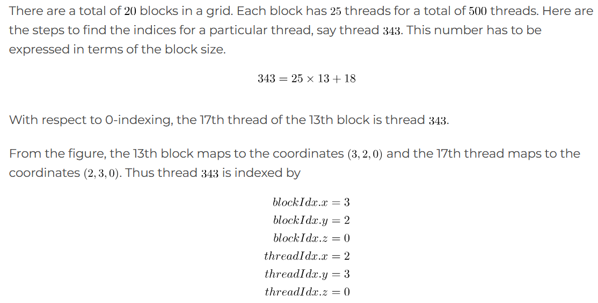
Programming Basics-Example

Slide 10
Sequence of steps for GPU programming
Allocate CPU Data Structure
Initialize Data on CPU
Allocate GPU Data Structure
Copy Data from CPU to GPU
Define Execution Configuration
Run Kernel
CPU synchronizes with GPU
Copy Data from GPU to CPU
De-allocate GPU and CPU memory

Slide 11
Hello World! with Device Code
__global__ void mykernel(void) {
}
int main(void) {
mykernel<<<1,1>>>();
printf("Hello World!\n");
return 0;
}
Two new syntactic elements…

Slide 12
Hello World! with Device Code
__global__ void mykernel(void) {
}
CUDA C/C++ keyword __global__ indicates a function that:
Runs on the device
Is called from host code
nvcc separates source code into host and device components
Device functions (e.g. mykernel()) processed by NVIDIA compiler
Host functions (e.g. main()) processed by standard host compiler
gcc, cl.exe

Slide 13
Hello World! with Device COde
mykernel<<<1,1>>>();
Triple angle brackets mark a call from host code to device code
Also called a “kernel launch”
We’ll return to the parameters (1,1) in a moment
That’s all that is required to execute a function on the GPU!

Slide 14
Hello World! with Device Code
__global__ void mykernel(void){
}
int main(void) {
mykernel<<<1,1>>>();
printf("Hello World!\n");
return 0;
}
mykernel() does nothing
Output:
$ nvcc hello.cu
$ a.out
Hello World!
$

Slide 15
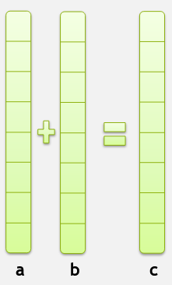
Parallel Programming in CUDA C/C++
GPU computing is about massive parallelism!
We need a more interesting example…
We’ll start by adding two integers and build up to vector addition

