Slide 1
GPU Programming
Lecture 06

Slide 2
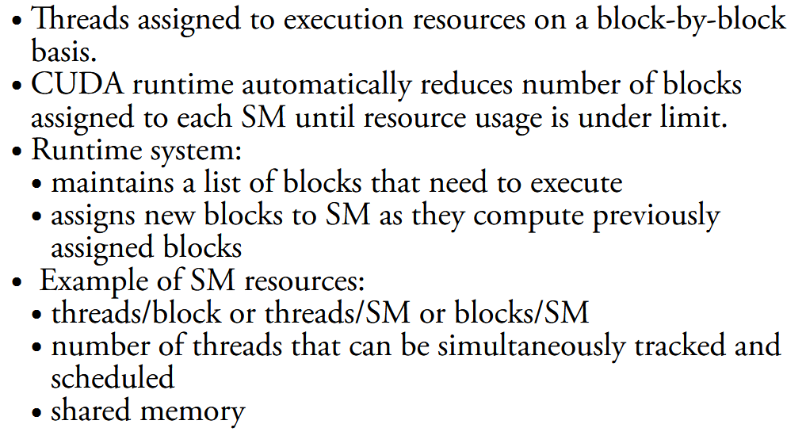
CUDA Runtime system

Slide 3
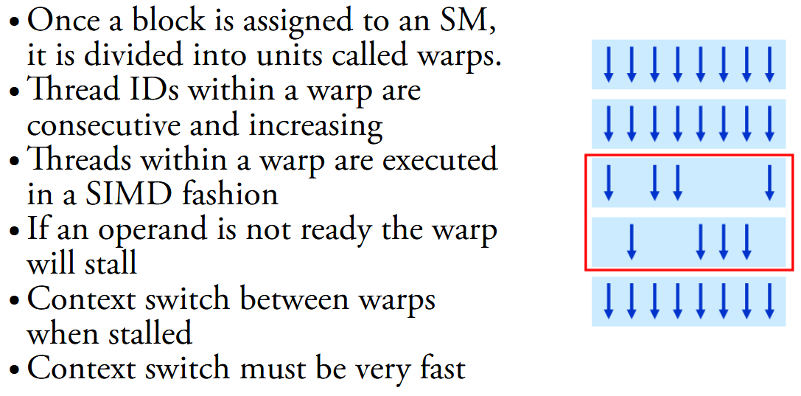
Recap: Warps

Slide 4
Context Switching in GPU
Why Context Switching Happens in GPUs?
Time-sharing between applications
Multiple processes (e.g., graphics + CUDA compute) share the GPU.
GPU drivers and hardware schedule which process gets execution time.
Preemption
If a high-priority task (like graphics rendering) arrives, a lower-priority compute task may be suspended.
Multi-tenancy
In cloud GPUs, tasks from multiple users must interleave execution.
A context switch in GPUs is the process of saving the state of one running task (or kernel) and loading the state of another, so the GPU can switch between different applications or kernels.
Just like in CPUs, the "context" means all the information needed to resume execution later. On a GPU, this includes:
Thread and warp states (program counters, registers, execution masks)
Memory mappings (page tables, virtual memory state)
Scheduler states (which warps were active, ready queues)
Caches and shared memory usage

Slide 5
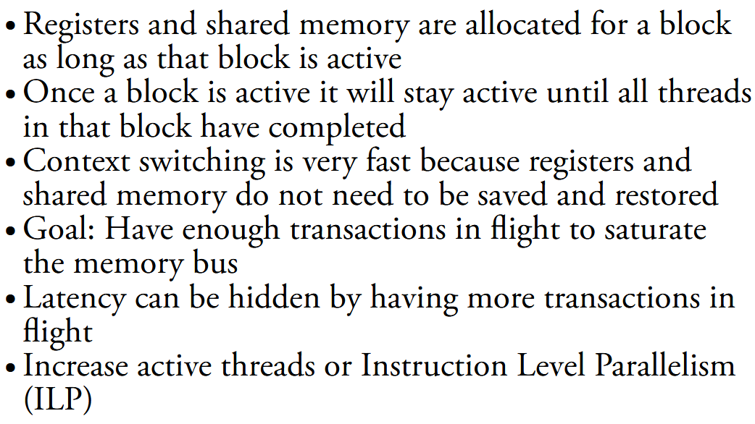
Context Switching

Slide 6
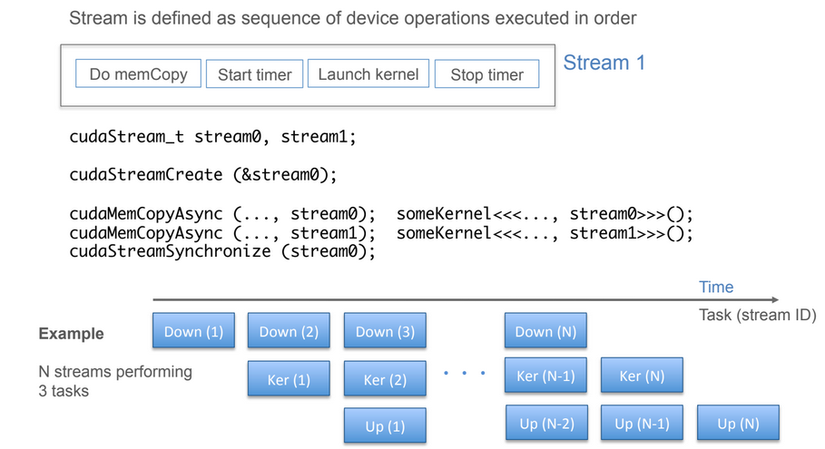
CUDA Streams

Slide 7
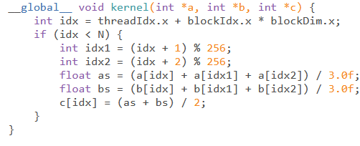
Example
A CUDA kernel that calculates the average of three values supplied from two vectors
The first step is to allocate some host memory to hold the a, b and c arrays.
In order to use the host memory locations within the stream (i.e. Copy their values to and from the GPU in the stream), it will need to be allocated as page-locked memory.
Page-locked memory is the same as normal heap memory (that we would allocate through malloc), except it is guaranteed never to be swapped into the virtual memory on disk by the OS.
The OS ensures that the memory is always within the physical memory of the system.
https://turing.une.edu.au/~cosc330/lectures/display_notes.php?lecture=22

Slide 8
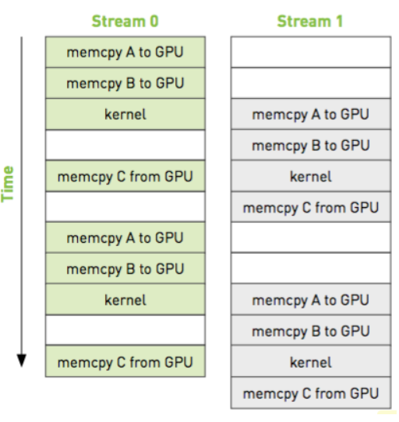
Example
Our system has a finite amount of physical memory - so be careful with the page-locked memory allocation.
GPU can use direct memory access (DMA) to copy data from this location in the host.
DMA works without intervention from the CPU.
Even when copying from pageable memory, the GPU still uses DMA.

Slide 9
Stencil Computation
Why Stencils Matter?
In CUDA, stencil computations are a great fit for the GPU because they involve:
Data parallelism: each output element can be computed independently (ideal for CUDA threads).
Regular memory access patterns: helps with memory coalescing.
Shared memory usage: neighboring data can be reused by threads in the same block.
A stencil defines a pattern of data points (or elements) used to compute a new value for each point in a data structure, typically a grid or an array. The new value at a grid point is computed based on its neighbors, according to a fixed rule.
The "stencil" describes which neighbors are used and how they're combined.
Let's say you have an array A, and you want to create a new array B, where each element in B is the average of its neighbors in A
B[i] = (A[i-1] + A[i] + A[i+1]) / 3;
This is called a 3-point stencil in 1D.

Slide 10
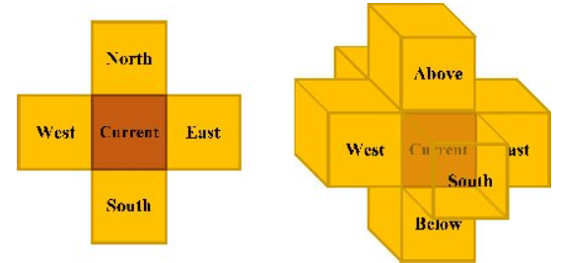
2D Stencil (Image Processing)
In 2D, a 5-point stencil on a grid
(like an image or a matrix) could be:
[ ]
[ A ] ← current point
[ A ][ A ][ A ] ← left, center, right
[ A ]
[ ]
7-point stencil in 3D

Slide 11
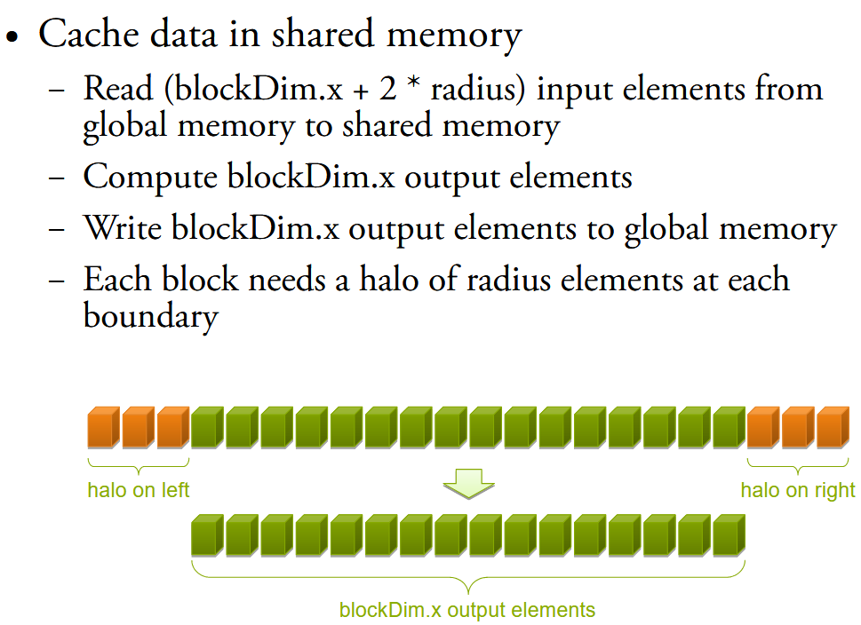
Implementing With Shared Memory

Slide 12
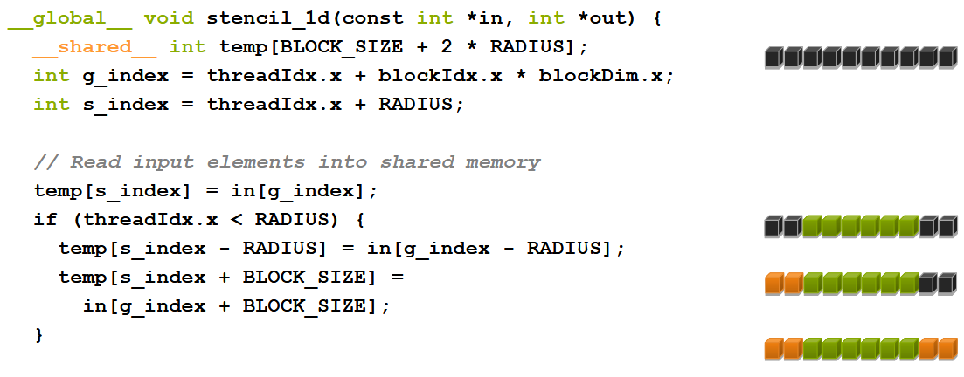
Implementing With Shared Memory

Slide 13
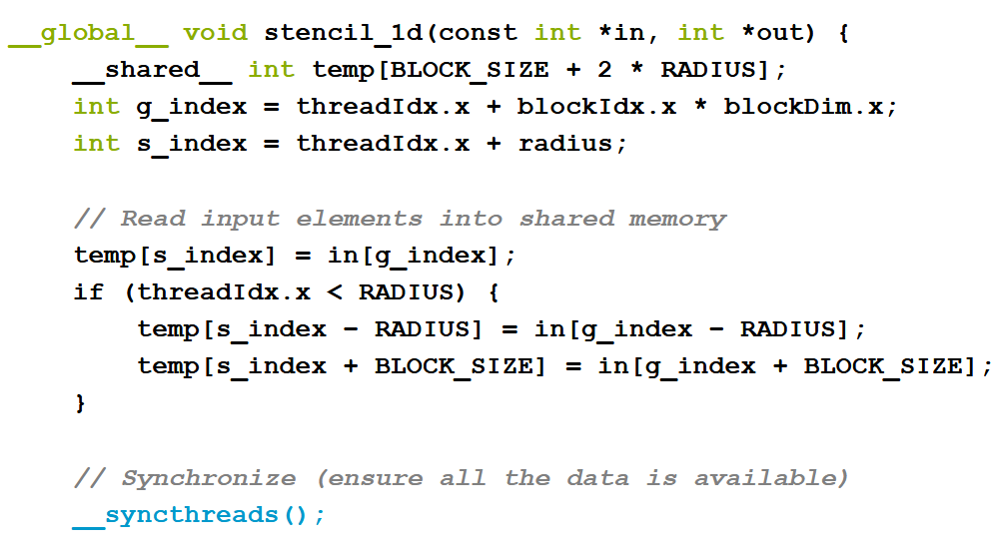
__syncthreads()

Slide 14
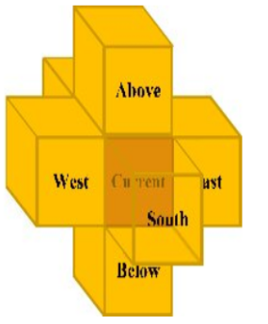
Stencil Computation
https://khushi-411.github.io/stencil/
out[i*N*N + j*N + k] =
c0 * in[i*N*N + j*N + k] // center
+ c1 * in[i*N*N + j*N + (k - 1)] // left (x-1)
+ c2 * in[i*N*N + j*N + (k + 1)] // right (x+1)
+ c3 * in[i*N*N + (j - 1)*N + k] // down (y-1)
+ c4 * in[i*N*N + (j + 1)*N + k] // up (y+1)
+ c5 * in[(i - 1)*N*N + j*N + k] // back (z-1)
+ c6 * in[(i + 1)*N*N + j*N + k]; // front (z+1)
This computes a weighted sum of:
Center point: (i, j, k)
6 neighbors: ±x, ±y, ±z The weights c0, c1, ..., c6 are constants (probably defined as __constant__ or macros elsewhere), representing stencil coefficients.

Slide 15
Example Use Case
Imagine a heat diffusion simulation
T[i][j][k] =
0.25 * T[i][j][k] + 0.1 * (T[i][j][k-1] + T[i][j][k+1] + T[i][j-1][k] + T[i][j+1][k] + T[i-1][j][k] + T[i+1][j][k])
This kernel:
Runs one thread per grid point.
Computes a 7-point stencil (center + 6 axis-aligned neighbors).
Skips boundary cells.
Reads data from global memory and writes the result to an output array.

Slide 16
Arithmetic Intensity (AI) calculation
With 3D 7-point stencil,
each thread performs 13 floating-point operations. It’ll take 4 bytes to load each floating point. Therefore, AI is 13 / (7 * 4) = 0.46 OP/B.
Let the input tile be a cube with T grid points in each dimension; hence, T - 2 will be the output grid points. Therefore, each block will have (T - 2)³ active threads calculating the output grid point values. Therefore, the number of operations performed is given by 13 * (T - 2)³ (note 13 here is the number of floating-point arithmetic operations). AI is given by (13 * (T - 2)³) / (4 * T³) OP/B. More input grid point values are reused if the T value is larger.
Recall that AI is given by (total number of operations)/(total amount of data moved)

