Slide 1
GPU Programming
Lecture 07: Parallel Kernel Programming

Slide 2
Matrix Multiplication (MM) Kernel
__global__ void matrix_mul(int *a, int *b, int *c, int n) {
int row = blockIdx.y * blockDim.y + threadIdx.y; // row = Y
int col = blockIdx.x * blockDim.x + threadIdx.x; // col = X
if (row < n && col < n) {
int sum = 0;
for (int k = 0; k < n; k++) {
sum += a[row * n + k] * b[k * n + col];
}
c[row * n + col] = sum;
}
}

Slide 3
Explanation
Example, c[2][3] = a[2][0]*b[0][3] + a[2][1]*b[1][3] + ... + a[2][4]*b[4][3]
C =
[ c00 c01 c02 c03 c04 ]
[ c10 c11 c12 c13 c14 ]
[ c20 c21 c22 c23 c24 ]
[ c30 c31 c32 c33 c34 ]
[ c40 c41 c42 c43 c44 ]
Thread (row=0, col=0) → computes c00
Thread (row=0, col=1) → computes c01
…
Thread (row=4, col=4) → computes c44

Slide 4
Tiled MM Kernel
__global__ void matrix_mul(int *a, int *b, int *c, int n) {
// Shared memory tiles for sub-blocks of A and B
__shared__ int tileA[TILE_SIZE][TILE_SIZE];
__shared__ int tileB[TILE_SIZE][TILE_SIZE];
int row = blockIdx.y * TILE_SIZE + threadIdx.y;
int col = blockIdx.x * TILE_SIZE + threadIdx.x;
int temp = 0;
// Loop over all tiles required to compute C[row][col]
for (int m = 0; m < (n + TILE_SIZE - 1) / TILE_SIZE; m++) {
// Load elements of A into shared memory
if (row < n && (m * TILE_SIZE + threadIdx.x) < n)
tileA[threadIdx.y][threadIdx.x] = a[row * n + (m * TILE_SIZE + threadIdx.x)];
else
tileA[threadIdx.y][threadIdx.x] = 0;
// Load elements of B into shared memory
if (col < n && (m * TILE_SIZE + threadIdx.y) < n)
tileB[threadIdx.y][threadIdx.x] = b[(m * TILE_SIZE + threadIdx.y) * n + col];

Slide 5
Tiled MM Kernel….
else
tileB[threadIdx.y][threadIdx.x] = 0;
__syncthreads(); // Synchronize to ensure all threads have loaded their tile
// Multiply current tile
for (int k = 0; k < TILE_SIZE; k++) {
temp += tileA[threadIdx.y][k] * tileB[k][threadIdx.x];
}
__syncthreads(); // Wait before loading new tiles
}
// Store result
if (row < n && col < n)
c[row * n + col] = temp;
}

Slide 6
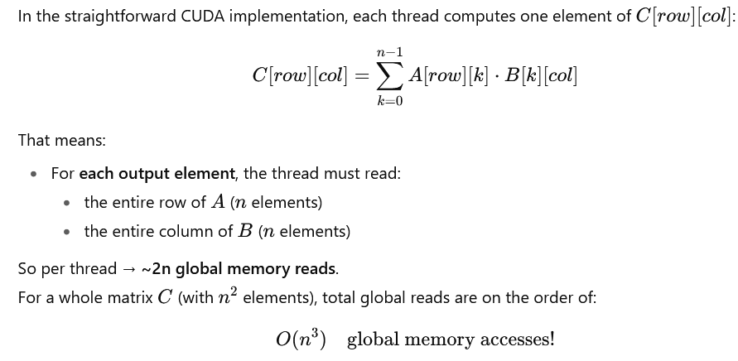
Usage of Tiling

Slide 7
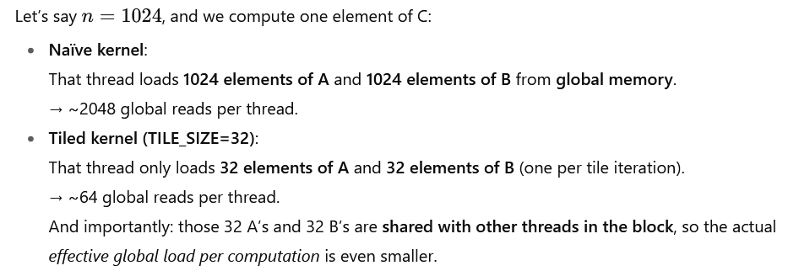
Usage of Tiling

Slide 8
Without tiling: each thread fetches ~n elements of A and B from global memory.
With tiling: each thread fetches only TILE_SIZE elements per tile from global memory, then reuses them multiple times from shared memory. This drastically reduces global memory bandwidth usage and makes the kernel faster.
C matrix (5x5) is divided like this
(tiles computed by each block):
+---------+---------+
| Block(0,0) | Block(1,0) |
| 4x4 | 4x4 |
+---------+---------+
| Block(0,1) | Block(1,1) |
| 4x4 | 4x4 |
+---------+---------+
With tiling:
Threads in a block cooperatively load tiles of A and B into shared memory.
Each tile has size TILE_SIZE × TILE_SIZE.
After loading, threads reuse those elements multiple times from shared memory instead of fetching again from global memory.
since N=5, the last row/col of tiles is only partially filled.
CUDA handles this with boundary checks (if(row < n && col < n))

Slide 9
Visualization
Example: Block(0,0) with TILE_SIZE=4
Threads inside Block(0,0) compute C[0..3][0..3]C[0..3][0..3]C[0..3][0..3].
Each thread loads 1 element of A and 1 element of B into shared memory tiles tileA and tileB. Iteration over tiles (m loop):
First tile load (m=0):
A loads row[0..3], col[0..3]
B loads row[0..3], col[0..3]
Multiply → partial results for C[0..3][0..3].
Second tile load (m=1): A loads row[0..3], col[4] (last column, padded with 0 for unused space).
B loads row[4], col[0..3] (last row, padded with 0).
Multiply → add contribution from last row/col.
C (5x5)
[ Block(0,0) covers ] [ Block(1,0) covers ]
C[0,0] C[0,1] C[0,2] C[0,3] | C[0,4]
C[1,0] C[1,1] C[1,2] C[1,3] | C[1,4]
C[2,0] C[2,1] C[2,2] C[2,3] | C[2,4]
C[3,0] C[3,1] C[3,2] C[3,3] | C[3,4]
-------------------------------------------------
[ Block(0,1) covers ] [ Block(1,1) covers ]
C[4,0] C[4,1] C[4,2] C[4,3] | C[4,4]
Each small square is computed by one thread.

Slide 10
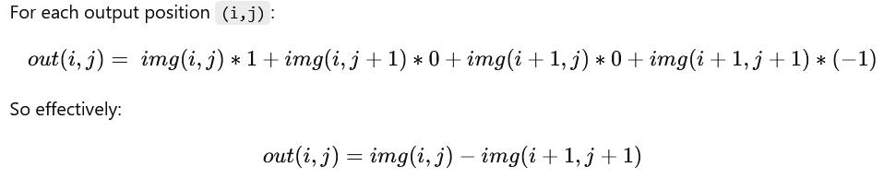
Convolution Kernel (Refer code from Collab)
Input: a 5×5 image, Filter: a 2×2 kernel
Output: size will be (5 - 2 + 1) × (5 - 2 + 1) = 4 × 4.
Each CUDA thread computes one output pixel by applying the filter over the image region (stencil).
We’ll use shared memory for better locality (stencil approach).
out(0,0) = 1 - 7 = -6
out(0,1) = 2 - 8 = -6
out(0,2) = 3 - 9 = -6
out(0,3) = 4 - 10 = -6
out(1,0) = 6 - 12 = -6
out(1,1) = 7 - 13 = -6
out(1,2) = 8 - 14 = -6
out(1,3) = 9 - 15 = -6

Slide 11
Convolution with RGB Input (Refer code from Collab)
Input is now a 5×5 RGB matrix with values (R,G,B). Kernel is applied on each channel separately. Output is printed as three 5×5 matrices (R, G, B).
out(i,j) = 5*center - top - bottom - left - right
0, -1, 0,
-1, 5, -1,
0, -1, 0
Kernel
10 20 30 40 50
15 25 35 45 55
20 30 40 50 60
25 35 45 55 65
30 40 50 60 70
Result (for R channel):
15 35 55 75 155
20 25 35 45 120
30 35 45 55 130
40 35 45 55 140
85 90 110 130 155
R channel INPUT

Slide 12
Stencil-based Computation
We are going to perform convolution in slightly different manner. This is stencil-based computation. We need to do zero-padding around the elements of the input matrix (say, R channel)
Consider the element=20 now.
So, center=20
With zero-padded condition, we can see that neighbors beyond the edge=0
left=10, right=30, top=0, bottom=25
out(i,j) = 5*center - top - bottom - left - right
out(0,1) = 5*20 - 0 - 25 -10 - 30
out(0,1) = 35
Consider the top row. The first element is “10”. So, this will become the centre. Hence, center=10 in the below equation
out(i,j) = 5*center - top - bottom - left - right
With zero-padded condition, we can see that neighbors beyond the edge=0
out(0,0) = 5*10 - (top=0 + left=0 + right=20 + bottom=15)
out(0,0) = 50 - 35
out(0,0) = 15

Slide 13
(0,0): center=10, right=20, down=15 → 5*10 -20 -15 = 50 -35 = 15
(0,1): center=20, left=10, right=30, down=25 → 100 - (10+30+25) = 100 -65 = 35
(0,2): center=30, left=20, right=40, down=35 → 150 - (20+40+35) = 55
(0,3): center=40, left=30, right=50, down=45 → 200 - (30+50+45) = 75
(0,4): center=50, left=40, down=55 → 250 - (40+55) = 155
Row 0 (R): 15 35 55 75 155
(1,0): center=15, up=10, down=20, right=25 → 75 - (10+20+25) = 20
(1,1): center=25, up=20, down=30, left=15, right=35 → 125 - (20+30+15+35) = 25
(1,2): center=35, up=30, down=40, left=25, right=45 → 175 - (30+40+25+45) = 35
(1,3): center=45 → 225 - (40+50+35+55) = 45
(1,4): center=55 → 275 - (50+60+45) = 120
Row 1 (R): 20 25 35 45 120
2,0): center=20 → 100 - (15+25+30) = 30
(2,1): center=30 → 150 - (25+35+20+35) = 35
(2,2): center=40 → 200 - (35+45+30+45) = 45
(2,3): center=50 → 250 - (45+55+40+55) = 55
(2,4): center=60 → 300 - (55+65+50) = 130
Row 2 (R): 30 35 45 55 130
(3,0): center=25 → 125 - (20+30+35) = 40
(3,1): center=35 → 175 - (30+40+25+45) = 35
(3,2): center=45 → 225 - (40+50+35+55) = 45
(3,3): center=55 → 275 - (50+60+45+65) = 55
(3,4): center=65 → 325 - (60+70+55) = 140
Row 3 (R): 40 35 45 55 140
(4,0): center=30 → 150 - (25+40) = 85
(4,1): center=40 → 200 - (35+45+30) = 90
(4,2): center=50 → 250 - (45+55+40) = 110
(4,3): center=60 → 300 - (55+65+50) = 130
(4,4): center=70 → 350 - (65+70+60) = 155
Row 4 (R): 85 90 110 130 155

Slide 14
Visualization (Convolution with RGB Input)
Stencil Approach
The stencil method solves this by:
Partitioning the image into tiles (e.g., 16×16 threads per block).
Each block of threads cooperatively loads a tile of pixels + halo (extra 1-pixel border) into shared memory.
Example: A 16×16 block needs an 18×18 tile in shared memory (extra 1 pixel around for neighbors).
Once the tile is in shared memory, every thread in the block can reuse the data to compute its convolution result.
What convolution requires
For each output pixel at (i,j) in an image, convolution with a 3×3 kernel needs:
The center pixel (i,j)
Its neighbors: (i±1,j±1), (i±1,j), (i,j±1)
So, every output pixel requires overlapping neighborhoods of the input image.
If each thread independently fetched its pixel and neighbors directly from global memory, there would be:
Many redundant memory accesses (neighbors fetched multiple times).
Poor memory bandwidth usage.

Slide 15
Visualization (Convolution with RGB Input)
How Parallelism Happens
Thread assignment: Each thread computes 1 output pixel (say thread (tx,ty) → output pixel (i,j)).
Independent computation: Once shared memory is loaded, each thread can do:
sum = Σ (kernel[x,y] * tile[tx+x, ty+y])
Synchronization: Only 1 sync (__syncthreads()) is required after loading shared memory, ensuring all neighbor data is ready.
Parallel execution: Thousands of threads (organized into blocks) work simultaneously, each processing one pixel’s convolution.
Why It’s Efficient
Data reuse: Each input pixel is loaded once per block into shared memory, instead of multiple times by different threads.
Reduced global memory traffic: Accesses are coalesced and minimized.
High parallelism: Every thread computes independently once data is staged.

Slide 16
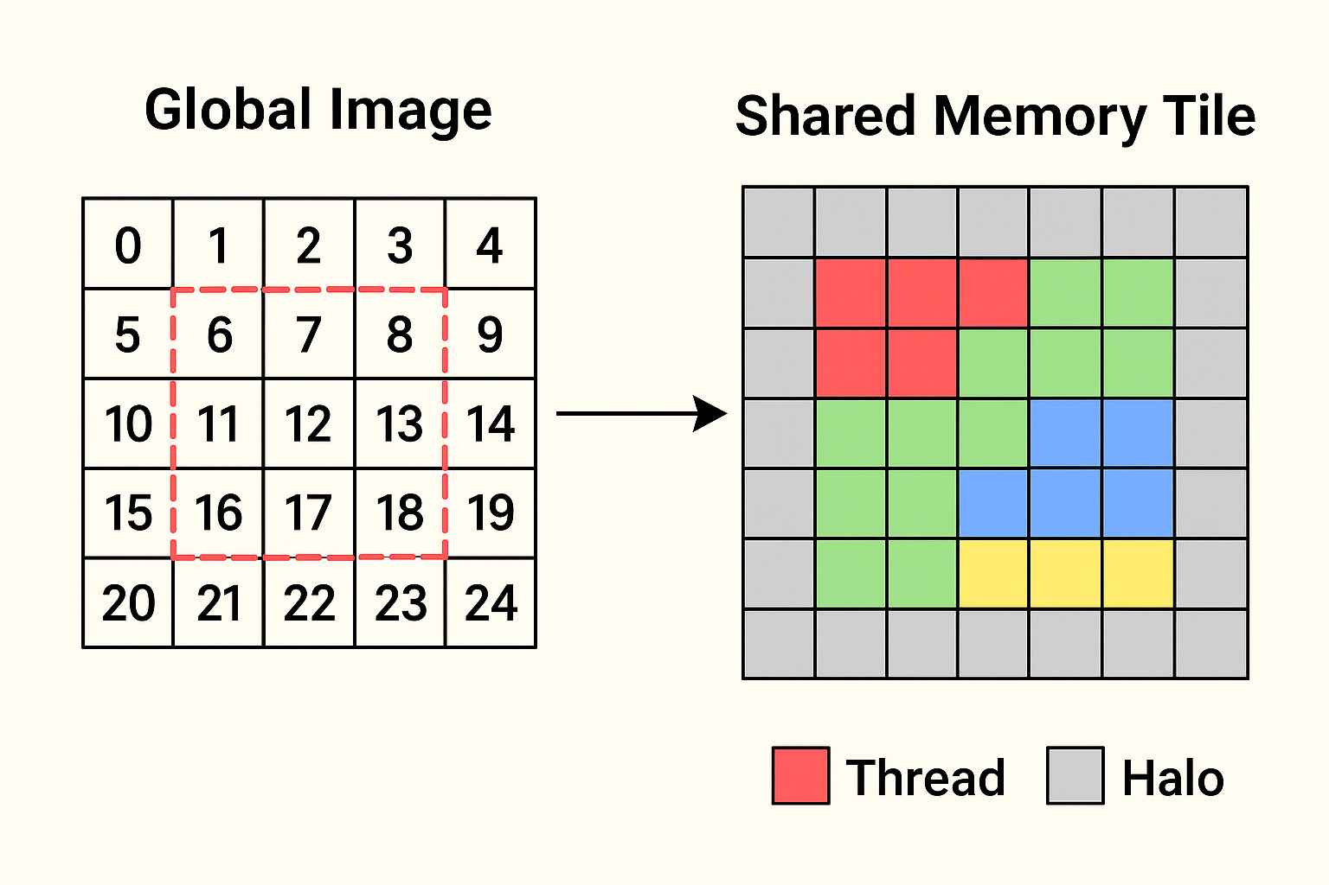
Visualization (Convolution with RGB Input)
Example (5×5 image, 3×3 kernel, 4×4 block)
Each thread block of 4×4 threads covers part of the image.
They load a 6×6 tile (4×4 + halo).
Each of the 16 threads computes one output pixel in parallel.
Borders of the tile are shared between threads, so they are fetched once not 16 times.

