Slide 1
GPU Programming
Lecture-09

Slide 2
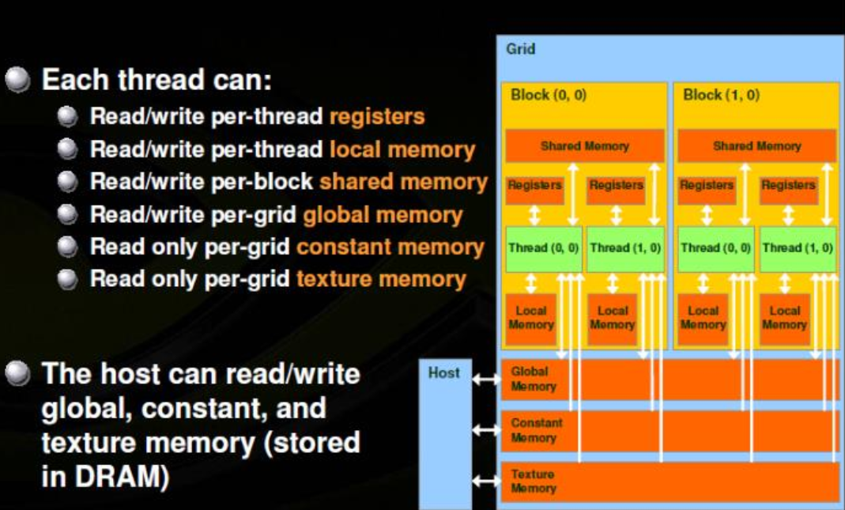

Slide 3
Example Code
Code:
Initially A = Flag = 0
P1 P2
A = 23; while (Flag != 1) {;}
Flag = 1; ... = A;
Idea:
P1 writes data into A and sets Flag to tell P2 that data value can be read from A.
P2 waits till Flag is set and then reads data from A.

Slide 4
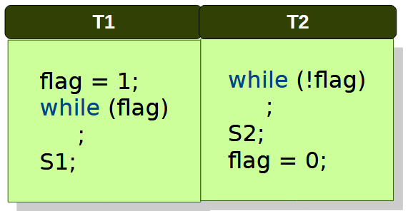
Data Race
If initially flag == 0, then S2 executes before S1.
If initially flag == 1, then S2 executes and after that S1 may execute or T1 may hang.
T1 never gets CPU after setting flag = 1
Suppose T2 runs continuously while T1 is stuck inside while(flag);
T2 executes S2, then sets flag = 0
But if T1 never gets scheduled again, it will appear as “T1 hangs” — in reality, it’s just waiting for CPU time
Normal Interleaving (Expected Behavior)
T1 sets flag = 1 and starts waiting (while(flag);)
T2 runs next, sees flag = 1, executes S2, sets flag = 0
Now T1 exits the loop and executes S1

Slide 5
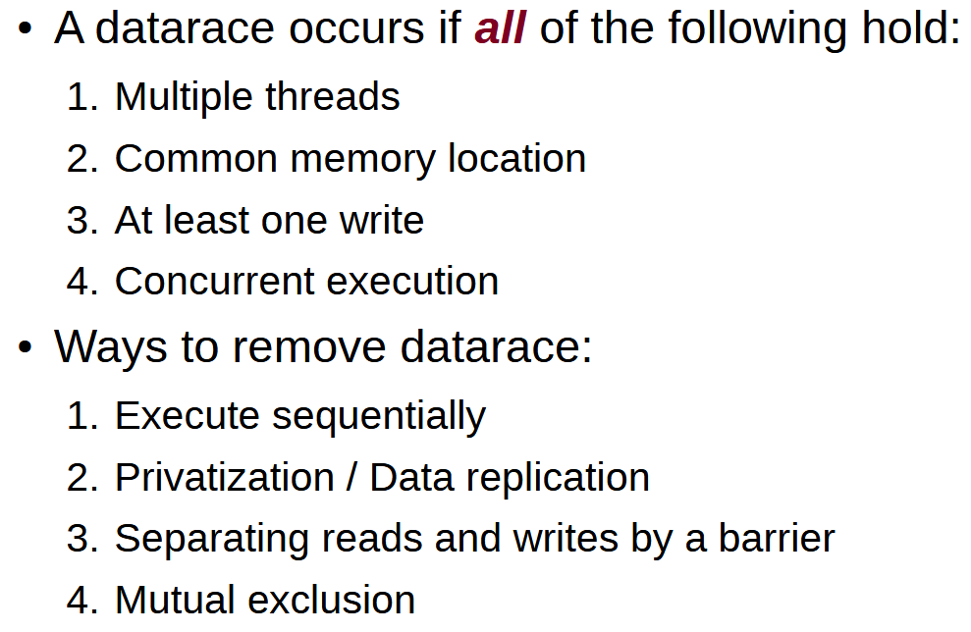
Data Race

