Slide 1
GPU Programming
Lecture-10

Slide 2
Critical Section
In multi-threaded programming, a critical section is a block of code where shared resources (like global variables, files, or memory) are accessed or modified — and only one thread should execute that section at a time.
If multiple threads enter the critical section simultaneously, you get race conditions, leading to incorrect or unpredictable behavior.
The solution to critical section problem must ensure the following three conditions:
Mutual Exclusion
Progress
Bounded Waiting

Slide 3
Data Race Example
If both threads run this simultaneously:
Thread 1 reads counter (say it's 0)
Thread 2 also reads counter (still 0)
Both add 1 → each gets 1
Both write back 1 Final result = 1, not 2
That’s a race condition because both modified a shared variable without coordination.
int counter = 0;
void increment() {
counter = counter + 1; // <-- CS
}

Slide 4
Dekker’s Algorithm-Version 1
Dekker’s Algorithm is one of the first software-based mutual exclusion algorithms for two processes. It ensures that only one process at a time enters its critical section (CS)
main(){
int thread_no = 1;
startThreads();
}
Thread1(){
do {
// entry section
// wait until thread_no is 1
while (thread_no == 2)
;
// critical section
// exit section
// give access to the other thread
thread_no = 2;
// remainder section
} while (completed == false)
}
Thread2(){
do {
// entry section
// wait until thread_no is 2
while (threadno == 1)
;
// critical section
// exit section
// give access to the other thread
thread_no = 1;
// remainder section
} while (completed == false)
}
The while loop is basically for waiting at that point (before proceeding further).

Slide 5
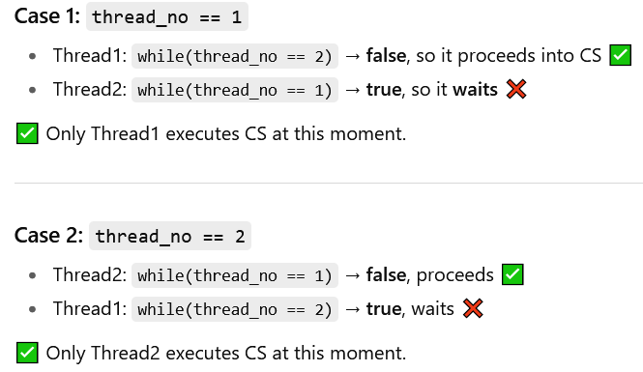
Explanation
Thread1 can enter CS only if thread_no == 1.
After finishing CS, it sets thread_no = 2, giving permission to Thread2.
Thread2 can enter CS only if thread_no == 2.
After finishing CS, it sets thread_no = 1, giving permission back to Thread1.

Slide 6
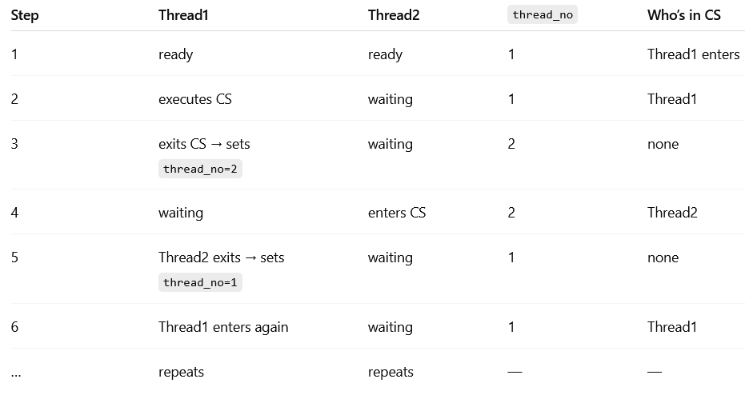
Explanation

Slide 7
Dekker’s Algorithm-Version 2
It is done by using two flags to indicate its current status and updates them accordingly at the entry and exit section.
main(){
// flags to indicate whether each thread is in
// its critical section or not.
boolean th1 = false;
boolean th2 = false;
startThreads();
}
Thread1(){
do {
// entry section
// wait until th2 is in its critical section
while (th2 == true)
;
// indicate thread1 entering its critical section
th1 = true;
// critical section
// exit section
// indicate th1 exiting its critical section
th1 = false;
// remainder section
} while (completed == false)
}
Thread2(){
do {
// entry section
// wait until th1 is in its critical section
while (th1 == true)
;
// indicate th2 entering its critical section
th2 = true;
// critical section
// exit section
// indicate th2 exiting its critical section
th2 = false;
// remainder section
} while (completed == false)
}
The while loop is basically for waiting at that point (before proceeding further).

Slide 8
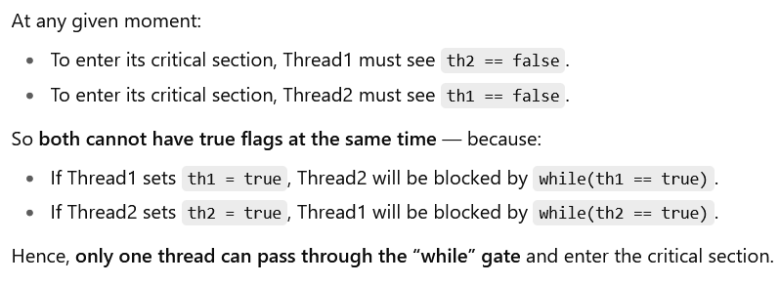
Explanation
Both Thread1 and Thread2 want to enter their critical section, but never simultaneously — i.e., mutual exclusion [both threads “check” each other’s flag before proceeding].
If th2 is true, Thread2 is in or wants to enter the critical section — so Thread1 must wait.
If th1 is true, Thread1 is in or wants to enter the critical section — so Thread2 must wait.
This version can lead to deadlock if both threads set their flag to true simultaneously.

Slide 9
Dekker’s Algorithm-Version 3
In this version, critical section flag is set before entering critical section test to ensure mutual exclusion.
main(){
// flags to indicate whether each thread is in
// queue to enter its critical section
boolean th1wantstoenter = false;
boolean th2wantstoenter = false;
startThreads();
}
Thread1(){
do {
th1wantstoenter = true;
// entry section
// wait until th2 wants to enter
// its critical section
while (th2wantstoenter == true)
;
// critical section
// exit section
// indicate th1 has completed
// its critical section
th1wantstoenter = false;
// remainder section
} while (completed == false)
}
Thread2(){
do {
th2wantstoenter = true;
// entry section
// wait until th1 wants to enter
// its critical section
while (th1wantstoenter == true)
;
// critical section
// exit section
// indicate th2 has completed
// its critical section
th2wantstoenter = false;
// remainder section
} while (completed == false)
}
The while loop is basically for waiting at that point (before proceeding further).

Slide 10
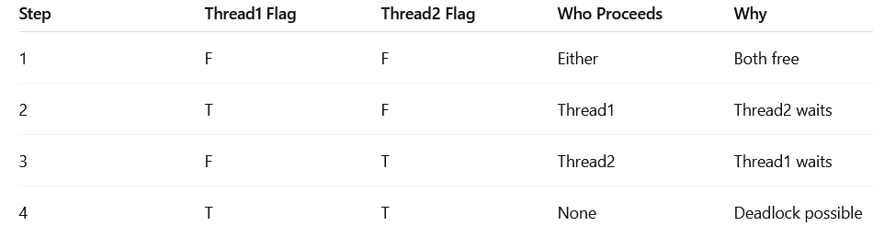
Explanation
Two threads (Thread1 and Thread2) both want to enter a critical section, but they must not be inside it simultaneously. At any time, only one thread can have both:
Its own flag = true, and
The other’s flag = false

Slide 11
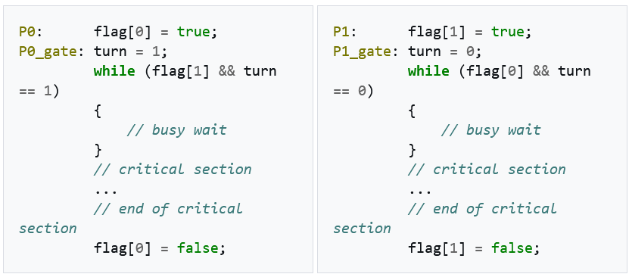
Peterson's Algorithm
volatile bool flag[2] = {false, false};
volatile int turn;

Slide 12
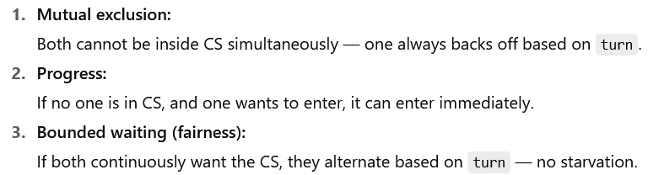
Explanation
There are two mechanisms working together:
Flags (flag[i]) — signal intention to enter the critical section. → “I want to enter.”
Turn variable (turn) — acts as a tie-breaker if both want to enter at the same time. → “Whose turn is it to go first?”

Slide 13
__syncthreads() (barrier)
#include <stdio.h>
// CUDA kernel to compute partial sums per block
__global__ void block_sum(int *input, int *output, int n) {
extern __shared__ int sdata[]; // shared memory for the block
int tid = threadIdx.x; // thread index within the block
int i = blockIdx.x * blockDim.x + tid; // global index
// Load input into shared memory (if within bounds)
if (i < n)
sdata[tid] = input[i];
else
sdata[tid] = 0;
// Barrier — ensure all threads have written to shared memory
__syncthreads();
// Perform parallel reduction in shared memory
for (int stride = blockDim.x / 2; stride > 0; stride >>= 1) {
if (tid < stride)
sdata[tid] += sdata[tid + stride];
// Barrier — wait for all threads to complete this step
__syncthreads();
}
………………………….
Acts as a block-level barrier. Ensures all threads in the block reach this point before any can proceed further. Guarantees memory consistency in shared memory.
After each thread loads its part of input[] into shared memory.
After each addition step in the reduction loop.
Without __syncthreads(), some threads might:
Read stale data (not yet written by others),
Or overwrite shared memory before others have finished reading.

Slide 14
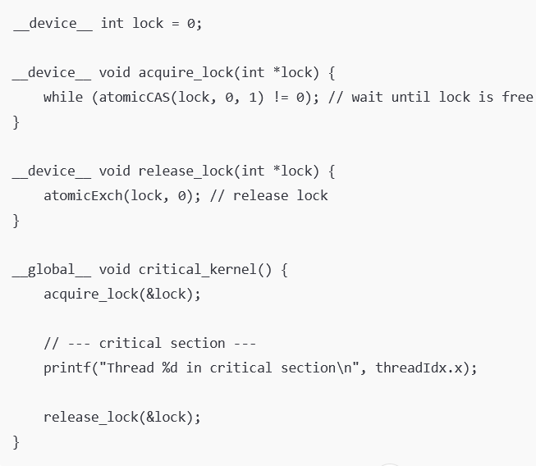
GPU Equivalent of Dekker’s Algorithm: Atomic Compare-and-Swap
Across global memory (device-wide)

Slide 15
Visualization of _syncthreads()
Time →
Thread 0: ───► work A ──┬─X─X─X─X─┬──► work B
Thread 1: ─────► work A ─┬─X─X─X──┬──► work B
Thread 2: ─────────► work A ─┬─X──┬──► work B
Thread 3: ─────────────► work A ─┬──┬──► work B
^Barrier ( __syncthreads() )
Threads execute work A independently.
When each reaches __syncthreads(), it waits (X) until all threads in the block reach it.
Once everyone arrives, they all proceed together to work B.
Effect:
Ensures shared memory updates by work A are visible to all before work B.
No one passes the barrier early.
But it’s only inside one block, not across blocks.

Slide 16
Visualization of atomicCAS()
Only one thread at a time succeeds in entering the critical section; others spin-wait (busy-wait)
Time →
Thread 0: ───► atomicCAS(lock) ─► #### critical #### ─► unlock ─► done
Thread 1: ───► atomicCAS(lock) ──X─X─X─X─X─X─X─X─► #### critical #### ─► done
Thread 2: ───► atomicCAS(lock) ──X─X─X─X─X─X─X─X─X─X─► #### critical #### ─► done
Thread 3: ───► atomicCAS(lock) ──X─X─X─X─X─X─X─X─X─X─X─X─► #### critical #### ─► done
All threads try atomicCAS(lock, 0, 1) simultaneously.
Only one thread (Thread 0) succeeds in setting the lock from 0→1.
Others spin (busy-wait) until the lock is released (atomicExch(lock, 0)).
Then next thread acquires it, executes, releases, and so on. Effect:
Enforces mutual exclusion (critical section protected).
Doesn’t synchronize all threads — only the ones trying to enter the lock.
Works across blocks (device-wide) using global memory.

Slide 17
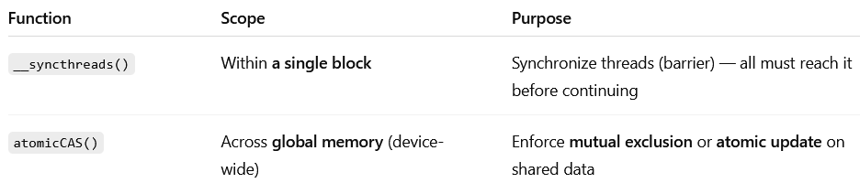
Comparisons
When to use which
Use __syncthreads() when:
You’re coordinating shared memory access inside a block.
Example: tiled matrix multiplication.
Use atomicCAS() when:
Multiple threads may update the same global variable or data structure.
Example: incrementing a global counter, pushing to a shared list, implementing locks.

Slide 18
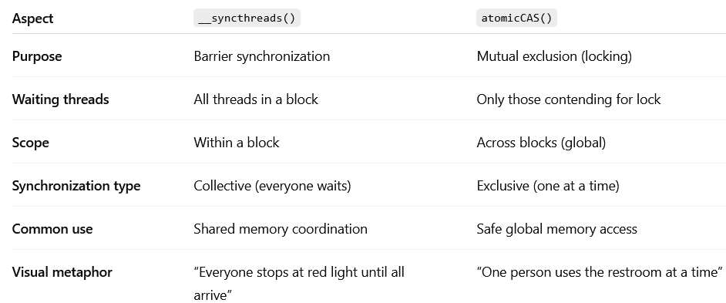
Comparisons

