Slide 1
GPU Programming
Lecture-11

Slide 2
Lamport’s Bakery algorithm (Synchronization among N threads)
Software-only mutex for N threads; gives FIFO-like fairness
Properties: mutual exclusion, bounded waiting (fair), requires atomic read/write semantics
number[] and choosing[] must be atomic or protected by memory fences.
shared choosing[1..N] = {false}
shared number[1..N] = {0}
enter(i):
choosing[i] = true
number[i] = 1 + max(number[1..N]) // take a ticket
choosing[i] = false
// wait for others with smaller ticket (or tie-break by id)
for j = 1..N:
while choosing[j] ; // wait if j is picking a number
while (number[j] != 0 && ( number[j] < number[i] ||
(number[j] == number[i] && j < i) )) ;
// critical section
exit(i):
number[i] = 0

Slide 3
Explanation
For every other process j:
First while choosing[j];
Wait until process j finishes choosing its number.
Prevents reading a half-updated value of number[j].
Then check: Wait if j currently holds a smaller ticket number, or
If both have the same ticket and j has a smaller ID (tie-breaker).
⇒ This ensures FIFO-like ordering by ticket, then ID.
When both loops finish for all j, process i can safely enter its critical section.
Step 1: Mark choosing[i] = true → thread i is about to pick a ticket.
Step 2: Pick a ticket number one higher than the maximum of all currently held tickets. This ensures a unique increasing sequence.
Step 3: Set choosing[i] = false → done choosing, others can now read your number[i]

Slide 4
Filter algorithm (generalized Peterson)
mutual exclusion and bounded waiting (each level filters one thread out)
Each thread goes through N−1 levels (or “gates”) before entering the critical section (CS). At each level k, a thread must:
Announce that it has reached level k (level[i] = k), and
Set itself as the victim of that level (victim[k] = i).
Then it waits until no other thread at the same or higher level wants to proceed while it is still the victim.
This “filtering” ensures that only one thread can pass all levels and reach the CS.
shared level[1..N] = {0} // level[i] 0..N-1
shared victim[1..N-1] // victim[k] is thread last to enter level k
enter(i):
for k = 1..N-1:
level[i] = k
victim[k] = i
// wait while any thread j with level[j] >= k and victim[k] == i
while exists j != i: (level[j] >= k && victim[k] == i) ;
exit(i):
level[i] = 0
victim[k] is not the one who automatically enters the critical section because victim[k] is the last thread to enter level k. Being the victim means: you will step back if others are still competing at this level or higher.

Slide 5
How Mutual Exclusion Holds?
shared level[1..N] = {0}
shared victim[1..N-1] enter(i):
for k = 1..N-1:
level[i] = k
victim[k] = i
while exists j != i: (level[j] >= k && victim[k] == i) ;
exit(i):
level[i] = 0
Let’s prove only one thread can reach the critical section at a time:
Suppose (for contradiction) that two threads p and q are in the CS simultaneously.
Then both must have passed all levels 1, 2, ..., N−1 successfully.
Consider the highest level k where both p and q were simultaneously waiting or trying.
At that level:
Both had level[p] ≥ k and level[q] ≥ k.
One of them, say victim[k] = p.
Then, by the waiting condition:
Thread p must have waited while q satisfied (level[q] ≥ k && victim[k] == p).
So as long as q is still at level ≥ k and victim[k] == p, thread p cannot proceed.
Thus, both cannot pass level k at the same time — contradiction.
Therefore, only one thread reaches the CS.

Slide 6
Priority Scheduling with Mutex and Condition Variables
mutex lock;
priority_queue<Thread, vector<Thread>, ComparePriority> waitQueue;
void requestCS(Thread t) {
lock.lock();
waitQueue.push(t);
while (waitQueue.top() != t) {
condVar.wait(lock);
}
lock.unlock();
}
void releaseCS(Thread t) {
lock.lock();
waitQueue.pop();
condVar.notify_all(); // wake next highest priority thread
lock.unlock();
}
Threads request access by adding themselves to a queue along with their priority.
The synchronization primitive (monitor or custom lock) selects the highest-priority waiting thread to enter the critical section next.
Pros: Ensures higher-priority threads get the critical section first.
Cons: Lower-priority threads may starve.

Slide 7
Priority via Ordered Access (Atomic Locks + Priority Levels)
__device__ int currentPriority = 0;
__device__ void priority_lock(int myPriority) {
while (atomicCAS(&currentPriority, myPriority, myPriority) != myPriority) {
// Wait until it's this thread's turn
}
}
__device__ void priority_unlock() {
atomicAdd(&currentPriority, 1); // Allow next priority to proceed
}
Keep waiting while the global priority counter is not equal to my priority.
Each thread has a unique priority value myPriority (e.g. 0, 1, 2, …). The thread keeps looping (busy-waiting) until it’s its turn.
The function atomicCAS has the following format:
atomicCAS(address, compare, val)
atomicCAS(...) != myPriority
means
Keep waiting while the global priority counter is not equal to my priority.
Each thread has a priority value (lower = higher priority). You maintain a shared atomic variable that holds the current serving priority.

Slide 8
Warp or Block-Level Priority Scheduling
__global__ void priority_kernel(int *data, int numBlocks) {
int priority = blockIdx.x; // e.g., smaller index = higher priority
__shared__ bool proceed;
do {
proceed = (priority <= globalPriority);
__syncthreads();
} while (!proceed);
// Critical section / work
process_data(data);
if (threadIdx.x == 0)
atomicAdd(&globalPriority, 1); // next block may proceed
}
Assign entire warps or blocks a “priority class” and make scheduling decisions inside the kernel.
Each block computes its priority score
High-priority blocks perform their work first
Low-priority blocks spin/wait until high-priority ones finish

Slide 9
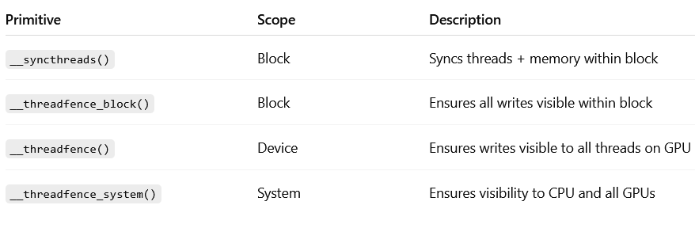
Cooperative Groups
With CUDA Cooperative Groups, we can form subgroups of threads based on priority and synchronize them separately.
#include <cooperative_groups.h>
using namespace cooperative_groups;
__global__ void prioritized_work(int *data, int *priority) {
grid_group g = this_grid();
int myPriority = priority[blockIdx.x];
for (int p = 0; p < MAX_PRIORITY; ++p) {
if (myPriority == p) {
// Perform work for this priority
process_data(data);
}
g.sync(); // Wait for all priorities at this level to complete
}
}

Slide 10
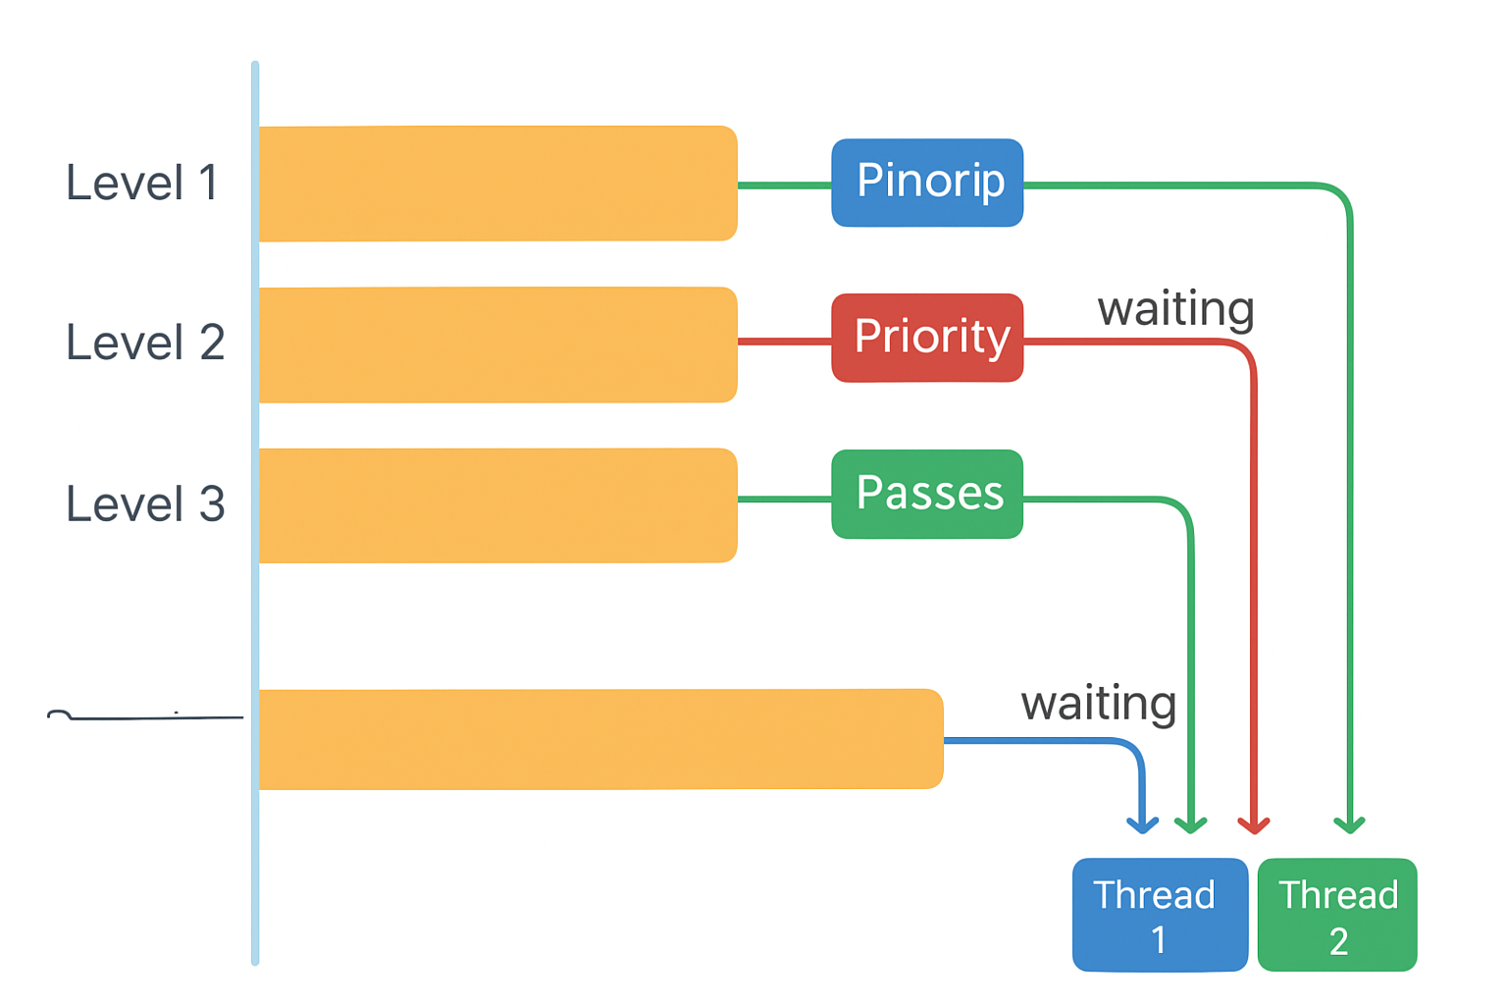
Filter Lock structure (with Priority)
Level 1:
All threads begin here.
Thread 1 has the highest priority → It bypasses waiting and proceeds directly.
Threads 2 and 3 wait until Thread 1 moves to the next level.
Level 2:
Thread 1 (priority) continues forward.
Thread 2 gets a chance next because Thread 1 moves up and becomes the “victim” at this level.
Thread 3 (lowest priority) continues waiting since both higher-priority threads are ahead.
Level 3:
Thread 1 reaches the critical section.
Threads 2 and 3 are waiting — Thread 2 will proceed next when Thread 1 exits.
Thread 3 remains waiting until Thread 2 also completes.
Please look at explanation on next-slide
Thread 1 (blue) → Highest priority,
Thread 2 (green) → Medium priority

Slide 11
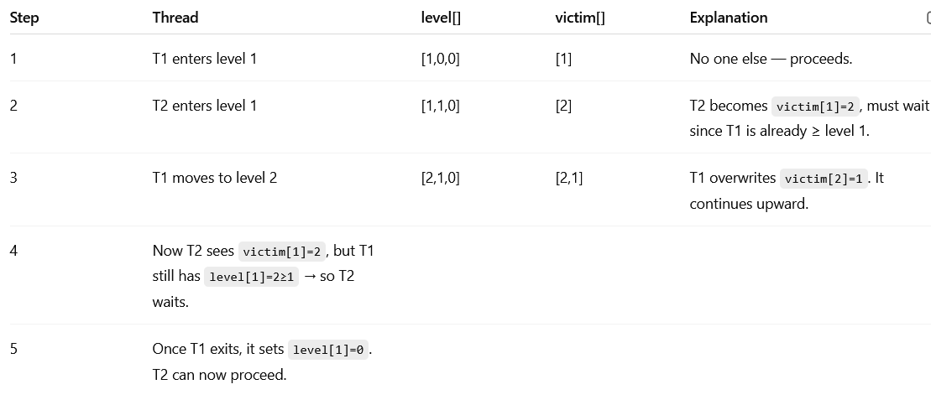
Explanation
Each thread must pass through N−1 “levels”, like a multi-stage filter before reaching the critical section (CS).

Slide 12
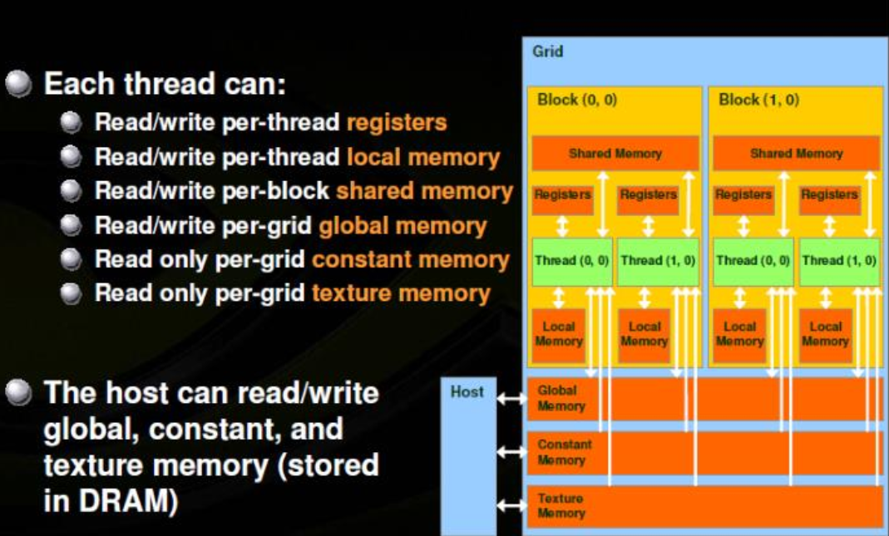

Slide 13
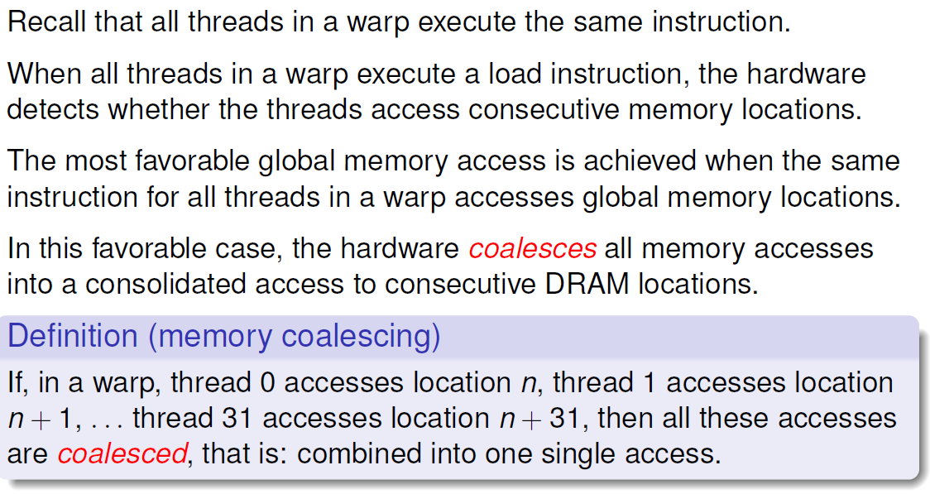
Memory coalescing

Slide 14
Shared memory and memory banks
Shared memory in CUDA is divided into banks. Each bank can service one access per clock cycle.
Shared memory has 32 banks that are organized such that successive 32-bit words are assigned to successive banks, i.e.: interleaved.
The bandwidth of shared memory is 32 bits per bank per clock cycle. Because shared memory is on chip, uncached shared memory latency is roughly 100× lower than global memory.
A bank conflict occurs if two or more threads access any bytes within different 32-bit words belonging to the same bank
If two or more threads access any bytes within the same 32-bit word, then there is no bank conflict between these threads.

Slide 15
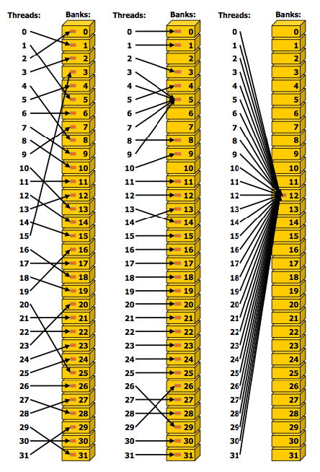
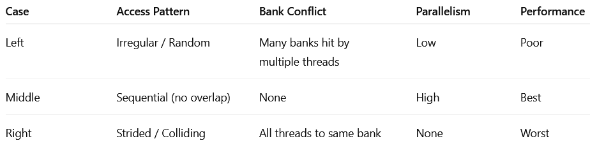
Irregular and colliding shared memory accesses
Middle
Left
How to Avoid Conflicts
Use padding: Add small offsets (like +1 element) to array dimensions to change alignment.
Use interleaved addressing: Make each thread access threadIdx.x + warp_id * stride to spread accesses.
Use warp shuffles instead of shared memory for some patterns.
Use broadcast: If all threads read the same address, hardware can broadcast without conflict.

Slide 16
Irregular and colliding shared memory accesses
Case 1: Irregular / Random Access Pattern
Each thread accesses an arbitrary shared memory bank.
Lines show criss crossing arrows from threads to banks.
Several threads target the same bank (e.g., multiple lines converging on one yellow box).
This causes multiple bank conflicts.
🔸 Effect:
The GPU must serialize accesses to the same bank.
Threads accessing the same bank are executed one after another.
Performance drops dramatically.
Case 2: Regular (No Conflict) Access Pattern
Each thread accesses a unique bank.
Arrows are straight and non-overlapping: thread i → bank i.
No two threads target the same bank.
🔸 Effect:
Perfectly parallel access.
All 32 threads can access shared memory simultaneously in one cycle.
No serialization → maximum throughput.
Case 3: Colliding / Strided Access Pattern
All threads access addresses separated by a stride (e.g., thread i → bank (i * stride) % 32).
In this example, stride = 0 or 32, causing all threads to map to the same bank (Bank 12).
The result: every thread hits exactly the same shared memory bank.
🔸 Effect:
Worst-case scenario (32-way bank conflict)
Each access must be performed sequentially, one per thread.
Latency increases 32×.

Slide 17
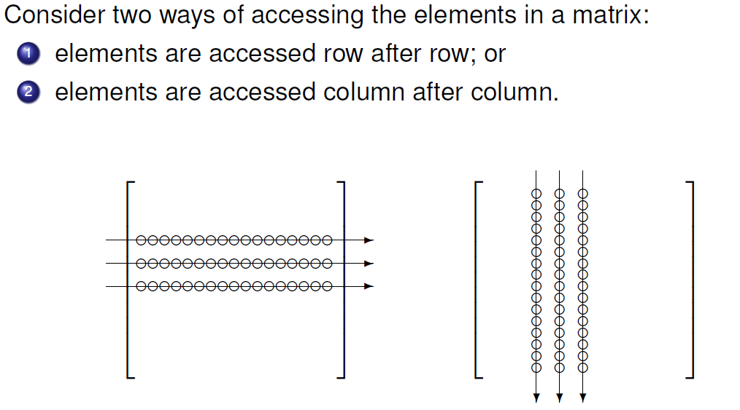
Accessing the elements in a matrix

Slide 18
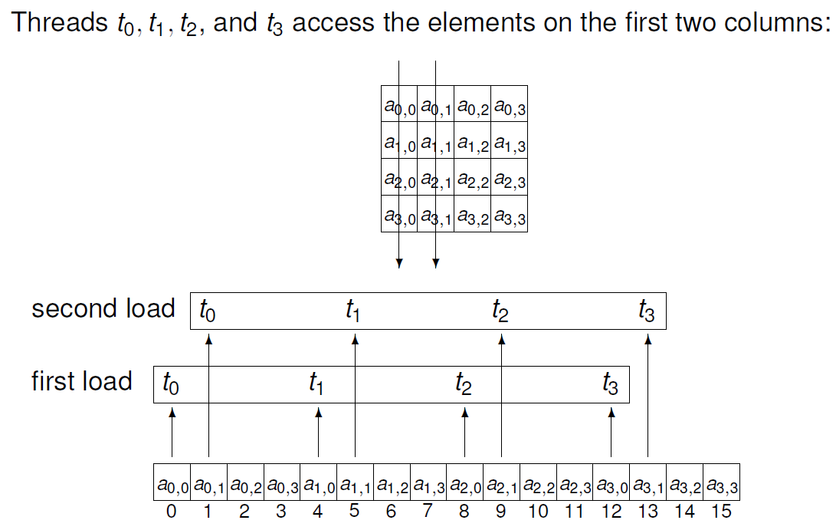
First Access

Slide 19
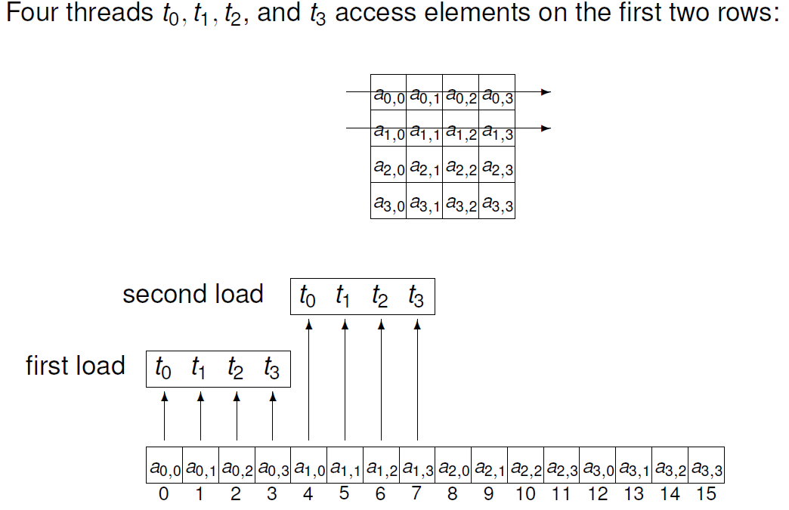
Second Access

Slide 20
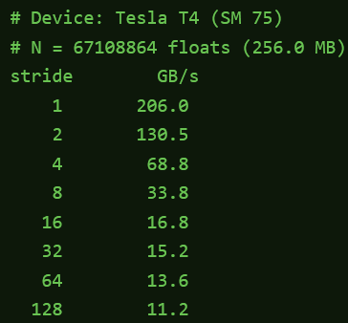
Impact of stride on Throughput
Consider the code segment:
for (size_t j = (size_t)t * (size_t)stride; j < N; j += (size_t)T * (size_t)stride) {
// across a warp, addresses differ by (stride * sizeof(float))
float v = in[j]; // perfectly coalesced for stride == 1
acc = acc * 2 + v;
}
Reference: https://modal.com/gpu-glossary/perf/memory-coalescing

Slide 21
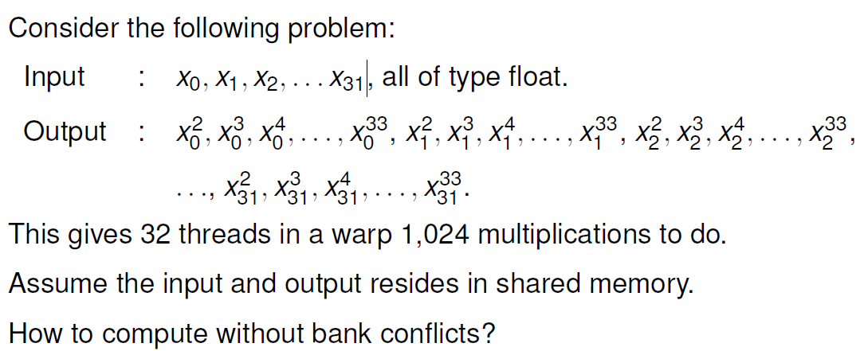
Question: consecutive powers

Slide 22
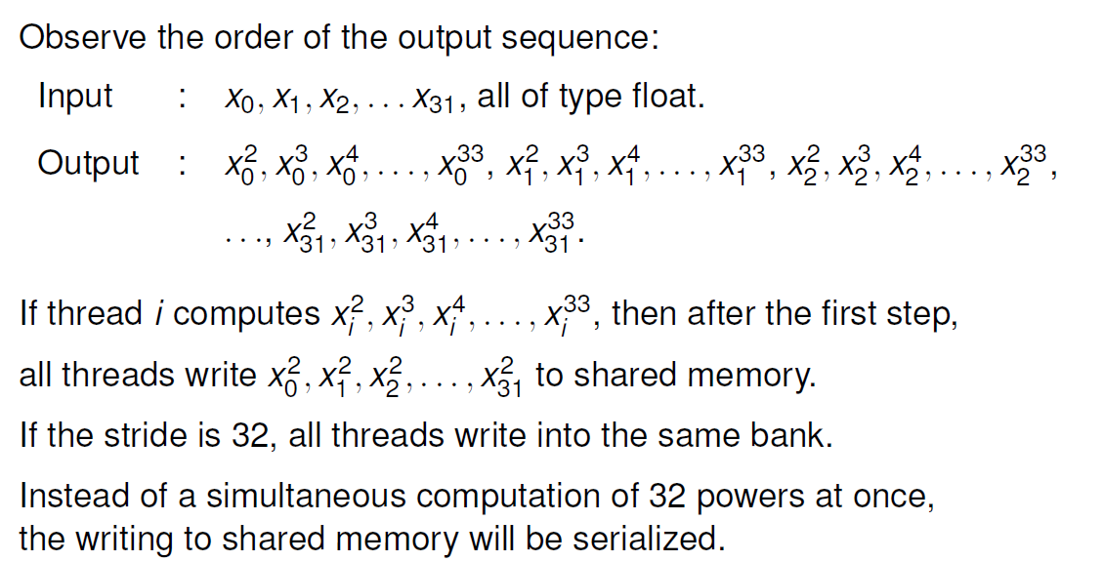
Writing with stride

Slide 23
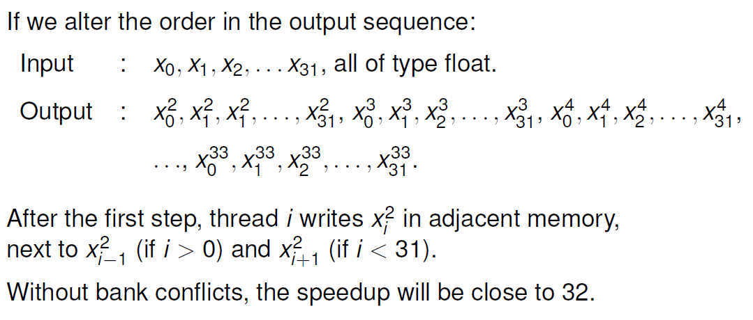
Changed order of storage

