Slide 1
GPU Programming
Lecture 08
Explanation of codes uploaded on GC

Slide 2
Matrix Multiplication (with Tiling)
C matrix (5x5) is divided like this
(tiles computed by each block):
+---------+---------+
| Block(0,0) | Block(1,0) |
| 4x4 | 4x4 |
+---------+---------+
| Block(0,1) | Block(1,1) |
| 4x4 | 4x4 |
+---------+---------+
With tiling:
Threads in a block cooperatively load tiles of A and B into shared memory.
Each tile has size TILE_SIZE × TILE_SIZE.
After loading, threads reuse those elements multiple times from shared memory instead of fetching again from global memory.
since N=5, the last row/col of tiles is only partially filled.
CUDA handles this with boundary checks (if(row < n && col < n))
With tiling: each thread fetches only TILE_SIZE elements per tile from global memory, then reuses them multiple times from shared memory.This drastically reduces global memory bandwidth usage and makes the kernel faster.

Slide 3
Visualization
Example: Block(0,0) with TILE_SIZE=4
Threads inside Block(0,0) compute C[0..3][0..3]C[0..3][0..3]C[0..3][0..3].
Each thread loads 1 element of A and 1 element of B into shared memory tiles tileA and tileB. Iteration over tiles (m loop):
First tile load (m=0):
A loads row[0..3], col[0..3]
B loads row[0..3], col[0..3]
Multiply → partial results for C[0..3][0..3].
Second tile load (m=1): A loads row[0..3], col[4] (last column, padded with 0 for unused space).
B loads row[4], col[0..3] (last row, padded with 0).
Multiply → add contribution from last row/col.
C (5x5)
[ Block(0,0) covers ] [ Block(1,0) covers ]
C[0,0] C[0,1] C[0,2] C[0,3] | C[0,4]
C[1,0] C[1,1] C[1,2] C[1,3] | C[1,4]
C[2,0] C[2,1] C[2,2] C[2,3] | C[2,4]
C[3,0] C[3,1] C[3,2] C[3,3] | C[3,4]
-------------------------------------------------
[ Block(0,1) covers ] [ Block(1,1) covers ]
C[4,0] C[4,1] C[4,2] C[4,3] | C[4,4]
Each small square is computed by one thread.

Slide 4
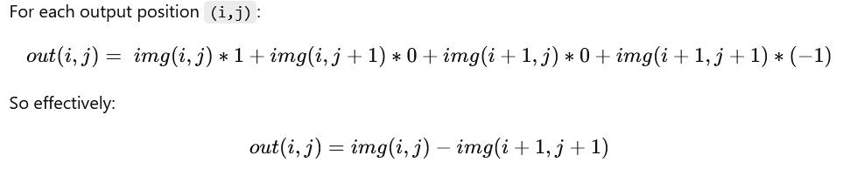
Convolution Kernel (Refer code from Collab)
out(0,0) = 1 - 7 = -6
out(0,1) = 2 - 8 = -6
out(0,2) = 3 - 9 = -6
out(0,3) = 4 - 10 = -6
1 2 3 4 5
6 7 8 9 10
11 12 13 14 15
16 17 18 19 20
21 22 23 24 25
out(1,0) = 6 - 12 = -6
out(1,1) = 7 - 13 = -6
out(1,2) = 8 - 14 = -6
out(1,3) = 9 - 15 = -6
1 0
0 -1
Filter
Continue similarly for other 8 elements
Input Image

Slide 5
Execution by CUDA Threads
Each thread computes one output pixel (since output is 4×4 = 16 elements).
Each output pixel needs FILTER_SIZE × FILTER_SIZE = 2×2 = 4 multiplications/additions.
Total work = 16 outputs × 4 ops = 64 arithmetic ops.
In the parallel GPU execution model:
Ideally, all 16 threads (for 16 outputs) run in one warp (32 threads per warp on NVIDIA GPUs).
That means they all execute in lock-step in roughly the time it takes to do 4 multiply-add instructions.
Input: a 5×5 image, Filter: a 2×2 kernel/Filter
Output: size will be (5 - 2 + 1) × (5 - 2 + 1) = 4 × 4.
Each CUDA thread computes one output pixel by applying the filter over the image region (stencil).
We’ll use shared memory for better locality (stencil approach).

Slide 6
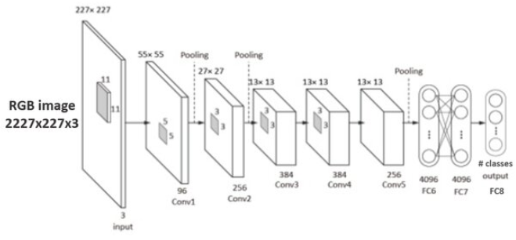
How GPU performance matters over CPU?
Let’s consider practical application where we have larger images (e.g. 1024×1024 with 5×5 filter)?
Output size = (1024-5+1) x (1024-5+1)
Output size = 1020 x 1020 = 1040400
Each output pixel needs 5x5 = 25 operations
Let’s launch 1040400 kernels
Assuming 1 thread-block has 512 threads,
Total number of thread-blocks=2032.03(!)
Each thread does 25 operations
Model Description of Alexnet for Image Classification Application

Slide 7
Code Explanation (Stencil-based convolution)
__global__ void conv2D_stencil(int *img, int *filter, int *out) {
__shared__ int tile[IMG_SIZE][IMG_SIZE]; // shared memory tile
int tx = threadIdx.x;
int ty = threadIdx.y;
We declare a shared memory tile to store the 5×5 image.
Each thread knows its coordinates (tx, ty) inside the block.
// Load the image into shared memory
if (tx < IMG_SIZE && ty < IMG_SIZE) {
tile[ty][tx] = img[ty * IMG_SIZE + tx];
}
__syncthreads();
All threads cooperatively load the image into shared memory.
The check ensures we don’t go out of bounds.
__syncthreads() → synchronize threads so the whole tile is loaded before continuing.

Slide 8
Code Explanation (Stencil-based convolution)
// Each thread computes one output element
if (tx < OUT_SIZE && ty < OUT_SIZE) {
int sum = 0;
for (int i = 0; i < FILTER_SIZE; i++) {
for (int j = 0; j < FILTER_SIZE; j++) {
sum += tile[ty + i][tx + j] * filter[i * FILTER_SIZE + j];
}
}
out[ty * OUT_SIZE + tx] = sum;
}
}
Only threads in the valid output region (4×4) do computation.
Each thread:
Slides the 2×2 filter window over the image region it covers.
Multiplies image pixels with filter values.
Sums them up (sum).
Writes result into the output array.
1 0
0 -1
Filter
1 2 3 4 5
6 7 8 9 10
11 12 13 14 15
16 17 18 19 20
21 22 23 24 25
Image

Slide 9
Convolution with RGB Input (Refer code from Collab)
Input is now a 5×5 RGB matrix with values (R,G,B). Kernel is applied on each channel separately. Output is printed as three 5×5 matrices (R, G, B).
With zero-padding of input, output per channel is as below:
out(i,j) = 5*center - top - bottom - left - right
0, -1, 0,
-1, 5, -1,
0, -1, 0
Kernel/Filter
Result (for R channel)
15 35 55 75 155
20 25 35 45 120
30 35 45 55 130
40 35 45 55 140
85 90 110 130 155
10 20 30 40 50
15 25 35 45 55
20 30 40 50 60
25 35 45 55 65
30 40 50 60 70
R channel INPUT

Slide 10
Stencil-based Computation
We are going to perform convolution in slightly different manner. This is stencil-based computation. We need to do zero-padding around the elements of the input matrix (say, R channel)
Consider the element=20 now.
So, center=20
With zero-padded condition, we can see that neighbors beyond the edge=0
left=10, right=30, top=0, bottom=25
out(i,j) = 5*center - top - bottom - left - right
out(0,1) = 5*20 - 0 - 25 -10 - 30
out(0,1) = 35
Consider the top row. The first element is “10”. So, this will become the centre. Hence, center=10 in the below equation
out(i,j) = 5*center - top - bottom - left - right
With zero-padded condition, we can see that neighbors beyond the edge=0
out(0,0) = 5*10 - (top=0 + left=0 + right=20 + bottom=15)
out(0,0) = 50 - 35
out(0,0) = 15

Slide 11
Convolution Output (RGB input)
1st 3x3 matrix is as below:
0 0 0
0 10 20
0 15 25
Kernel:
0, -1, 0,
-1, 5, -1,
0, -1, 0
With zero-padding,
the input becomes as follows:
0 0 0 0 0 0 0
0 10 20 30 40 50 0
0 15 25 35 45 55 0
0 20 30 40 50 60 0
0 25 35 45 55 65 0
0 30 40 50 60 70 0
0 0 0 0 0 0 0
Resultant matrix contents:
= 0*0 + 0*-1 + 0*0 + 0*-1 + 10*5 + 20*-1 + 0*0 + 15*-1 +25*0
= 0 + 0 + 0 + 0 + 50 + (-20) + 0 + (-15) + 0
= 50-20-15
= 15

Slide 12
Example of convolution of RGB input (with padding factor as 1)
2,0): center=20 → 100 - (15+25+30) = 30
(2,1): center=30 → 150 - (25+35+20+35) = 35
(2,2): center=40 → 200 - (35+45+30+45) = 45
(2,3): center=50 → 250 - (45+55+40+55) = 55
(2,4): center=60 → 300 - (55+65+50) = 130
Row 2 (R): 30 35 45 55 130
(0,0): center=10, right=20, down=15 → 5*10 -20 -15 = 50 -35 = 15
(0,1): center=20, left=10, right=30, down=25 → 100 - (10+30+25) = 100 -65 = 35
(0,2): center=30, left=20, right=40, down=35 → 150 - (20+40+35) = 55
(0,3): center=40, left=30, right=50, down=45 → 200 - (30+50+45) = 75
(0,4): center=50, left=40, down=55 → 250 - (40+55) = 155
Row 0 (R): 15 35 55 75 155
(1,0): center=15, up=10, down=20, right=25 → 75 - (10+20+25) = 20
(1,1): center=25, up=20, down=30, left=15, right=35 → 125 - (20+30+15+35) = 25
(1,2): center=35, up=30, down=40, left=25, right=45 → 175 - (30+40+25+45) = 35
(1,3): center=45 → 225 - (40+50+35+55) = 45
(1,4): center=55 → 275 - (50+60+45) = 120
Row 1 (R): 20 25 35 45 120
(3,0): center=25 → 125 - (20+30+35) = 40
(3,1): center=35 → 175 - (30+40+25+45) = 35
(3,2): center=45 → 225 - (40+50+35+55) = 45
(3,3): center=55 → 275 - (50+60+45+65) = 55
(3,4): center=65 → 325 - (60+70+55) = 140
Row 3 (R): 40 35 45 55 140
(4,0): center=30 → 150 - (25+40) = 85
(4,1): center=40 → 200 - (35+45+30) = 90
(4,2): center=50 → 250 - (45+55+40) = 110
(4,3): center=60 → 300 - (55+65+50) = 130
(4,4): center=70 → 350 - (65+70+60) = 155
Row 4 (R): 85 90 110 130 155

Slide 13
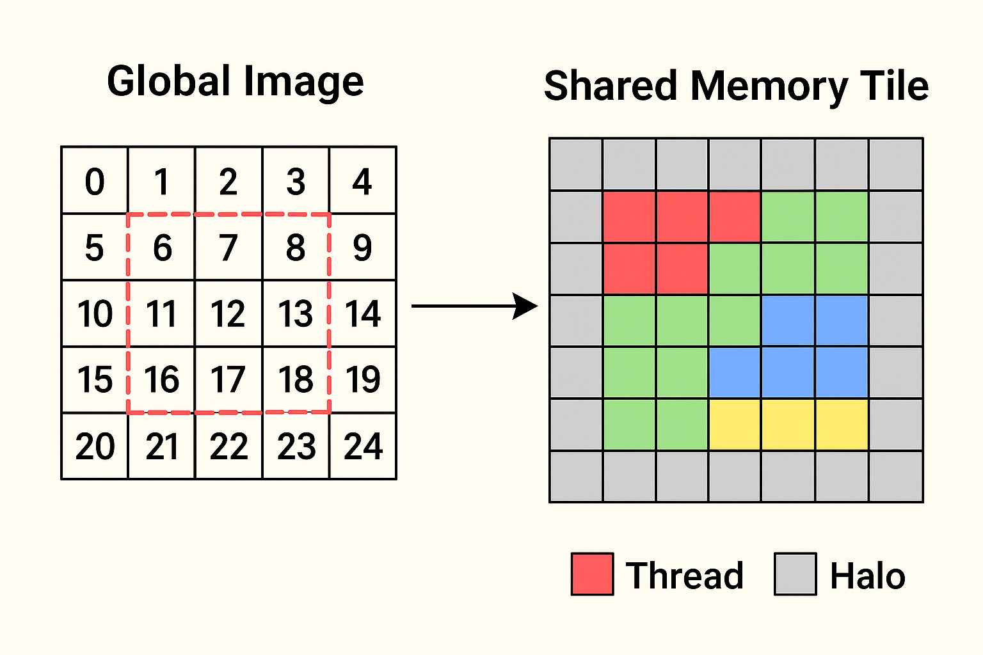
Visualization (Convolution with RGB Input)
Example (5×5 image, 3×3 kernel, 4×4 block)
Each thread block of 4×4 threads covers part of the image.
They load a 6×6 tile (4×4 + halo).
Each of the 16 threads computes one output pixel in parallel.
Borders of the tile are shared between threads, so they are fetched once not 16 times.

Slide 14
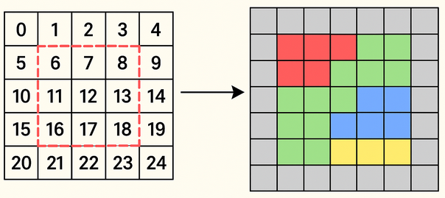
Execution by CUDA Threads
Each thread (tx,ty) in the 4×4 block maps to one pixel in the inner 4×4 region.
Thread (0,0) computes pixel 6. Needs neighbors 0,1,2,5,7,10,11,12 — all already in the tile.
Thread (1,2) computes pixel 13. Needs neighbors 7,8,9,12,14,17,18,19 — also in the tile.
Every neighbor is already staged in shared memory once, so threads don’t need to repeatedly fetch from global memory.
We assumed one 4×4 CUDA thread block is covering the sub-region:
[ 6 7 8 9
11 12 13 14
16 17 18 19
21 22 23 24 ]
Thread (0,0)-> 6, Thread (0,1)-> 7
Thread (0,2)-> 8, Thread (0,3)-> 9
Thread (1,0)-> 11, Thread (1,1)-> 12
Thread (1,2)-> 13, Thread (1,3)-> 14

Slide 15
Execution by CUDA Threads
Without stencil (naïve convolution)
Each output pixel needs a 3×3 neighborhood = 9 pixels.
If we compute an output of size N×N:
Total memory reads = N × N × 9 = 9N² global memory accesses.
Problem: overlap — neighbors get reloaded by multiple threads.
With stencil (tiling + shared memory)
Each block of size B×B threads computes a B×B output tile. But to compute convolution, it needs a halo of 1 pixel border → so it loads (B+2) × (B+2) pixels into shared memory once.
Global memory reads per block = (B+2)²
Each pixel in that tile is reused by up to 9 threads from shared memory.
For the whole image (N×N):
Number of blocks ≈ (N/B)²
Total global memory reads = (N/B)² × (B+2)²
Take N=1024 image, block size B=16, Savings ≈ 86% fewer global memory accesses

Slide 16
RGB Convolution Code Explanation
1. Shared memory tile declaration
__shared__ unsigned char tile[BLOCK_SIZE+2][BLOCK_SIZE+2][3];
Each block computes a BLOCK_SIZE × BLOCK_SIZE patch of the image. A +2 halo in both directions is needed (for 3×3 kernel). The 3 dimension stores R, G, B channels. Threads in a block cooperatively fill this shared memory tile.
2. Thread & block indexing
int tx = threadIdx.x;
int ty = threadIdx.y;
int col = blockIdx.x * BLOCK_SIZE + tx;
int row = blockIdx.y * BLOCK_SIZE + ty;
(tx, ty) → thread position inside the block.
(row, col) → global pixel coordinates in the image.
So each thread corresponds to one output pixel.
3. Load shared memory (stencil + halo)
int in_row = min(max(row-1,0), height-1);
int in_col = min(max(col-1,0), width-1);
tile[ty][tx][c] = in[(in_row*width + in_col)*3 + c];
Each thread loads one input pixel shifted by -1 (top-left offset).
The min/max clamps indices to handle borders (replicate padding).
This way, shared memory gets filled with a tile that already includes the halo region.
After this, all neighbor pixels are in shared memory.
__syncthreads() ensures every thread has finished loading before convolution starts.

Slide 17
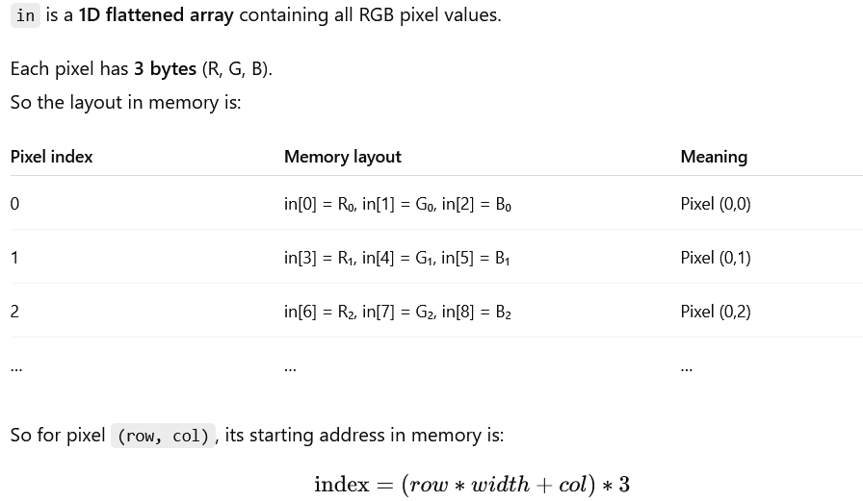
Assigning pixel values to tile
tile[ty][tx][c] = in[(in_row * width + in_col) * 3 + c];
The thread at position (tx, ty) inside the block copies the pixel at (in_row, in_col) for color channel c from the global input image in[] into shared memory tile[][][]
(in_row * width + in_col) * 3 + c
c = 0 → Red value
c = 1 → Green value
c = 2 → Blue value
We pick each channel from the input image one-by-one.

Slide 18
RGB Convolution Code Explanation
4. Compute convolution
for (int c = 0; c < 3; c++) {
float sum = 0.0f;
for (int i = 0; i < 3; i++) {
for (int j = 0; j < 3; j++) {
int sm_y = ty + i;
int sm_x = tx + j;
sum += kernel[i*3+j] * tile[sm_y][sm_x][c];
}
}
out[(row*width + col)*3 + c] = min(max(int(sum), 0), 255);
}
Each thread runs over the 3×3 kernel window.
Instead of fetching neighbors from global memory, it uses shared memory tile.
The convolution sum is applied per color channel.
Clamped to [0,255] (valid image range).
Written back to global memory output.
Each block loads (BLOCK_SIZE+2)² × 3 pixels into shared memory once.
Then, every thread reuses these pixels for its own 3×3 convolution.
Without stencil, each thread would read 9 pixels from global memory, with lots of redundancy.
With stencil, redundancy is removed → only one global read per pixel in a block.

