Slide 1
Sound and Music Description
Xavier Serra
Music Technology Group
Universitat Pompeu Fabra, Barcelona
http://mtg.upf.edu

Slide 2
Index
Introduction
Sound and music content analysis
Towards a semantic description
Applications

Slide 3
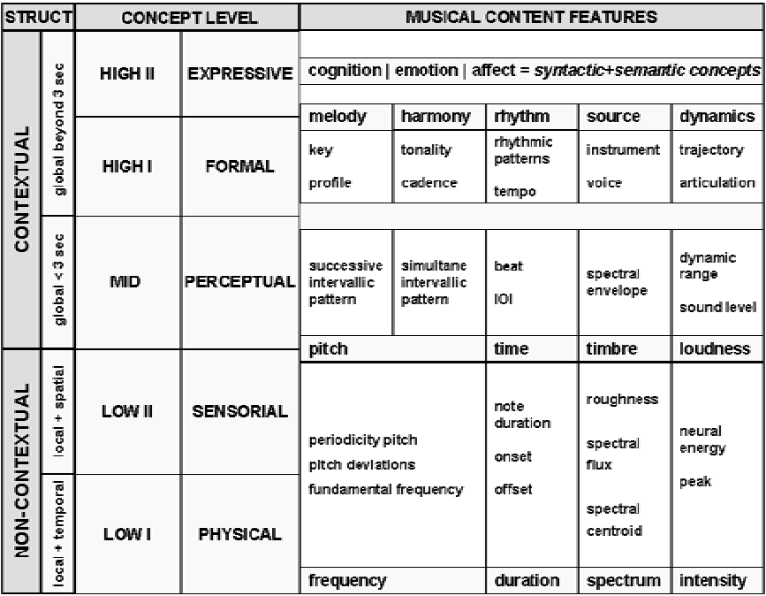
Taxonomy of musical features
Lesaffre et alt.,
2003

Slide 4

Audio content analysis
Content: The implicit and explicit information that is related to a sound or a piece of music and that is embedded in the signal itself.
Content
Manually labelled
Automatically extractable
Abstraction
Signal
Goal: Automatically describe and deal (search, edit, transform) with audio data in a meaningful way.

Slide 5
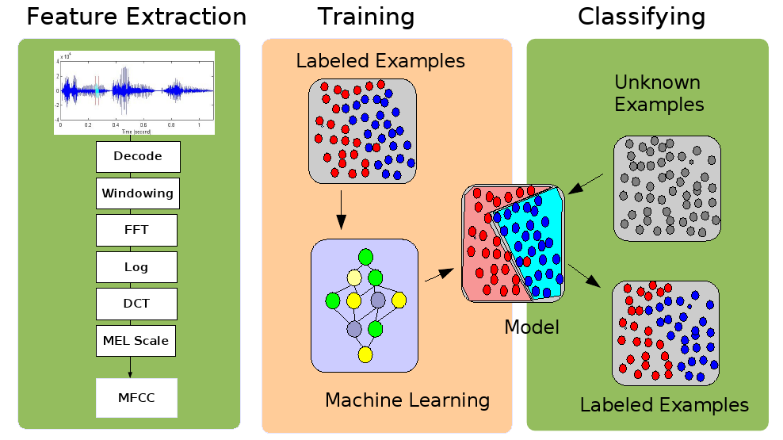
Audio content classification

Slide 6
Levels of description
Low-level (signal-centered) descriptors: computed from the audio signal in a direct or derived (ex: spectral analysis) way: average energy, spectral centroid, MFCCs ….
Mid-level (object-centered) descriptors: requiring an induction operation or data modeling: key, genre, instrument …
High-level (user-centered) descriptors: requiring a user model: mood (ex: happy, sad), …

Slide 7
Facets of music content
Timbre
Melody /
Harmony
Music Content
Analysis
Rhythm
Structure

Slide 8
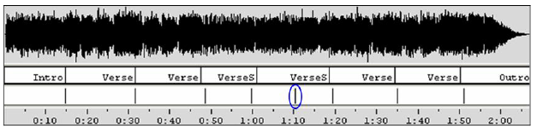
Structure description
Partitioning the sound stream into homogeneous regions
Detecting special roles for the segmented regions: intro, verse, chorus, bridge,
Other segments can also be identified: instrumental / singing; solo / ensemble; chords…
(Ong, 2006)

Slide 9
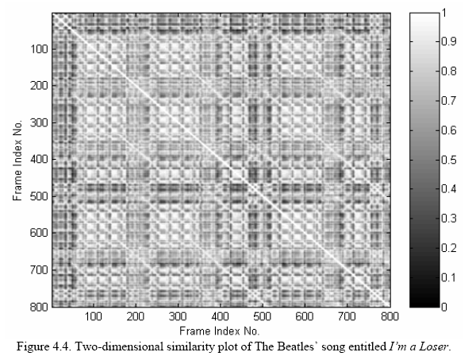
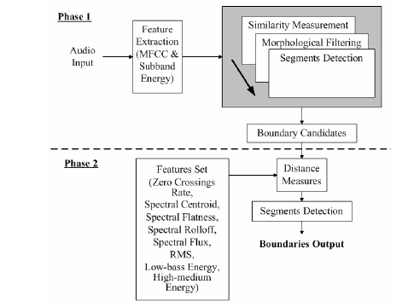
Structure description
(Ong, 2006)

Slide 10
Tonal description
Extract:
  Melody (predominant melody or score)
  Harmony (chords)
  Key, modulations
Much research is related to automatic transcription of music (Klapuri PhD 2004)
  Fundamental frequency / Multipitch estimation (de Cheveigné)
  Melody extraction (Predominant pitch, note segmentation)
  Still unsolved, even for monophonic signals.
Pitch class distribution of a piece
Mid and high level features -> apply a tonal model / musical analysis (Krumhansl, Leman, Temperley, ….)

Slide 11
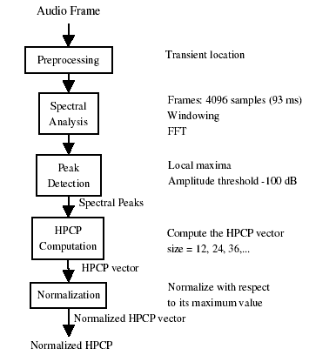
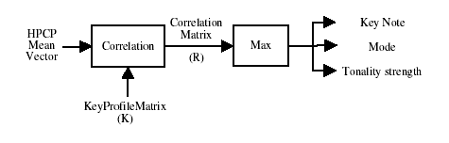
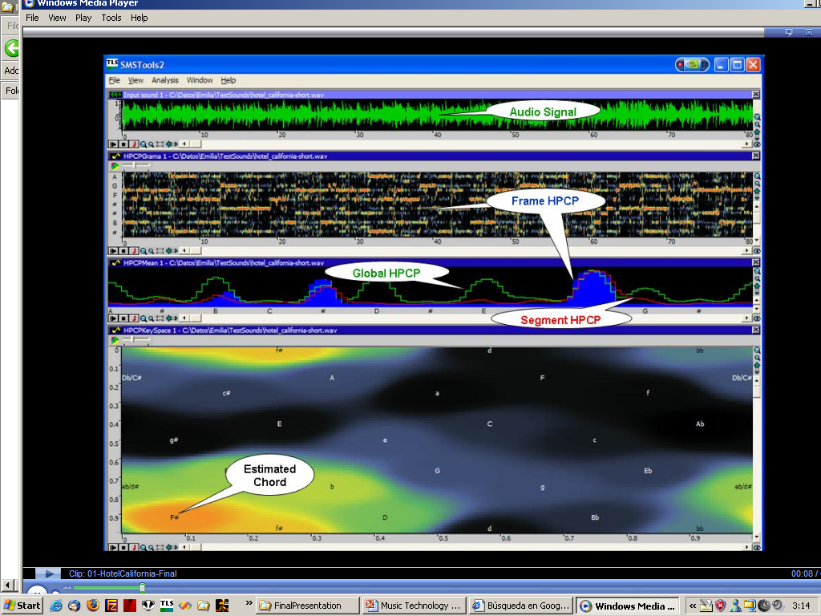
Tonal description

Slide 12
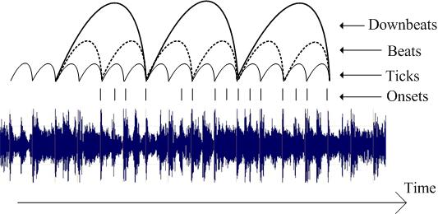
Rhythm description
Extraction of the metrical structure of a piece
(Gouyon, 2005)

Slide 13
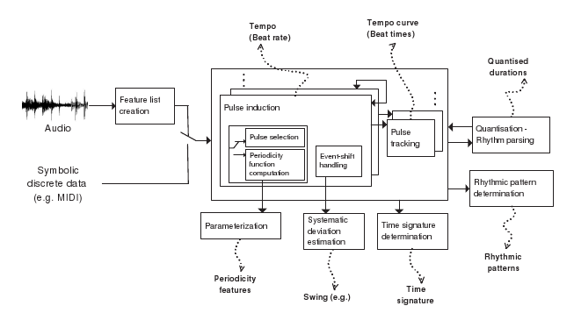
Rhythm description
(Gouyon, 2005)

Slide 14

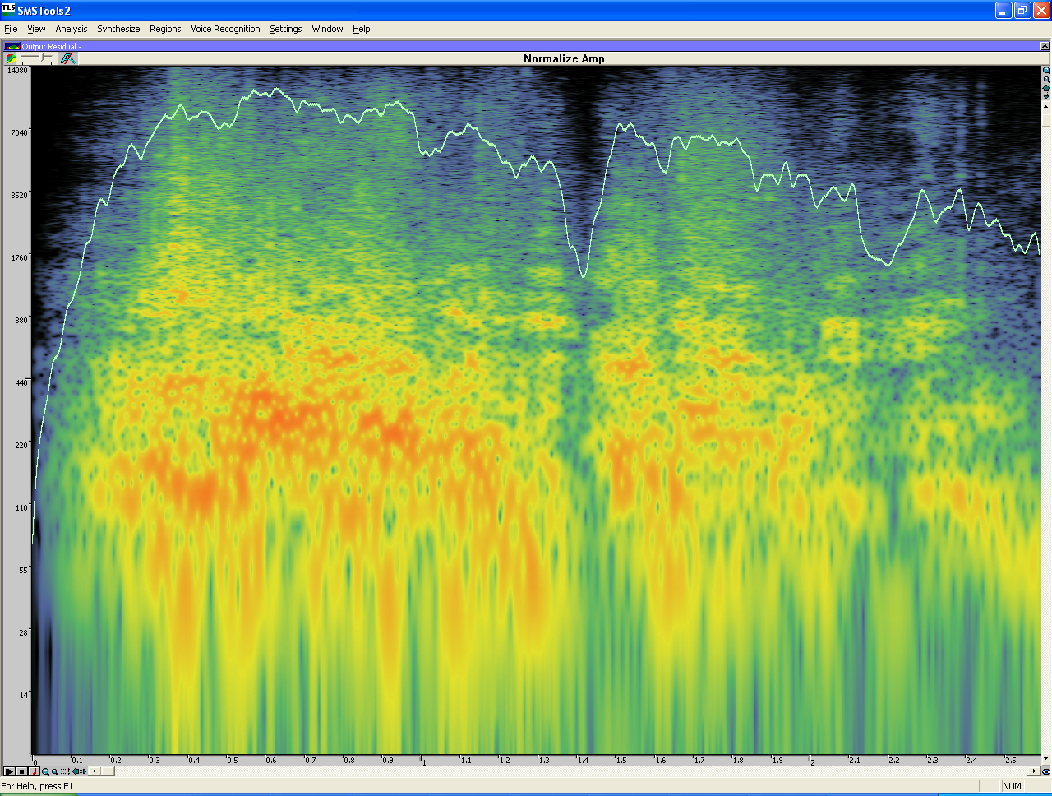
Sound trademarks
The sound mark is a sound of a lion roar having a duration of approximately 2.5 seconds. It is composed of two successive roars (0 to around 1.4s and 1.4 to 2.6), the second one having a slightly lower amplitude. The sound is non-harmonic, has fast (>15Hz) non-periodic amplitude envelope modulation (perception of sound roughness) and has dominant frequency content in the low and low-medium range (approximate -6dB range: 40 to 400 Hz for both roars with a peak at 170Hz for the first one and a peak at 130Hz for the second one). The perceived dominant frequency range (related to the spectral centroid) of the first roar increases until around 0.35s and decreases afterwards. In the second roar, it increases until around 1.7s, decreases until around 2.2s, increases again until around 2.3s and decreases afterwards.
spectrogram and description for the sound trademark of MGM

Slide 15
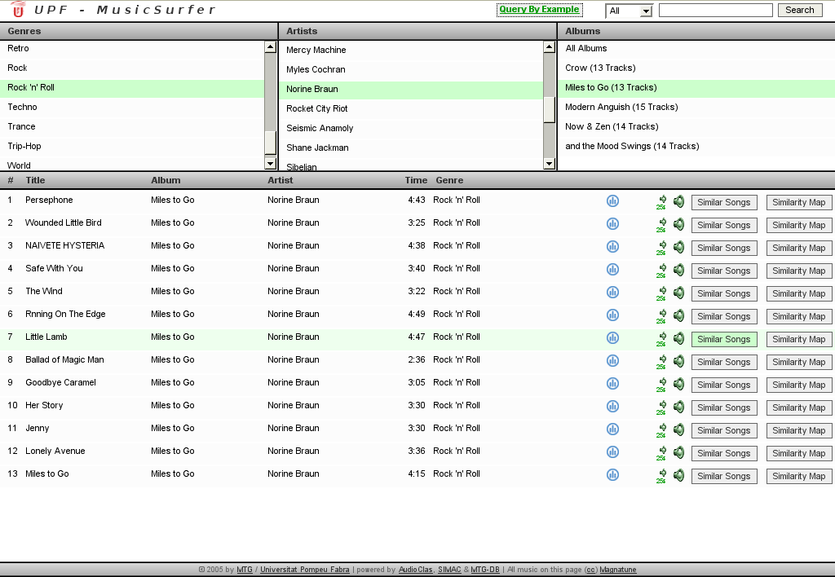
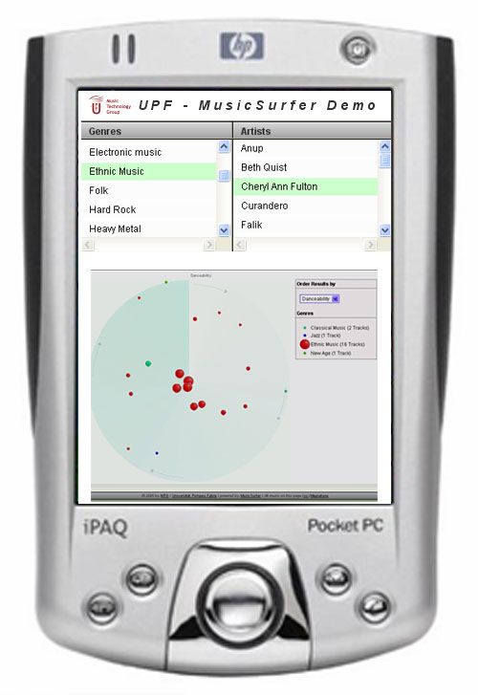
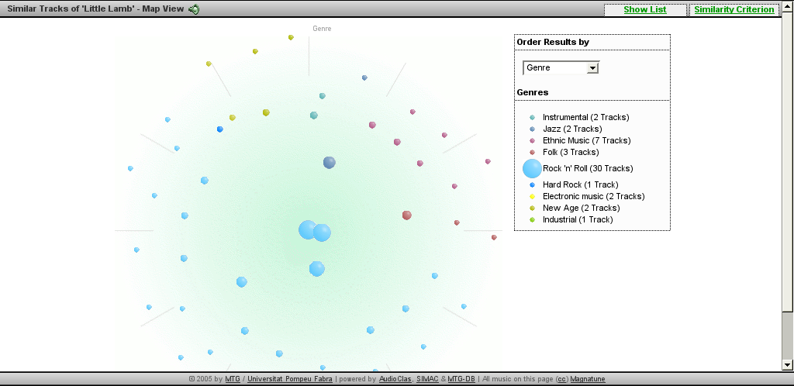
Application: music retrieval
Efficient management of sound archives, music retrieval, …
MusicSurfer
Notes:
Content Management
Content Structure
Content Semantics

Slide 16
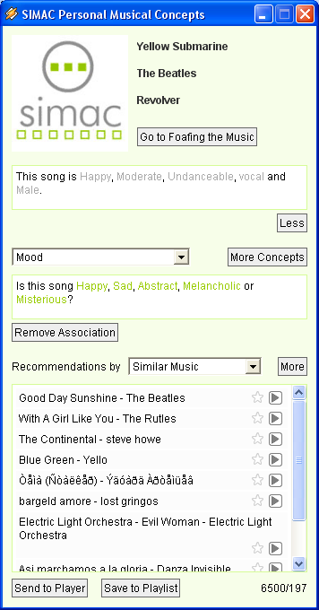
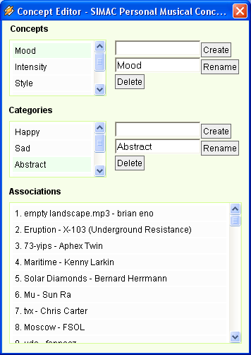
Application: personal annotation
Good Vibrations, a winamp plugin for building “personomies” and automatically annotating collections (Sandvold, Celma, Herrera, 2005)

Slide 17
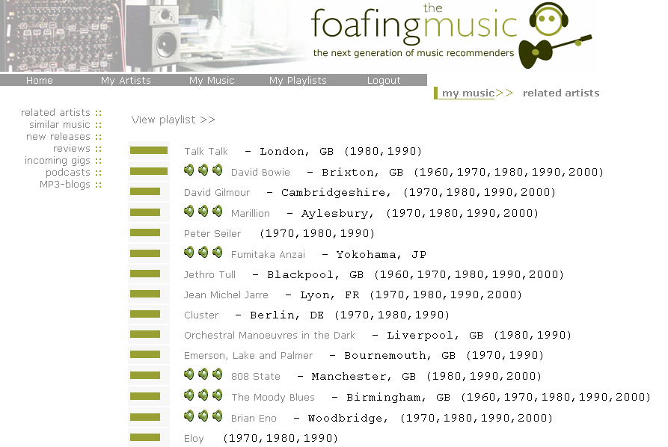
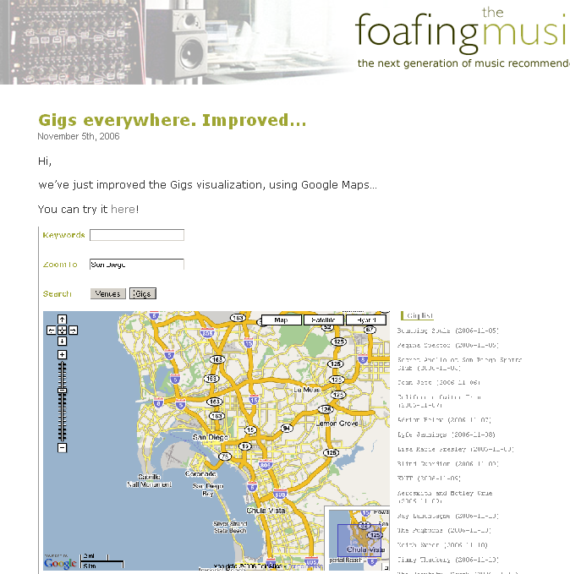
Application: music recommendation
(Celma, 2006)

Slide 18
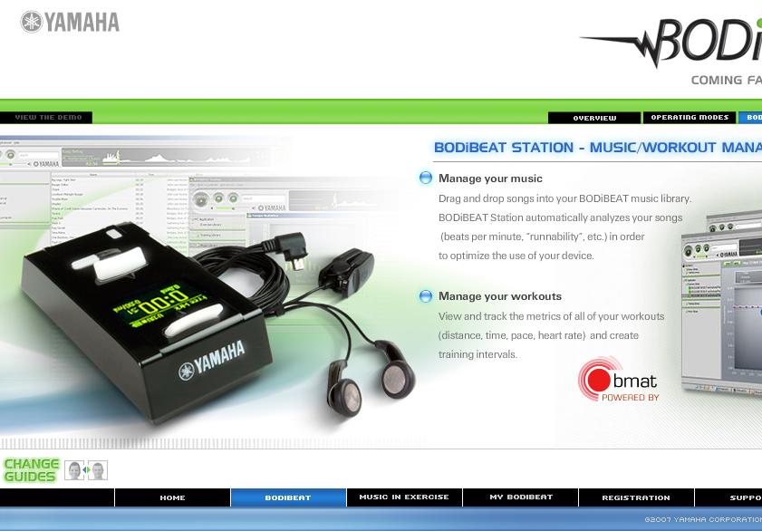
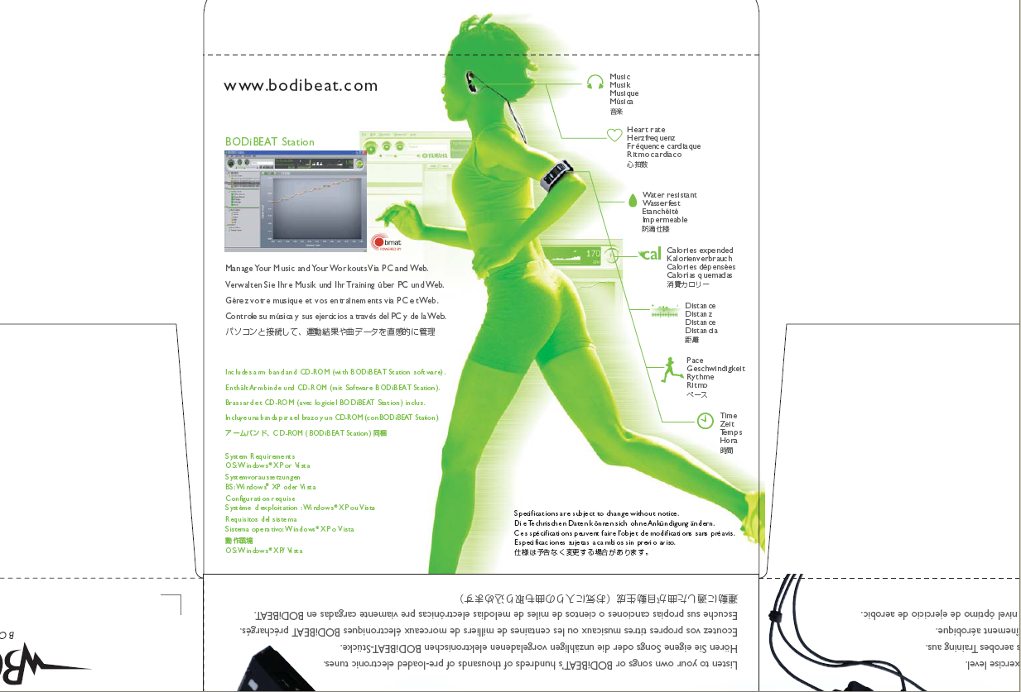
Application: music selection
music selection based on heart beat rate

Slide 19
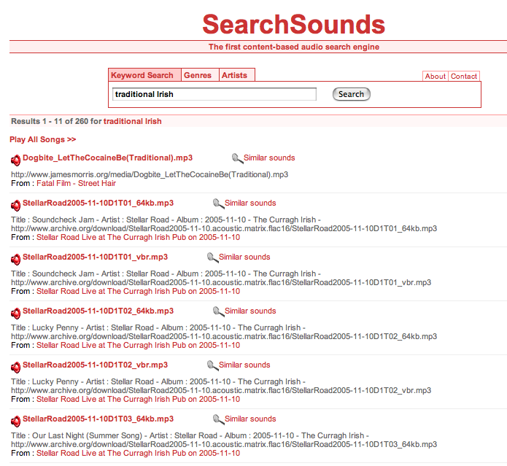
Application: sound search

Slide 20
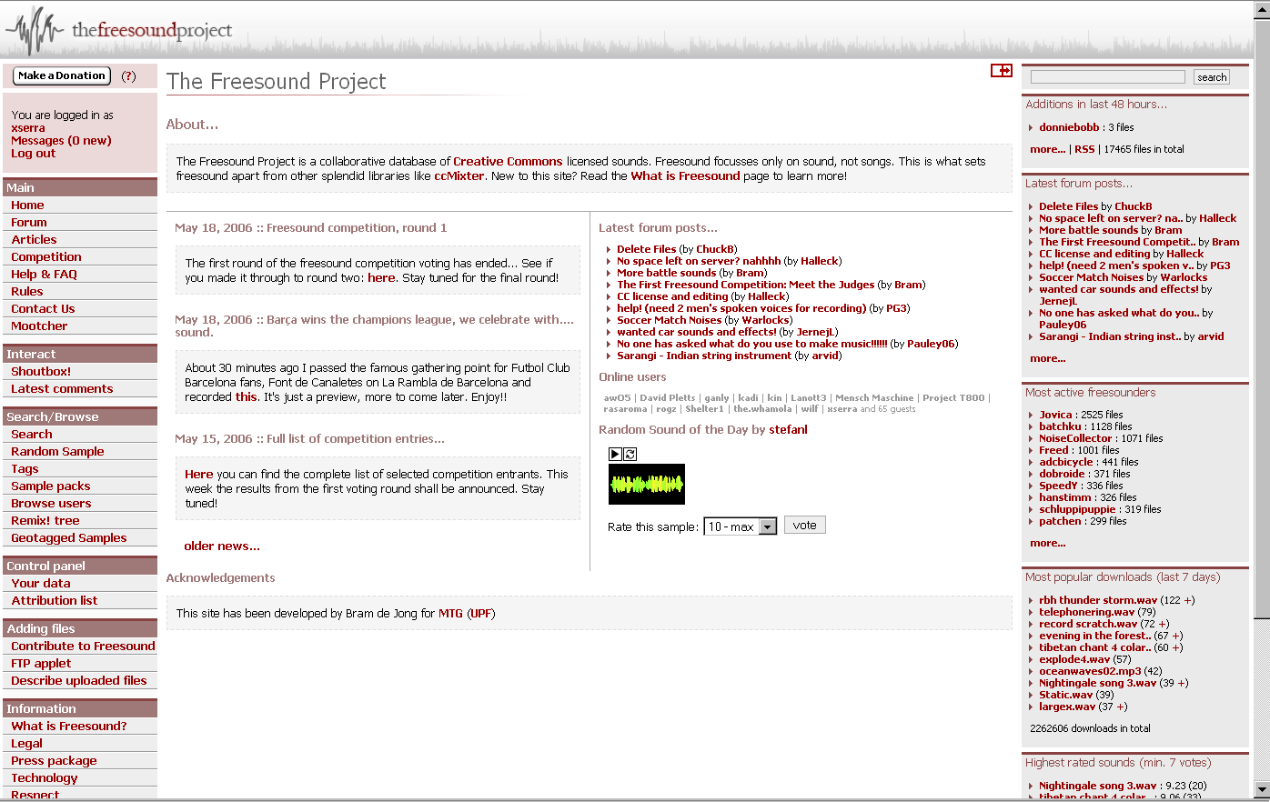
Application: music communities
http://freesound.org

Slide 21
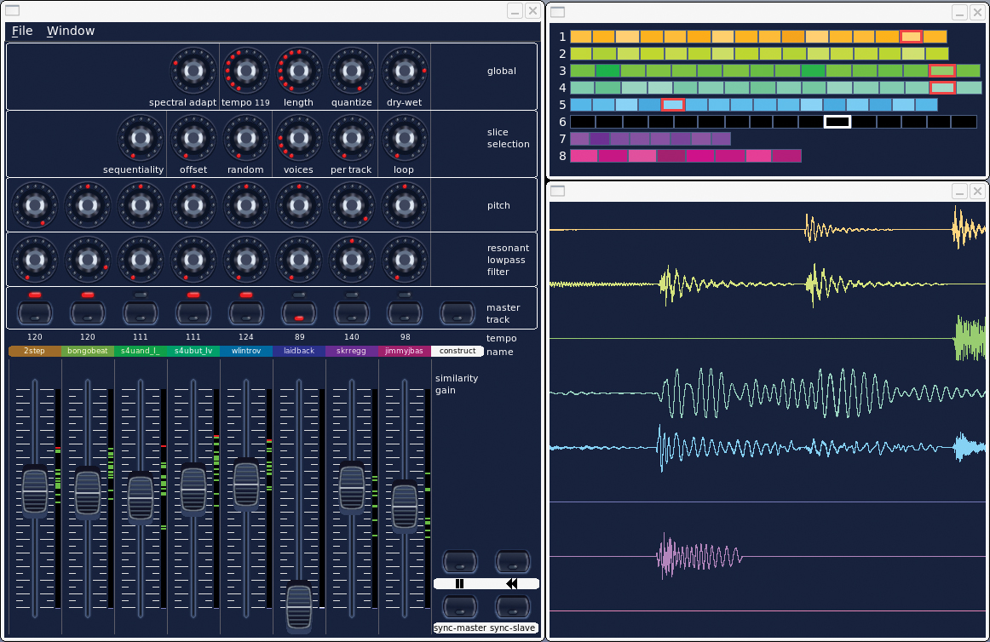
Application: music interaction
LoopMash:
sound synthesis based on mosaicing

