Slide 1
Spectral-based
Sound Transformations
Xavier Serra
Music Technology Group
Universitat Pompeu Fabra, Barcelona
http://mtg.upf.edu

Slide 2
Index
Filtering
Morphing
Frequency scaling
Time stretching

Slide 3
Short-time Fourier transform
w[n]
x[n]
|X[k]|
yw[n]
y[n]
FFT
IFFT
Overlap-add
xw[n]
<X[k]

Slide 4
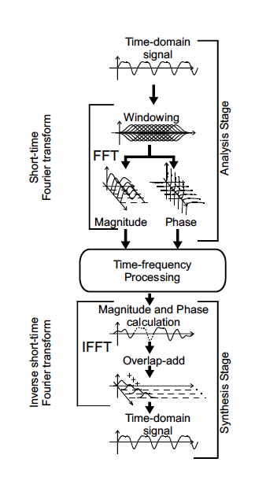
STFT
Notes:
We were asked for an

Slide 5
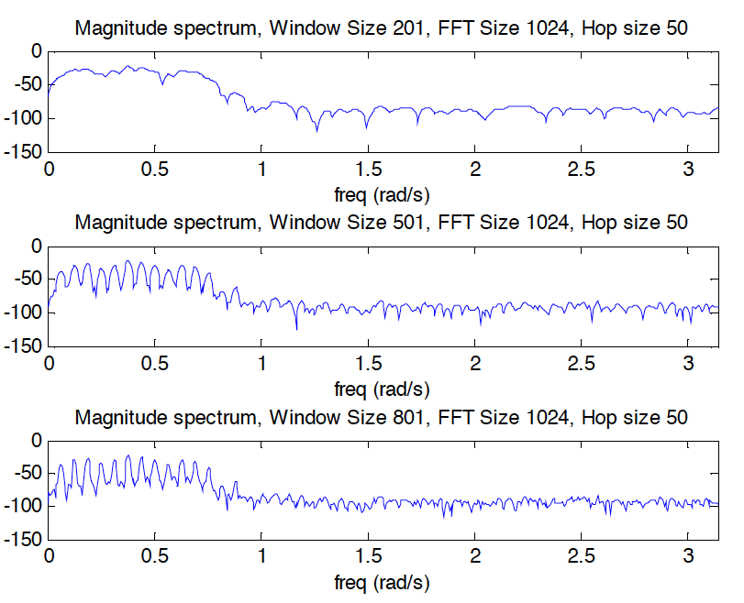

Slide 6
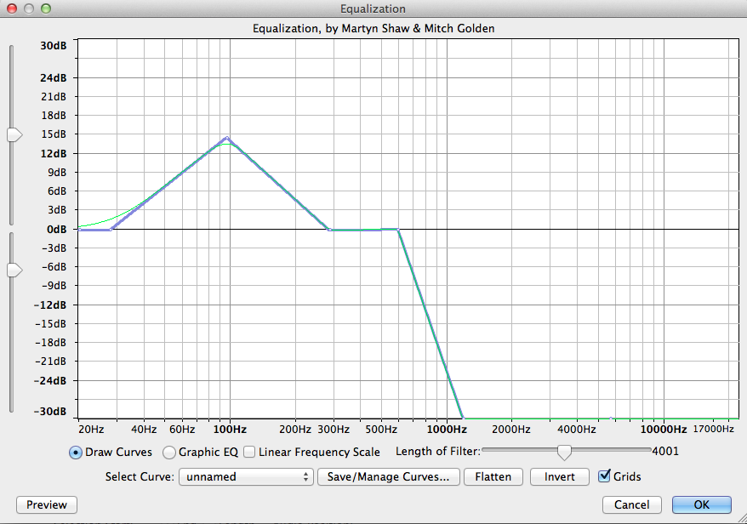
Filtering: Equalization

Slide 7
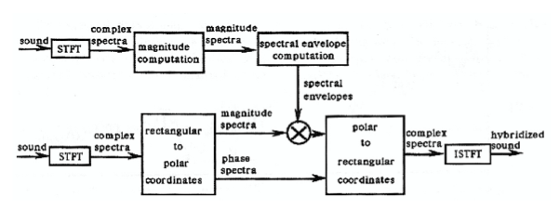
Morphing with STFT
Notes:
We were asked for an

Slide 8
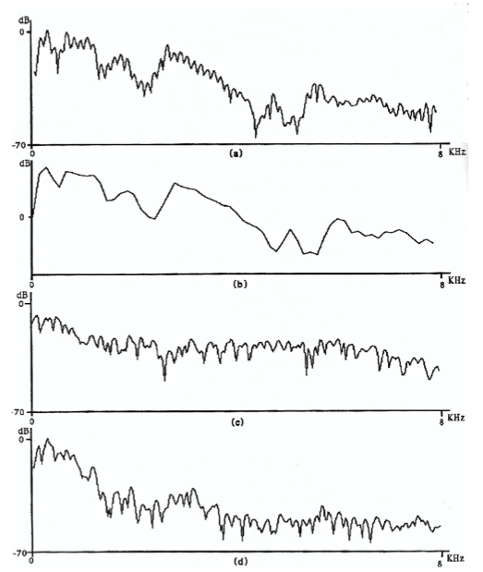
Morphing

Slide 9
Harmonic plus residual model
wh[n]
x[n]
|X[k]|
A_{r}
f_{r}
p_{r}
X
FFT
Peak detection
F0
detection
xwh[n]
<X[k]
p_{h}
f₀
A_{h}
f_{h}
wr[n]
Sine spectral
synthesis
X[k]
-
Yh[k]
X
FFT
+
xwr[n]
Yr[k]
+
Y[k]
IFFT
yw[n]
Overlap-add
y[n]

Slide 10
Filtering sine waves
Filter=[ 0 2099 2100 3000 3001 fs/2; % Hz
-200 -200 0 0 -200 -200 ]; % db
ysmag = ysmag+interp1(Filter(1,:),Filter(2,:),ysloc/Ns*fs);

Slide 11
Frequency shifting of sine waves
fshift = 100;
ysloc = (ysloc>0).*(ysloc + fshift/fs*Ns);

Slide 12
Frequency stretching of sine waves
fstretch = 1.1;
ysloc = ysloc .* (fstretch.^[0:length(ysloc)-1]');

Slide 13
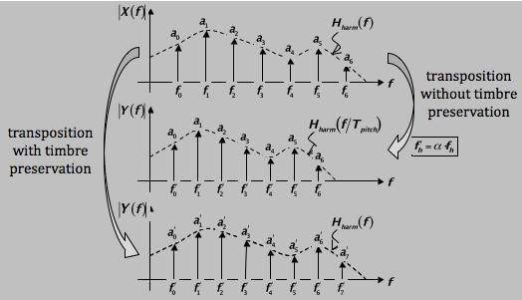
Pitch transposition with timbre preservation

Slide 14
Harmonic plus Stochastic model
wh[n]
x[n]
|X[k]|
A_{r}
f_{r}
p_{r}
X
FFT
Peak detection
F0
detection
xwh[n]
<X[k]
p_{h}
f₀
A_{h}
f_{h}
wr[n]
Sine spectral
synthesis
X[k]
-
Yh[k]
X
FFT
+
xwr[n]
Yr[k]
Stochastic approximation
|Ys[k]|
<Ys[k]
Ys[k]
Random phase generation
Stochastic spec. synthesis
+
Y[k]
IFFT
yw[n]
Overlap-add
y[n]

Slide 15
Time scaling
It’s a frame based frequency domain technique
Time
Scale
Windowing
&
Overlapp
input
FFT
IFFT
output
AF_{n}
SF_{m}
AF_{n} = Analysis Frame number n
SF_{m} = Analysis Frame number m
Analysis and synthesis processes must use the same window size and window type
Notes:
This leaves time as the only degree of freedom and the only thing of interest then is to place the start and end points of each phoneme to be aligned.
The most commonly used and also successful way to align voice to text is

Slide 16
Frame positions
Analysis frames
Used twice!
TS>1
Synthesis frames
Analysis frames
Not used!
TS<1
Synthesis frames

Slide 17
The Time-Scale module
Phase
Z⁻¹
Spectrum Phase Generation
Phase
AF_{n}
Peak
Detection
Z⁻¹
Peak
Continuation
SF_{m}
Peak
Detection
Amplitude
Amplitude
Notes:
-Dynamic: The spectral characteristics of a voiced sound change with the loudness.

Slide 18
Delta phase around each peak
The phase around each peak is obtained applying the delta phase function of the original frame
Amplitude
f₁
Amplitude
f₁
f₂
f₂
Phase
Phase
AF_{n}
SF_{m}
Notes:
-Vibrato: Two types of vibrato exist in singing. The classical vibrato in opera music corresponds to periodic modulation of the phonation frequency, and in popular music the vibrato implies an added amplitude modulation of the voice source. In speech, no vibrato exists.

Slide 19
References
http://en.wikipedia.org/wiki/Sound_effects
http://en.wikipedia.org/wiki/Equalization_filter
http://en.wikipedia.org/wiki/Audio_timescale-pitch_modification

Slide 20
Credits
All the slides of this presentation are released under an Attribution-Noncommercial-Share Alike license.

