Slide 1
Spectral features
Xavier Serra
Music Technology Group
Universitat Pompeu Fabra, Barcelona
http://mtg.upf.edu

Slide 2
Index
Sound and Music features
Feature correlations
Feature detection and extraction
Segmentation
Segment features
Instrument models
Musical features

Slide 3
Sound and music features
Basic Sines+Residual parameters
  Instantaneous frequency and amplitude of partials
  Instantaneous spectrum of residual
Instantaneous features
  Fundamental frequency
  Amplitude and spectral shape of sinusoidal component
  Amplitude and spectral shape of residual
  Degree of harmonicity
  Noisiness
  Spectral tilt
  Spectral centroid
Segment features

Slide 4
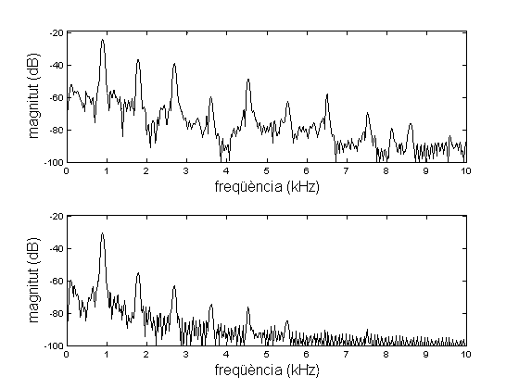
Feature correlations
Loud piano note
Soft piano note
Fundamental frequency
Spectral shape
Fundamental frequency
Amplitude
Amplitude
Spectral shape

Slide 5
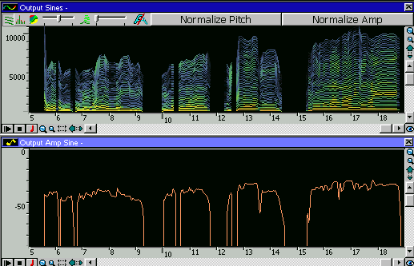
Feature detection and extraction
Frame attributes:

Slide 6


Amplitude of sinusoids:
Amplitude of residual:
Fundamental frequency:

Slide 7
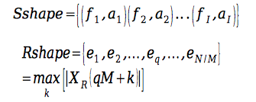
Spectral shape of sinusoids:
Spectral shape of residual:
2f0 2f1 2f2 2f 3 2f 4 2f 5 2f 6 2f 7 2f 8 2f 9 2f 10 2f 11
Octave transposition
f0 f1 f2 f3 f4 f5 f6 f7 f8 f9 f10 f11
2f0 2f1 2f2 2f 3 2f 4 2f 5 2f 6 2f 7 2f 8 2f 9 2f 10 2f 11

Slide 8
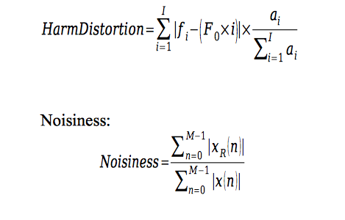
Harmonic distortion:

Slide 9
inharmonicity in different
piano strings (Fletcher 91)
inharmonicity in different
pianos (Fletcher 91)
X. Serra

Slide 10
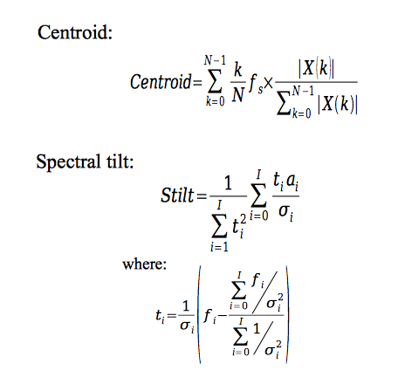

Slide 11
Spectral tilt as a function of amplitude
(Benet and Rodet, 89)

Slide 12
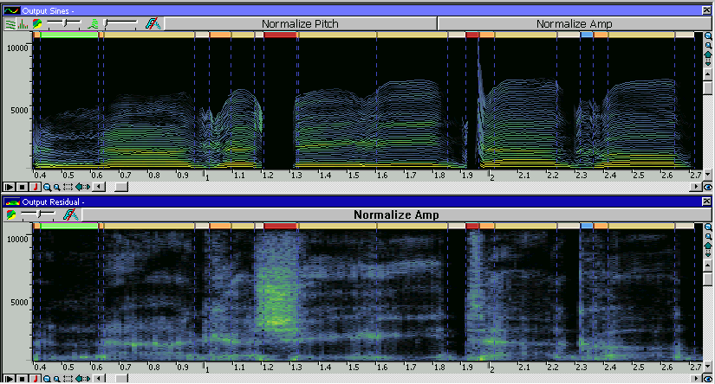
Segmentation
unconstrained
constrained

Slide 13
AttackEnd
DecayStart
AttackStart
DecayEnd

Slide 14
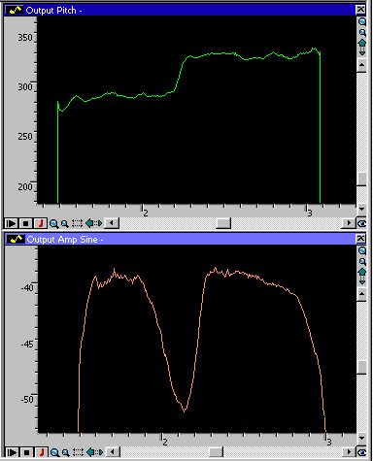
frequency articulation
amplitude articulation
X. Serra

Slide 15
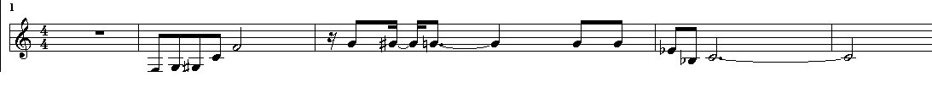
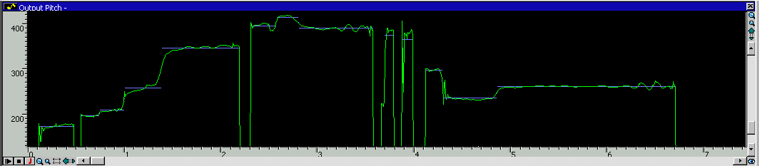
musical script
constrained segmentation

Slide 16
Segment features
Mean and variance of frame attributes
  Amplitude of sinusoidal and residual amplitudes
  Fundamental frequency
  Spectral shape of sinusoidal and residual component
Vibrato

Slide 17
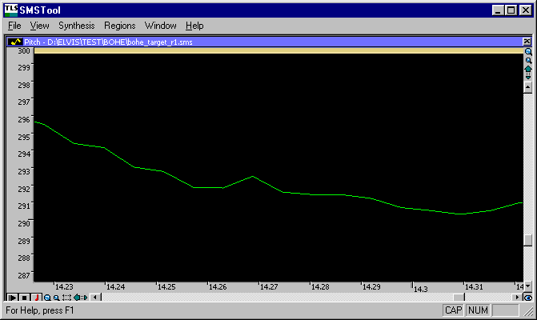
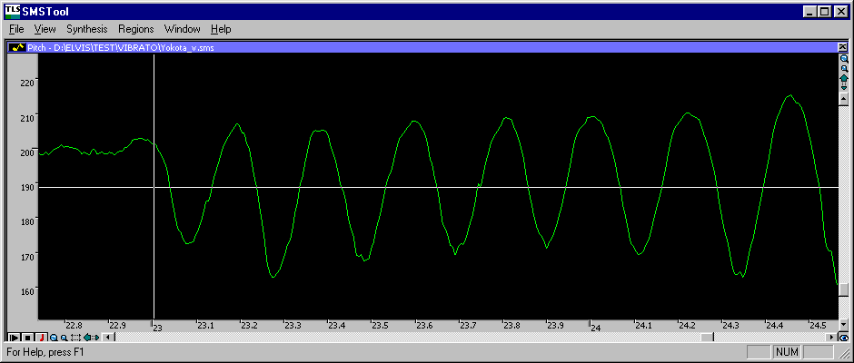
steady state without
vibrato
steady state with
vibrato
X. Serra

Slide 18
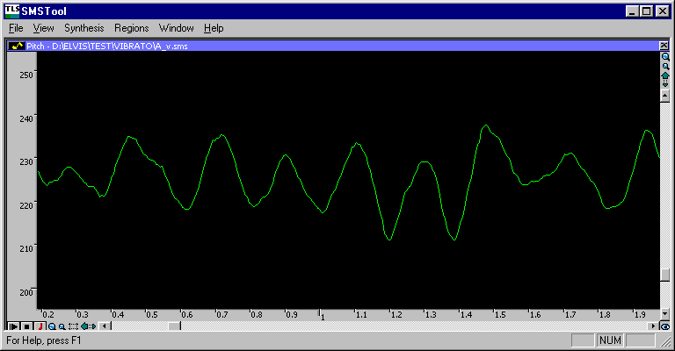
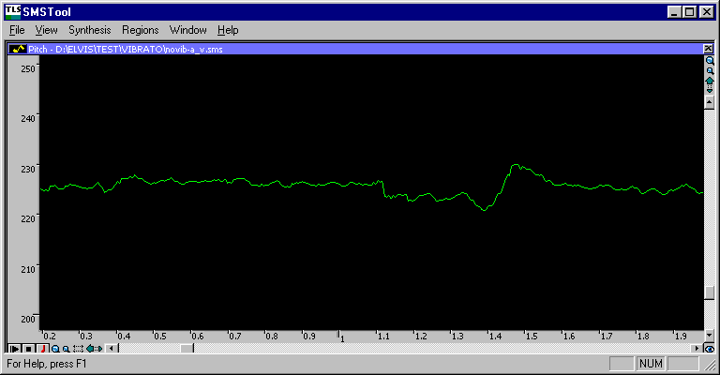
steady state with
vibrato
steady state with extracted
vibrato
X. Serra

Slide 19
Instrument features
Spectral Shape Models (formants, average shape, ...)
Phase Models (constant, formant-based, ...)
Frequency Models (harmonic model, piano model)
Vibrato Models
Articulation Models (frequency, amplitude functions)
Residual Models
Brightness-Loudness model (amplitude versus spectral tilt)

