Slide 1
Introduction to
Audio Signal Processing for
Music Applications
Xavier Serra
Music Technology Group
Universitat Pompeu Fabra, Barcelona
http://mtg.upf.edu

Slide 2
Index
What is audio signal processing?
Applications areas: storage, level compression, data compression, enhancement, effects and transformations, synthesis, description.

Slide 3
What is audio signal processing?
Definition: Intentional alteration of sound.
Control
System
Notes:
As audio signals may be electronically represented in either digital or analog format, signal processing may occur in either domain. Analog processors operate directly on the electrical signal, while digital processors operate mathematically on the binary representation of that signal.

Slide 4
Analog versus digital signals
An analog representation is usually electrical; a voltage level represents the air pressure waveform of the sound.
A digital representation expresses the pressure waveform as binary numbers. This permits signal processing using microprocessors and computers. Although such a conversion can be prone to loss, most modern audio systems use this approach as the techniques of digital signal processing are much more powerful and efficient than analog domain signal processing.

Slide 5
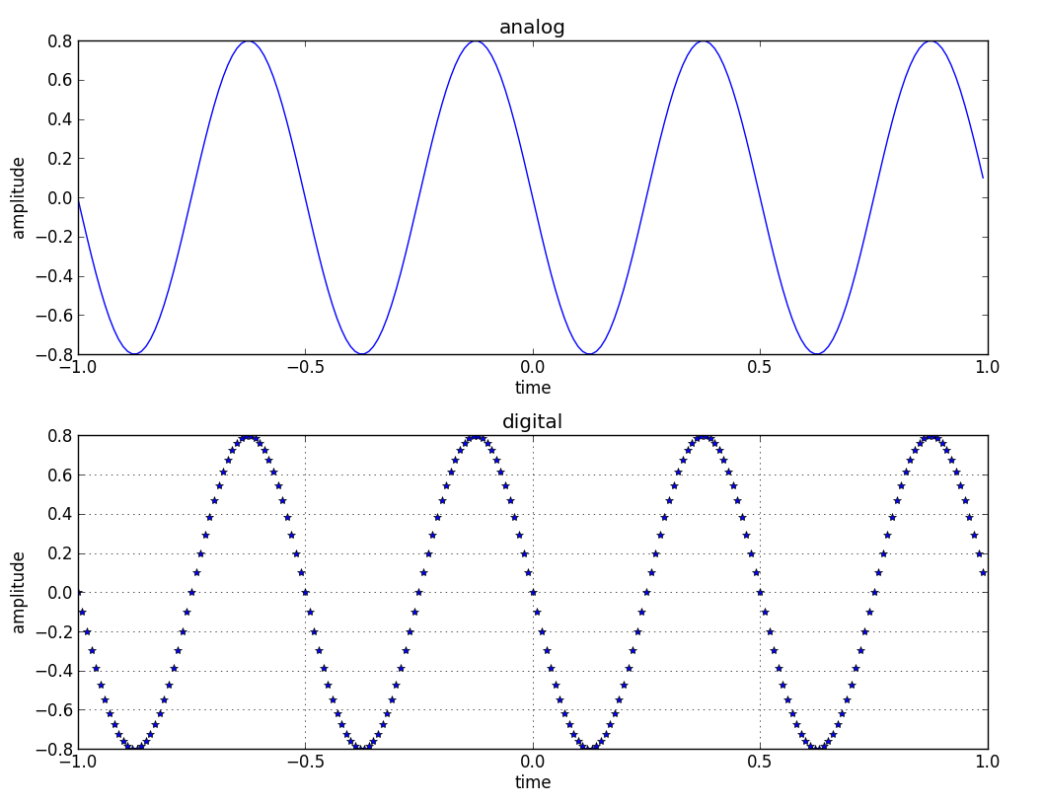

Slide 6
Application: Storage
Sound recording and reproduction is an electrical or mechanical inscription and recreation of sound waves.
The two main classes of sound recording technologies are analog recording and digital recording.

Slide 7
Application: Level compression
Dynamic range compression, also called DRC or simply compression, is a process that reduces the dynamic range of an audio signal, that is, narrows the difference between high and low audio levels or volumes.
Compression is commonly used during sound recording, live sound reinforcement, and broadcasting.

Slide 8
Application: Data compression
Designed to reduce the transmission bandwidth requirement of digital audio streams and the storage size of audio files.
Optimized audio lossless and lossy algorithms have been created. Lossy algorithms provide greater compression rates and are used in mainstream consumer audio devices.
In both lossy and lossless compression, information redundancy is reduced, using methods such as coding, pattern recognition and linear prediction to reduce the amount of information used to represent the uncompressed data.

Slide 9
Application: Enhancement
Filtering
Equalization
Noise cancellation
Echo or reverb removal
…

Slide 10
Application: Transformations
Echo, Reverb
Flanger, Phaser, Chorus
Pitch shift
Time stretching
Voice effects
3D audio effects
Morphing

Slide 11
Application: Synthesis
Additive synthesis
Subtractive synthesis
Granular synthesis
Non-linear synthesis: FM, Waveshaping
Sampling and Spectral synthesis
Physical modeling

Slide 12
Application: Description
Low-level: loudness, timbre, pitch, ..
Mid-level: rhythm, harmony, melody, …
High-level: genre, emotions, similarity, …

Slide 13
References
https://en.wikipedia.org/wiki/Audio_signal_processing
Davide Rocchesso, 2003. Introduction to Sound Processing. http://www.theassayer.org/cgi-bin/asbook.cgi?book=522

Slide 14
Credits
All the slides of this presentation are released under an Attribution-Noncommercial-Share Alike license.

