Slide 1
Introduction to
Audio Signal Processing for
Music Applications
Xavier Serra
Music Technology Group
Universitat Pompeu Fabra, Barcelona
http://mtg.upf.edu

Slide 2
Index
What is audio signal processing?
Application areas:
  storage, level compression, data compression, enhancement, effects and transformations, synthesis, description.

Slide 3
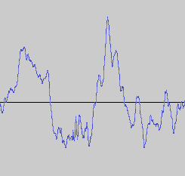
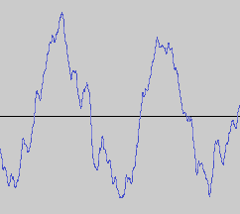
What is audio signal processing?
Definition: Intentional alteration of sound.
Control
Audio signal
processing
system

Slide 4
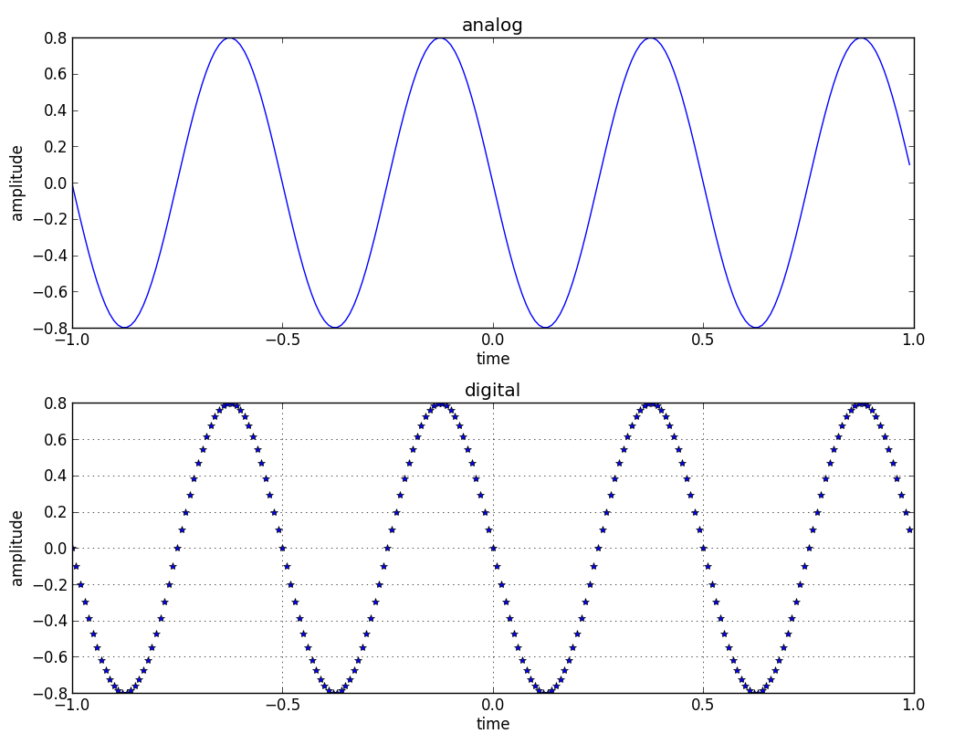
Analog versus digital signals

Slide 5
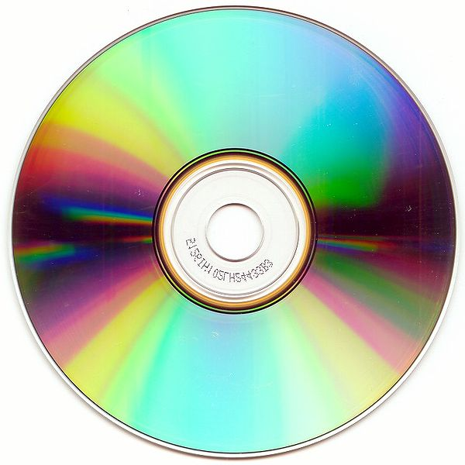
Applications: Storage

Slide 6
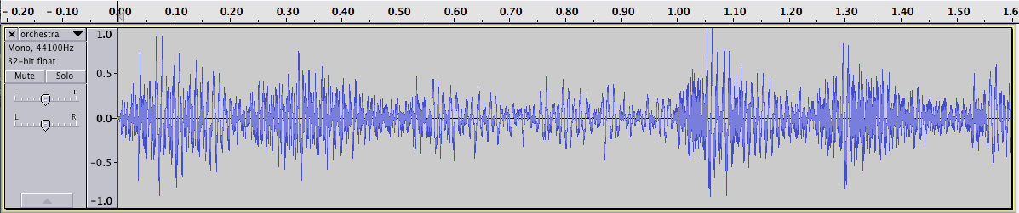
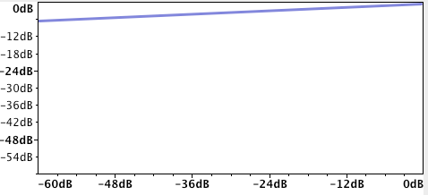
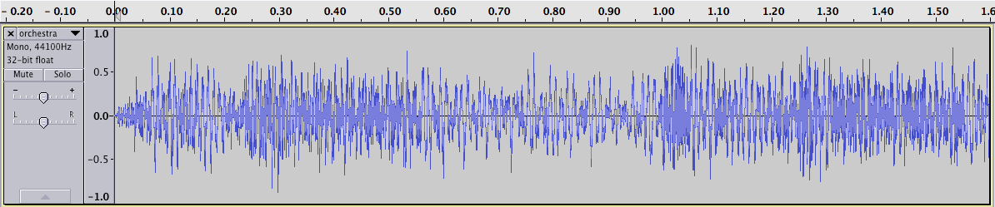
Applications: Level compression
[Audacity]

Slide 7


Applications: Data compression
perceptual
audio coder

Slide 8
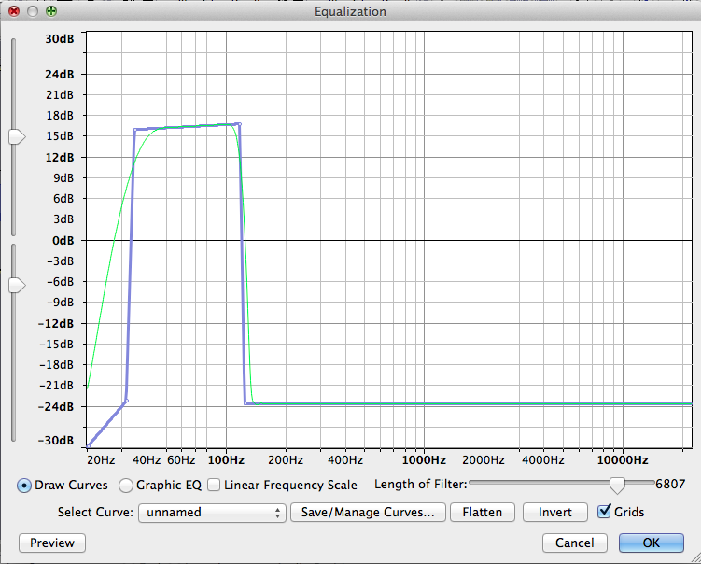
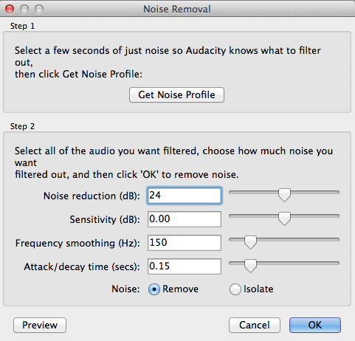
Applications: Enhancement
[Audacity]

Slide 9
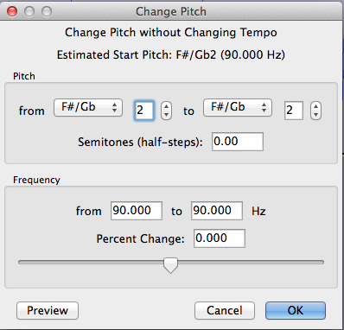
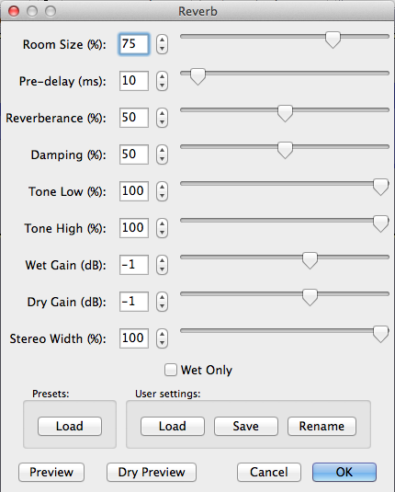
Applications: Transformations
[Audacity]
Echo, Reverb, Flanger, Phaser, Chorus,
Pitch shift, Time stretching, Voice effects,
3D audio effects, Morphing, ....

Slide 10


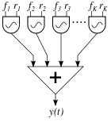
Applications: Synthesis
Additive synthesis, Subtractive synthesis,
Granular synthesis, Physical modeling
Non-linear synthesis: FM, Waveshaping,
Sampling and Spectral synthesis, ...

Slide 11
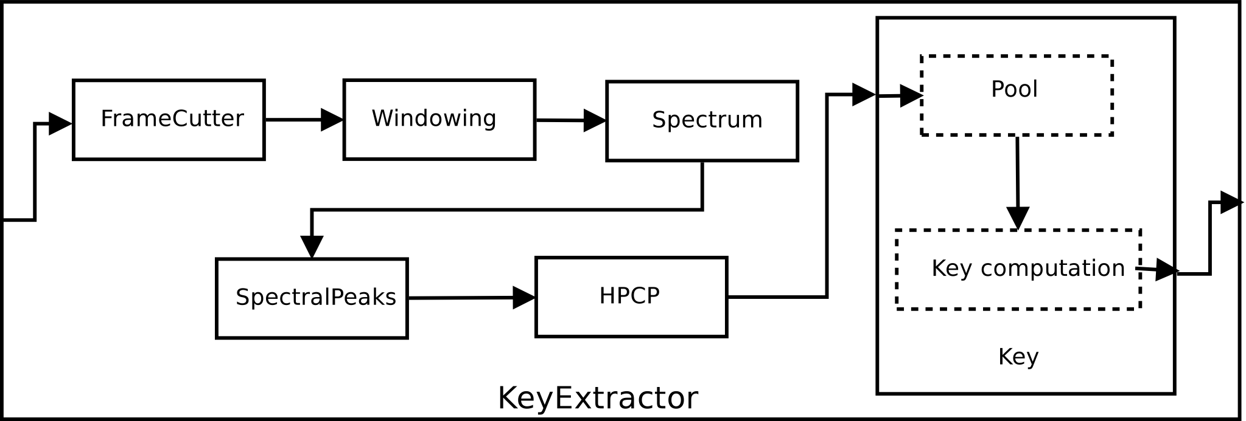
Applications: Description
Low-level: loudness, timbre, pitch, ..
Mid-level: rhythm, harmony, melody, …
High-level: genre, emotions, similarity, …

Slide 12
Credits
Information taken fromhttps://en.wikipedia.org/wiki/Audio_signal_processing
Some images taken from http://commons.wikimedia.org/
Sounds taken from http://www.freesound.org/people/xserra/packs/13038/
Some examples generated using http://audacity.sourceforge.net
All slides and code produced for this course are available from https://github.com/MTG/sms-tools and released using the CC Attribution-Noncommercial-Share Alike license or Affero GPL license.

