Slide 1
Sinusoidal Modeling
(2 of 2)
Xavier Serra
Music Technology Group
Universitat Pompeu Fabra, Barcelona
http://mtg.upf.edu

Slide 2
Index
Sinusoidal model equation
Sinusoidal synthesis
System diagram

Slide 3
Sinusoidal model

Slide 4
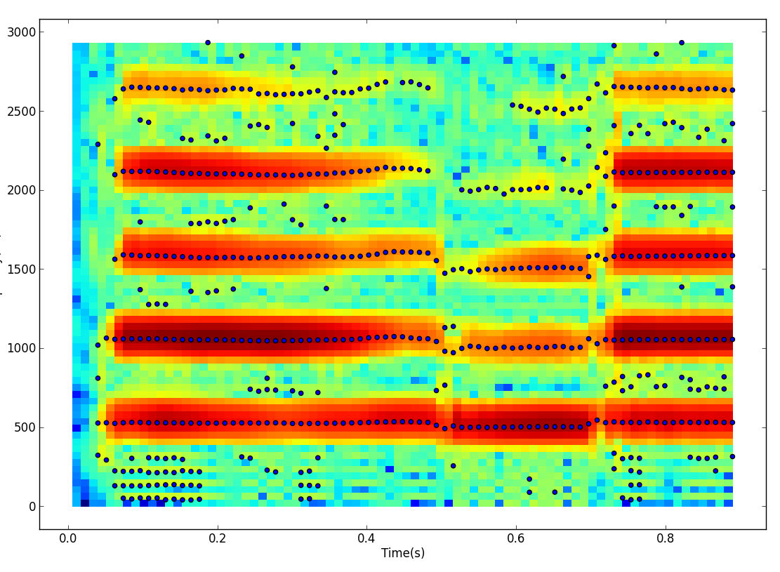

Slide 5
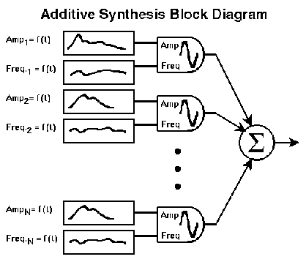
Sinusoidal synthesis

Slide 6
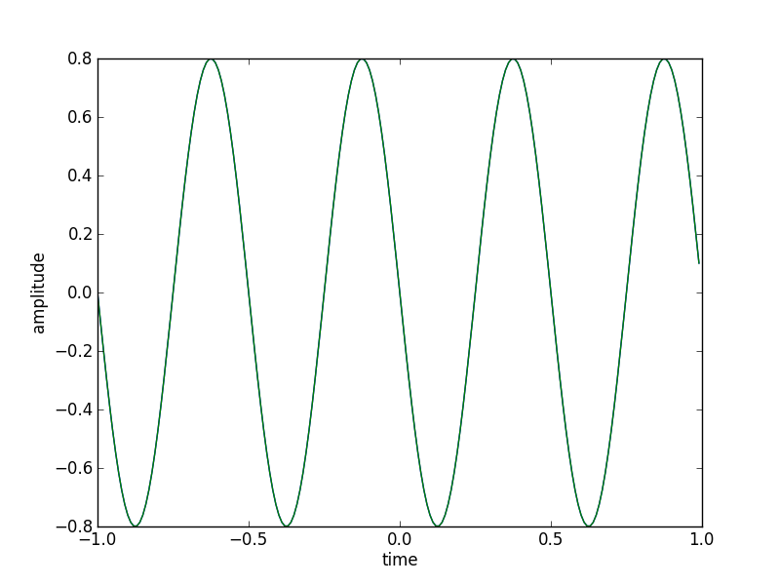
Sinusoidal synthesis
Ar = .8
Fr = 2.0
phi = np.pi/2
fs = 100
t = np.arange(-1, 1, 1.0/fs)
x = Ar * np.cos(2*np.pi*fr*t+phi)
plt.plot(t, x)

Slide 7
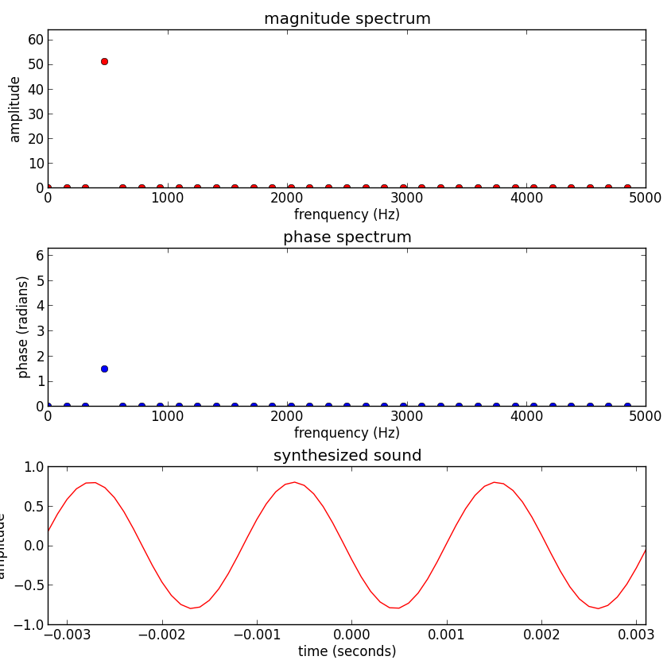
Spectral-based sinusoidal synthesis

Slide 8
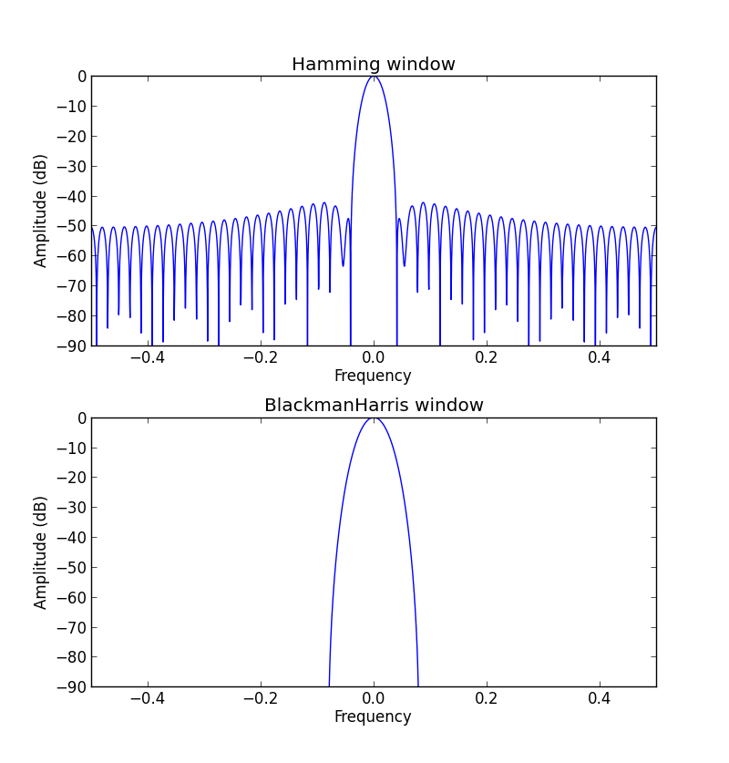
Sinusoids in spectrum

Slide 9
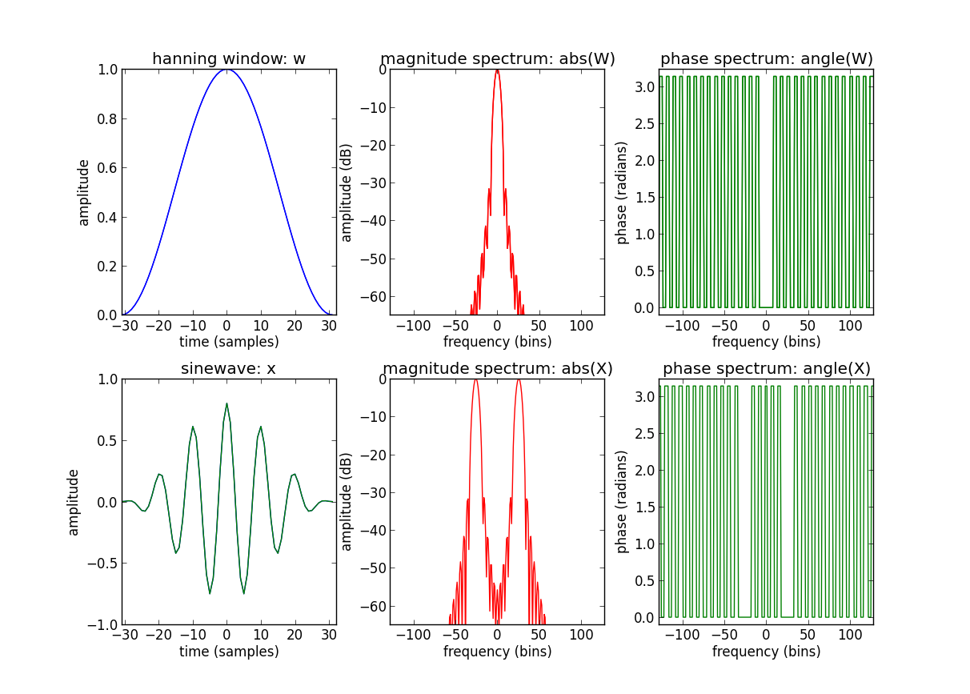
Sinewave spectrum

Slide 10
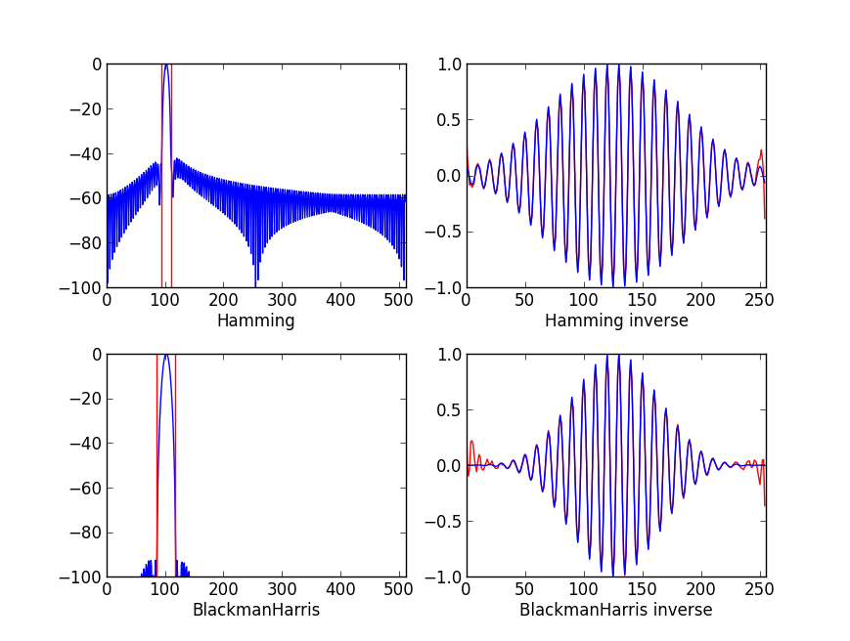
Inverse of spectral sinusoid

Slide 11
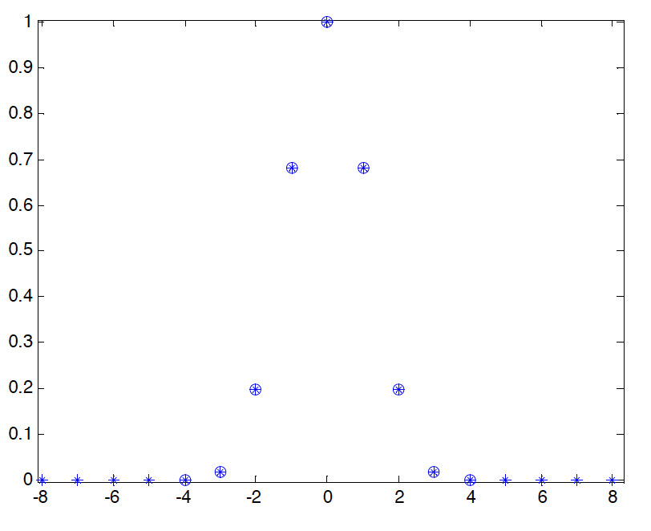
Blackman-Harris main-lobe

Slide 12
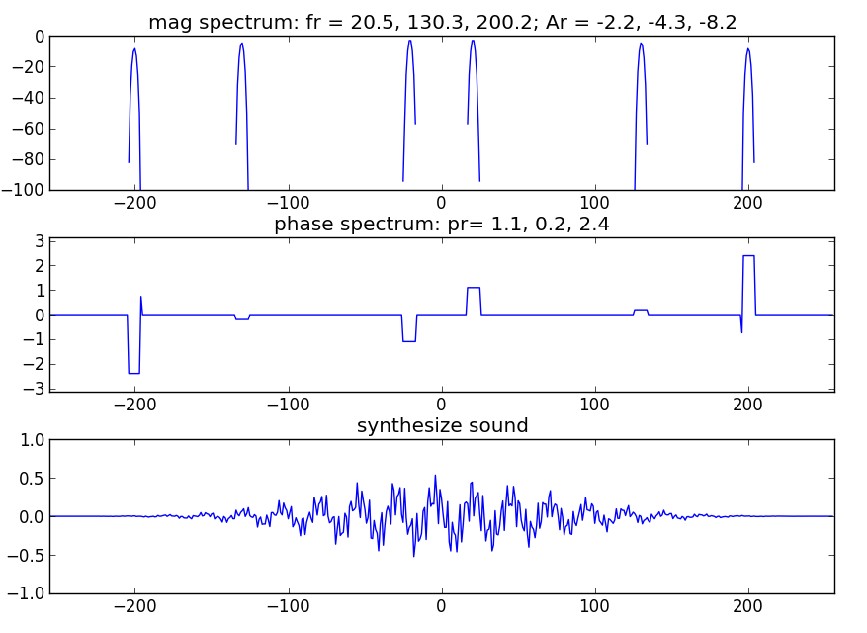
Synthesized spectrum and signal

Slide 13
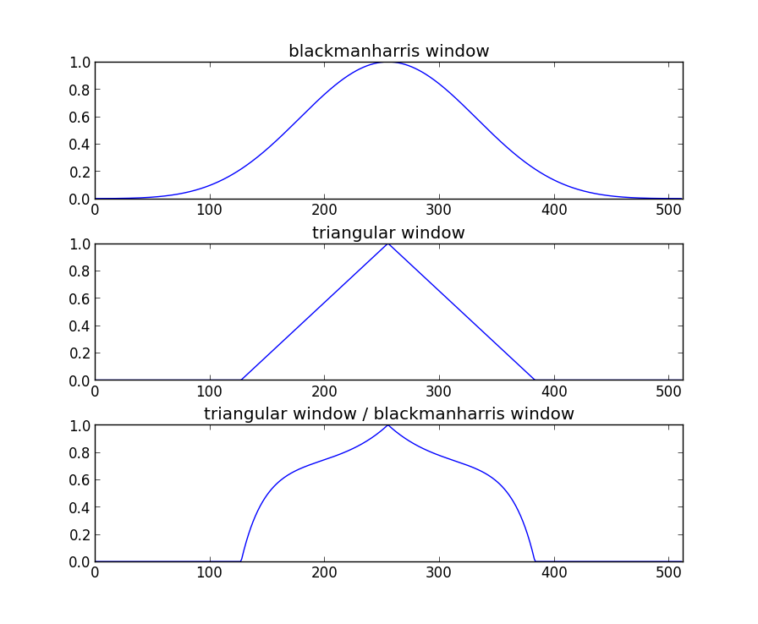
Synthesis window

Slide 14
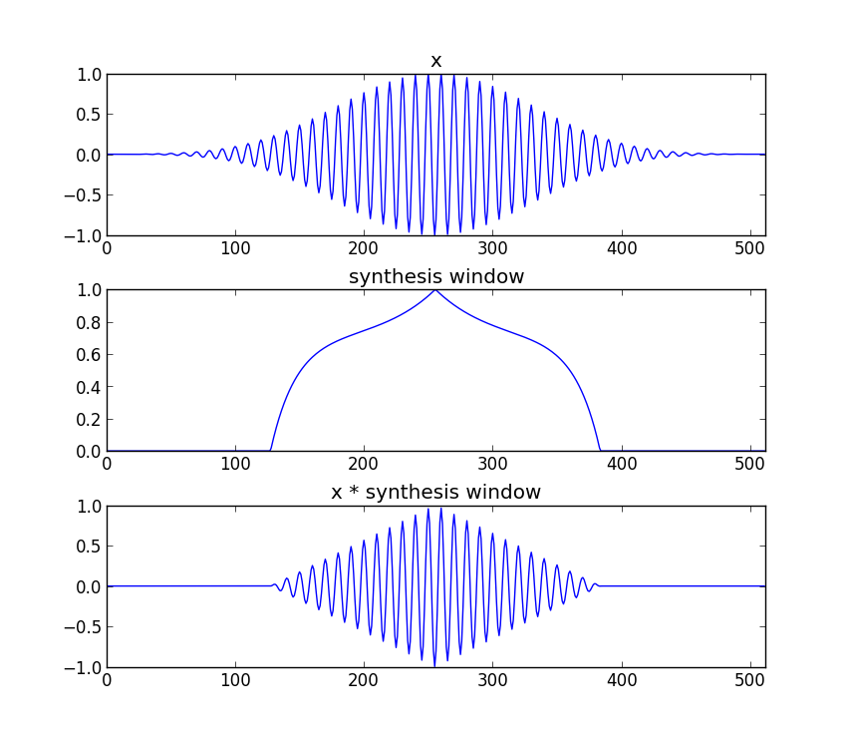
Synthesis window

Slide 15
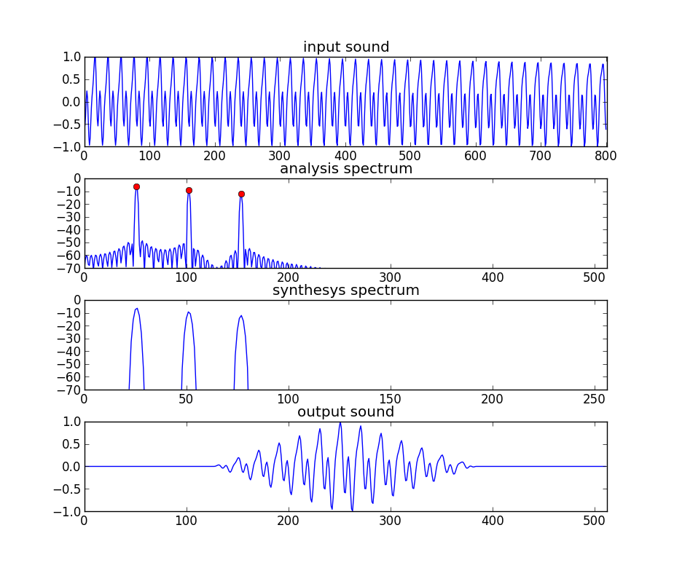
Analysis / Synthesis
M = 801
window = hamming(M)
N = 1024
t = -40
fr = 100.2, 200.3, 300.2
Ar = .99, .7, .5
fs = 2000
Ns = 512

Slide 16
System diagram
Analysis
Synthesis
w[n]
|X[k]|
Peak detection
A_{r}
Sine spectral
synthesis
x[n]
FFT
f_{r}
xw[n]
<X[k]
p_{r}
Y[k]
IFFT
yw[n]
Overlap-add
y[n]

Slide 17
References
https://ccrma.stanford.edu/~jos/sasp/Spectrum_Analysis_Sinusoids.html
http://en.wikipedia.org/wiki/Additive_synthesis

Slide 18
Credits
All the slides of this presentation are released under an Attribution-Noncommercial-Share Alike license.

