Slide 1
Sinusoidal plus Residual Modeling
(2 of 2)
Xavier Serra
Music Technology Group
Universitat Pompeu Fabra, Barcelona
http://mtg.upf.edu

Slide 2
Index
Sinusoidal plus residual model
Stochastic approximation of residual
Sinusoidal plus stochastic model
Harmonic plus Stochastic system diagram

Slide 3
Sinusoidal plus residual model
when yr[n] is an stochastic signal, it can be modeled as filtered white noise:
otherwise:

Slide 4
Stochastic model
Spectral view:

Slide 5
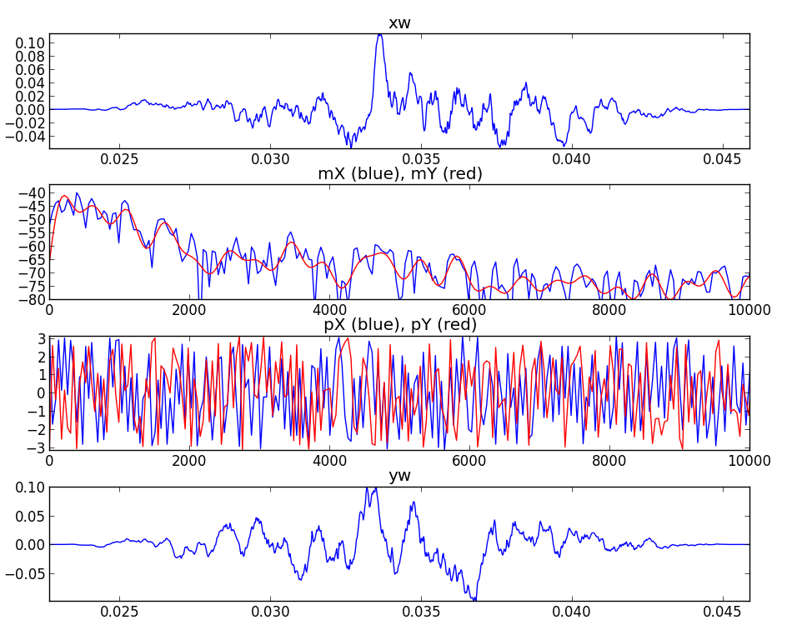

Slide 6
Filter approximation
LPC model:
The error is minimized by minimizing the mean of the total squared error with
respect to each of the parameters.

Slide 7


Stochastic synthesis using filters
Noise generation:
  Algorithms for random number generation
  White noise, other types of noises
  Gaussian noise
direct form
structure
lattice
structure

Slide 8
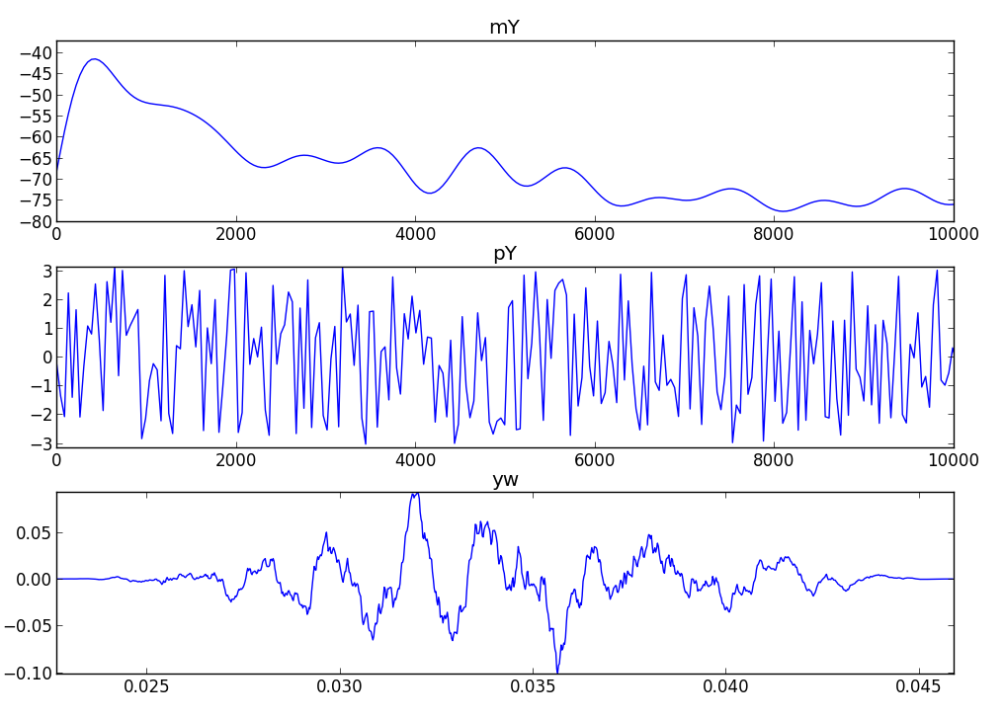
Stochastic synthesis using IFFT

Slide 9
Sinusoidal plus Stochastic model
Spectral view:

Slide 10
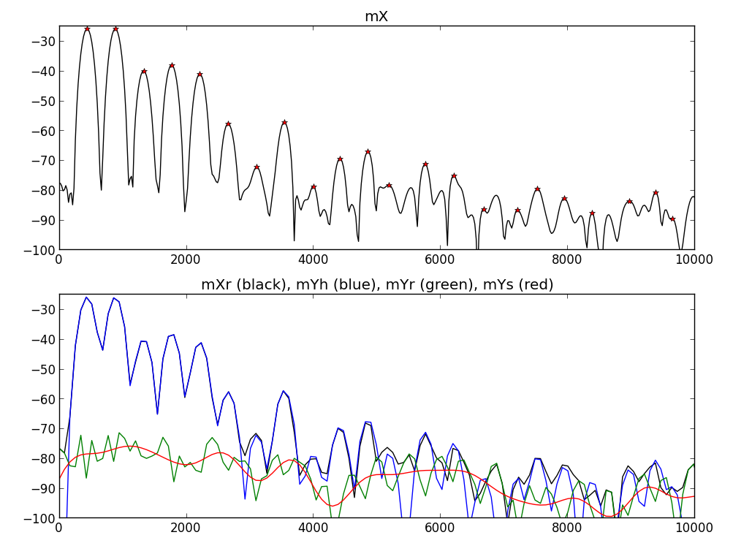

Slide 11
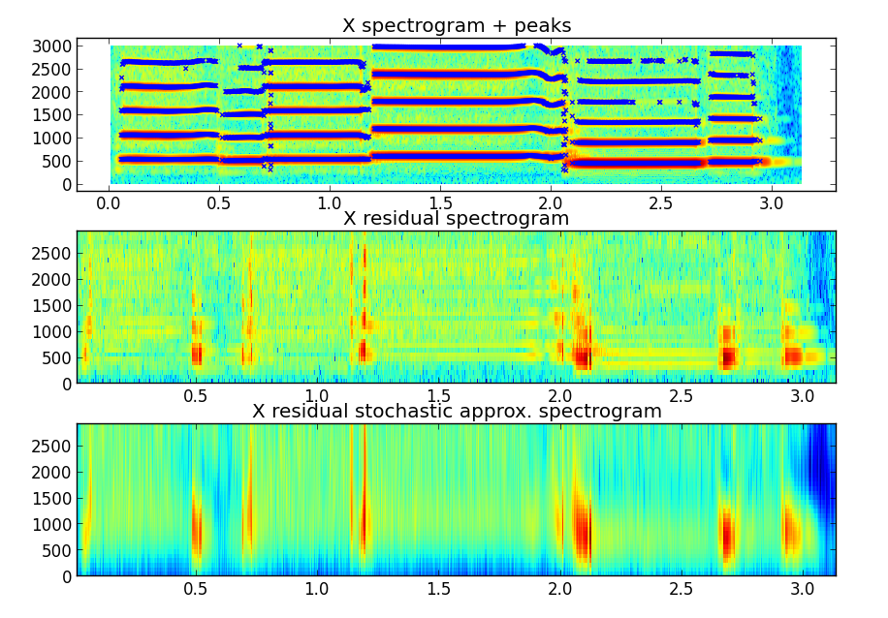

Slide 12
Implementation: HpS model
wh[n]
x[n]
|X[k]|
A_{r}
f_{r}
p_{r}
X
FFT
Peak detection
F0
detection
xwh[n]
<X[k]
f₀
A_{h}
f_{h}
p_{h}
wr[n]
Sine spectral
synthesis
X[k]
-
Yh[k]
X
FFT
+
xwr[n]
Yr[k]
Stochastic approximation
|Ys[k]|
Random phase generation
<Ys[k]
Ys[k]
Stochastic spec. synthesis
+
Y[k]
IFFT
yw[n]
Overlap-add
y[n]

Slide 13
References
https://ccrma.stanford.edu/~jos/sasp/Spectrum_Analysis_Sinusoids.html
http://en.wikipedia.org/wiki/Stochastic_process
http://en.wikipedia.org/wiki/Linear_predictive_coding
Sounds: http://www.freesound.org/people/xserra/packs/13038/

Slide 14
Credits
All the slides of this presentation are released under an Attribution-Noncommercial-Share Alike license.

