Slide 1
8T2: Spectral-based sound transformations
(2 of 2)
Xavier Serra
Universitat Pompeu Fabra, Barcelona
&
Stanford University

Slide 2
Index
Harmonic plus residual model
  Frequency transformations
Harmonic plus stochastic model
  Time scaling
  Morphing

Slide 3
Harmonic plus residual model
w[n]
|X[k]|
f_{p}
p_{p}
f₀
x[n]
A_{p}
F0
detection
Harmonic
detection
X
FFT
Peak detection
xw[n]
<X[k]
xw[n]
X[k]
-
f_{h}
A_{h}
p_{h}
X
FFT
+
Yh[k]
Sine spectral
synthesis
f_{h}
A_{h}
w[n]
transformation
f_{h}
A_{h}
p_{h}
Xr[k]
Yh[k]
Sine spectral
synthesis
+
IFFT
yw[n]
Overlap-add
y[n]

Slide 4
Frequency transformations
frequency transposition:
frequency shifting:
frequency stretching:

Slide 5
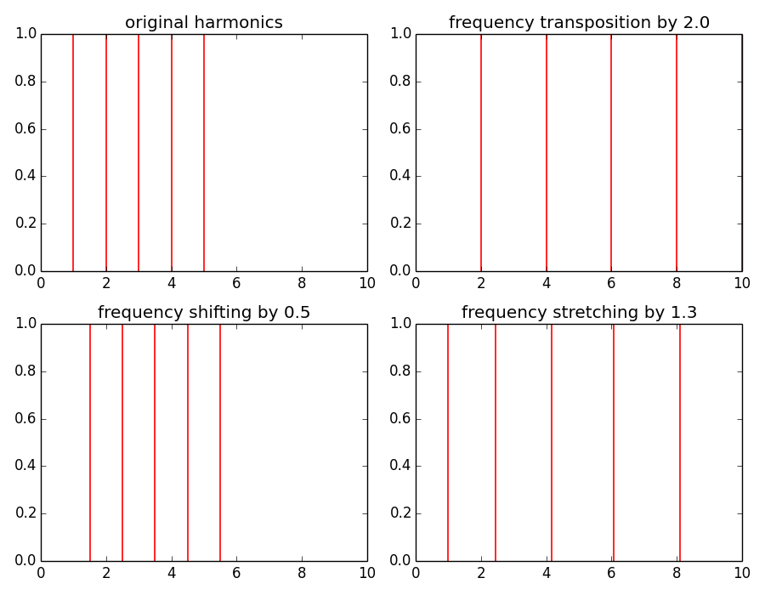

Slide 6
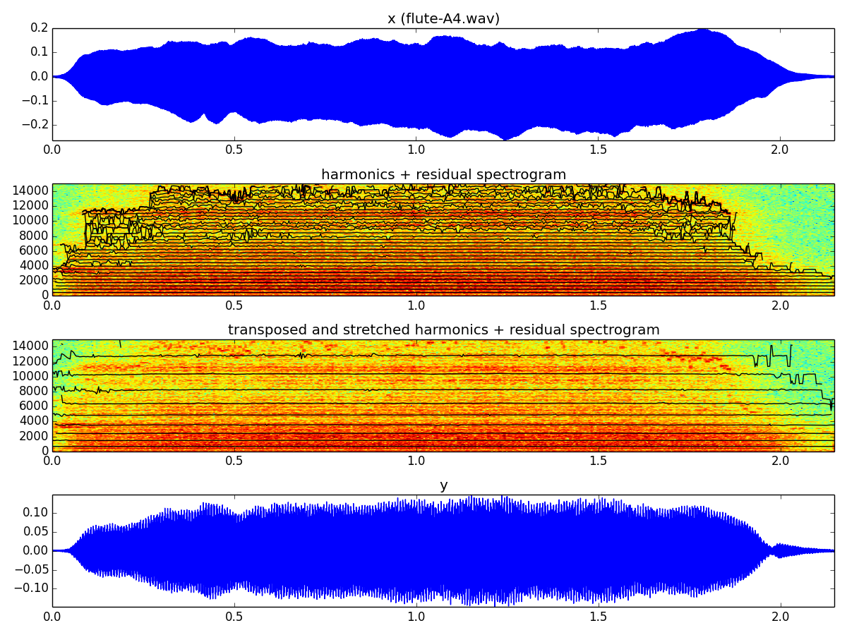

Slide 7
Harmonic plus stochastic model
w[n]
|X[k]|
f_{p}
p_{p}
f₀
x[n]
A_{p}
F0
detection
Harmonic
detection
X
FFT
Peak detection
xw[n]
<X[k]
xw[n]
-
f_{h}
A_{h}
p_{h}
X
FFT
X[k]
Yh[k]
Sine spectral
synthesis
+
Xr[k]
w[n]
Stochastic approximation
f_{h}
A_{h}
|Yst[k]|
transformation
transformation
|Yst[k]|
f_{h}
A_{h}
p_{h}
Random phase generation
Stochastic
spec. synthesis
Sine spectral
synthesis
+
<Yst[k]
Yst[k]
Yh[k]
IFFT
yw[n]
Overlap-add
y[n]

Slide 8
Scaling amplitude, frequency and time

Slide 9
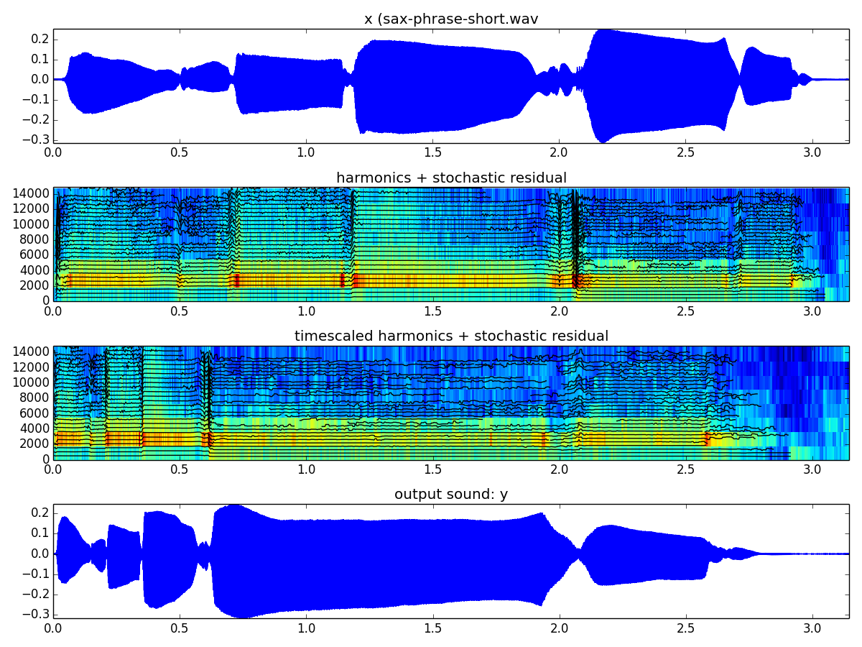

Slide 10
Morphing
f_{h}
A_{h}
f_{h}
A_{h}
HPS analysis
interpolation
HPS analysis
x1[n]
x2[n]
interpolation
|Yst[k]|
|Yst[k]|
|Yst[k]|
f_{h}
A_{h}
p_{h}
<Yst[k]
Random phase generation
Stochastic
spec. synthesis
+
Sine spectral
synthesis
Yst[k]
Yh[k]
IFFT
yw[n]
Overlap-add
y[n]

Slide 11
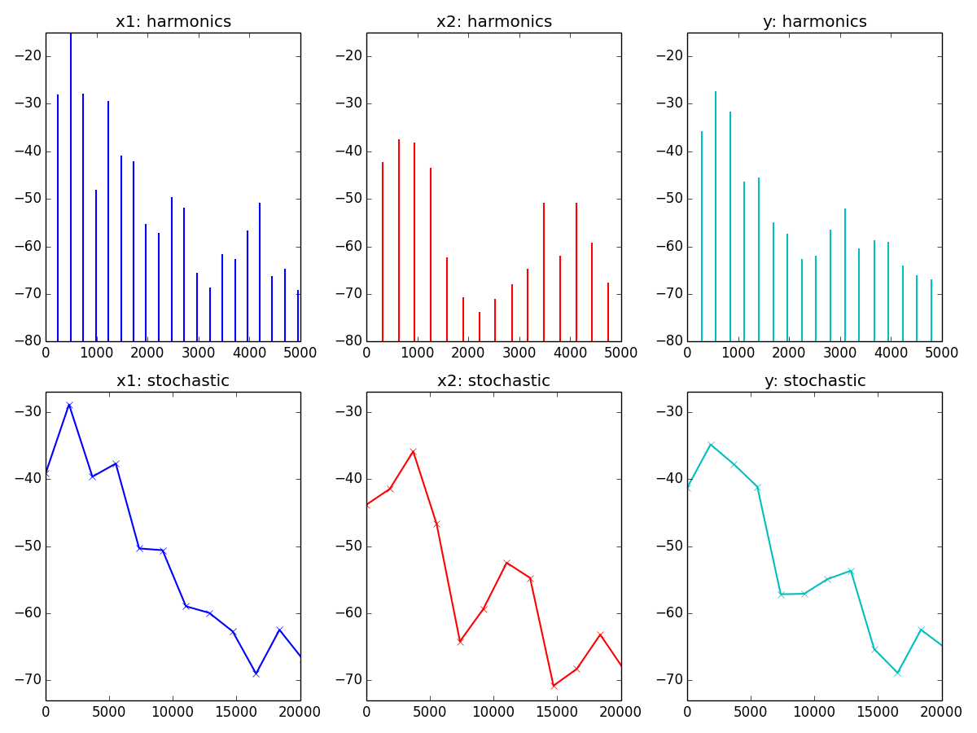

Slide 12
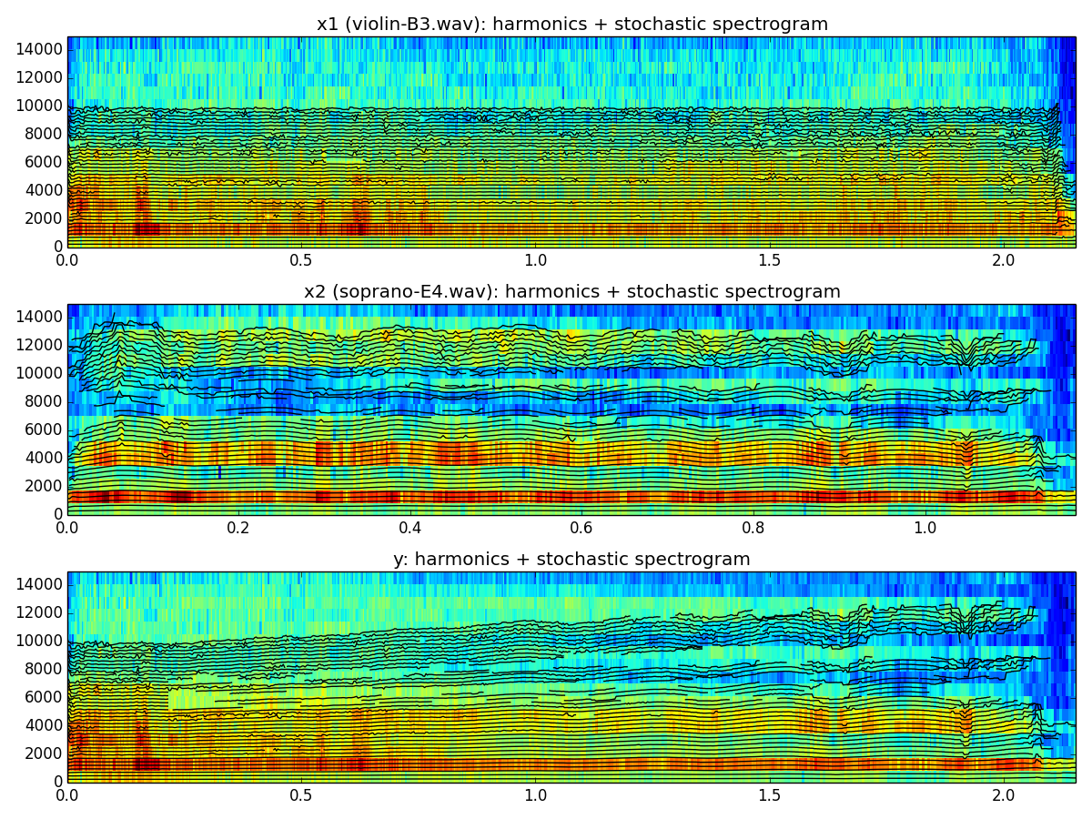

Slide 13
References
More information on this topic from Wikipedia:
  http://en.wikipedia.org/wiki/Sound_effects
  http://en.wikipedia.org/wiki/Audio_timescale-pitch_modification
Sounds: http://www.freesound.org/people/xserra/packs/13038/
The slides and code are released using the CC Attribution-Noncommercial-Share Alike license or the Affero GPL license and available from https://github.com/MTG/sms-tools

Slide 14
8T2: Spectral-based sound transformations
(2 of 2)
Xavier Serra
Universitat Pompeu Fabra, Barcelona
&
Stanford University

