Slide 1
9T1: Spectral-based audio features
Xavier Serra
Universitat Pompeu Fabra, Barcelona
&
Stanford University
Notes:
Welcome back ...
Last week we discussed some applications of the spectral modeling techniques that we have been presenting in the course, applications that were related with sound transformations.
This week we will cover another type of applications, the ones related with the description of sounds.
In this lecture we will start by talking about spectral-based audio features.

Slide 2
Index
Introduction: audio features
Single-frame spectral features
Multiple-frames spectral features
Notes:
We will start by presenting what we understand for audio features, ..

Slide 3
Audio features
w[n]
|X[k]|
x[n]
FFT
Feature analysis
Audio
features
xw[n]
<X[k]
Notes:
This is a generic block diagram of the extraction process of audio features based on spectral analysis.

Slide 4
Essentia descriptors
Spectral descriptors: BarkBands, MelBands, ERBBands, MFCC, GFCC, LPC, HFC, SpectralContrast, Inharmonicity and Dissonance, ...
Time-domain descriptors: EffectiveDuration, ZCR, Loudness, ...
Tonal descriptors: PitchSalienceFunction, PitchYinFFT, HPCP, TuningFrequency, Key, ChordsDetection, ...
Rhythm descriptors: BeatTrackerDegara, BeatTrackerMultiFeature, BpMHistogramDescriptors, NoveltyCurve, OnsetDetection, Onsets, ...
SFX descriptors: LogAttackTime, MaxToTotal, MinToTotal, TCToTotal,...
High-level descriptors: Danceability, DynamicComplexity, FadeDetection, SBic, ...
Notes:
There are many types of features that can be extracted from audio signals and many algorithms implementing their extraction. In this class we will use Essentia as the software tool to extract the audio features.
Essentia is an open-source library for audio analysis, developed and being maintained at the Music Technology Group in Barcelona, that contains algorithms for a large set of music descriptors.
In the programming lectures we will explain how to use Essentia and you will have the opportunity to learn how to use it.
Here we will just present some of the most common descriptors.

Slide 5
Single-frame spectral features
Energy, RMS, Loudness
Spectral centroid
Mel-frequency cepstral coefficients (MFCC)
Pitch salience
Chroma (Harmonic pitch class profile, HPCP)
Notes:
Most of the features, or descriptors, are computed one frame at at time. Let me now discuss in a little details a few of them.
...

Slide 6
Energy, RMS, Loudness
Energy:
Root mean square:
Steven's power law:
Notes:
The energy of an audio frame can be computed from the magnitude spectrum by summing over the square of the magnitudes.
The RMS, or root mean square, is the square root of the arithmetic mean of the energy.
Steven's power law is a proposed relationship between the energy and its perceived intensity. This is done by using the sound pressure level of a 3000 Hz tone as a way to perform a perceptual normalization. It is a very simple measure of loudness.

Slide 7
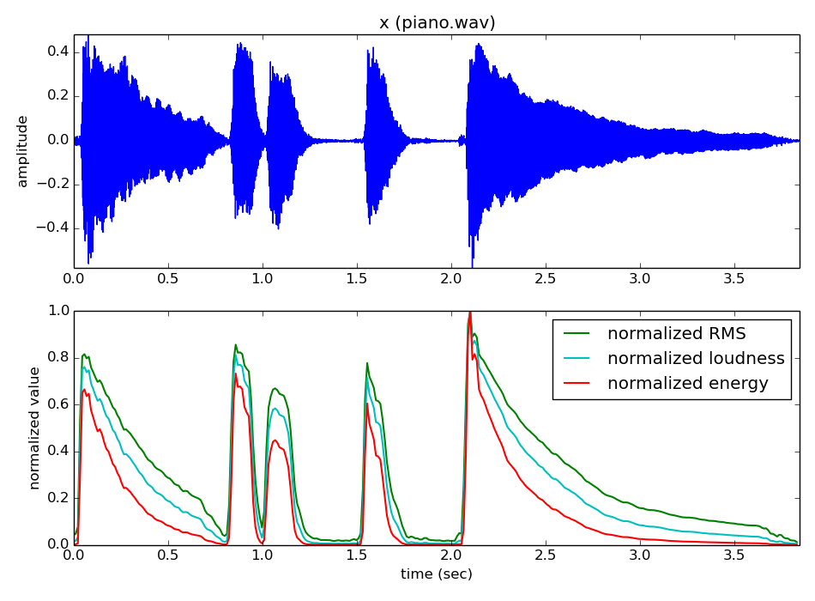
Notes:
Here we see the three energy related measures of our piano sound.

Slide 8
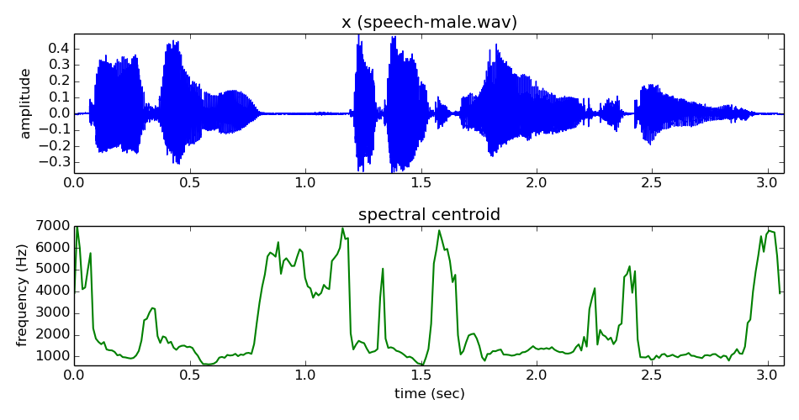
Spectral centroid
Notes:
The spectral centroid indicates where the "center of mass" of the spectrum is. Perceptually, it is very much related with the impression of "brightness" of a sound.
It is calculated as the weighted mean of the frequencies present in the signal.

Slide 9
Mel frequency cepstral coefficients
H_i[k]
Log_10
DCT
mfcc
Notes:
The mel frequency cepstral coeficients is a representation of the magnitude spectrum. It is computed by taking the cosine transform of the log magnitude spectrum on a nonlinear mel scale of frequency.

Slide 10
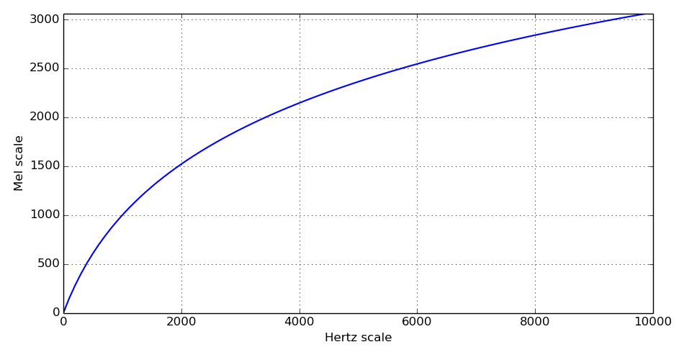
MFCC: Mel scale
Notes:
The mel scale approximates the frequency resolution of the auditory system. It relates the perceived frequency, or pitch, of a pure tone to its actual measured frequency. We, humans, are much better at discerning small changes in pitch at low frequencies than at high frequencies. Incorporating this scale makes the spectral features match more closely what humans hear.

Slide 11
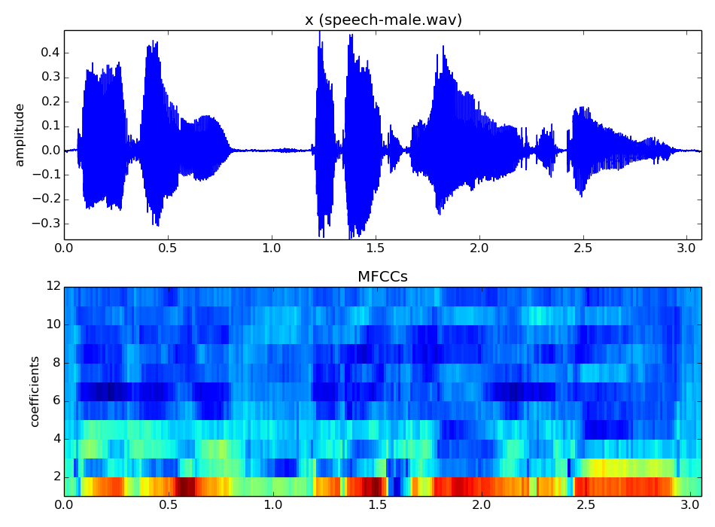
Notes:
This is a visualization of the mfcc analysis of a speech sound.
The resulting representation is not so intuitive, given that every coefficient represents a different level of abstraction of the spectral shape of the sound.
The mfcc features are extensively used in speech recognitions tasks and they have been adapted to music analysis.

Slide 12
Pitch salience
Peak detection
Pitch salience
Notes:
Pitch salience is a measure of the presence of pitched sounds in a signal.
This particular implementation of pitch salience start from the spectral peaks. From them it computes the salience of all possible pitches present. It does it by summing the weighted energies found at integer multiples (harmonics) of every peak frequency.

Slide 13
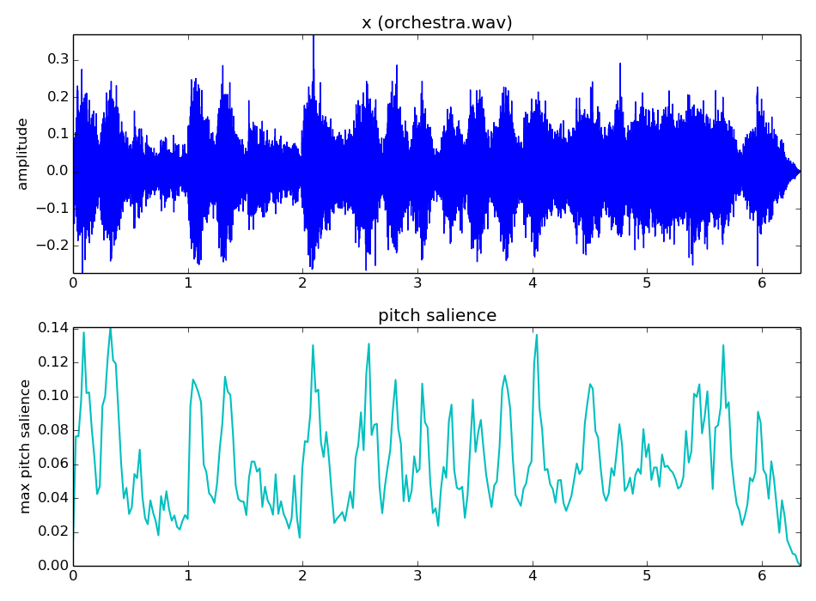
Notes:
Here we show the maximum pitch salience at every frame.
In this orchestral sound we have many overlapped pitched sounds.

Slide 14
Chroma (Harmonic Pitch Class Profile)
Peak
detection
HPCP
computation
Notes:
Chroma, in music perception, is a concept that represents the inherent circularity of pitch organization, same pitched notes in different octaves have the same chroma.
When we talk about pitch classes we refer to all the pitches that have the same chroma.
The HPCP, the harmonic pitch class profile,is a particular implementation of chroma features. It is a distribution of the signal’s energy across a predefined set of pitch classes.

Slide 15
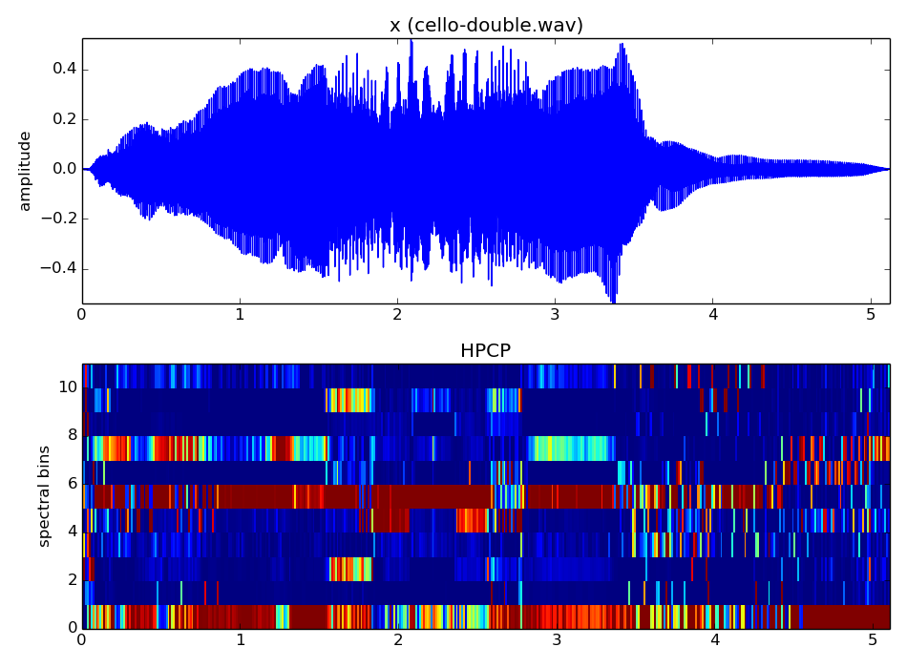
Notes:
This is an example of analyzing a sound with the HPCP implementation available in Essentia.

Slide 16
Multiple-frames spectral features
Event segmentation, onsets
Predominant pitch
Statistics of single-frame features
Notes:
Many audio characteristics are better described by taking multiple frames. So let me give you some examples of that.

Slide 17
Event segmentation, onsets
Spectral flux (used in segmentation)
Onset detection based on high-frequency content
Notes:
Spectral flux measures the change in magnitude in each frequency bin. There are many different implementations.

Slide 18
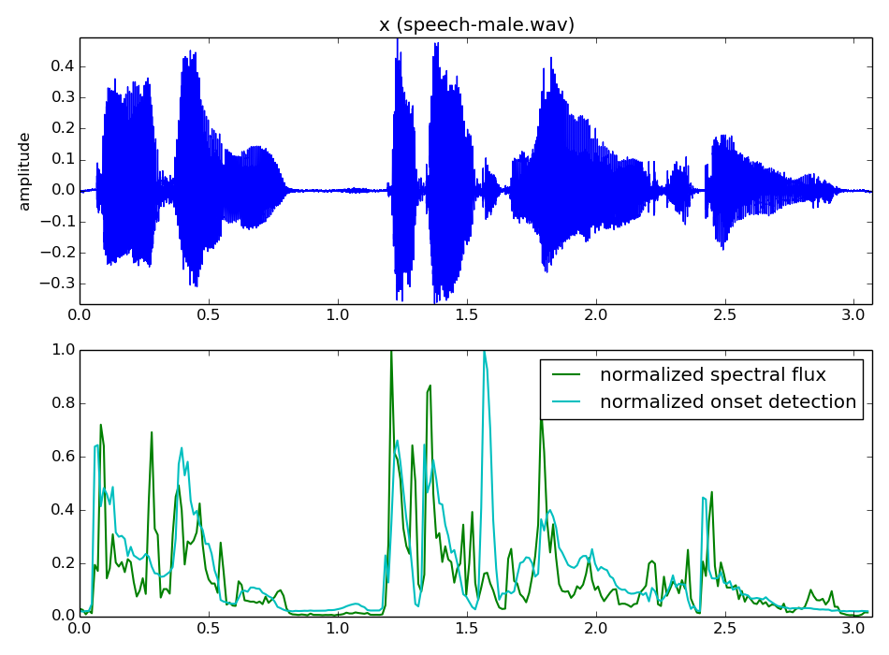
Notes:
This is one example result of this analysis.

Slide 19
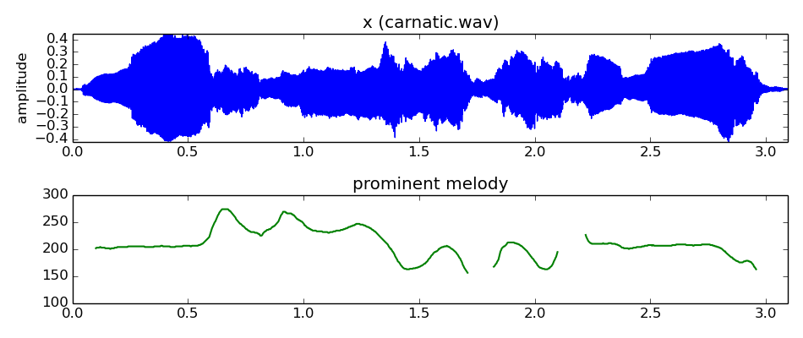
Predominant pitch
Peak detection
Pitch salience
Pitch contour
creation
Melody selection
F0 sequence
Notes:
The predominant pitch of a complex sound requires to analyze several frames of the sound. We introduced this when we talked about fundamental frequency detection in week 6.

Slide 20
Statistics of single frame features
Arithmetic mean (first moment)
Variance (second moment)
Skewness (third moment)
Notes:
Most frame-based audio features can be agregated over a complete recording or over a segment by computing their statistics.

Slide 21
References
Essentia: http://essentia.upf.edu
http://en.wikipedia.org/wiki/Spectral_centroid
http://en.wikipedia.org/wiki/Mel-frequency_cepstrum
http://en.wikipedia.org/wiki/Loudness
http://en.wikipedia.org/wiki/Harmonic_pitch_class_profiles
http://en.wikipedia.org/wiki/Onset_(audio)
http://en.wikipedia.org/wiki/Moment_(mathematics)
Slides and code released using the CC Attribution-Noncommercial-Share Alike license or the Affero GPL license and available from https://github.com/MTG/sms-tools
Notes:
There are a lot of references on the topics we covered in this lecture.

Slide 22
9T1: Spectral-based audio features
Xavier Serra
Universitat Pompeu Fabra, Barcelona
&
Stanford University
Notes:
This is all for this lecture.
We introduced the application of sound and music description by discussing several audio features that can be extracted for audio signals and that can be used to characterize sounds.
In the next lecture we will continue on this topic by extending the idea of characterizing a sound to the idea of characterizing collections of sounds.

