Slide 1
Sound/music description
Xavier Serra
Universitat Pompeu Fabra, Barcelona
&
Stanford University

Slide 2
Index
Introduction: information plane
Description of sounds
Description of sound collections
Description of music recordings
Description of music collections

Slide 3
Introduction: Information plane

Slide 4
Description of sounds
Timbre/texture
Dynamics
Pitch/Pitchness
Morphology

Slide 5
Description of sound collections
Similarity
Classification
Clustering

Slide 6
Facets of music content
Timbre
Melody /
Harmony
Music Content
Analysis
Rhythm
Structure

Slide 7
Description of music recordings
Timbre/texture
Pitch histogram
Beat histogram
Tonal description (key)
Rhythm description
Structure analysis

Slide 8
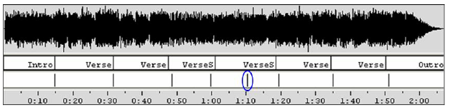
Structure description
Partitioning the sound stream into homogeneous regions
Detecting special roles for the segmented regions: intro, verse, chorus, bridge,
Other segments can also be identified: instrumental / singing; solo / ensemble; chords…

Slide 9
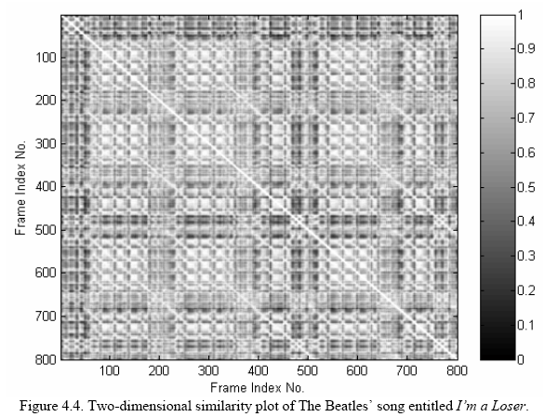
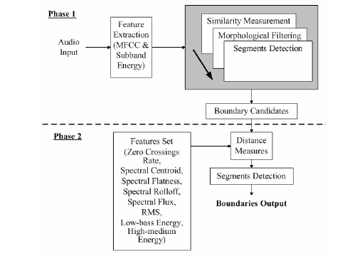
Structure description
(Ong, 2006)

Slide 10
Tonal description
Extract:
  Melody (predominant melody or score)
  Harmony (chords)
  Key, modulations
Much research is related to automatic transcription of music (Klapuri PhD 2004)
  Fundamental frequency / Multipitch estimation (de Cheveigné)
  Melody extraction (Predominant pitch, note segmentation)
  Still unsolved, even for monophonic signals.
Pitch class distribution of a piece
Mid and high level features -> apply a tonal model / musical analysis (Krumhansl, Leman, Temperley, ….)

Slide 11
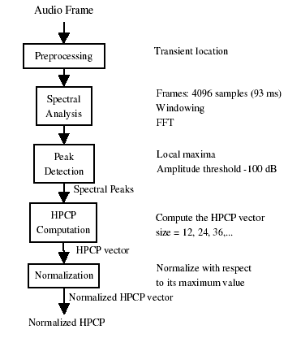
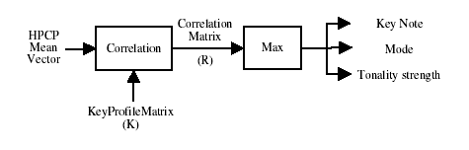
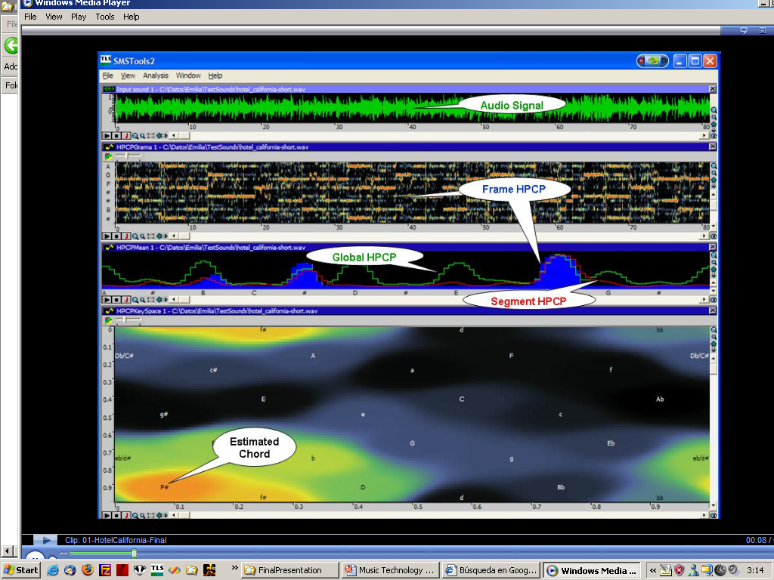
Tonal description

Slide 12
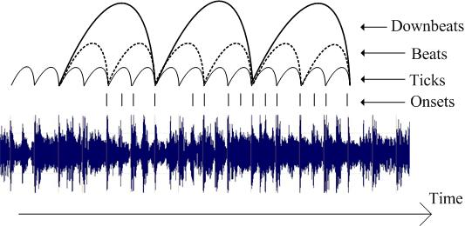
Rhythm description
Extraction of the metrical structure of a piece
(Gouyon, 2005)

Slide 13
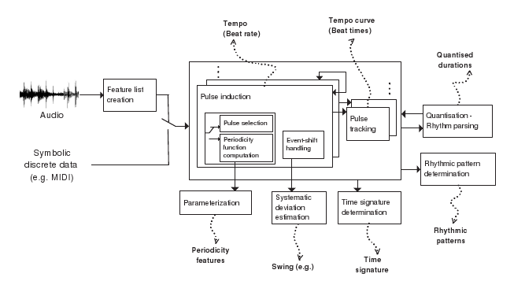
Rhythm description
(Gouyon, 2005)

Slide 14
Description of music collections

Slide 15
References and credits
http://en.wikipedia.org/wiki/Music_information_retrieval
All slides and code produced for this course are released using the CC Attribution-Noncommercial-Share Alike license or the Affero GPL license and available from https://github.com/MTG/sms-tools

