Slide 1
Spectral based sound description
Xavier Serra
Music Technology Group
Universitat Pompeu Fabra, Barcelona
http://mtg.upf.edu

Slide 2
Index
Sinusoidal plus residual model features
Spectral-based features in Essentia
Features for sound/music description
Features for instrument modeling
Music description

Slide 3
Sinusoidal+residual model features
Instantaneous frequency and amplitude of partials
Instantaneous spectrum of residual
Instantaneous fundamental frequency
Amplitude and spectral shape of sinusoidal component
Amplitude and spectral shape of residual

Slide 4
Essentia functionality
Essentia
audio file i/o; standard DSP building blocks; filters
Descriptors such as
  spectral: spectral shape, MFCC, Bark/Mel bands
  time-domain/rhythmic: loudness, dynamics, onsets, beats, beats per minute, danceability
  tonal: melody, pitch, chroma, key, scale, chords
  high-level: segmentation, genres, mood (happy/sad), instrumentation (acoustic, electronic, timbre dark/bright, voice male/female)

Slide 5
Spectral features in Essentia
BarkBands: computes the Bark band energies.
MelBands: computes the Mel band energies.
ERBBands: computes the energies in bands spaced on an Equivalent Rectangular Bandwidth scale.
MFCC: computes the Mel-frequency cepstral coefficients of a frame.
GFCC: computes the gammatone feature cepstrum coefficients similar to MFCCs.
LPC: computes the Linear Predictive Coding coefficients of a frame as well as the associated reflection coefficients.
HFC: computes the High-Frequency Content measure.
SpectralContrast: computes spectral contrast of a spectrum.
Inharmonicity and Dissonance: both try to estimate whether an audio frame “sounds” harmonic or not.
SpectralWhitening: whitens the input spectrum.
Panning: computes the panorama distribution of a stereo audio frame.

Slide 6
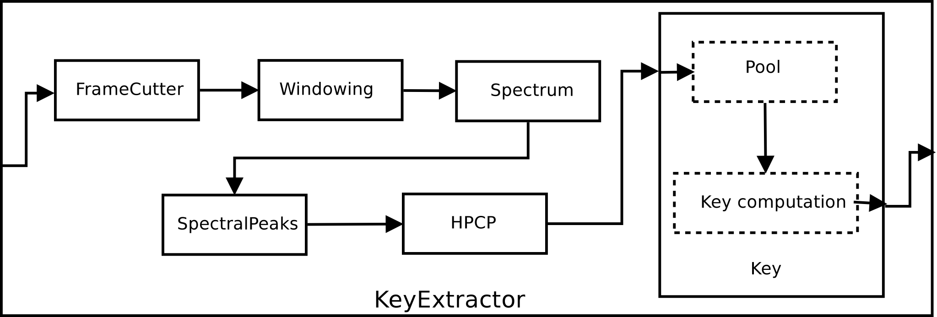
Essentia extractors
Extractors
Executable extractors built by combining algorithms in a “data-flow” manner

Slide 7
import essentia
from essentia.standard import *
from pylab import *
loader = essentia.standard.MonoLoader(filename = 'oboe.wav')
audio = loader()
w = Windowing(type = 'hann')
spectrum = Spectrum()
mfcc = MFCC()
pool = essentia.Pool()
for frame in FrameGenerator(audio, frameSize = 1024, hopSize = 512):
mfcc_bands, mfcc_coeffs = mfcc(spectrum(w(frame)))
pool.add('lowlevel.mfcc', mfcc_coeffs)
pool.add('lowlevel.mfcc_bands', mfcc_bands)
output = YamlOutput(filename = 'mfcc.sig')
output(pool)

Slide 8
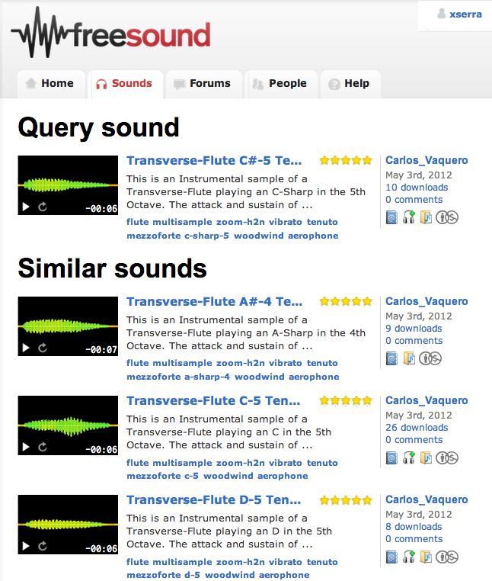
Sound similarity

Slide 9
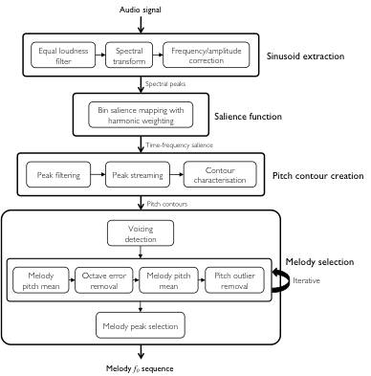
Prominent pitch detection
(Salamon, 2013)

Slide 10
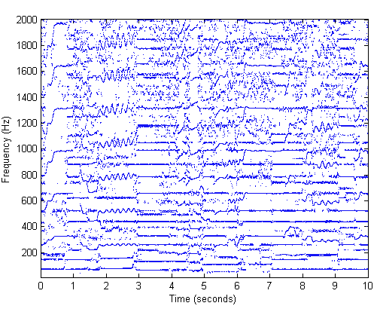
Peak tracking in polyphonic signals

Slide 11
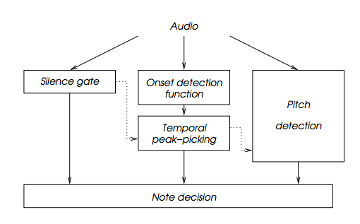
Onset detection

Slide 12
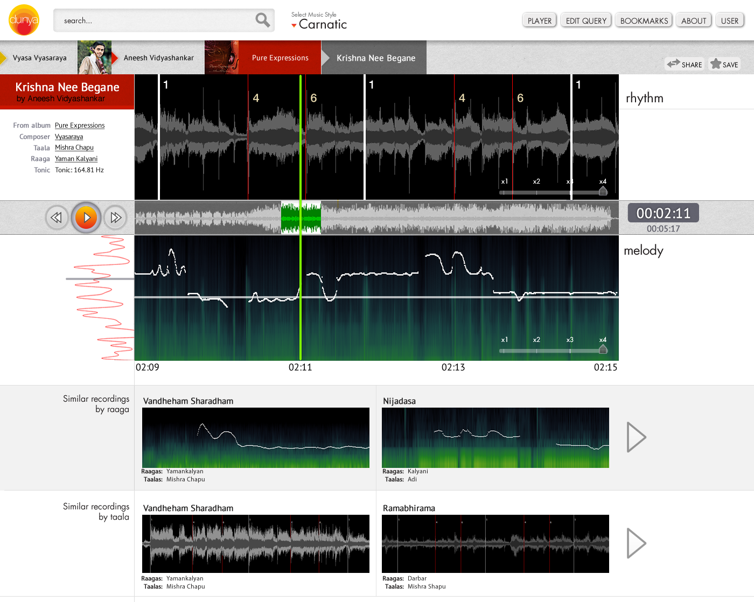
dunya.compmusic.upf.edu
  CompMusic EU project
Notes:
Music browser developed within CompMusic EU project focused on computational analysis of music. Suited for musicologists.

Slide 13
Instrument model
Spectral Shape Models (formants, average shape, ...)
Phase Models (constant, formant-based, ...)
Frequency Models (harmonic model, piano model)
Vibrato Models
Articulation Models (frequency, amplitude functions)
Residual Models
Brightness-Loudness model (amplitude versus spectral tilt)

Slide 14
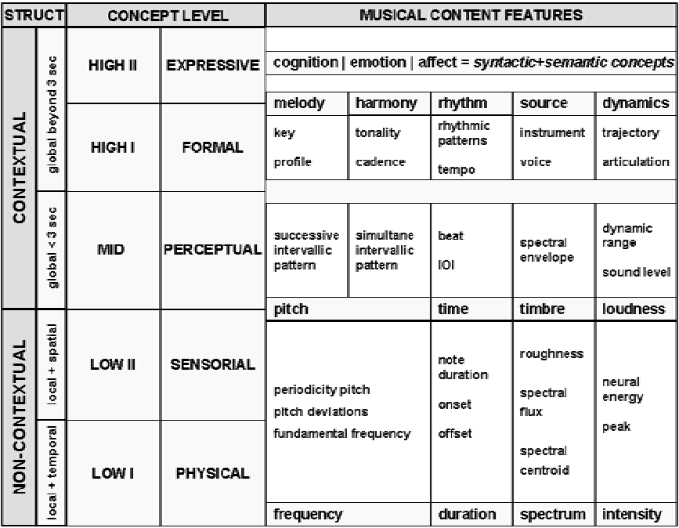
Taxonomy of musical features
Lesaffre et alt.,
2003

Slide 15
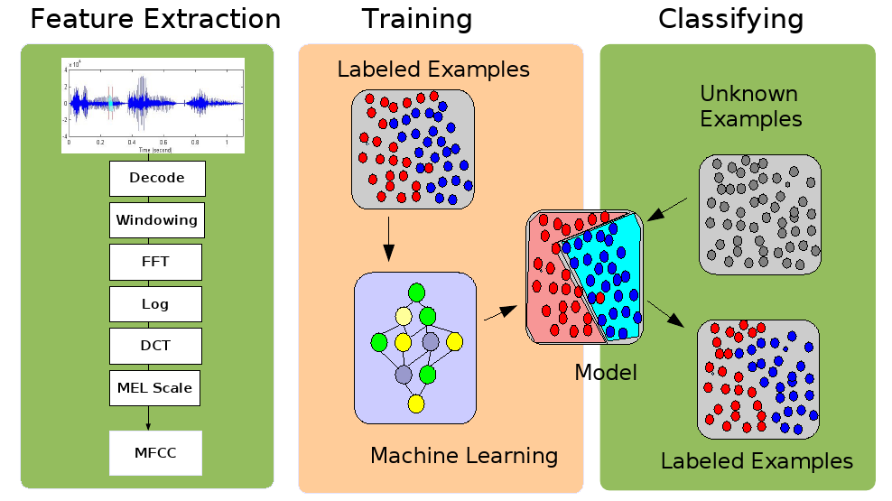
Audio content classification

Slide 16
Levels of description
Low-level (signal-centered) descriptors: computed from the audio signal in a direct or derived (ex: spectral analysis) way: average energy, spectral centroid, MFCCs ….
Mid-level (object-centered) descriptors: requiring an induction operation or data modeling: key, genre, instrument …
High-level (user-centered) descriptors: requiring a user model: mood (ex: happy, sad), …

Slide 17
Facets of music content
Timbre
Melody /
Harmony
Music Content
Analysis
Rhythm
Structure

Slide 18
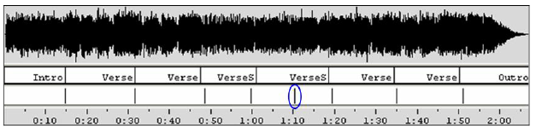
Structure description
Partitioning the sound stream into homogeneous regions
Detecting special roles for the segmented regions: intro, verse, chorus, bridge,
Other segments can also be identified: instrumental / singing; solo / ensemble; chords…
(Ong, 2006)

Slide 19
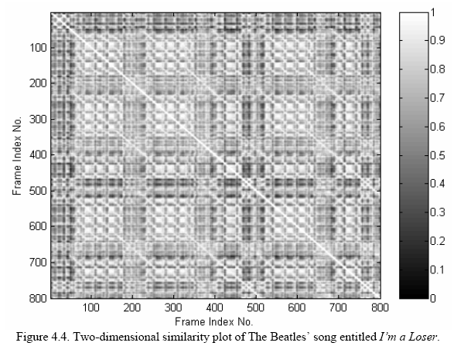
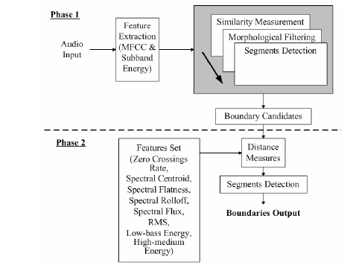
Structure description
(Ong, 2006)

Slide 20
Tonal description
Extract:
  Melody (predominant melody or score)
  Harmony (chords)
  Key, modulations
Much research is related to automatic transcription of music (Klapuri PhD 2004)
  Fundamental frequency / Multipitch estimation (de Cheveigné)
  Melody extraction (Predominant pitch, note segmentation)
  Still unsolved, even for monophonic signals.
Pitch class distribution of a piece
Mid and high level features -> apply a tonal model / musical analysis (Krumhansl, Leman, Temperley, ….)

Slide 21
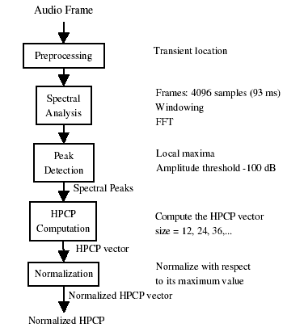
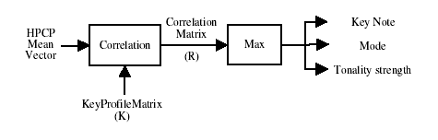
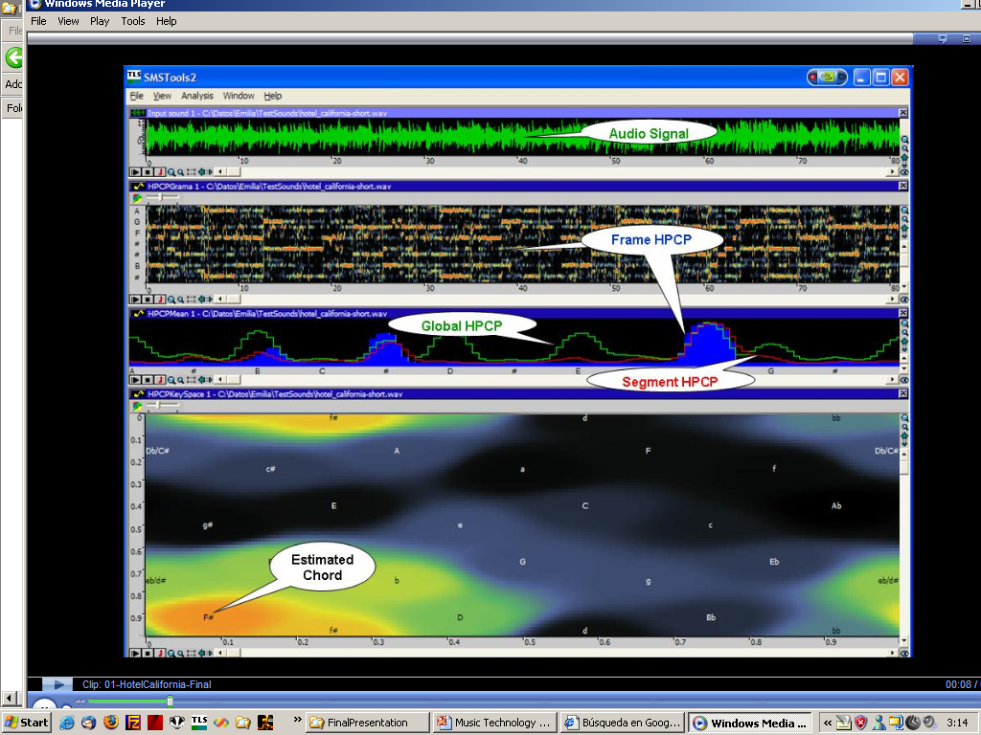
Tonal description

Slide 22
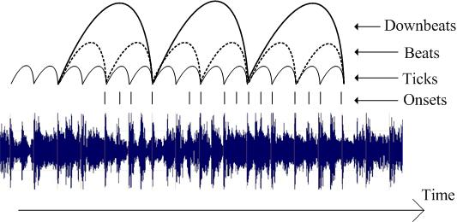
Rhythm description
Extraction of the metrical structure of a piece
(Gouyon, 2005)

Slide 23
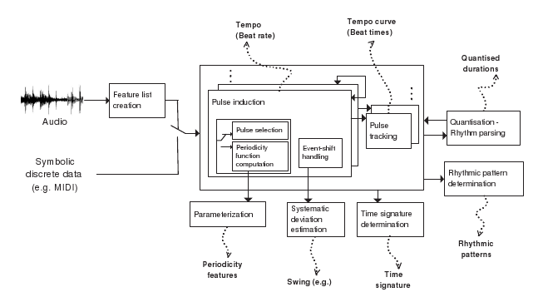
Rhythm description
(Gouyon, 2005)

Slide 24
References
http://essentia.upf.edu
http://en.wikipedia.org/wiki/Music_information_retrieval

Slide 25
Credits
All the slides of this presentation are released under an Attribution-Noncommercial-Share Alike license.

