Slide 1
Fourier Transform theorems and properties
Xavier Serra
Music Technology Group
Universitat Pompeu Fabra, Barcelona
http://mtg.upf.edu

Slide 2
Index
Linearity
Convolution
Shift
Evenness & phase unwrapping
Zero-padding
Power & amplitude in dB
Fast Fourier Transform (FFT)

Slide 3
Linearity

Slide 4
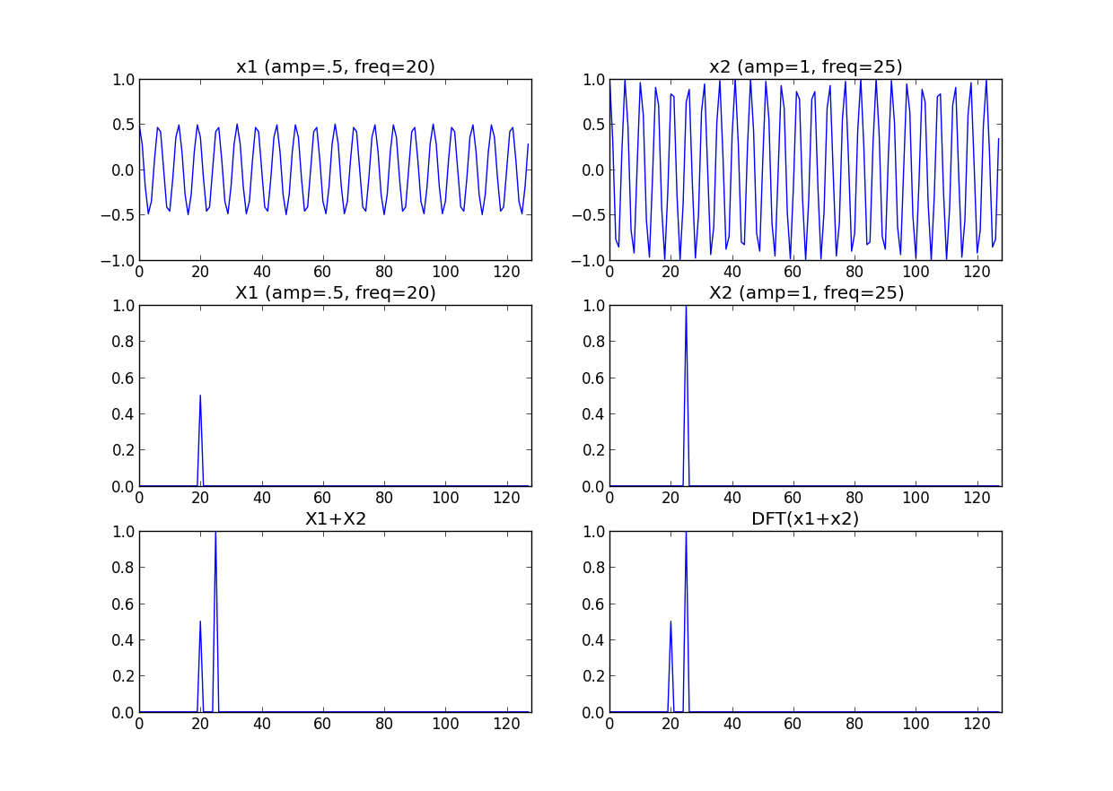

Slide 5
Shift

Slide 6
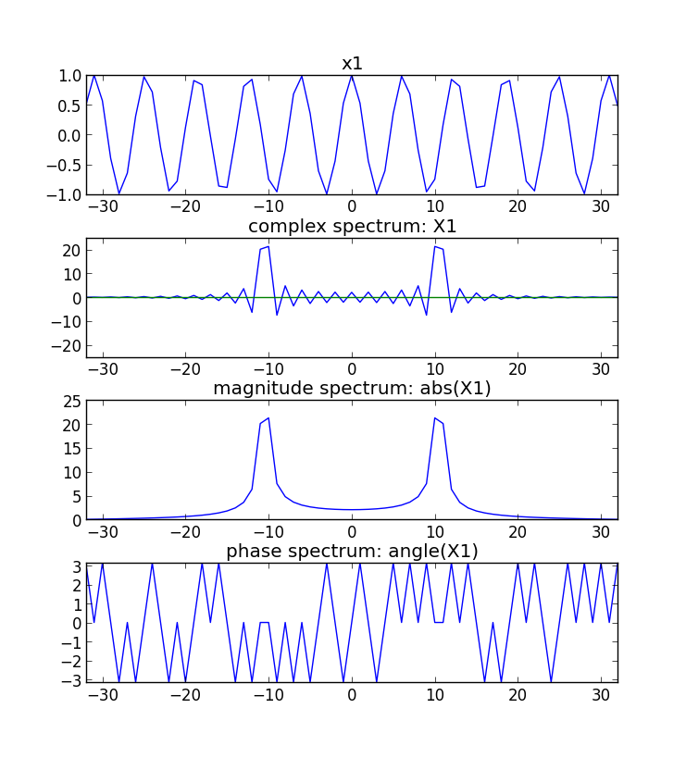
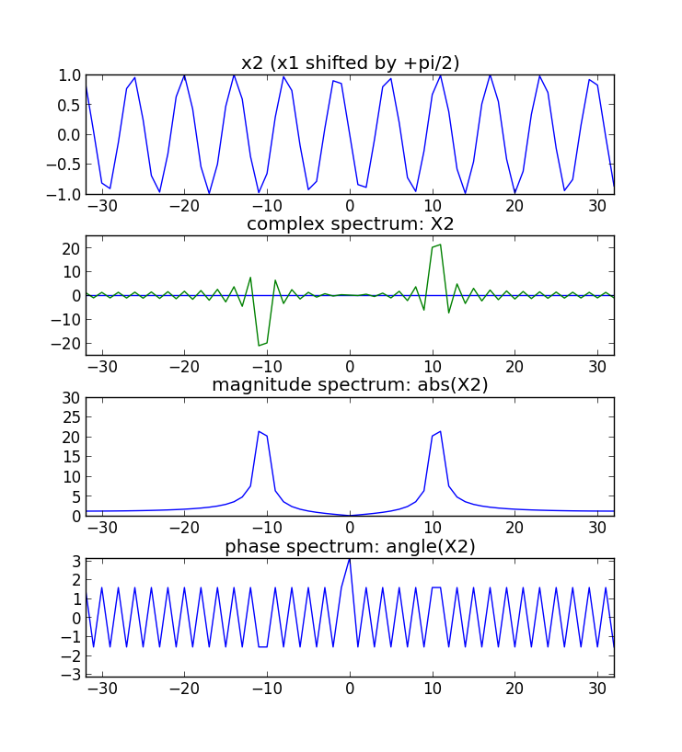

Slide 7
import numpy as np
import matplotlib.pyplot as plt
N = 64
k0 = 10.5
plt.figure(1)
x = np.cos(2*np.pi*k0/(N+1)*np.arange(-N/2, N/2+1))
plt.subplot(411)
plt.plot(np.arange(-N/2, N/2+1), x)
for k in range(-N/2, N/2+1):
s = np.exp(1j*2*np.pi*k/(N+1)*np.arange(-N/2, N/2+1))
X = np.append(X, sum(x*np.conjugate(s)))
plt.subplot(412)
plt.plot(np.arange(-N/2, N/2+1), np.real(X))
plt.plot(np.arange(-N/2, N/2+1), np.imag(X))
plt.subplot(413)
plt.plot(np.arange(-N/2, N/2+1), abs(X))
plt.subplot(414)
plt.plot(np.arange(-N/2, N/2+1), np.angle(X))
plt.figure(2)
x = np.cos(2*np.pi*k0/(N+1)*np.arange(-N/2, N/2+1)+ np.pi/2)
plt.subplot(411)
plt.plot(np.arange(-N/2, N/2+1), x)
for k in range(-N/2, N/2+1):
s = np.exp(1j*2*np.pi*k/(N+1)*np.arange(-N/2, N/2+1))
X = np.append(X, sum(x*np.conjugate(s)))
plt.subplot(412)
plt.plot(np.arange(-N/2, N/2+1), np.real(X))
plt.plot(np.arange(-N/2, N/2+1), np.imag(X))
plt.subplot(413)
plt.plot(np.arange(-N/2, N/2+1), abs(X))
plt.subplot(414)
plt.plot(np.arange(-N/2, N/2+1), np.angle(X))

Slide 8
Evenness

Slide 9
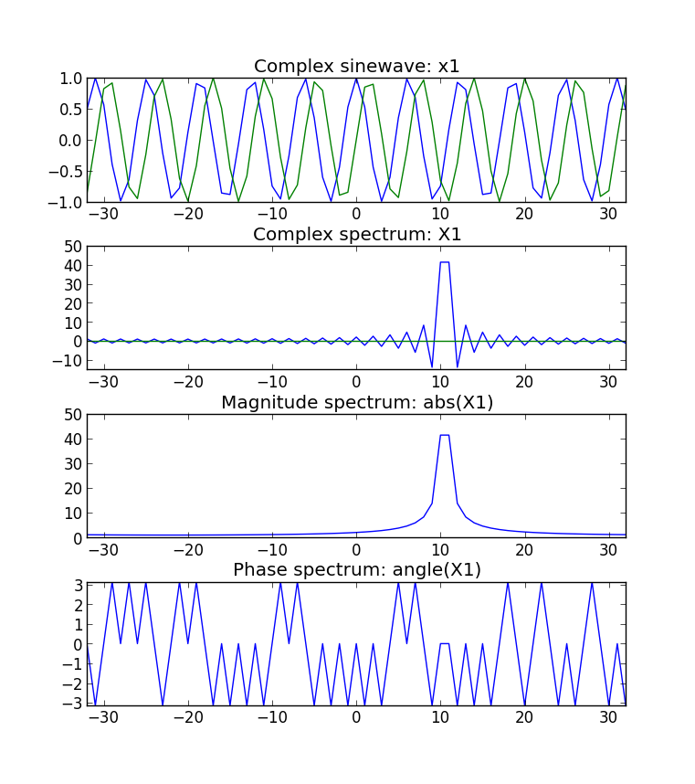
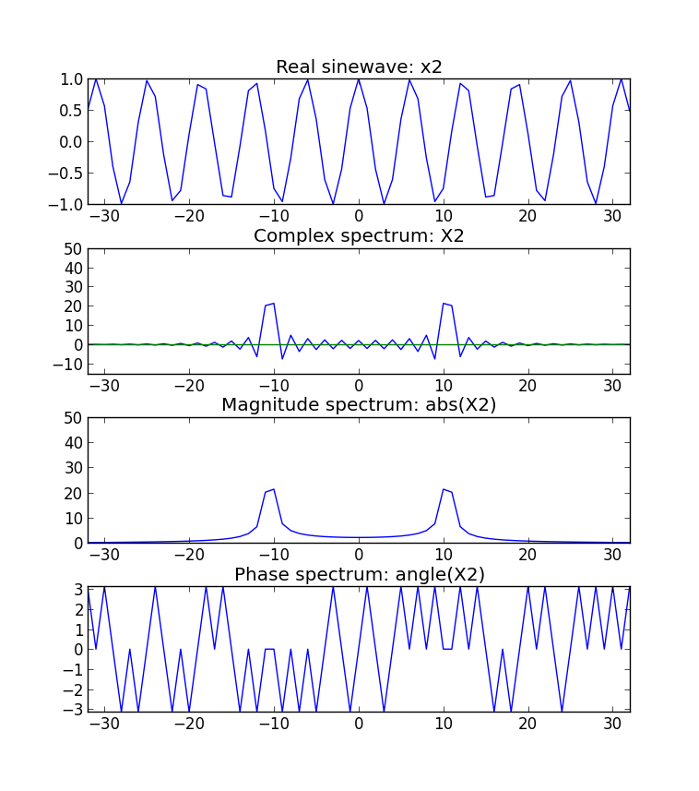

Slide 10
import numpy as np
import matplotlib.pyplot as plt
N = 64
k0 = 10.5
x = np.exp(1j*2*np.pi*k0/(N+1)*np.arange(-N/2, N/2+1))
plt.subplot(411)
plt.plot(np.arange(-N/2, N/2+1), np.real(x))
plt.plot(np.arange(-N/2, N/2+1), np.imag(x))
for k in range(-N/2, N/2+1):
s = np.exp(1j*2*np.pi*k/(N+1)*np.arange(-N/2, N/2+1))
X = np.append(X, sum(x*np.conjugate(s)))
plt.subplot(412)
plt.plot(np.arange(-N/2, N/2+1), np.real(X))
plt.plot(np.arange(-N/2, N/2+1), np.imag(X))
plt.subplot(413)
plt.plot(np.arange(-N/2, N/2+1), abs(X))
plt.subplot(414)
plt.plot(np.arange(-N/2, N/2+1), np.angle(X))
x = np.cos(2*np.pi*k0/(N+1)*np.arange(-N/2, N/2+1))
plt.subplot(411)
plt.plot(np.arange(-N/2, N/2+1), x)
for k in range(-N/2, N/2+1):
s = np.exp(1j*2*np.pi*k/(N+1)*np.arange(-N/2, N/2+1))
X = np.append(X, sum(x*np.conjugate(s)))
plt.subplot(412)
plt.plot(np.arange(-N/2, N/2+1), np.real(X))
plt.plot(np.arange(-N/2, N/2+1), np.imag(X))
plt.subplot(413)
plt.plot(np.arange(-N/2, N/2+1), abs(X))
plt.subplot(414)
plt.plot(np.arange(-N/2, N/2+1), np.angle(X))

Slide 11
Convolution

Slide 12
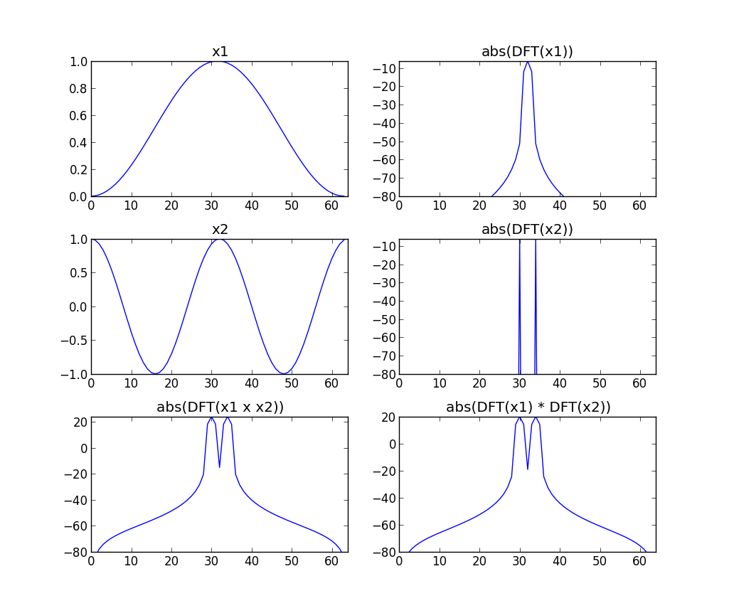

Slide 13
import matplotlib.pyplot as plt
import numpy as np
from scipy.fftpack import fft, fftshift
M = 64
N = 512
x1 = np.hanning(M)
x2 = np.cos(2*np.pi*2/M*np.arange(M))
y1 = x1*x2
mY1 = 20 * np.log10(np.abs(fftshift(fft(y1, M))))
plt.subplot(3,2,1)
plt.plot(x1)
plt.subplot(3,2,3)
plt.plot(x2)
plt.subplot(3,2,5)
plt.plot(mY)
Y2 = np.convolve(fftshift(fft(x1, M)), fftshift(fft(x2, M)))
mY2 = 20 * np.log10(np.abs(Y2))
mX1 = 20 * np.log10(np.abs(fftshift(fft(x1, M)))/M)
mX2 = 20 * np.log10(np.abs(fftshift(fft(x2, M)))/M)
plt.subplot(3,2,2)
plt.plot(mX1)
plt.subplot(3,2,4)
plt.plot(mX2)
plt.subplot(3,2,6)
plt.plot(mY2[M/2:M+M/2])

Slide 14
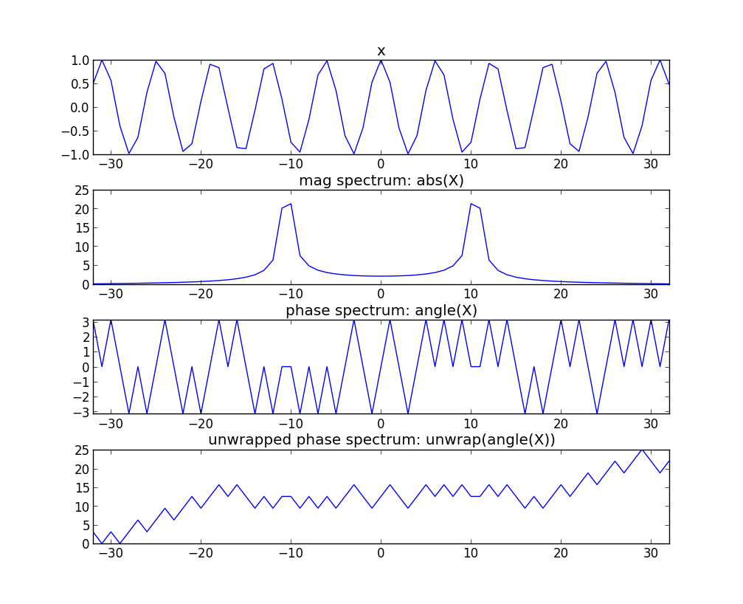
Phase unwrapping

Slide 15
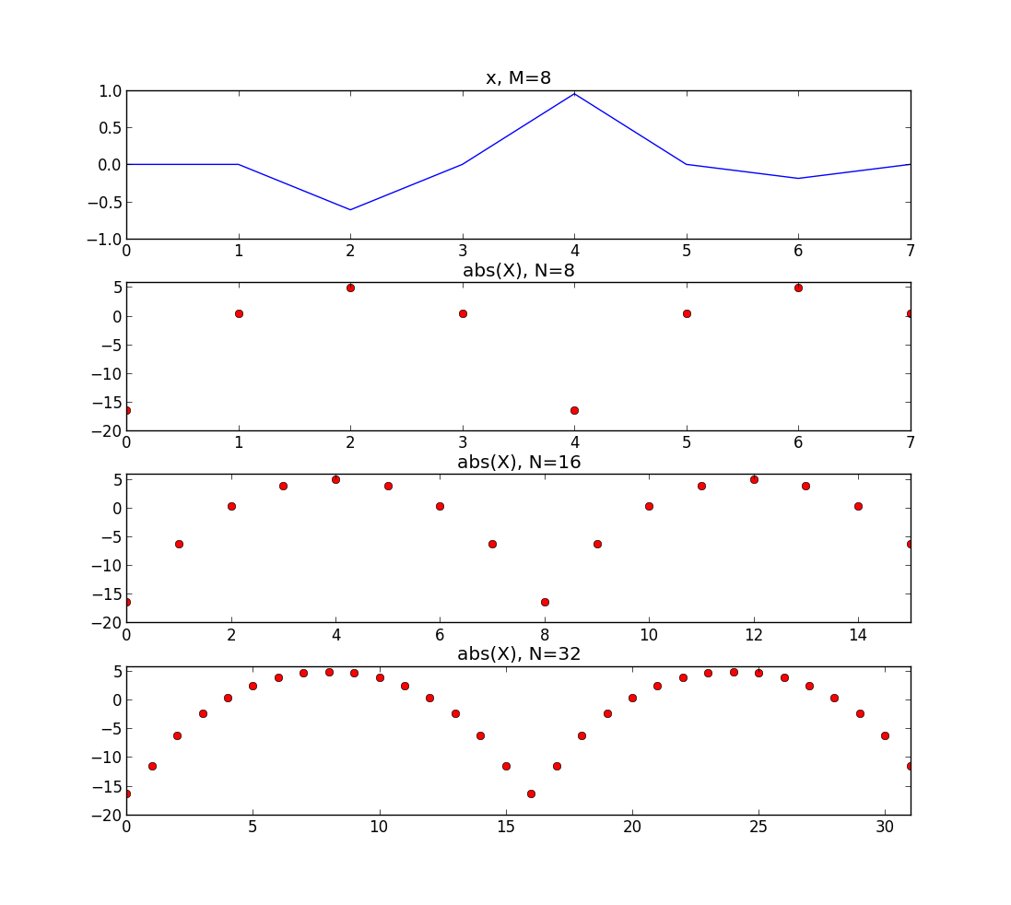
Zero-padding

Slide 16
import numpy as np
import matplotlib.pyplot as plt
from scipy.signal import hamming
from scipy.fftpack import fft, fftshift
M = 8
N1 = 8
N2 = 16
N3 = 32
x = np.cos(2*np.pi*2/M*np.arange(M)) * np.hanning(M)
plt.subplot(4,1,1)
plt.plot(x, 'b')
mX = 20 * np.log10(np.abs(fftshift(fft(x, N1))))
plt.subplot(4,1,2)
plt.plot(mX, 'ro')
mX = 20 * np.log10(np.abs(fftshift(fft(x, N2))))
plt.subplot(4,1,3)
plt.plot(mX, 'ro')
mX = 20 * np.log10(np.abs(fftshift(fft(x, N3))))
plt.subplot(4,1,4)
plt.plot(mX, 'ro')

Slide 17
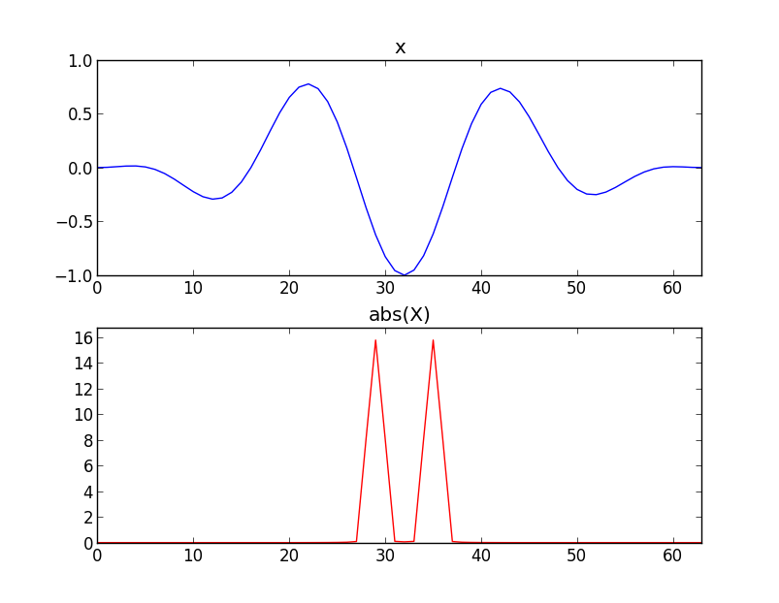
Power

Slide 18
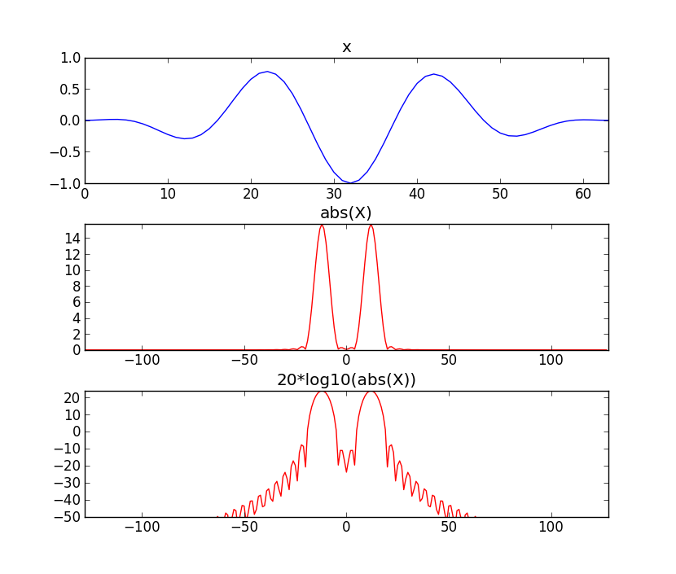
Amplitude in Decibels

Slide 19
import numpy as np
import matplotlib.pyplot as plt
from scipy.fftpack import fft, fftshift
M= 64
N = 256
x = np.cos(2*np.pi*3/M*np.arange(M)) * np.hanning(M)
plt.subplot(3,1,1)
plt.plot(x, 'b')
mX = np.abs(fftshift(fft(x, N)))
plt.subplot(3,1,2)
plt.plot(np.arange(-N/2,N/2,1), mX, 'r')
mX = 20 * np.log10(mX)
plt.subplot(3,1,3)
plt.plot(np.arange(-N/2,N/2,1), mX, 'r')

Slide 20

Fast Fourier Transform
The most common version uses the Coley-Tukey algorithm. It breaks down recursively the DFT of a power of 2 size into two pieces of size N/2.

Slide 21
References
https://ccrma.stanford.edu/~jos/mdft/
https://en.wikipedia.org/wiki/Fast_Fourier_transform
Full code of plots and accompanying labs available at:https://github.com/MTG/sms-tools

Slide 22
Credits
All the slides of this presentation are released under an Attribution-Noncommercial-Share Alike license.

