Slide 1
The Short-Time
Fourier Transform
(1 of 2)
Xavier Serra
Universitat Pompeu Fabra, Barcelona
Notes:
Until now we have seen how to compute the spectrum a signals, but real sounds cannot be represented by a single spectrum. Sounds change in time and we need to captures this time variation.
The short-time Fourier transform is our solution.

Slide 2
Index
Short-time Fourier Transform equation
Analysis window
Notes:
We will first explain the short-time Fourier transform equation and then what we call the analysis window.

Slide 3
Short-time Fourier Transform
w: analysis window
l: frame number
H: hop-size
Notes:
This is basically a modified version of the DFT.
...

Slide 4

Notes:
The windowing process is a way to step through a sound.
If we use the analogy of image and video we could relate a spectrum with a photograph and the STFT with video.
...

Slide 5
Transform of a windowed sinewave
Notes:
To better understand the effect of windowing a sound lets put an example of what happends when we window a real sinusoid.
...

Slide 6
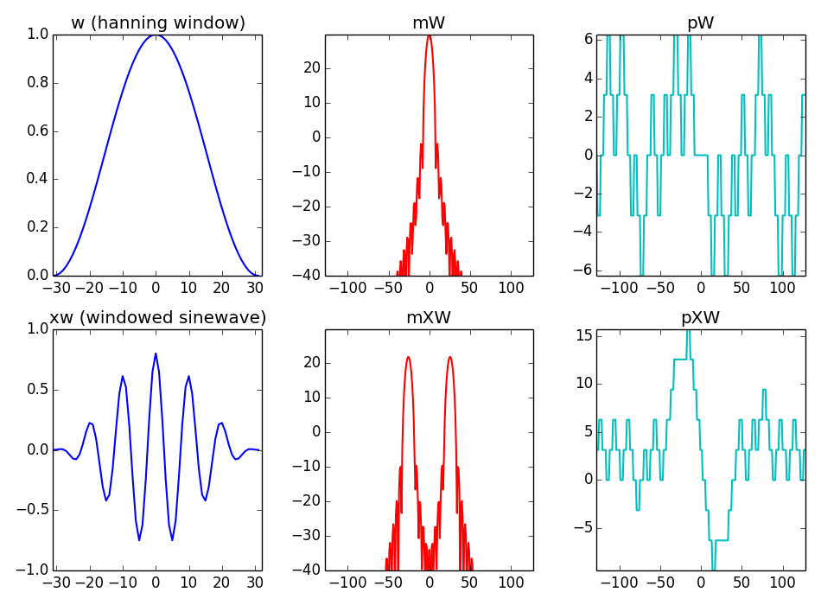
Notes:
With these plots we can understand the process better.
...
we can realize the importance of the analysis window in the spectrum of a sinusoid and thus of any sound.
It is clear that we have to spend some time explaining the windows.

Slide 7
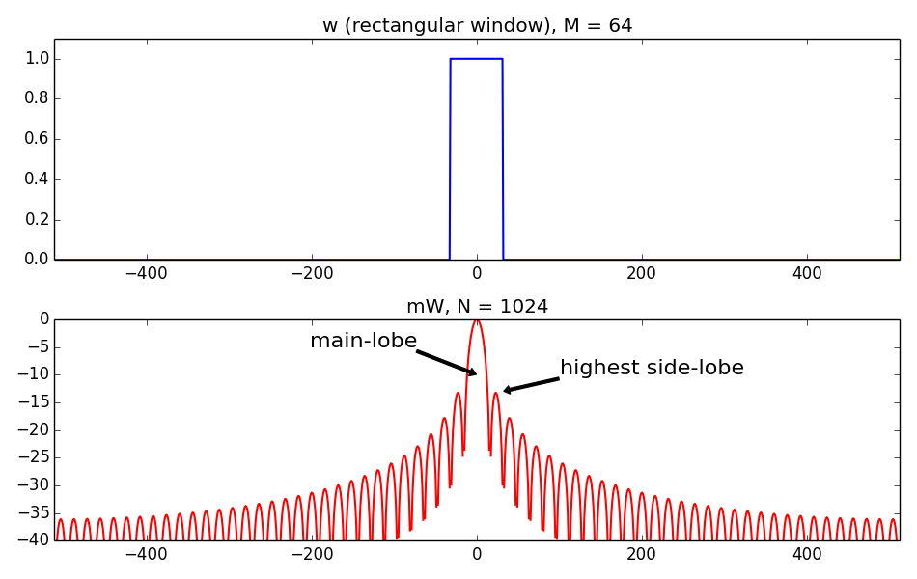
Analysis window
Notes:
An analysis window is generally a real function symmetric around the origen.
This is for example the simplest window, the reactangular window. In the time domain is nothing too particular, but its magnitude spectrum is much more interesting.
...

Slide 8
Window functions in Scipy
Window functions
barthann (M[, sym]) | Return a modified Bartlett-Hann window.
bartlett (M[, sym]) | Return a Bartlett window.
blackman (M[, sym]) | Return a Blackman window.
blackmanharris (M[, sym]) | Return a minimum 4-term Blackman-Harris window.
bohman (M[, sym]) | Return a Bohman window.
boxcar (M[, sym]) | Return a boxcar or rectangular window.
chebwin (M, at[, sym]) | Return a Dolph-Chebyshev window.
flattop (M[, sym]) | Return a flat top window.
gaussian (M, std[, sym]) | Return a Gaussian window.
general-gaussian (M, p, sig[, sym]) | Return a window with a generalized Gaussian shape.
hamming (M[, sym]) | Return a Hamming window.
hann (M[, sym]) | Return a Hann window.
kaiser (M, beta[, sym]) | Return a Kaiser window.
nuttall (M[, sym]) | Return a minimum 4-term Blackman-Harris window according to Nuttall.
parzen (M[, sym]) | Return a Parzen window.
slepian (M, width[, sym]) | Return a digital Slepian window.
triang (M[, sym]) | Return a triangular window.
Notes:
There are many windows used in audio signal processing. This is the list of windows available in the module Scipy of Python.
...
Each window can be distingushed from the other by measuring the main-lobe width and the side-lobe level. Each one has a different compromise.

Slide 9
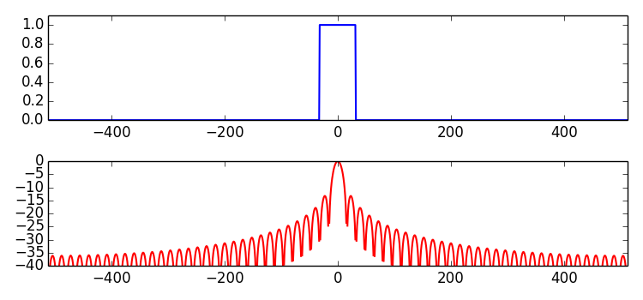
Rectangular window
main-lobe width: 2 bins
side-lobe level: -13.3 dB
Notes:
Now let go into some detail into several windows. We start by showing again the rectangular window.
...

Slide 10
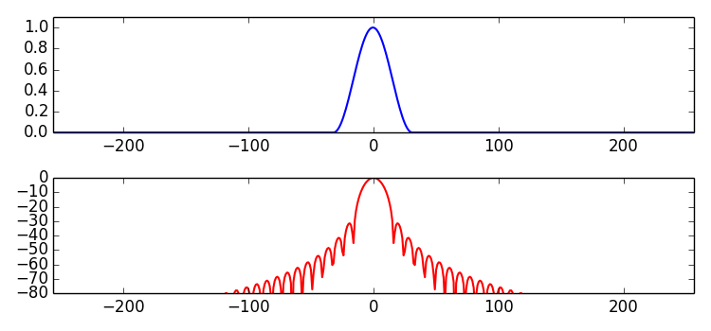
Hanning window
main-lobe width: 4 bins
side-lobe level: -31.5 dB
Notes:
Maybe the most popular window is the hanning window, which is a raise cosine.
...

Slide 11
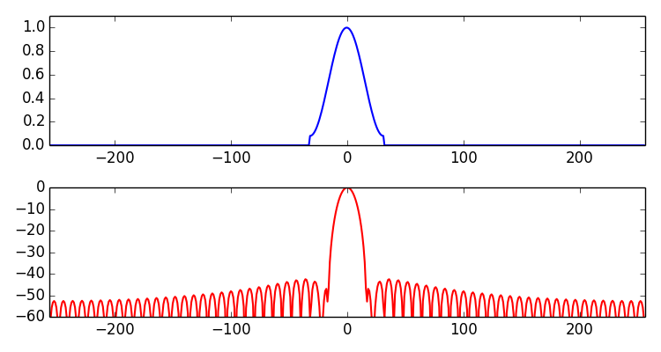
Hamming window
main-lobe width: 4 bins
side-lobe level: -42.7 dB
Notes:
The hamming window is very similar to the hanning window, but with a small but significant difference.
...

Slide 12
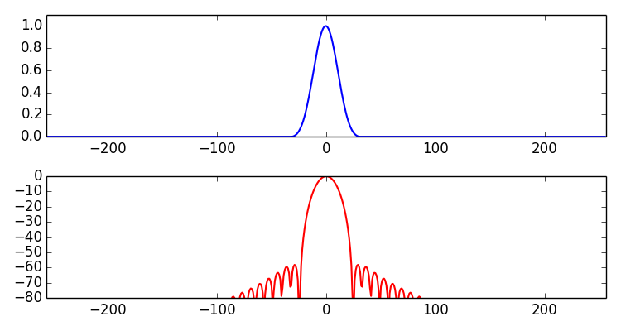
Blackman window
main-lobe width: 6 bins
side-lobe level: -58 dB
Notes:
The Blackman window is the sum of two sinusoids and with that we acomplish a significant improvement in ther of the side-lobe level measure.
...

Slide 13
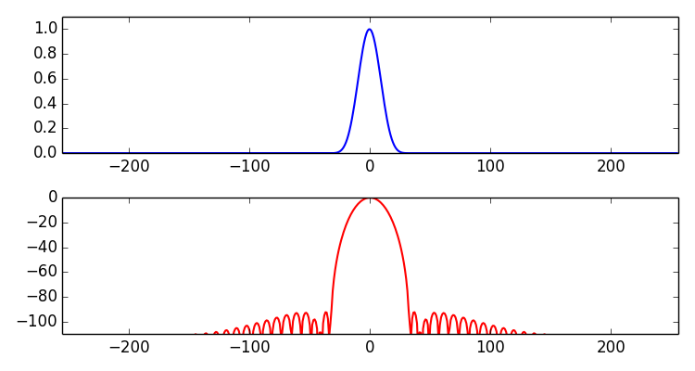
Blackman-Harris window
Notes:
The Blackman-Harris is a very special window, because we could basically say that it does not have side lobes.
...

Slide 14
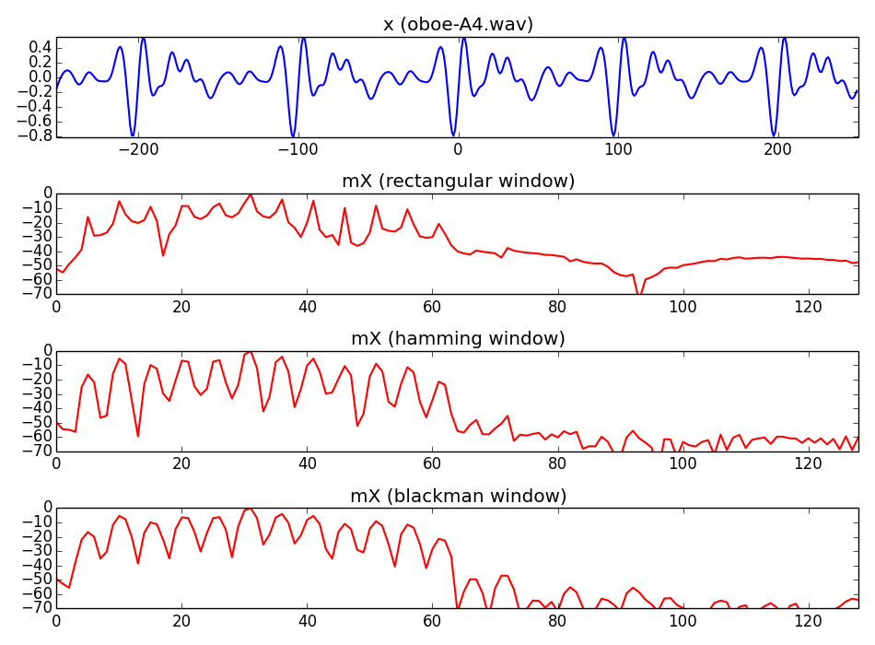
Notes:
This is an example of applying different windows to the same sound.
..

Slide 15
References and credits
More information on this topic from Wikipedia:
  https://en.wikipedia.org/wiki/STFT
  https://en.wikipedia.org/wiki/Window_function
Reference for the STFT by Julius O. Smith:https://ccrma.stanford.edu/~jos/sasp/
Sounds taken from Freesound: http://www.freesound.org/people/xserra/packs/13038/
The slides and code are released using the CC Attribution-Noncommercial-Share Alike license or the Affero GPL license and available from https://github.com/MTG/sms-tools
Notes:
There is a lot of signal processing literature on windows.
...

Slide 16
The Short-Time
Fourier Transform
(1 of 2)
Xavier Serra
Universitat Pompeu Fabra, Barcelona
Notes:
This is all for this lecture. We have explained the basic equation of the Short-time Fourier Transform and we have focused on the concept of analysis window.
In the next lecture we will continue with this topic.
See you next time!!

