Slide 1
The Short-Time Fourier Transform
(2 of 2)
Xavier Serra
Universitat Pompeu Fabra, Barcelona
Notes:
Welcome again to the course on Audio Signal Processing for Music applications.
In the last lecture we started talking about the Short-time Fourier transform.
Today we will continue with it.

Slide 2
Index
STFT and analysis window
Window size
FFT size
Hop size
Time-frequency compromise
Inverse STFT
STFT system
Notes:
In

Slide 3
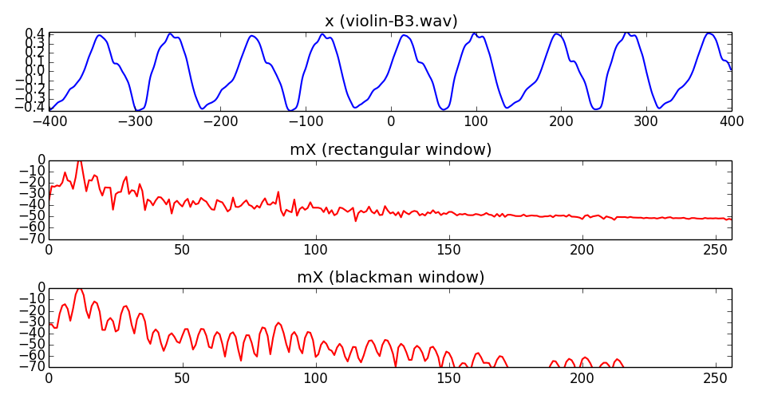
STFT and analysis window

Slide 4
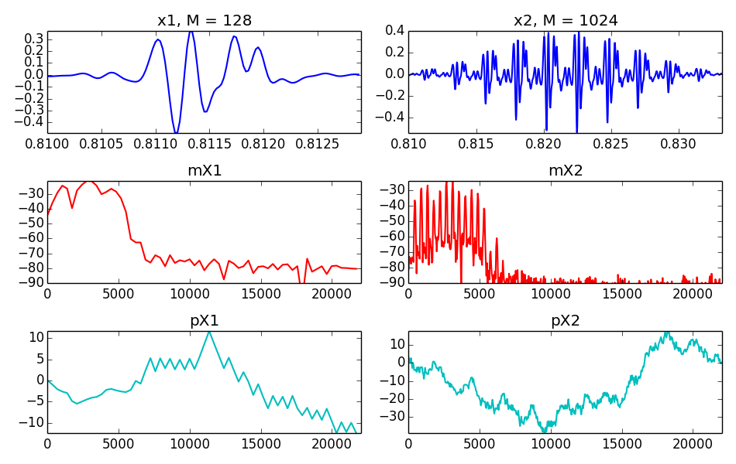
Window size

Slide 5
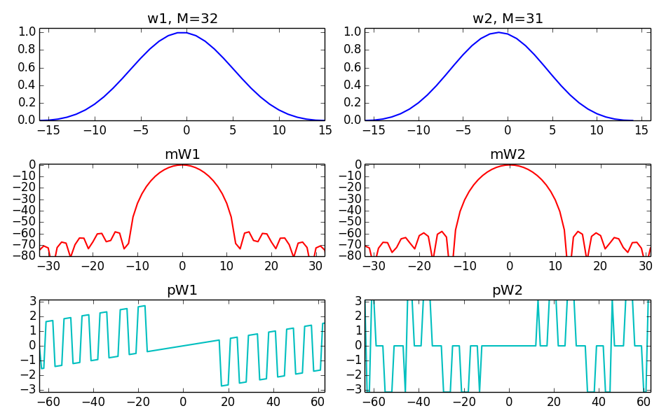
Even-odd size window

Slide 6
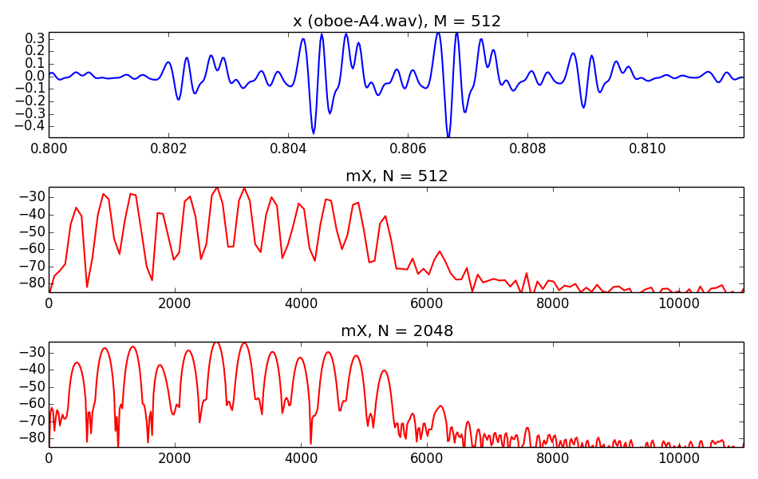
FFT size

Slide 7
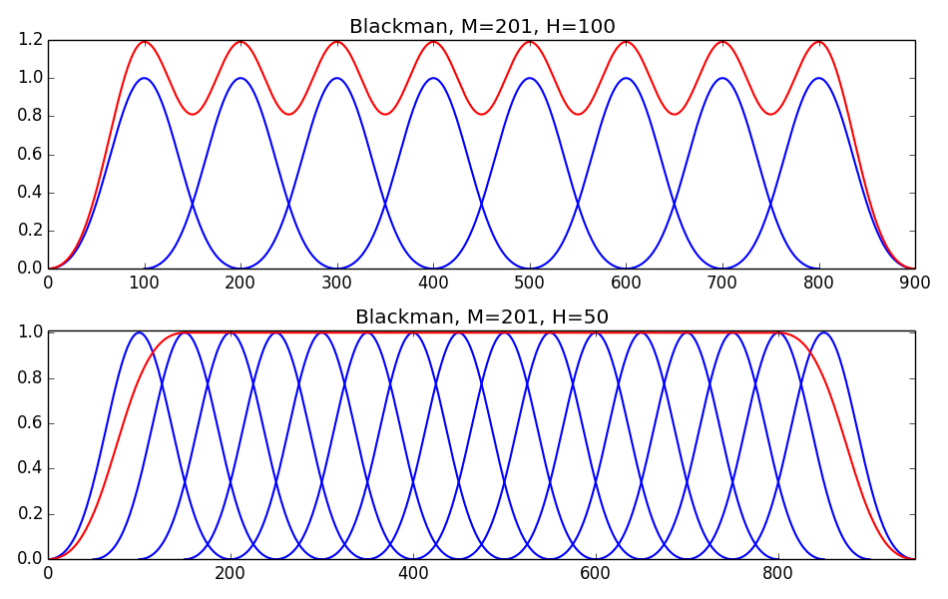
Hop size

Slide 8
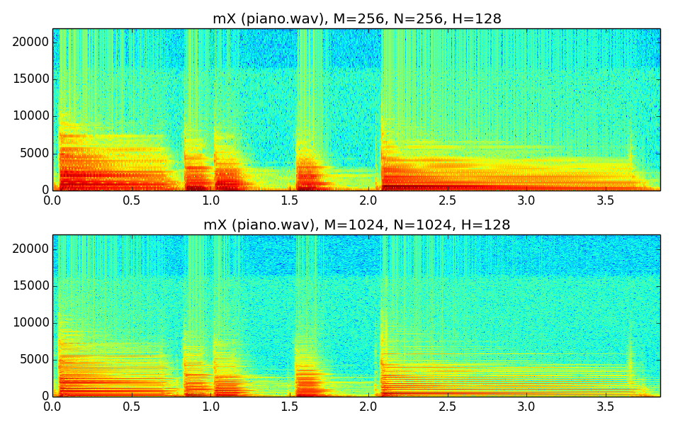
Time-frequency compromise

Slide 9
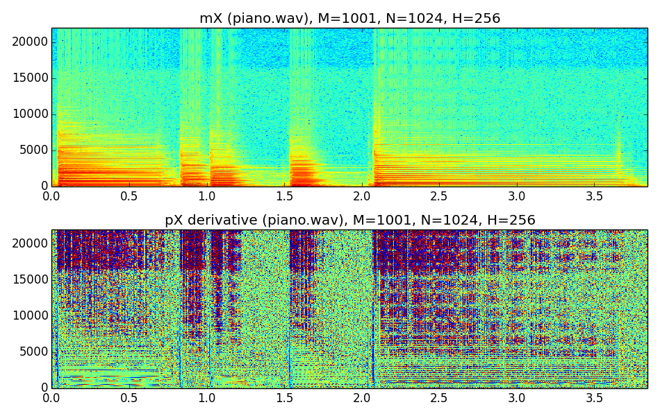
Magnitude and phase spectrogram

Slide 10
Inverse STFT
each output frame is:
and the output sound is:

Slide 11


Slide 12
STFT system
w[n]
x[n]
|X[k]|
yw[n]
y[n]
FFT
IFFT
Overlap-add
xw[n]
<X[k]

Slide 13
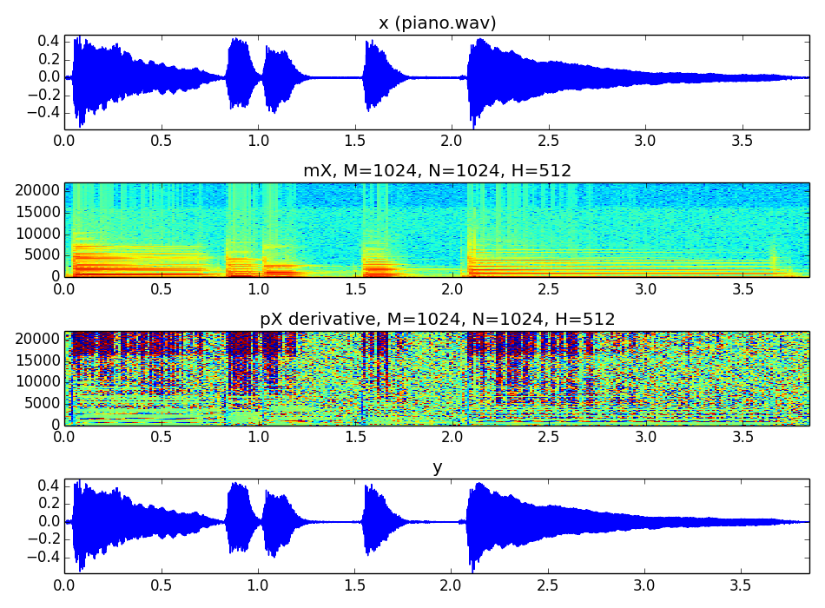

Slide 14
References and credits
More information on this topic from Wikipedia:
  https://en.wikipedia.org/wiki/STFT
  https://en.wikipedia.org/wiki/Window_function
Reference for the STFT by Julius O. Smith:https://ccrma.stanford.edu/~jos/sasp/
Sounds used taken from Freesound: http://www.freesound.org/people/xserra/packs/13038/
The slides and code are released using the CC Attribution-Noncommercial-Share Alike license or the Affero GPL license and available from https://github.com/MTG/sms-tools

Slide 15
The Short-Time
Fourier Transform
(1 of 2)
Xavier Serra
Universitat Pompeu Fabra, Barcelona

