Slide 1
2T2: The Discrete Fourier Transform (2 of 2)
Xavier Serra
Universitat Pompeu Fabra, Barcelona
&
Stanford University
Notes:
Welcome back to the course on Audio Signal Processing for Music Applications!!
We are in the second week of the course and this is the second part of the lecture on the Discrete Fourier Transform.
In the first part we focused on the basic equation of the DFT.
Let's continue.

Slide 2
Index
Review of DFT equation
DFT of complex sinusoids
DFT of real sinusoids
Inverse-DFT
Notes:
We will briefly review the DFT equation, then
...

Slide 3
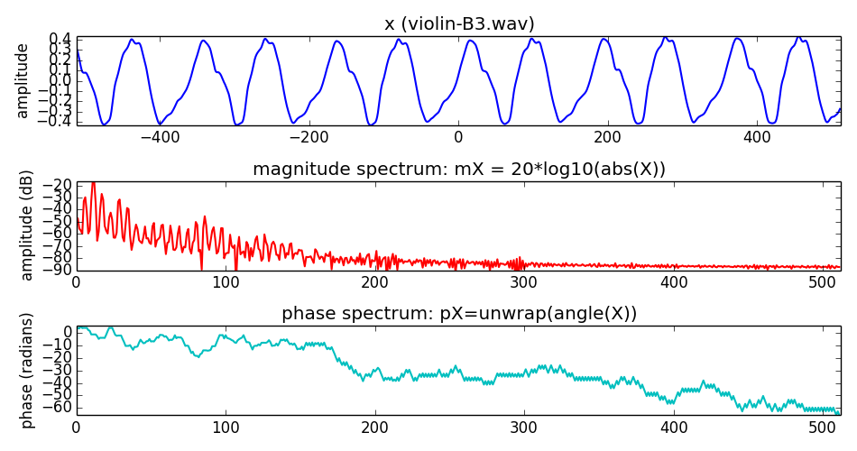
Discrete Fourier Transform
Notes:
The DFT can be understood as the projection of a signal into a finite set of complex sinewaves, thus it is able to identify how much of each of the sinusoids is present in the signal.
...

Slide 4
Discrete Fourier Transform
Notes:
The DFT can be understood as the projection of a signal into a finite set of complex sinewaves, thus it is able to identify how much of each of the sinusoids is present in the signal.
...

Slide 5
DFT of complex sinusoid
Notes:
If we explain how to compute the DFT of one single complex sinusoid we will understand this concept a bit better.
...
Let's see a plot of this operation.

Slide 6
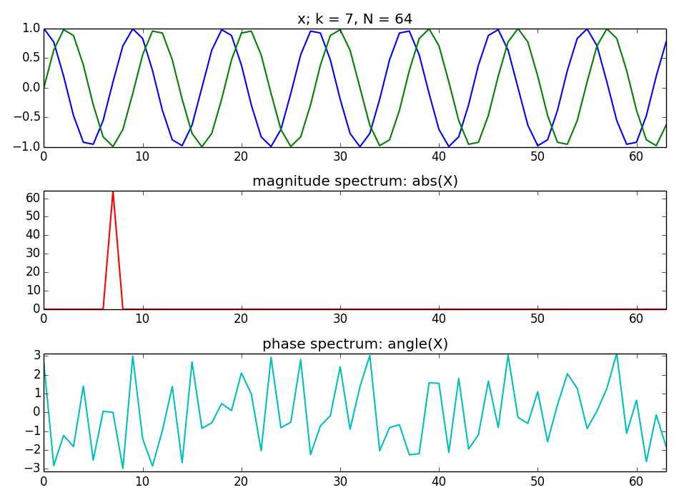
Notes:
This is the DFT of a complex exponential.
...
However this is a very special case in which the complex sinusoid is one of the basis functions of the DFT. This never happens when dealing with real signals.

Slide 7
DFT of any complex sinusoid
Notes:
Let's see a more realistic example, the DFT of a complex sinusoid of any frequency.
...
and let's see a plot of this operation.

Slide 8
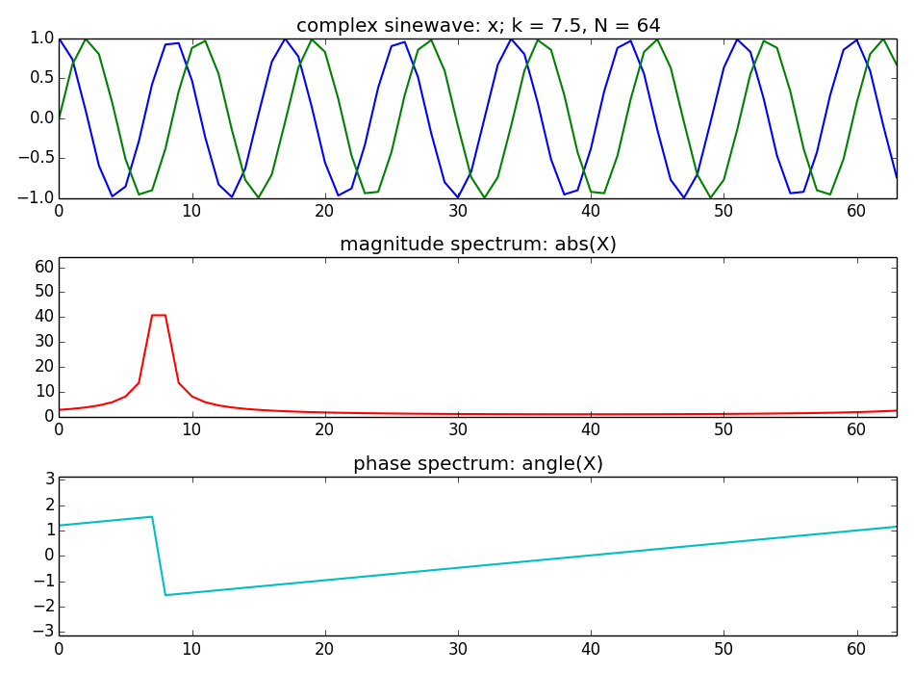
Notes:
This shows a display of what is the DFT of a complex sinusoid. It is not that nice!!
...
even this is not that real, we do not encounter complex sinusoids like this in our physical life...

Slide 9
DFT of real sinusoids
Notes:
Let's go a step further and compute the DFT of a real sinusoid, not of a complex one, thus closer to the reality of sounds. A bit more messy!!
...
and let's see a plot of it.

Slide 10
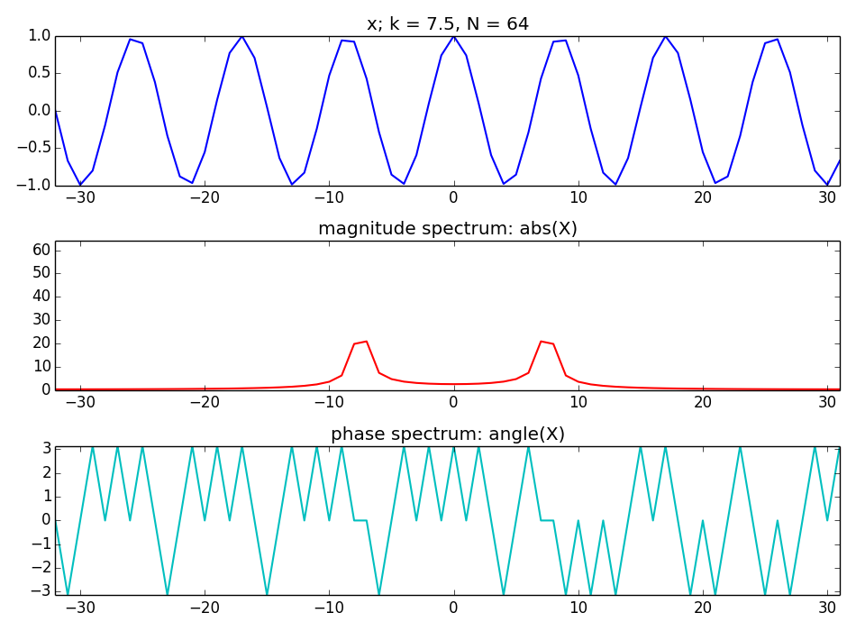
Notes:
This shows what is the output of calculating the DFT of a real sinewave.
...
Still we do not find sinusoids like this in our daily life, but we are gettig quite close. Some sounds are not that different to this.

Slide 11
Inverse DFT
Example:
Notes:
One of the great properties of the DFT is that is invertible, which means that we can get back the original signal from its spectrum.
...

Slide 12
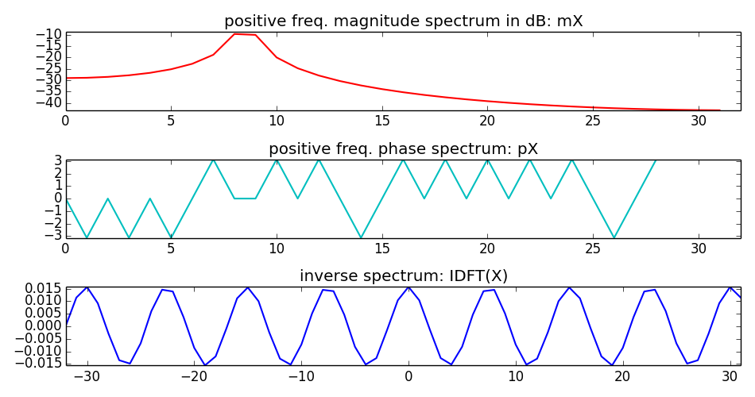
Inverse DFT for real signals
Notes:
For real signals we do not need to have the complete spectrum in order to recover the original signal.
It is enough to have half of the spectrum, tipically we use the positive side.
...
We will come back to these concept in the next lectures.

Slide 13
References and credits
More information in:
  https://en.wikipedia.org/wiki/Discrete_Fourier_transform
Reference on the DFT by Julius O. Smith: https://ccrma.stanford.edu/~jos/mdft/
Sounds from: http://www.freesound.org/people/xserra/packs/13038/
Slides and code released using the CC Attribution-Noncommercial-Share Alike license or the Affero GPL license and available from https://github.com/MTG/sms-tools
Notes:
Again you can find more information on Wikipedia or on the website of Julius Smith.
...

Slide 14
2T2: The Discrete Fourier Transform (2 of 2)
Xavier Serra
Universitat Pompeu Fabra, Barcelona
&
Stanford University
Notes:
In the first part of this lecture we introduced the DFT equation and in this second part we have seen how the DFT works when the input is a sinusoid. We have also explained the inverse DFT.
If you have been able to understand this you are doing very good!!! you should have no problem with the rest.
See you in the next lecture!!

