Slide 1
3T1: Fourier Transform properties (1 of 2)
Xavier Serra
Universitat Pompeu Fabra, Barcelona
&
Stanford University
Notes:
Welcome back to the course on Audio Signal Processing for Music Applications.
Last week we presented the Discrete Fourier Transform. But that was not enough to understand it fully, we have to go deaper into it. We want to really understand how it behaves when we analize sounds.
This is what we will do here, we will present several properties of the Fourier transform. We will do it in two parts.

Slide 2
Index
Linearity
Shift
Symmetry
Convolution
Notes:
In this first part we will go through the following Fourier properties
....

Slide 3
Linearity:
Notes:
Linearity is a very convenient property of many mathematical operations, in this case of the DFT.
It basically means that it is a well behaved operation.
...

Slide 4
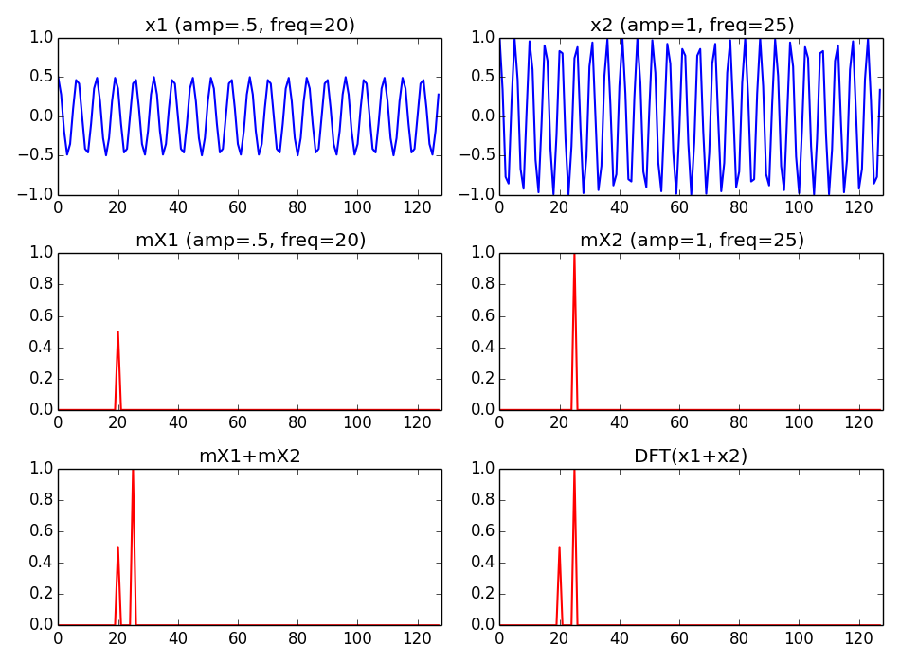
Notes:
To exemplify the linearity of the DFT let's consider two sinusoids.
...

Slide 5
Shift:
Notes:
Shifting means displacing the samples of a signal.
...

Slide 6
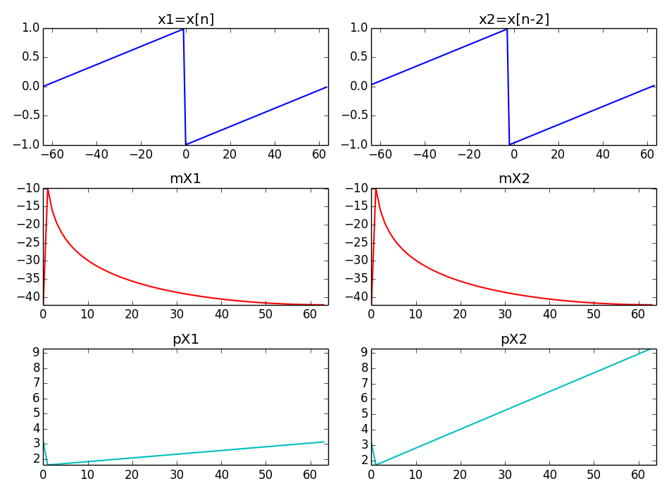
Notes:
To exemplify the Shift property let's show the DFT of a signal and of its shifted version.
We shift a sawtooth waveform.
...

Slide 7
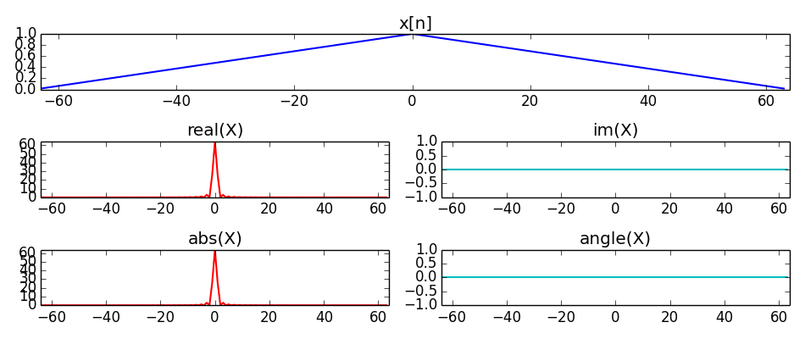
Symmetry:
Notes:
There are a lot of possible symmetries when dealing with the DFT, and that is good!!
For example, if one signal is real, its transform will have an even symmetry for the real part, or for the magnitude, and an odd symmetry for the imaginary part, or for the phase.
...

Slide 8
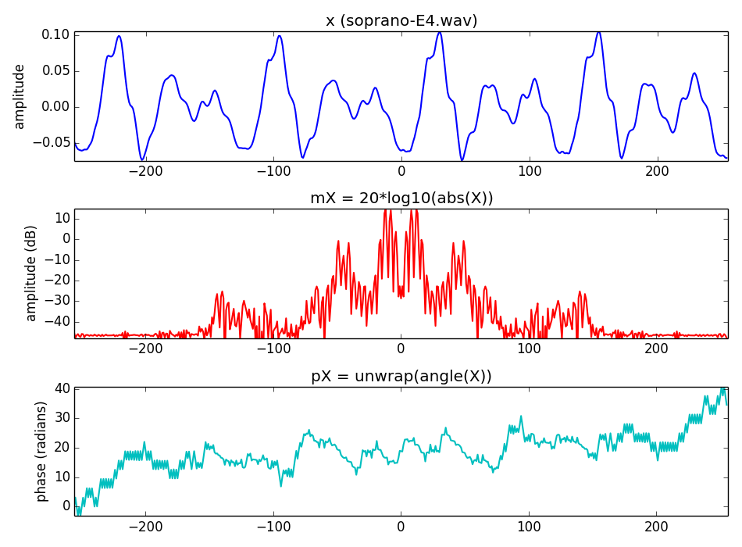
Notes:
Since we work with real signals, their DFT will always have the even-odd symmetry.
...

Slide 9
Notes:
Since we work with real signals, their DFT will always have the even-odd symmetry.
...

Slide 10
Convolution:
Notes:
The final property I will mention in this lecture is the one related to convolution.
...
Like most of the properties, this is reversible, that is, if we multiply two signals in the time domain it corresponds to convolve the spectrum of the signals in the frequency domain.

Slide 11
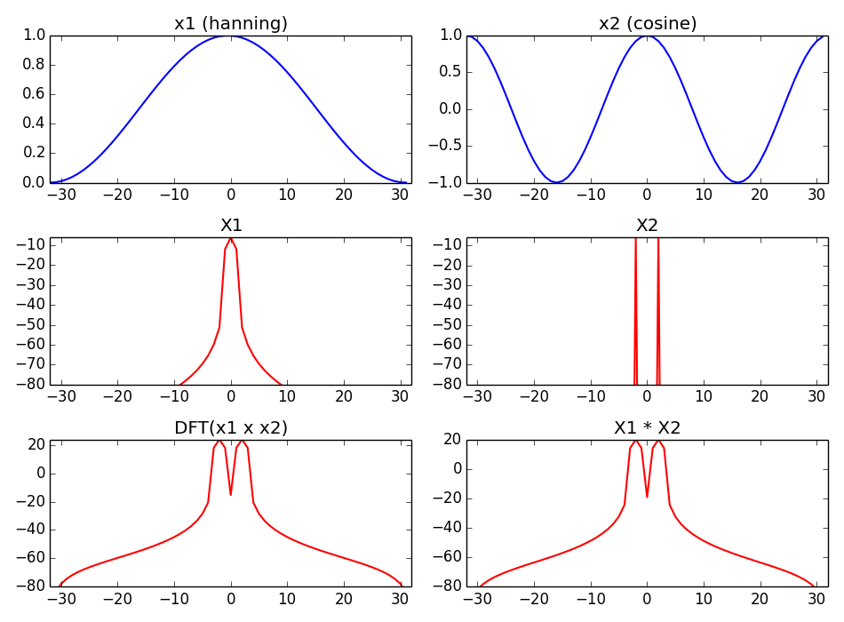
Notes:
This is a simple example of multiplying in the time domain.
....

Slide 12
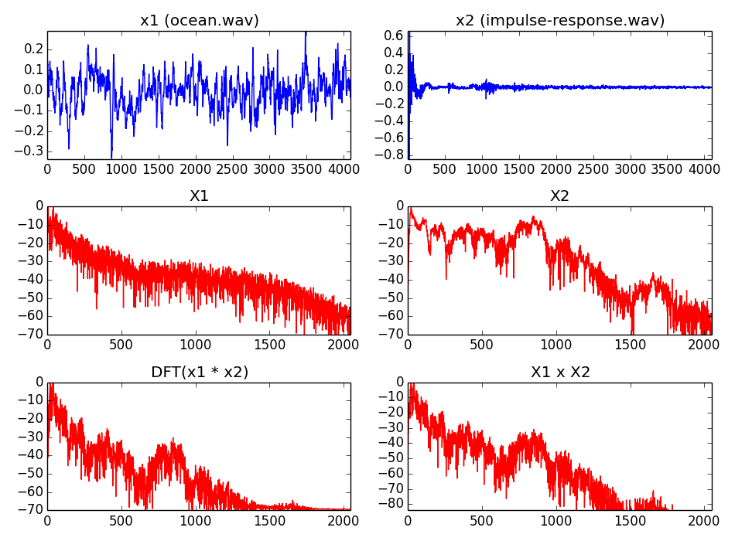
Notes:
This is an example of a common audio signal processing operation, filtering.
...

Slide 13
Notes:
This is an example of a common audio signal processing operation, filtering.
...

Slide 14
Notes:
This is an example of a common audio signal processing operation, filtering.
...

Slide 15
References and credits
More information in:
  https://en.wikipedia.org/wiki/Discrete_Fourier_transform
Reference on the DFT by Julius O. Smith: https://ccrma.stanford.edu/~jos/mdft/
Sounds from: http://www.freesound.org/people/xserra/packs/13038/
Slides and code released using the CC Attribution-Non Commercial-Share Alike license or the Affero GPL license and available from https://github.com/MTG/sms-tools
Notes:
You can find presentations of these properties in wikipedia and in Julius Smith web.
...

Slide 16
3T1: Fourier Transform properties (1 of 2)
Xavier Serra
Universitat Pompeu Fabra, Barcelona
&
Stanford University
Notes:
This is all for today!!
In order to understand the DFT in more real situations we have gone through some of its properties.
In the second part of this lecture we will continue with some more properties.
Thanks for you attention!!

