Slide 1
Beyond Audio Signal Processing in
Music Applications
Xavier Serra
Universitat Pompeu Fabra, Barcelona

Slide 2
Index
Introduction: beyond audio signals
Statistical analysis
Pattern analysis
Machine learning
Semantic technologies
User-centered studies

Slide 3
Introduction: beyond audio signals
Scores, lyrics
Contextual information

Slide 4
Levels of description
Low-level (signal-centered) descriptors: computed from the audio signal in a direct or derived (ex: spectral analysis) way: average energy, spectral centroid, MFCCs ….
Mid-level (object-centered) descriptors: requiring an induction operation or data modeling: key, genre, instrument …
High-level (user-centered) descriptors: requiring a user model: mood (ex: happy, sad), …

Slide 5
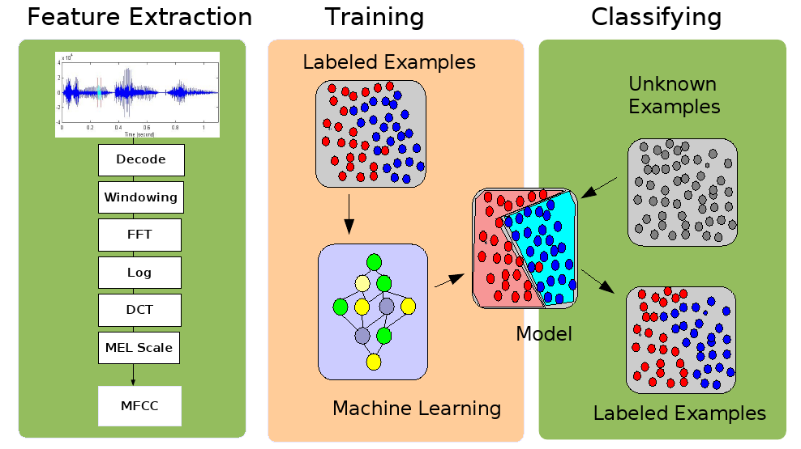
Audio content classification

Slide 6
References and credits
Xavier Serra, Michela Magas, Emmanouil Benetos, Magdalena Chudy, Simon Dixon, Arthur Flexer, Emilia Gómez, Fabien Gouyon, Perfecto Herrera, Sergi Jordà, Oscar Paytuvi, Geoffroy Peeters, Jan Schlüter, Hugues Vinet, Gerhard Widmer, "Roadmap for Music Information ReSearch", Geoffroy Peeters (editor), 2013.
All slides and code produced for this course are released using the CC Attribution-Noncommercial-Share Alike license or the Affero GPL license and available from https://github.com/MTG/sms-tools

