Slide 1
Some basic Mathematics
Xavier Serra
Music Technology Group
Universitat Pompeu Fabra, Barcelona
http://mtg.upf.edu

Slide 2
Index
Sinusoidal functions
Complex numbers
Euler’s formula
Complex sinusoids
Inner product of signals
Even and odd functions
Convolution

Slide 3
Sinusoidal functions (sine wave)

Slide 4
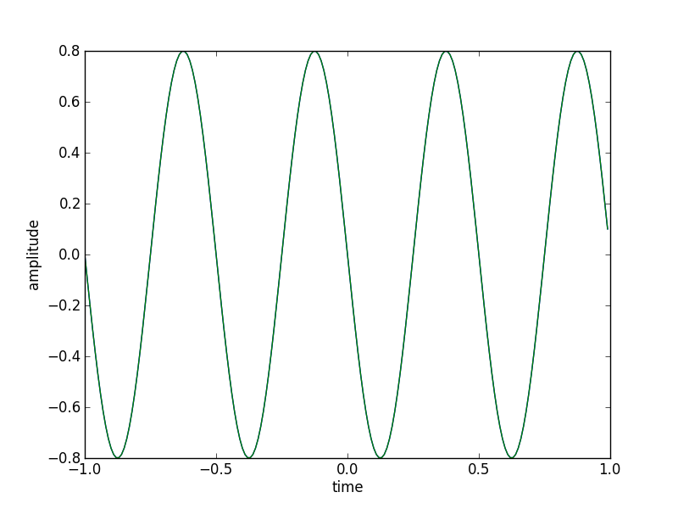
Sinusoid plot
import matplotlib.pyplot as plt
import numpy as np
A0 = .8
f0 = 2
phi0 = np.pi/2
fs = 100
t = np.arange(-1, 1, 1.0/fs)
x = A0 * np.cos(2*np.pi*f0*t+phi0)
plt.plot(t, x)

Slide 5
Complex numbers
where x: real part
y: imaginary part
y
Complex plane
x-axis (real part)
y-axis (imaginary part)
x

Slide 6
Rectangular co-ordinates
ordinate
y1
*
x1
abscissa
Polar co-ordinates
magnitude
*
phase

Slide 7
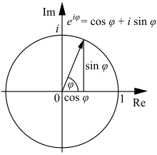
Euler's formula

Slide 8
Complex sinusoinds
Real sinusoid

Slide 9
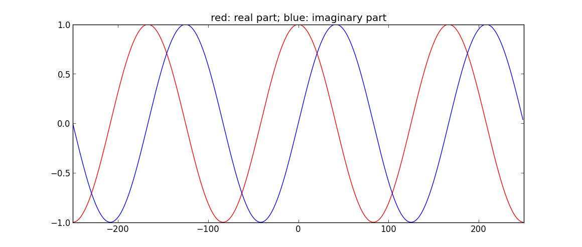
Complex sinewave

Slide 10
Inner product of signals
Operation of two signals (vectors) which produces a scalar.
Example:

Slide 11
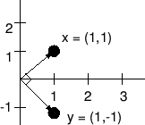
Orthogonality of vectors (signals)
Two vectors (signals) are orthogonal if their inner product is equal to zero
Example:

Slide 12
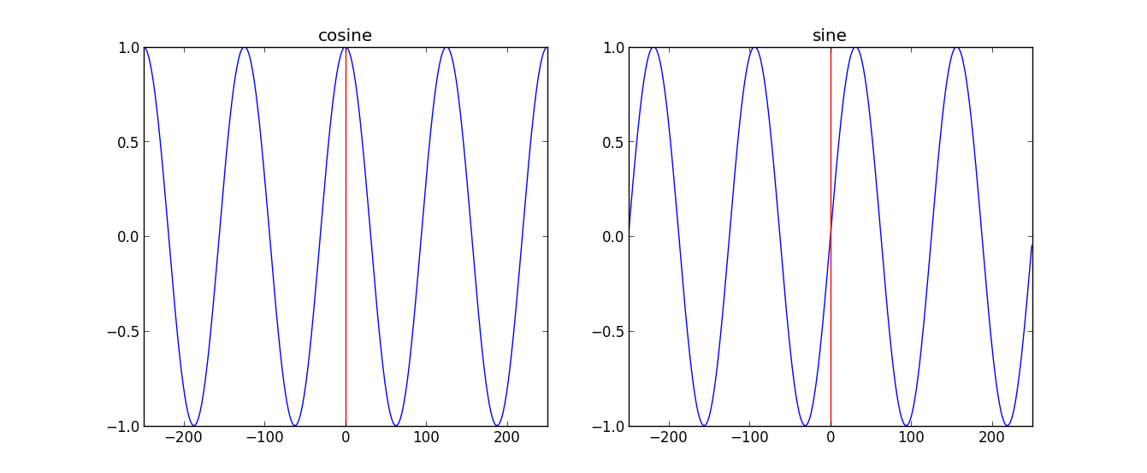
Even and odd functions
f(a) is even if f(-a) = f(a). An even function is symmetric.
f(a) is odd if f(-a) = -f(a). An odd function is antisymmetric.
The cosine function is even since cos (-a) = cos(a). The sine function is odd since sin(-a) = - sin(a)

Slide 13
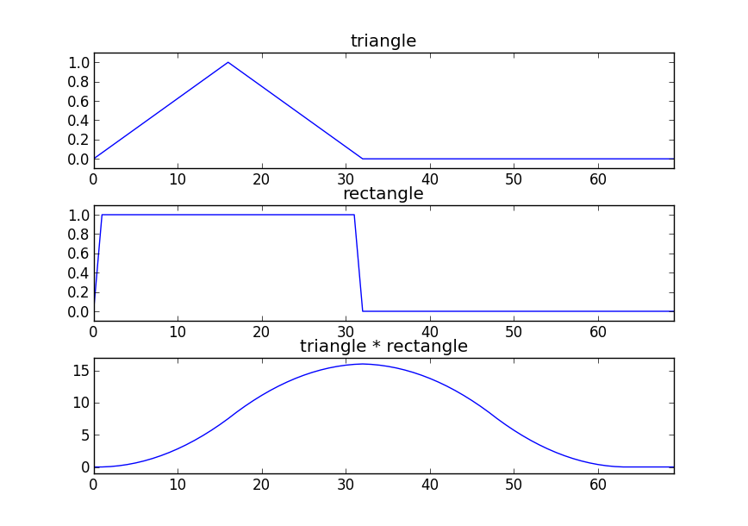
Convolution

Slide 14
References
https://en.wikipedia.org/wiki/Sinusoid
https://en.wikipedia.org/wiki/Complex_numbers
https://en.wikipedia.org/wiki/Euler_formula
https://en.wikipedia.org/wiki/Negative_frequency
https://en.wikipedia.org/wiki/Inner_product
https://en.wikipedia.org/wiki/Convolution
Full code of plots available at:https://github.com/MTG/sms-tools

Slide 15
Credits
All the slides of this presentation are released under an Attribution-Noncommercial-Share Alike license.

