Slide 1
Fundamental frequency detection
Xavier Serra
Universitat Pompeu Fabra, Barcelona

Slide 2
Index
F0 detection in time domain
  monophonic signals
F0 detection in frequency domain
  monophonic and polyphonic signals

Slide 3
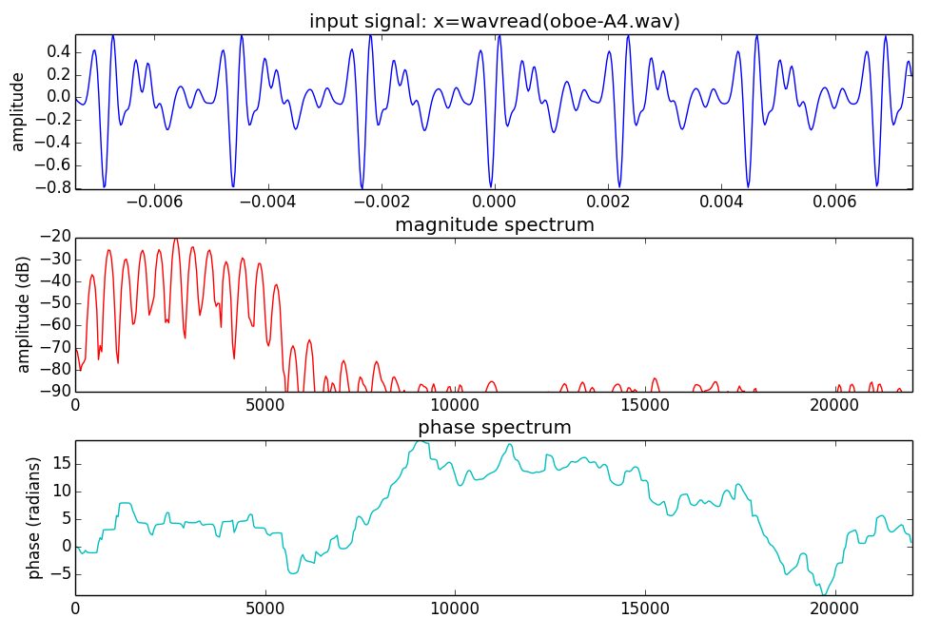

Slide 4
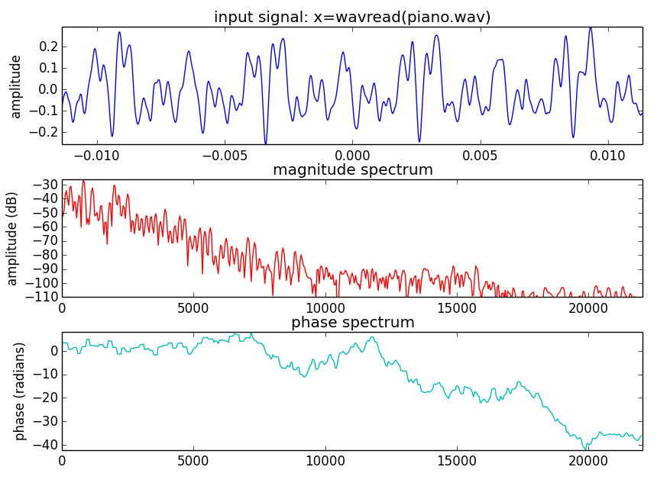

Slide 5
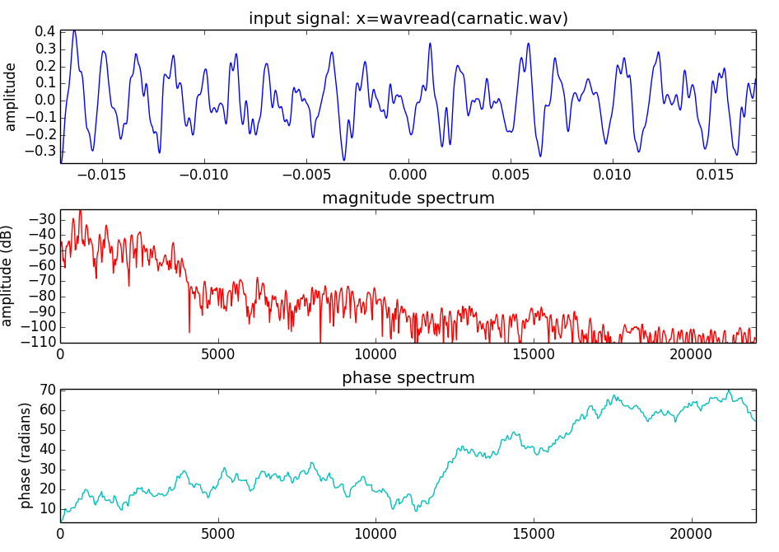

Slide 6
F0 detection in time domain
Autocorrelation (with tapering)

Slide 7
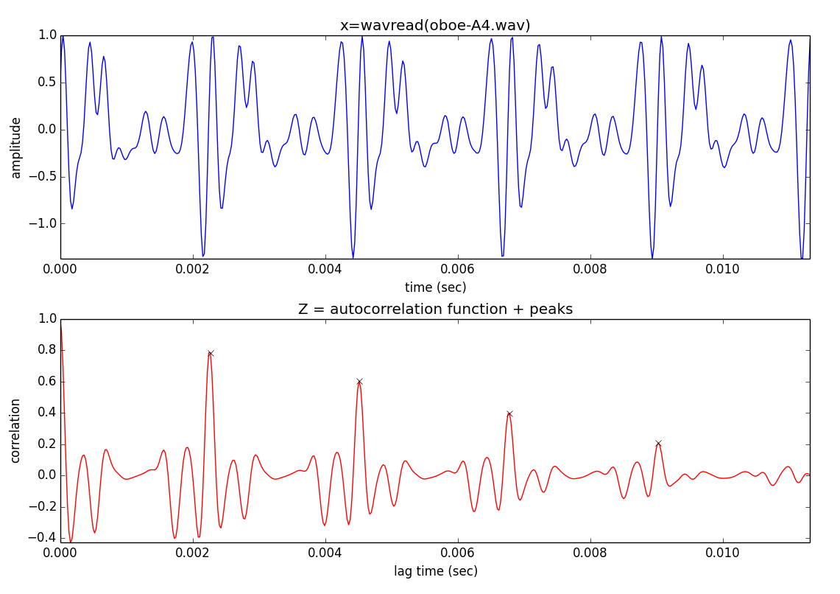

Slide 8
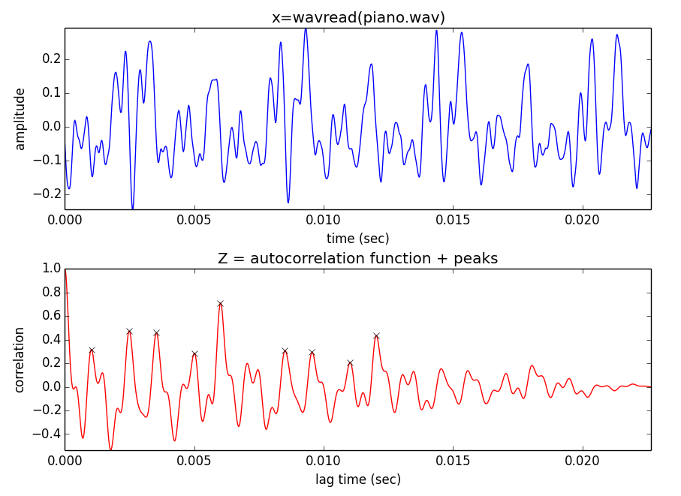

Slide 9
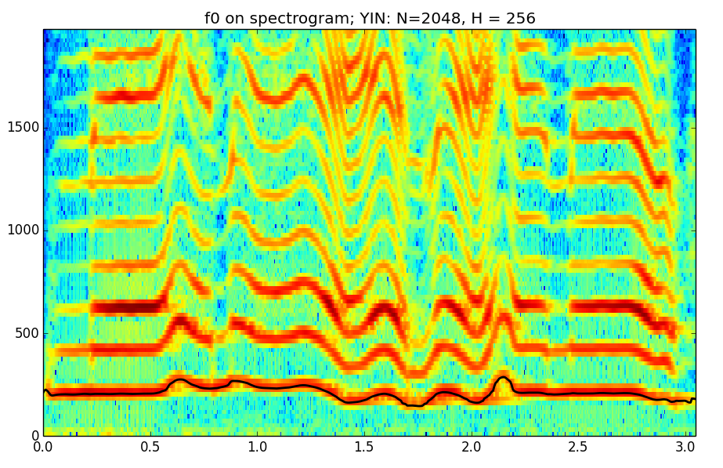
YIN Algorithm ( Cheveigné and Kawahara, 2002)

Slide 10
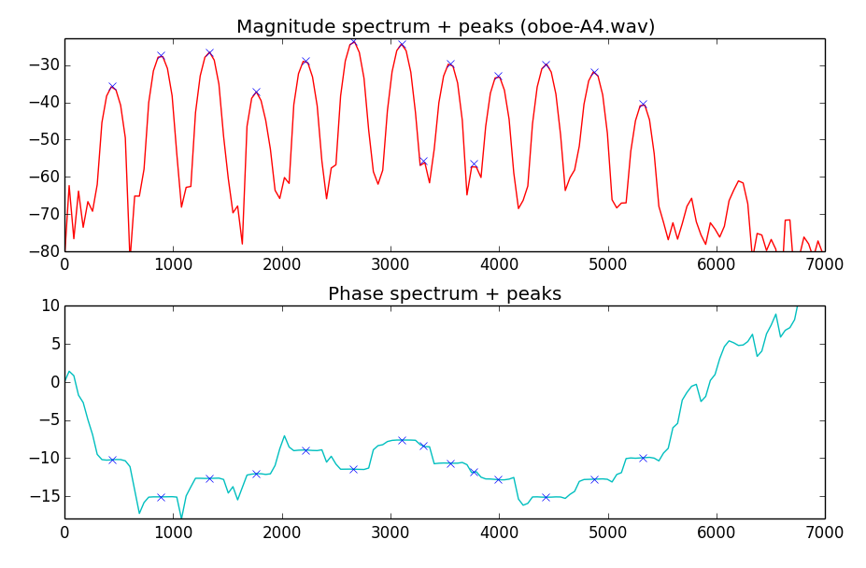
F0 detection in frequency domain

Slide 11
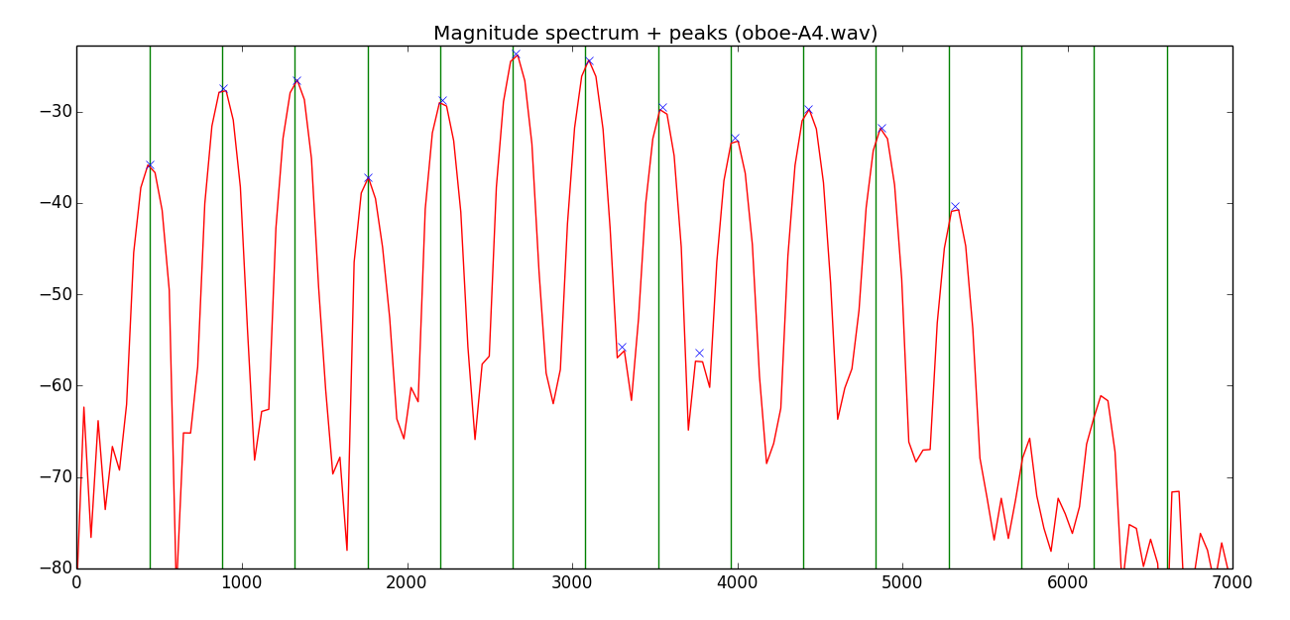
F0 detection
The fundamental frequency can be defined as the common divisor of the harmonic series that best explains the spectral peaks.

Slide 12
Two-way mismatch algorithm
(Maher and Beauchamp, 1994)
7F
6F
5F
4F
3F
2F
F
p
m

Slide 13
Total error:
Maher and Beauchamp propose:

Slide 14
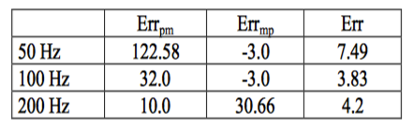
TWM calculation from a harmonic series that includes the frequencies: 200, 300, 500, 600, 700, 800.

Slide 15
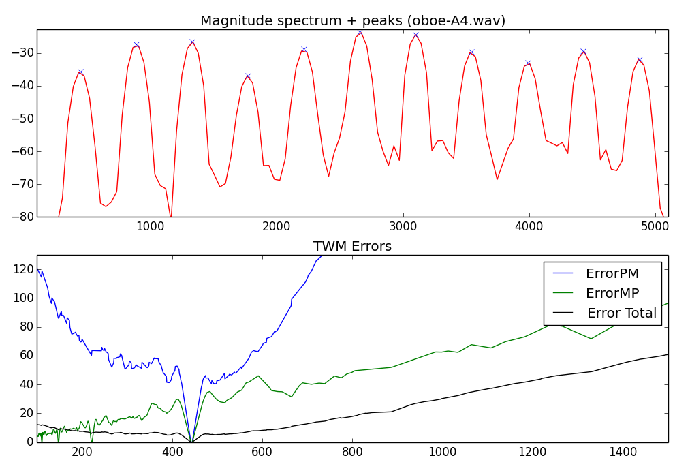

Slide 16
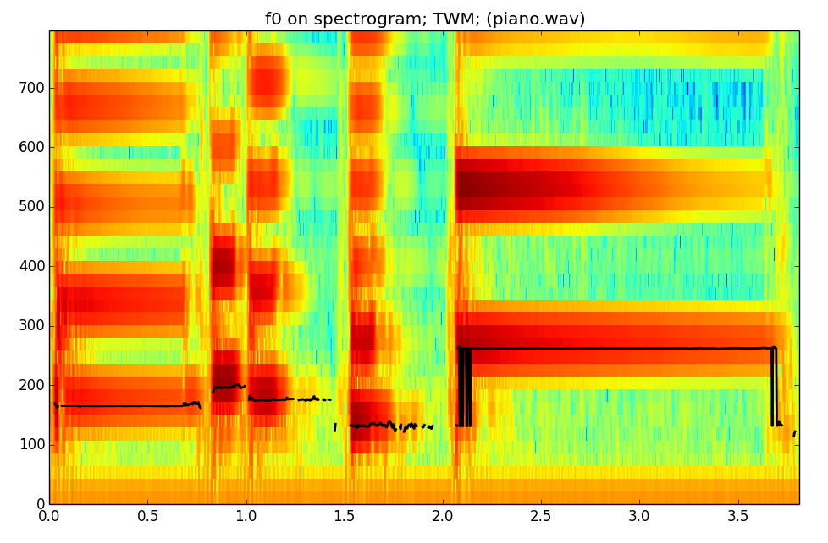

Slide 17
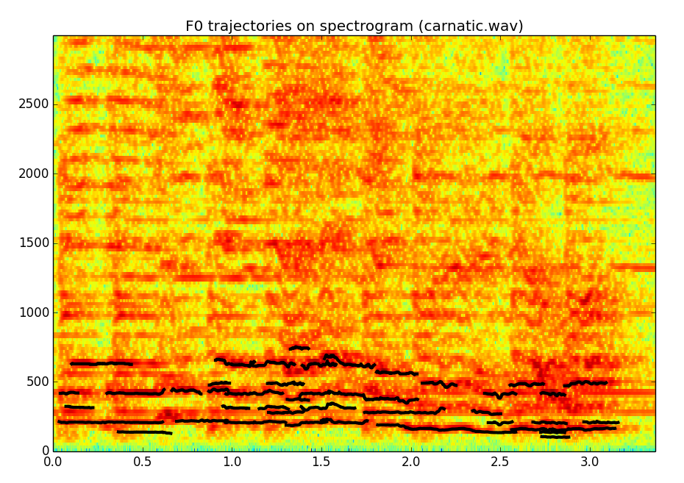
F0 in polyphonic signals

Slide 18
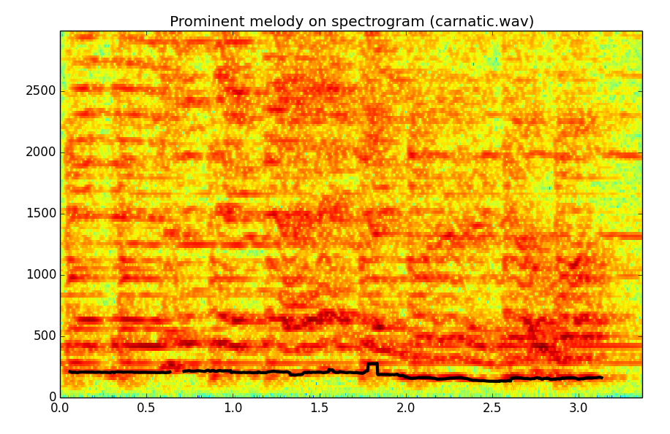
Prominent pitch in polyphonic signals
(Salamon and Gómez, 2012)

Slide 19
References and credits
More information on this topic from Wikipedia:
  http://en.wikipedia.org/wiki/Fundamental_frequency
  http://en.wikipedia.org/wiki/Pitch_detection_algorithm
  http://en.wikipedia.org/wiki/Autocorrelation
F0 detection algorithms:
  A. de Cheveigné and H. Kawahara. “YIN, a fundamental frequency estimator for speech and music,” J. Acoust. Soc. Am. 111, 1917 (2002).
  R. C. Maher and J. W. Beauchamp, “Fundamental frequency estimation of musical signals using a Two-Way Mismatch procedure,” J. Acoust. Soc. Am., vol. 95., no. 4, pp. 2254-2263 (1994).
  J. Salamon and E. Gómez, "Melody extraction from polyphonic music signals using pitch contour characteristics," IEEE Transactions on Audio, Speech, and Language Processing, vol. 20, no. 6, pp. 1759–1770 (2012).
All slides and code produced for this course are released using the CC Attribution-Noncommercial-Share Alike license or the Affero GPL license and available from https://github.com/MTG/sms-tools

