Slide 1

Some basic mathematics
Xavier Serra
Universitat Pompeu Fabra, Barcelona

Slide 2
Index
Sinusoidal functions
Complex numbers
Euler’s formula
Complex sinusoids
Scalar product of sequences
Even and odd functions
Convolution

Slide 3
Sinusoidal functions (sinewaves)

Slide 4
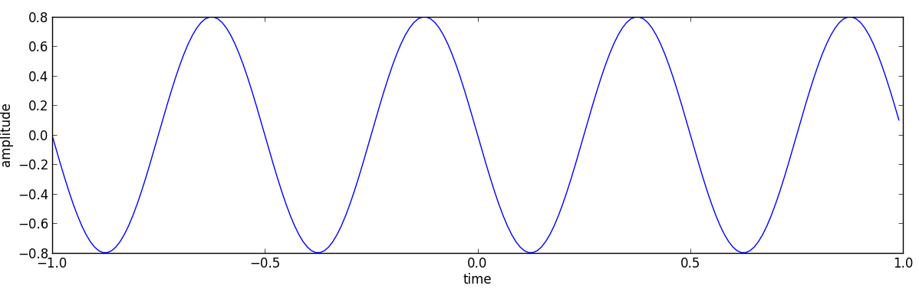
Sinewave plot
A0 = .8
f0 = 2
phi0 = pi/2
fs = 100
t = arange(-1, 1, 1.0/fs)
x = A0 * cos(2*np.pi*f0*t+phi0)

Slide 5
Complex numbers
a, b are real numbers
, imaginary unit
Im
Complex plane:
Re (real axis)
Im (imaginary axis)
Re

Slide 6
Im
Rectangular form:
a
x
b
Re
Polar form:
Im
A
x
φ
Re

Slide 7
Euler's formula
Im
x
Re

Slide 8
Complex sinusoid
Real sinusoid:

Slide 9
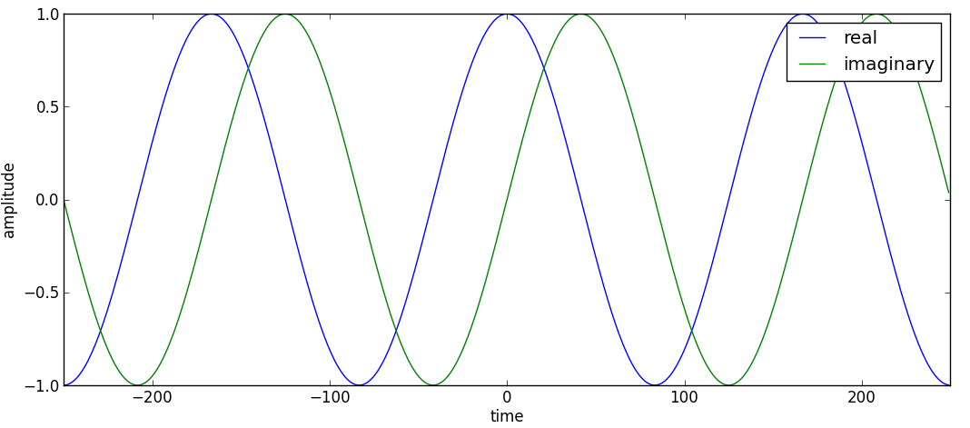
Complex sinewave

Slide 10
Scalar product of sequences
Example:

Slide 11
Orthogonality of sequences
Example:
2
x=(2,2)
1
1
2
3
4
-1
-2
y=(2,-2)

Slide 12
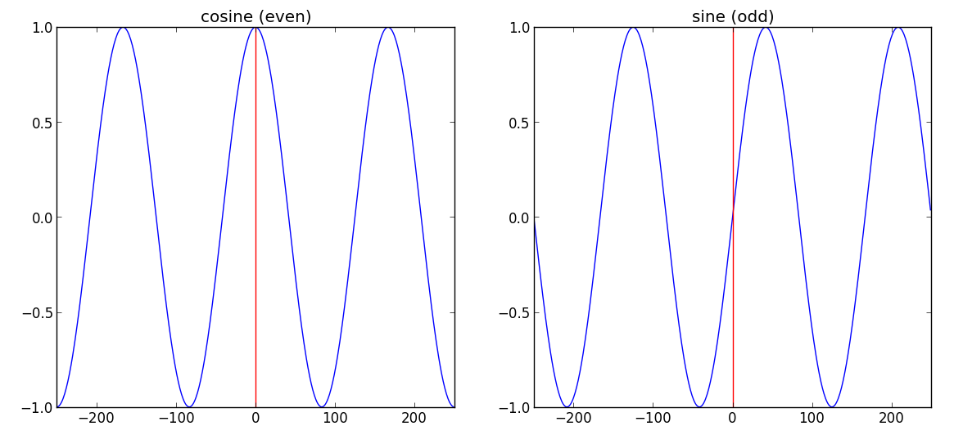
Even and odd functions
f(a) is even if f(-a) = f(a) [symmetric]
f(a) is odd if f(-a) = -f(a). [antisymmetric]

Slide 13
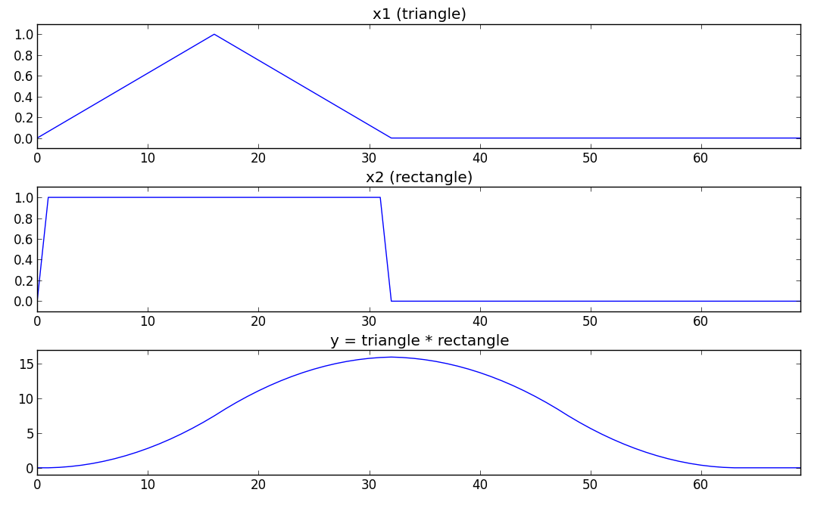
Convolution

Slide 14
References and credits
More information on this topic in Wikipedia:
  https://en.wikipedia.org/wiki/Sinusoid
  https://en.wikipedia.org/wiki/Complex_numbers
  https://en.wikipedia.org/wiki/Euler_formula
  http://en.wikipedia.org/wiki/Dot_product
  https://en.wikipedia.org/wiki/Convolution
Good reference for the mathematics of the DFT by Julius O. Smith: https://ccrma.stanford.edu/~jos/mdft/
All slides and code produced for this course are released using the CC Attribution-Noncommercial-Share Alike license or the Affero GPL license and available from https://github.com/MTG/sms-tools

