Slide 1
The Short-Time Fourier Transform
Xavier Serra
Music Technology Group
Universitat Pompeu Fabra, Barcelona
http://mtg.upf.edu

Slide 2
Index
Short-time Fourier Transform equation
Window type
Window size
FFT size
Hop size
Time-frequency compromise
Inverse STFT
STFT implementation

Slide 3
Short-time Fourier Transform
w: real window
l: number of frame
H: time advance of window (hop-size)

Slide 4


Slide 5
Transform of a windowed sinewave

Slide 6
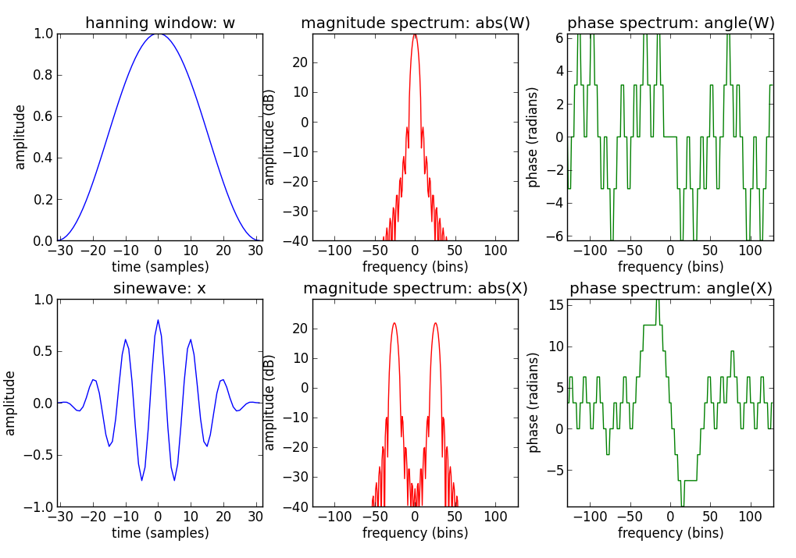

Slide 7
N = 256
M = 63
f0 = 1000
fs = 10000
A0 = .8
hN = N/2
hM = (M+1)/2
x = A0 * np.cos(2*np.pi*f0/fs*np.arange(-hM+1,hM))
w = np.hanning(M)
plt.subplot(2,3,1)
plt.plot(np.arange(-hM+1, hM), w, 'b')
fftbuffer[:hM] = w[hM-1:]
fftbuffer[N-hM+1:] = w[:hM-1]
X = fft(fftbuffer)
X1[:hN] = X[hN:]
X1[N-hN:] = X[:hN]
mX = 20*np.log10(abs(X1))
plt.subplot(2,3,2)
plt.plot(np.arange(-hN, hN), mX, 'r')
pX = np.angle(X1)
plt.subplot(2,3,3)
plt.plot(np.arange(-hN, hN), np.unwrap(pX), 'g')
plt.subplot(2,3,4)
xw = x*w
plt.plot(np.arange(-hM+1, hM), xw, 'b')
fftbuffer[0:hM] = xw[hM-1:]
fftbuffer[N-hM+1:] = xw[:hM-1]
X = fft(fftbuffer)
X2[:hN] = X[hN:]
X2[N-hN:] = X[:hN]
mX2 = 20*np.log10(abs(X2))
plt.subplot(2,3,5)
plt.plot(np.arange(-hN, hN), mX2, 'r')
pX = np.angle(X2)
plt.subplot(2,3,6)
plt.plot(np.arange(-hN, hN), np.unwrap(pX), 'g')

Slide 8
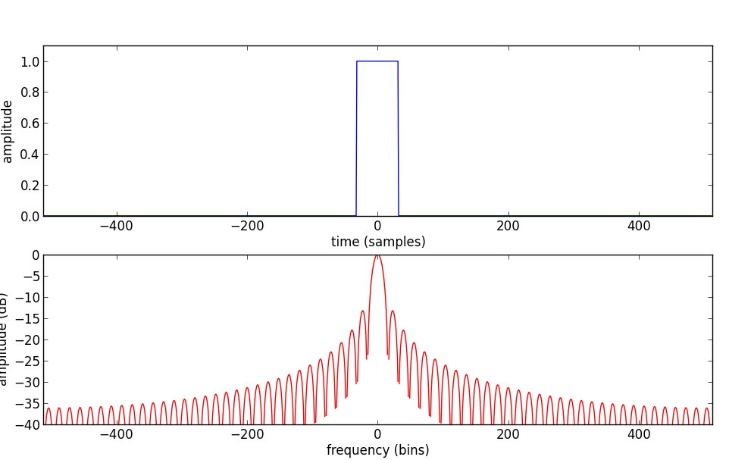
Window type
All standard windows are real and symmetric and have a frequency spectrum with a sinc-like shape.
rectangular
window
magnitude
spectrum
The choice is mainly determined by two of the spectrum’s characteristics:
1. Width of main lobe
2. Highest side-lobe level

Slide 9
Window functions in Scipy
Window functions
barthann (M[, sym]) | Return a modified Bartlett-Hann window.
bartlett (M[, sym]) | Return a Bartlett window.
blackman (M[, sym]) | Return a Blackman window.
blackmanharris (M[, sym]) | Return a minimum 4-term Blackman-Harris window.
bohman (M[, sym]) | Return a Bohman window.
boxcar (M[, sym]) | Return a boxcar or rectangular window.
chebwin (M, at[, sym]) | Return a Dolph-Chebyshev window.
flattop (M[, sym]) | Return a flat top window.
gaussian (M, std[, sym]) | Return a Gaussian window.
general-gaussian (M, p, sig[, sym]) | Return a window with a generalized Gaussian shape.
hamming (M[, sym]) | Return a Hamming window.
hann (M[, sym]) | Return a Hann window.
kaiser (M, beta[, sym]) | Return a Kaiser window.
nuttall (M[, sym]) | Return a minimum 4-term Blackman-Harris window according to Nuttall.
parzen (M[, sym]) | Return a Parzen window.
slepian (M, width[, sym]) | Return a digital Slepian window.
triang (M[, sym]) | Return a triangular window.

Slide 10
Rectangular window
elsewhere
main-lobe width: 2 bins
side-lobe level: -13.3 dB

Slide 11
import matplotlib.pyplot as plt
import numpy as np
from scipy.fftpack import fft
M = 64
N = 1024
hN = N/2
hM = M/2
fftbuffer = np.zeros(N)
fftbuffer[hN-hM:hN+hM]=np.ones(M)
plt.subplot(2,1,1)
plt.plot(np.arange(-hN, hN), fftbuffer, 'b')
X = fft(fftbuffer)
mX = 20*np.log10(abs(X))
mX1[:hN] = mX[hN:]
mX1[N-hN:] = mX[:hN]
plt.subplot(2,1,2)
plt.plot(np.arange(-hN, hN), mX1-max(mX), 'r')

Slide 12
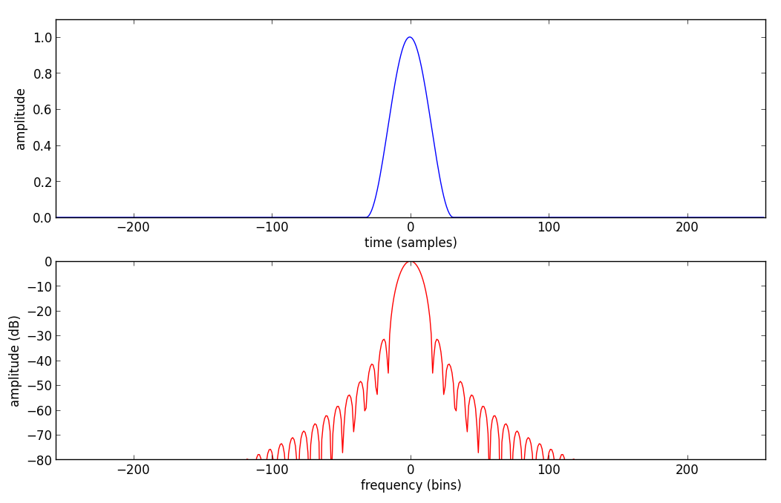
Hanning window
where
main-lobe width: 4 bins
side-lobe level: -31.5 dB

Slide 13
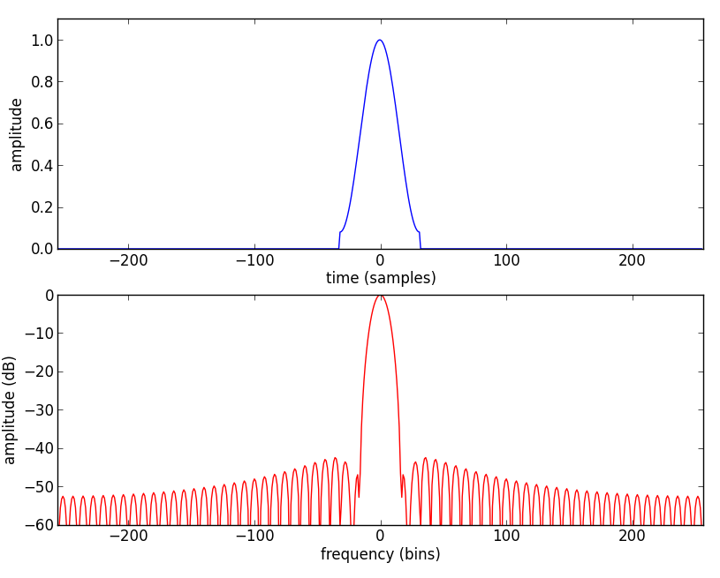
Hamming window
main-lobe width: 4 bins
side-lobe level: -42.7 dB

Slide 14
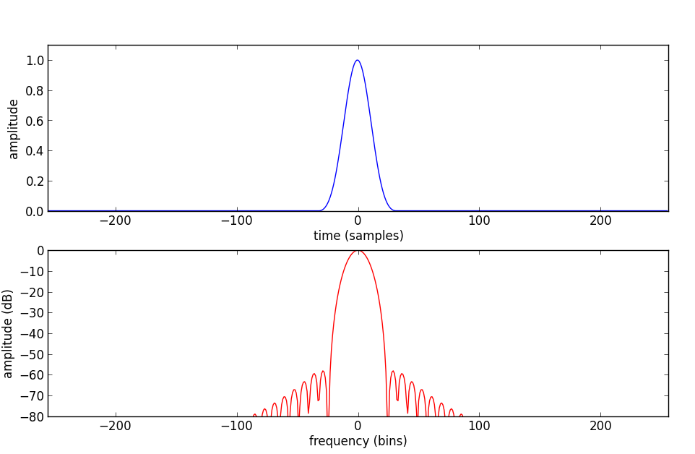
Blackman window
main-lobe width: 6 bins
side-lobe level: -58 dB

Slide 15
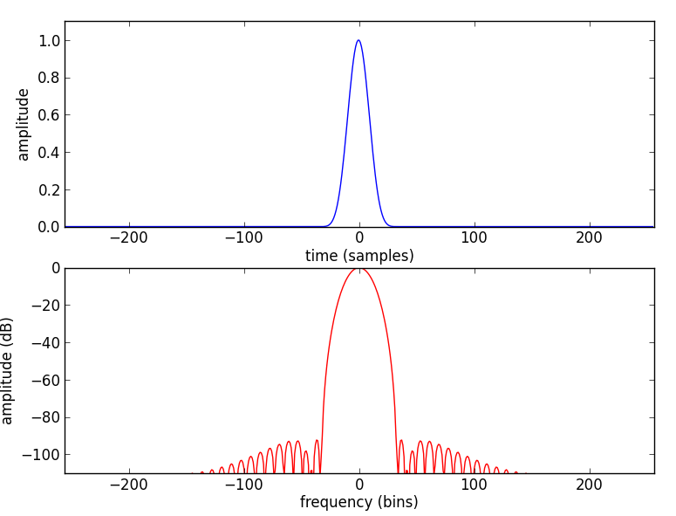
Blackman-Harris window
minimum 4-term Blackman-Harris window

Slide 16
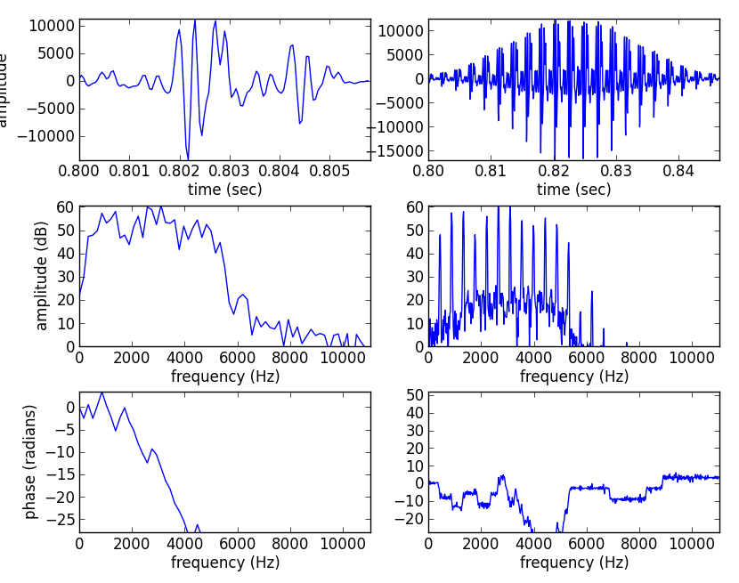
Window size
Affects the time versus frequency resolution
M = 128
M = 1024

Slide 17
(fs, x) = read('oboe.wav')
N = 128
start = .8*fs
xw = x[start:start+N] * np.hamming(N)
plt.subplot(321)
plt.plot(np.arange(start, (start+N), 1.0)/fs, xw)
X = fft(xw)
mX = 20 * np.log10(abs(X)/N)
pX = np.unwrap(np.angle(X))
plt.subplot(323)
plt.plot(np.arange(0, fs/2.0, float(fs)/N), mX[0:N/2])
plt.subplot(325)
plt.plot(np.arange(0, fs/2.0, float(fs)/N), pX[:N/2])
N = 1024
start = .8*fs
xw = x[start:start+N] * np.hamming(N)
plt.subplot(322)
plt.plot(np.arange(start, (start+N), 1.0)/fs, xw)
X = fft(xw)
mX = 20 * np.log10(abs(X)/N)
pX = np.unwrap(np.angle(X))
plt.subplot(324)
plt.plot(np.arange(0, fs/2.0, float(fs)/N), mX[0:N/2])
plt.subplot(326)
plt.plot(np.arange(0, fs/2.0, float(fs)/N), pX[:N/2])

Slide 18
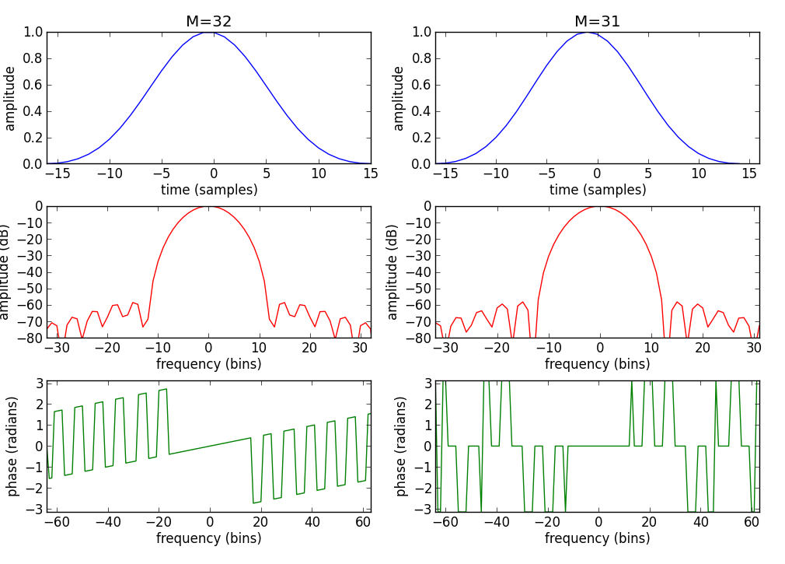
Even-Odd size Window

Slide 19
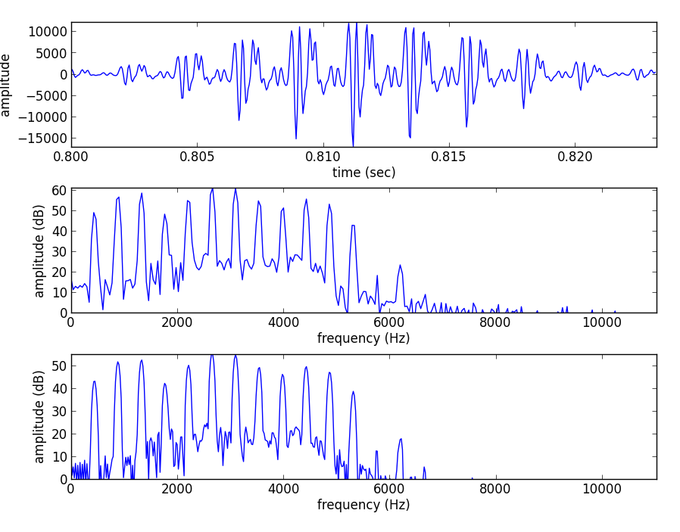
FFT size
FFT size, N, should be equal or larger than the window size, M

Slide 20
(fs, x) = read('oboe.wav')
M = 512
N = 512
start = .8*fs
xw = x[start:start+M] * np.hamming(M)
plt.subplot(311)
plt.plot(np.arange(start, (start+M), 1.0)/fs, xw)
X = fft(xw, N)
mX = 20 * np.log10(abs(X)/N)
pX = np.unwrap(np.angle(X))
plt.subplot(312)
plt.plot(np.arange(0, fs/2.0, float(fs)/N), mX[0:N/2])
M = 512
N = 1024
start = .8*fs
xw = x[start:start+M] * np.hamming(M)
X = fft(xw, N)
mX = 20 * np.log10(abs(X)/N)
plt.subplot(313)
plt.plot(np.arange(0, fs/2.0, float(fs)/N), mX[0:N/2])

Slide 21
Hop size
Successive frames should overlap in time in such a
way that all the data are weighted equally.
For certain windows exists perfect overlap factors.
Rectangular: M/j, Hanning and Hamming: (M/2)/j,
where j = 0, 1, ....
The overlap factor can be expressed by:

Slide 22
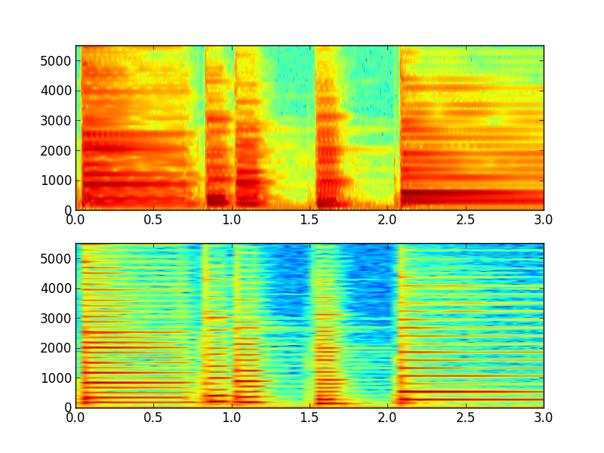
Time-frequency compromise
M=226
N=256
H=128
M=1024
N=1024
H=128

Slide 23
from pylab import *
from scipy.io.wavfile import read
(fs, x) = read('piano.wav')
subplot(2,1,1)
specgram(x, NFFT=256, Fs=fs, noverlap=128)
subplot(2,1,2)
specgram(x, NFFT=1024, Fs=fs, noverlap=128)

Slide 24
Inverse STFT
each synthesized frame is:
and the synthesized sound is:

Slide 26
STFT implementation diagram
w[n]
x[n]
|X[k]|
yw[n]
y[n]
FFT
IFFT
Overlap-add
xw[n]
<X[k]

Slide 27
def stft(x, fs, w, N, H):
hN = N/2
hM = (w.size+1)/2
pin = hM
pend = x.size-hM
w = w / sum(w)
while pin<pend:
#-----analysis-----
xw = x[pin-hM:pin+hM-1] * w
fftbuffer[:hM] = xw[hM-1:]
fftbuffer[N-hM+1:] = xw[:hM-1]
X = fft(fftbuffer)
mX = 20 * np.log10( abs(X[:hN]) )
pX = np.unwrap( np.angle(X[:hN]) )
#-----synthesis-----
Y[:hN] = 10**(mX/20) * np.exp(1j*pX)
Y[hN+1:] = 10**(mX[:0:-1]/20) * np.exp(-1j*pX[:0:-1])
fftbuffer = np.real( ifft(Y) )
yw[:hM-1] = fftbuffer[N-hM+1:]
yw[hM-1:] = fftbuffer[:hM]
y[pin-hM:pin+hM-1] += H*yw
pin += H
return y

Slide 28
References
https://ccrma.stanford.edu/~jos/sasp/
https://en.wikipedia.org/wiki/STFT
https://en.wikipedia.org/wiki/Window_function
Full code of plots and accompanying labs available at: https://github.com/MTG/sms-tools

Slide 29
Credits
All the slides of this presentation are released under an Attribution-Noncommercial-Share Alike license.

