Slide 1
5T1: Sinusoidal model
(1 of 3)
Xavier Serra
Universitat Pompeu Fabra, Barcelona
&
Stanford University
Notes:
Welcome again to the course on Audio Signal Processing for Music applications!!
Last week we talked about the Short-time Fourier Transform. That offered a sound representation from which we can synthesize sounds without lossing any information, and at the same time it is a good tool for understanding, describing and transforming sounds.
This week we go a step further in the direction of obtaining a higher-level representation, that in exchange of losing a bit in terms of the identiy properties of the STFT, we gain quite a lot of flexibility and level of abstraction in the representation.
This is what we call the sinusoidal model. We will cover this topic in three theory lectures.

Slide 2
Index
Sinusoidal model
Spectrum of sinewave
Sinewaves as spectral peaks
Notes:
In the first part of the lecture we will go over the sinusoidal model and the concept of how can we identify sinusoids in the spectrum.
...

Slide 3
Sinusoidal model
Notes:
The sine model is very simple, it is just a sum of time-varying sinusoids.
...

Slide 4
Spectrum of sinewave
Notes:
But we are interested in modeling the sinusoids in the frequency domain, in the spectrum. So let's see what that looks like.
...

Slide 5
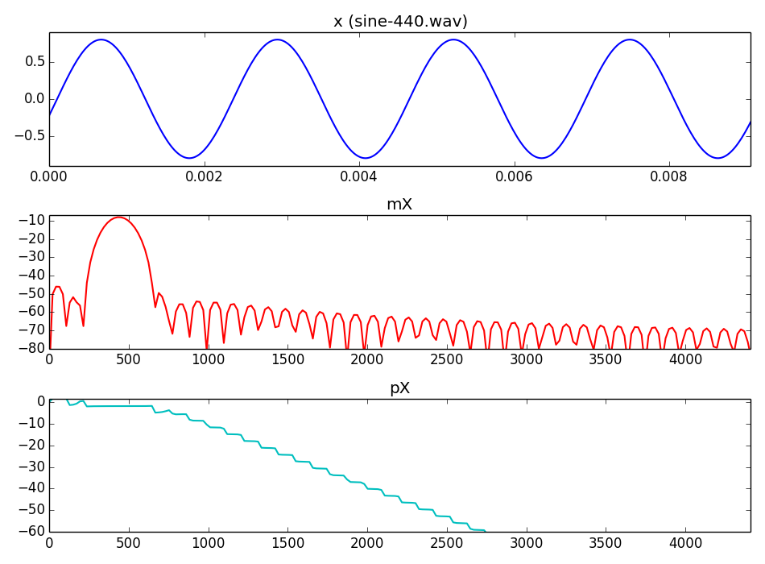
Notes:
If we start from a sinewave
...
the positive side of its spectrum looks like this
...

Slide 6
Notes:
If we start from a sinewave
...
the positive side of its spectrum looks like this
...

Slide 7
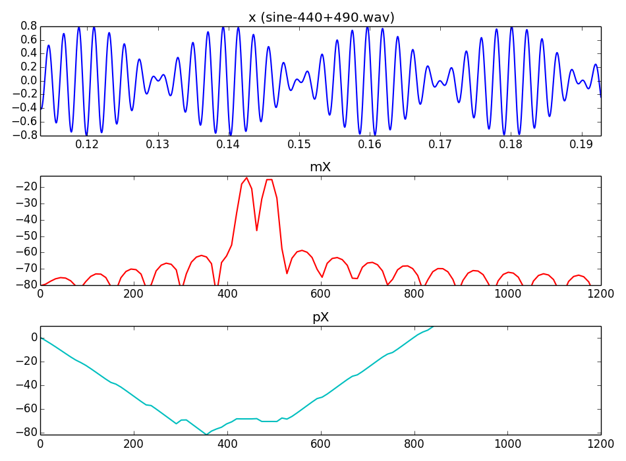
Notes:
Let's make it a bit more dificult, what happens when our sound is made up of two sinewaves.
...

Slide 8
Notes:
Let's make it a bit more dificult, what happens when our sound is made up of two sinewaves.
...

Slide 9
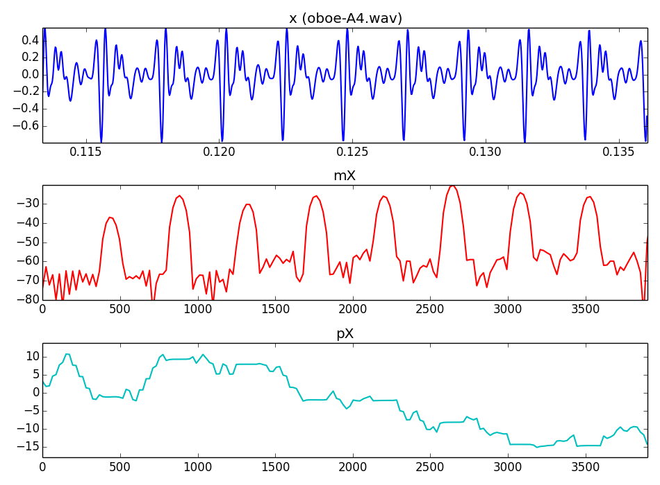
Notes:
Let's show an example using a real sound, a sound that includes many sinewaves, like the sound of an oboe.
...
But how do we detect the frequency, amplitude and phase of each of these sinewaves?

Slide 10
Notes:
Let's show an example using a real sound, a sound that includes many sinewaves, like the sound of an oboe.
...
But how do we detect the frequency, amplitude and phase of each of these sinewaves?

Slide 11
Sinewaves as spectral peaks
Sinusoid peak in magnitude spectrum
Frequency resolution: 1/2 bin
Improvement of frequency resolution by:
  zero-padding
  spectral interpolation
Notes:
A simple way to identify a sinusoid in the spectrum is by just focusing on its spectral magnitude peak, on its location and height.
The location is the frequency and the height is the amplitude of the sinusoid.
...

Slide 12
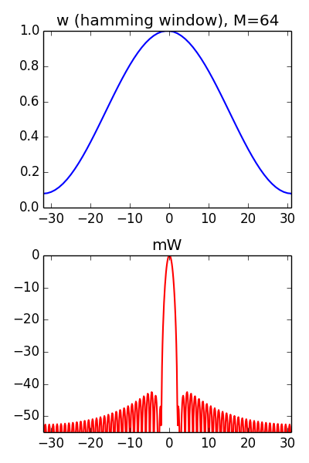
Spectral peaks and window-size
Notes:
To detect the spectral peaks we have to understand the effect of the window.
The most important factor is the window size.
...

Slide 13
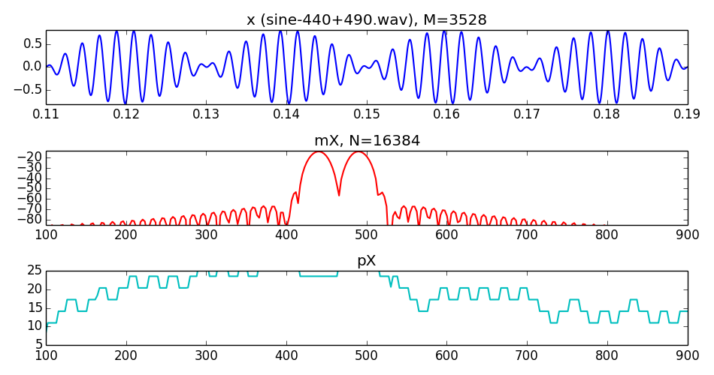
Notes:
Let's show an example,
..

Slide 14
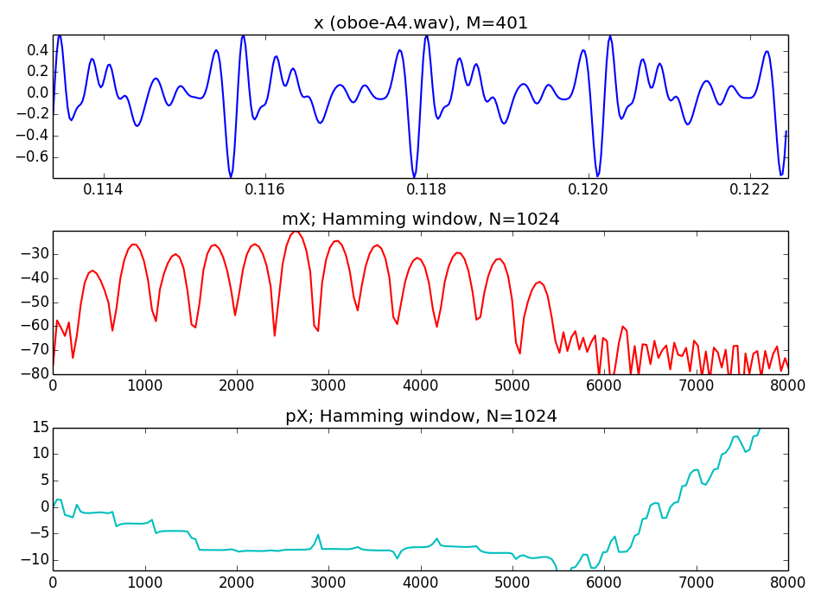
Notes:
and let's see what happens with different sounds.
...

Slide 15
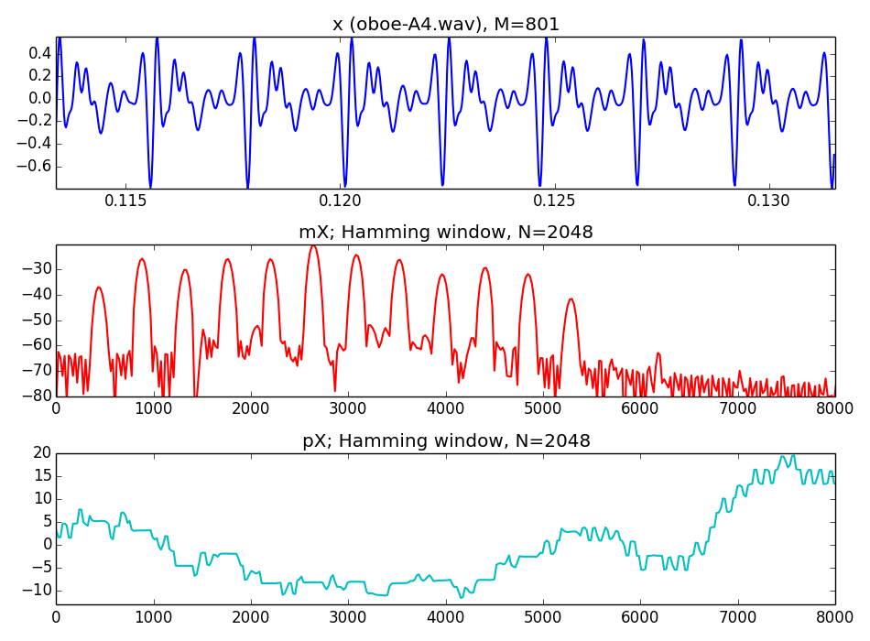
Notes:
and let's look at a real sound
...

Slide 16
References and credits
More information in:
  http://en.wikipedia.org/wiki/Sinusoidal_model
Reference on sinusoidal modeling by Julius O. Smith: https://ccrma.stanford.edu/~jos/sasp/Spectrum_Analysis_Sinusoids.html
Sounds from: http://www.freesound.org/people/xserra/packs/13038/
Slides and code released using the CC Attribution-Noncommercial-Share Alike license or the Affero GPL license and available from https://github.com/MTG/sms-tools
Notes:
On the topics covered until now there were many good references, but starting from this topic there is less. These techniques are more specific to music applications and thus much less has been published.
This is good for me, you will have to pay more attention to this course!!
...

Slide 17
5T1: Sinusoidal model
(1 of 3)
Xavier Serra
Universitat Pompeu Fabra, Barcelona
&
Stanford University
Notes:
This is all for this class.
We have presented the sinusoidal model, a sound representation that can be built on top of the Short-time Fourier Transform and that can reduce the amount of spectral information to be considered.
However, to use it, we have to understand a bit about spectra and about windows. Hopefully you understood some of that in this class.
Now we have to complete the explanation of how to identify the spectral peaks and how to synthesize sounds from that. This will be covered in the next two theory lectures.
Thanks for your attention.

