Slide 1
10T2: Review
Xavier Serra
Universitat Pompeu Fabra, Barcelona
&
Stanford University

Slide 2
Index
A spectral view of sound and music
Framework covered in this course
Sound spectra: DFT, STFT
Sinusoids and harmonics
Residuals and stochastic components
Transforming sounds
Describing sounds and music
...and beyond

Slide 3
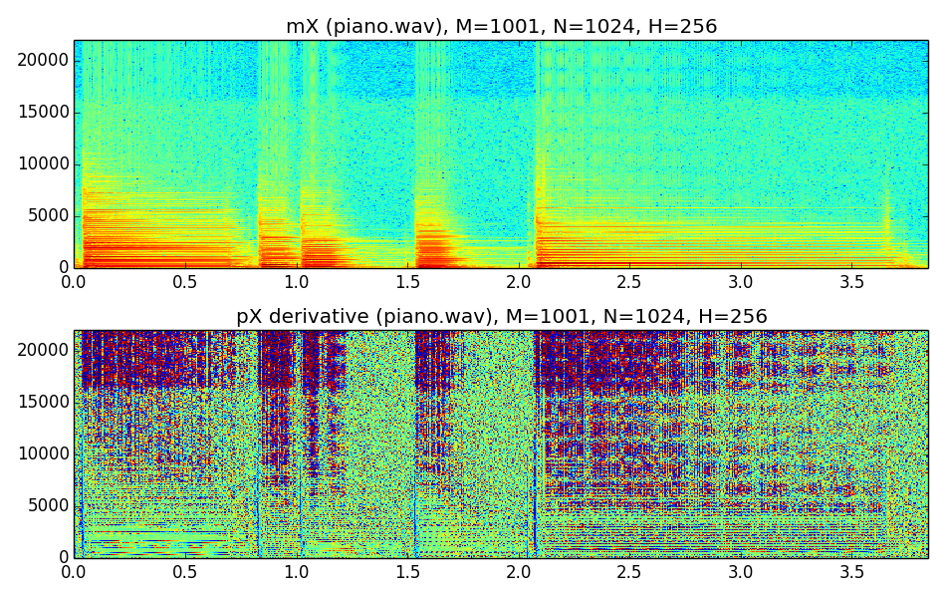
A spectral view of sound and music

Slide 4
Framework covered in this course
x[n]
FFT
peak detection
residual analysis
partial detection
feature analysis
features
transformations
synthesis
y[n]

Slide 5
Sound spectra
Discrete Fourier Transform:
Short-time Fourier Transform:

Slide 6
Sinusoids and harmonics
Sinusoidal model:
Harmonic model:

Slide 7
Residual and stochastic components
Sinusoidal plus residual model:
Sinusoidal plus stochastic model:

Slide 8
Transforming sounds
manipulating sinusoids and stochastic component:

Slide 9
Describing sounds and music
cognitive | emotion, music style, semantic concepts
formal | melody, key, tonality | rhythmic patterns, tempo, meter | instrument, voice | articulation
perceptual | successive and simultaneous intervals | time (beat) | timbre (spectral envelope) | dynamics
sensorial | pitch | time | timbre | loudness
physical | frequency | duration (onset) | spectrum (centroid) | intensity

Slide 10
...and beyond
...audio signal processing is more than this
...sounds and music is more than audio

Slide 11
References and credits
All slides for this course are released using the CC Attribution-Noncommercial-Share Alike license and available from https://github.com/MTG/sms-tools

Slide 12
10T2: Review
Xavier Serra
Universitat Pompeu Fabra, Barcelona
&
Stanford University

