Slide 1
10T3: MTG-UPF
Xavier Serra
Universitat Pompeu Fabra, Barcelona
&
Stanford University
Notes:
Welcome everyone to the course on Audio Signal Processing for Music Applications.
This is the Welcome class, where I want to introduce you to the practical aspects of the course.

Slide 2
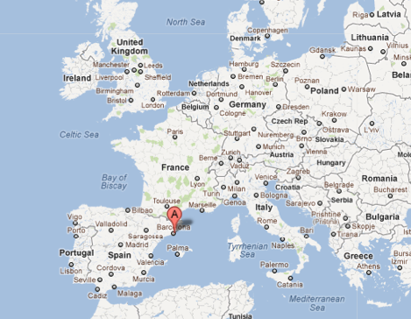
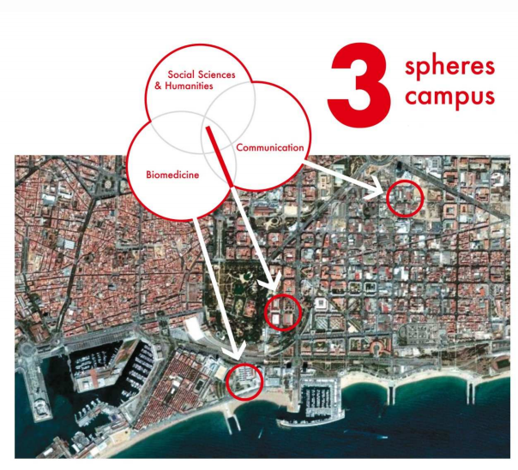
Universitat Pompeu Fabra
Notes:
UPF is a young, public and modern university founded in 1990 and is becoming one of the leading European universities.
Undergraduate students: 10000
Graduate students: 5000

Slide 3
Music Technology Group - UPF
part of the Department of Information and Communication Technologies
Education:
  Master in Sound and Music Computing
  PhD in Information and Communication Technologies
Research:
  Audio Signal Processing
  Sound and Music Description
  Musical and Advanced Interaction
  Semantic Technologies for Sound and Music
Notes:
...

Slide 4

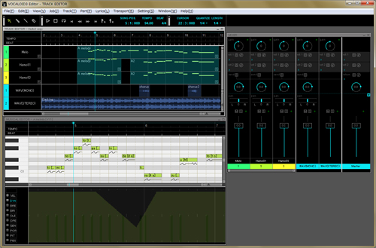

Audio signal processing
Singing voice synthesis
Notes:
...

Slide 5
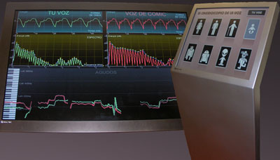
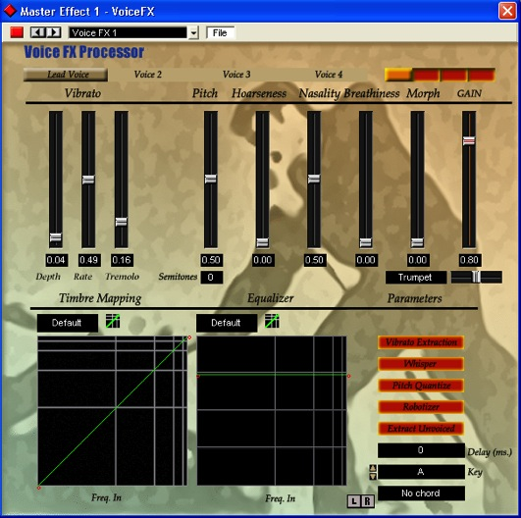
Audio signal processing
Voice transformations
Notes:
...

Slide 6
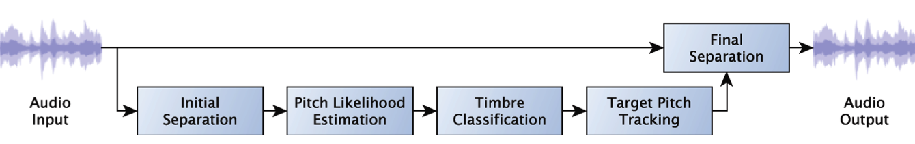
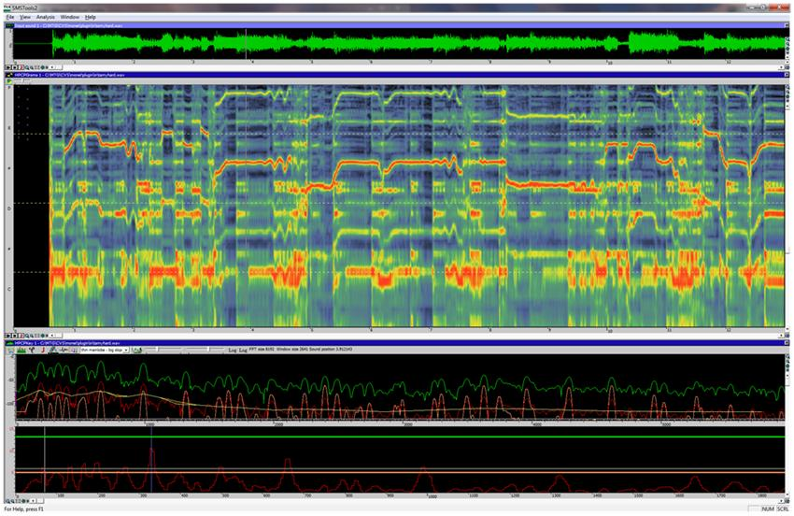
Audio signal processing
Sound source separation
Notes:
...

Slide 7
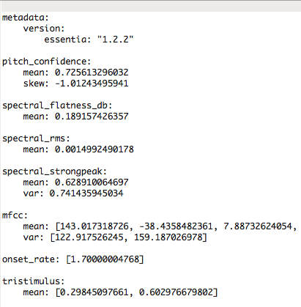

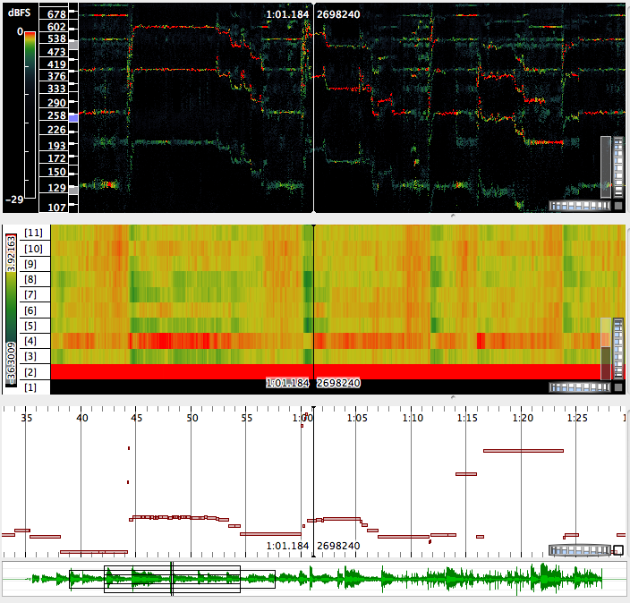
Sound and music description
Audio features
Notes:
...

Slide 8
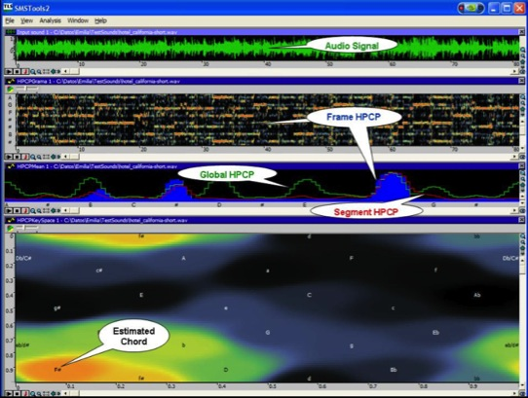
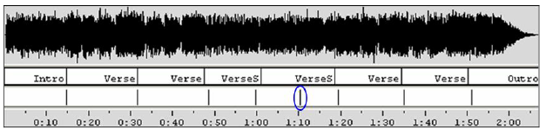
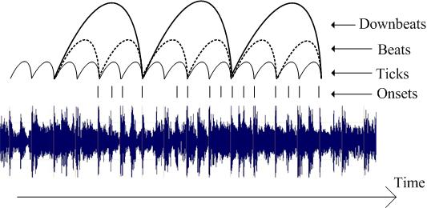
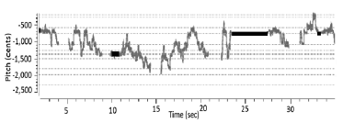
Sound and music description
Musical features
structure
harmony
melody
rhythm
Notes:
...

Slide 9
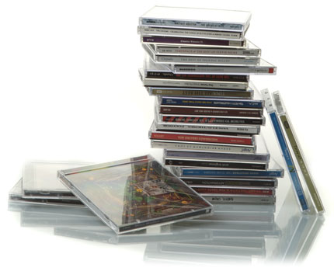
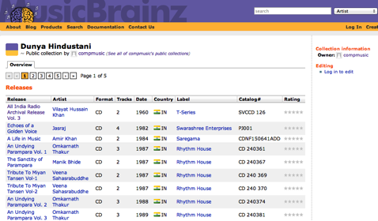


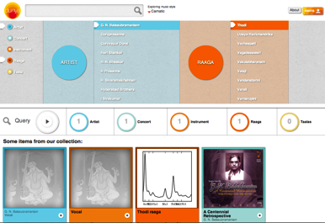
Sound and music description
Music collections
Signal processing
Melodic patterns
Machine learning
Rhythmic patterns
Semantic analysis
Semantic relationships
Notes:
...

Slide 10


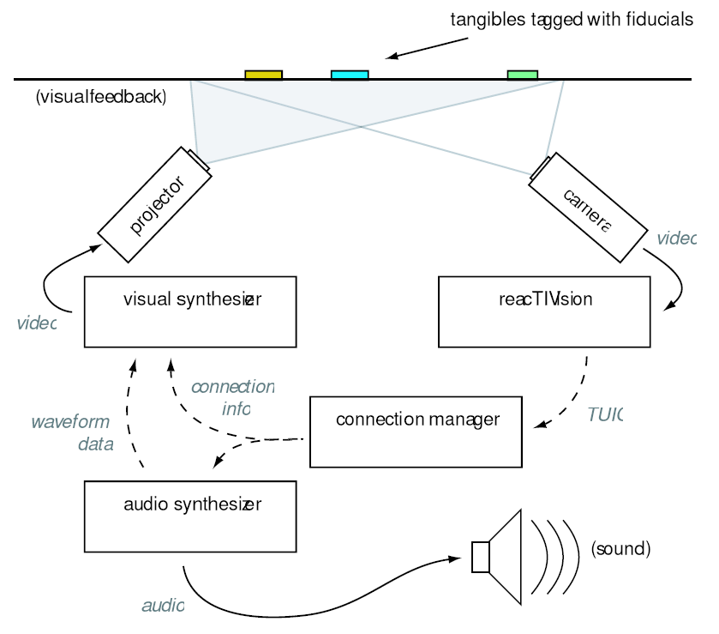
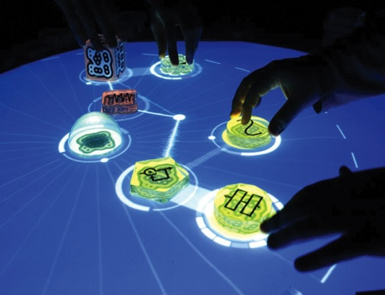
Musical and advance interfaces
Reactable
Notes:
...

Slide 11
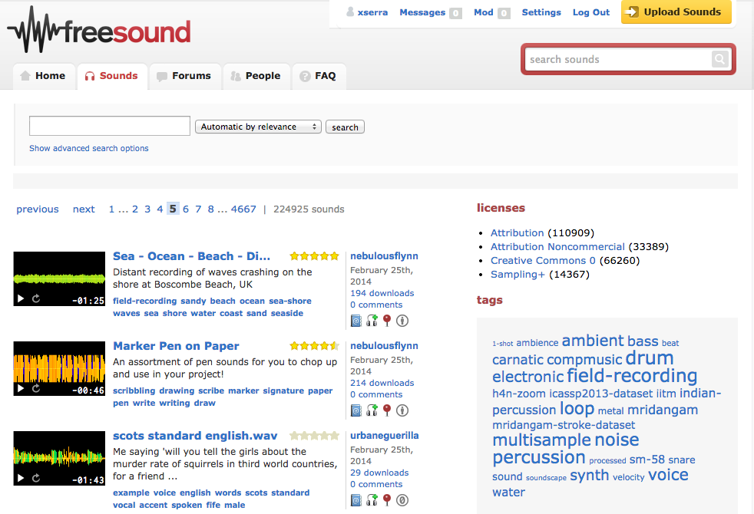
Semantic technologies for sound and music
Freesound
Notes:
...

Slide 12
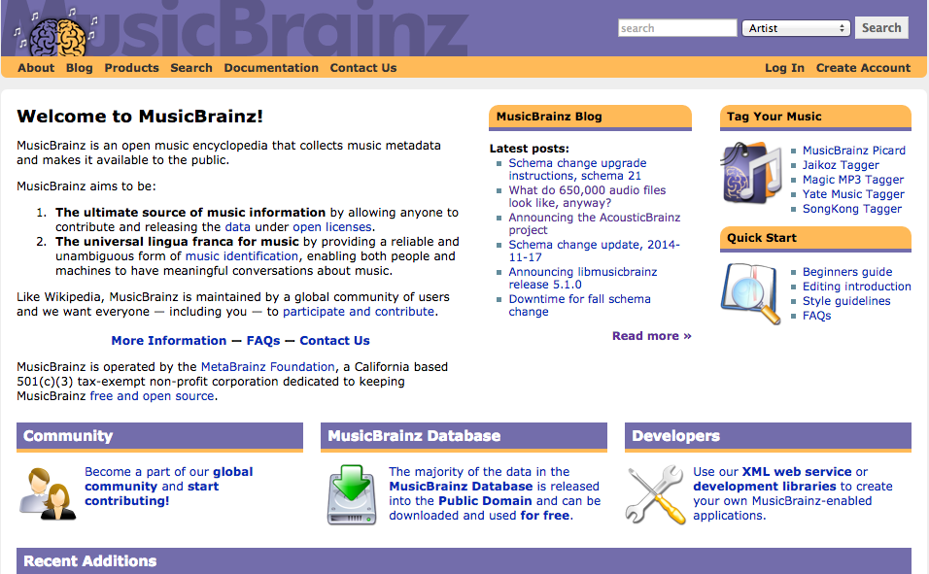
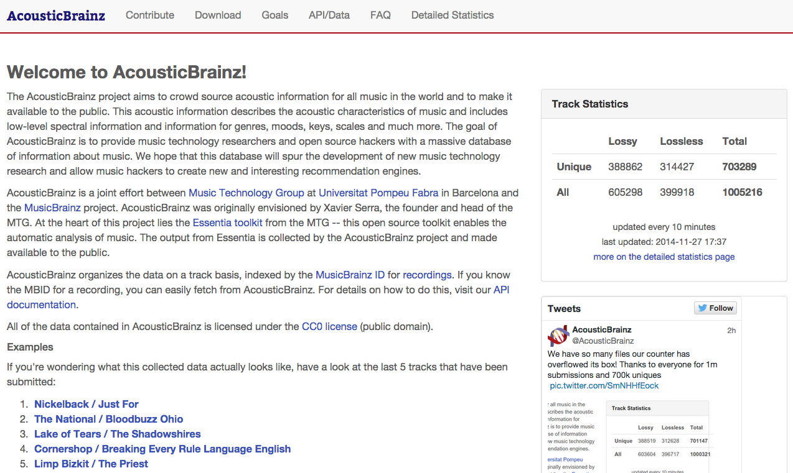
Semantic technologies for sound and music
AcousticBrainz
Notes:
...

Slide 13
References and credits
http://upf.edu, http://www.upf.edu/dtic/, http://mtg.upf.edu
http://en.wikipedia.org/wiki/Vocaloid
http://compmusic.upf.edu/
http://en.wikipedia.org/wiki/Reactable
http://acousticbrainz.org/
All slides for this course are released using the CC Attribution-Noncommercial-Share Alike license and available from https://github.com/MTG/sms-tools

Slide 14
10T3: MTG-UPF
Xavier Serra
Universitat Pompeu Fabra, Barcelona
&
Stanford University
Notes:
Welcome everyone to the course on Audio Signal Processing for Music Applications.
This is the Welcome class, where I want to introduce you to the practical aspects of the course.

