Slide 1
10T4: Audio Signal Processing for Music Applications:
Goodby
Xavier Serra
Universitat Pompeu Fabra, Barcelona
&
Stanford University
Notes:
This is it, this is my last video lecture of the course on Audio ..

Slide 2
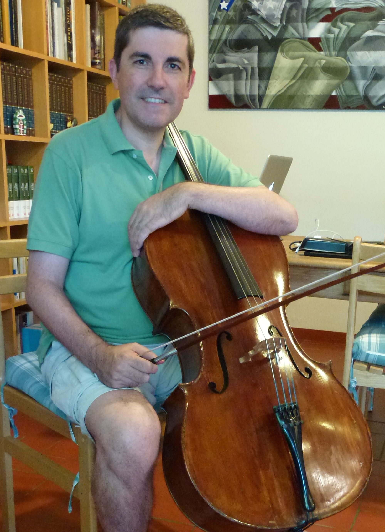
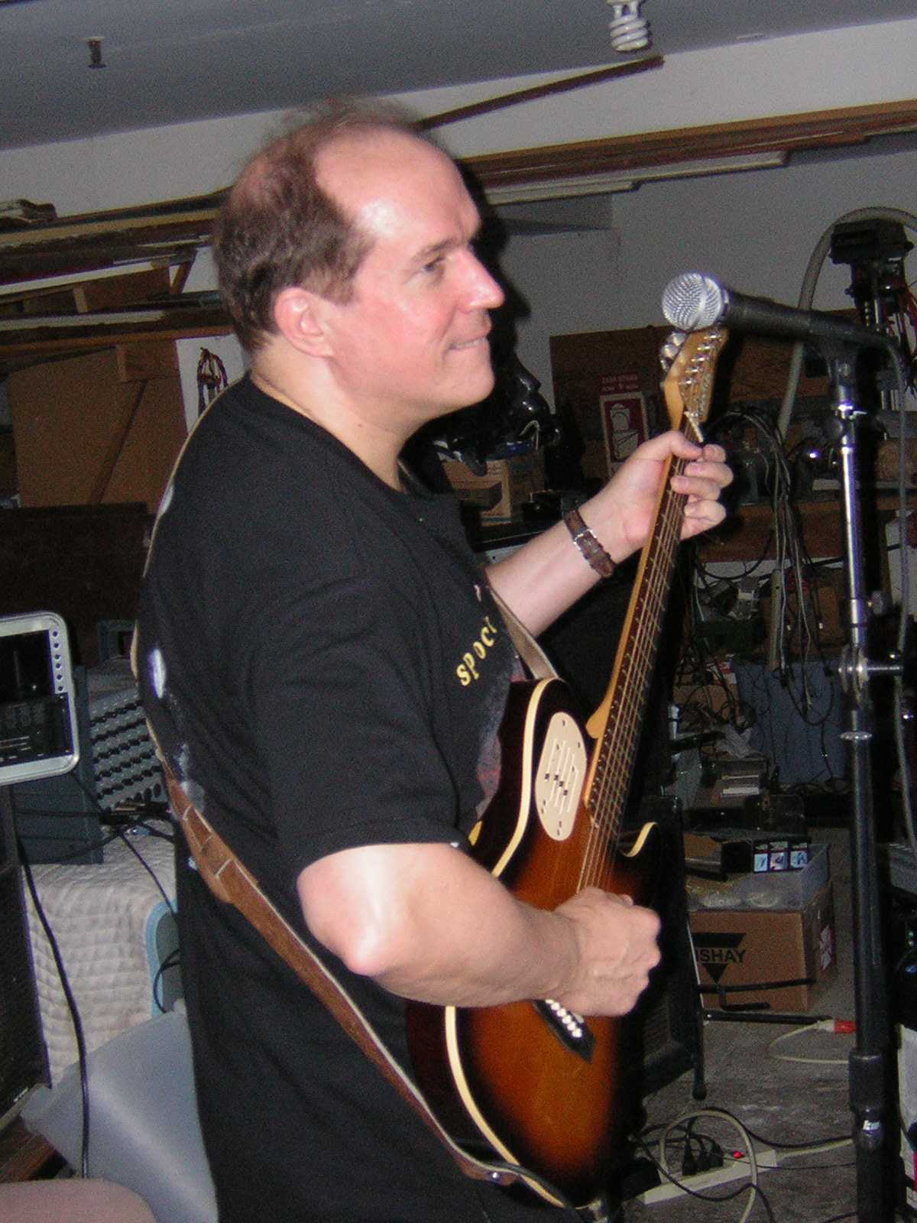
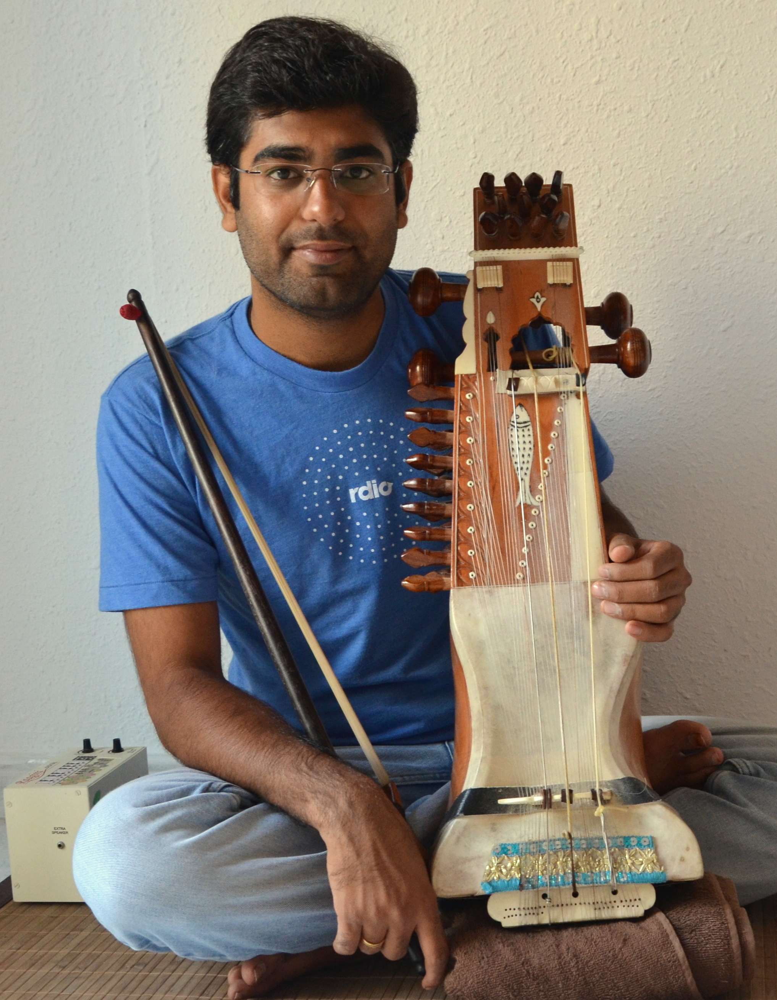
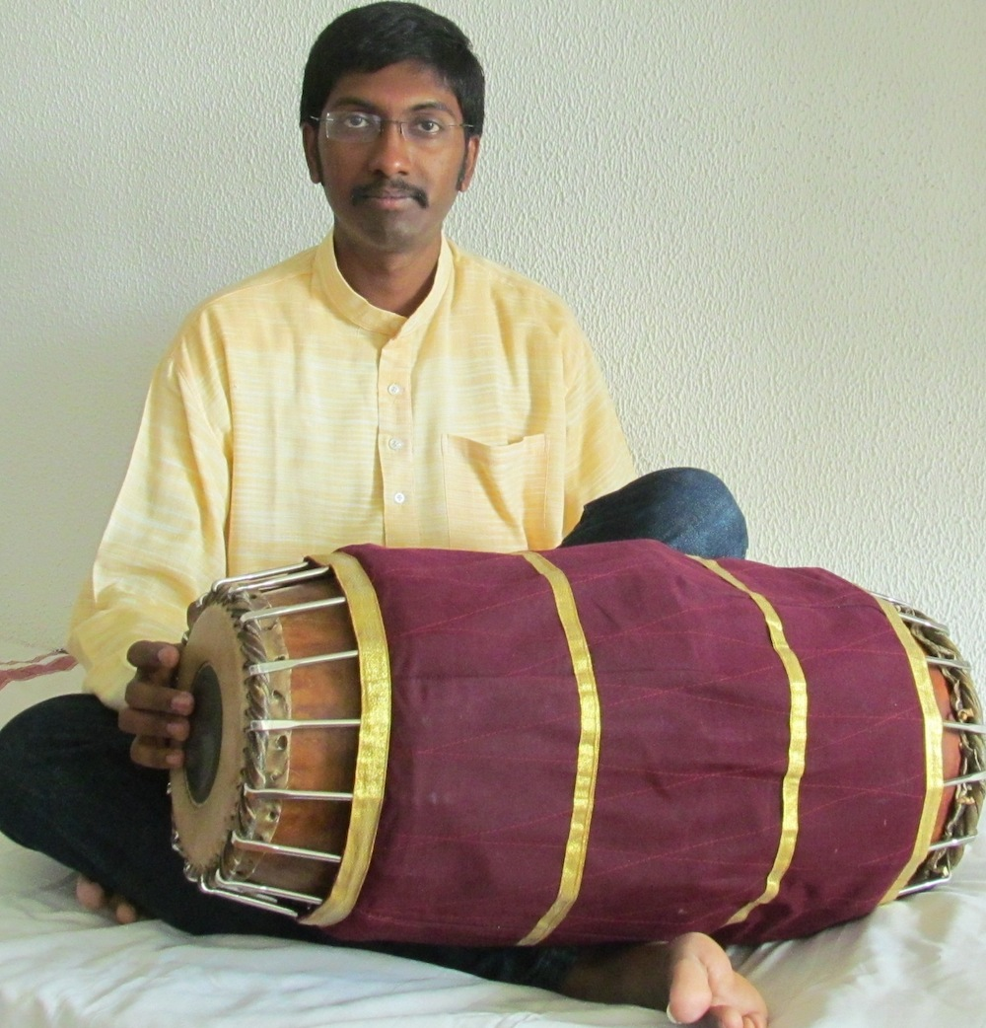
Thank-you!!!
Notes:
Thank-you. We want to thank you all for keeping up with the course and thus giving a meaning to this first experiment of us. We have learned a lot doing and and we will definately use this experience to improve the next session of the course.

Slide 3
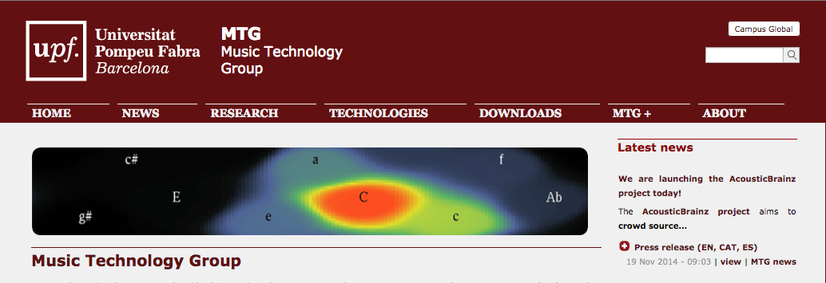
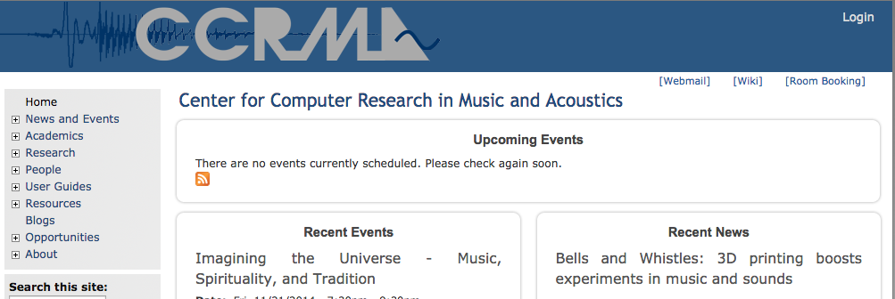
Notes:
We also have to aknowledge the institutions that we come from. They made it possible.

Slide 4
Where to learn more
Research centers
Master and PhD programs
Conferences
Journals
Notes:
In this short finishing lecture let me give you some pointers to places where you can learn more about the topics of the course.

Slide 5
Research centers
Many!!!
...with different disciplinary backgrounds and focus
...for a partial list: http://smcnetwork.org/resources

Slide 6
Master programs
PhD programs
Master in Sound and Music Computing, Universitat Pompeu Fabra, Barcelona
Master in Music, Science, and Technology, Stanford University
...
PhD at MTG-Universitat Pompeu Fabra
PhD at CCRMA-Stanford University
...

Slide 7
Relevant Conferences
International Computer Music Conference (ICMC), http://www.computermusic.org
Sound and Music Computing Conference (SMC), http://smcnetwork.org
International Conference on Digital Audio Effects (DAFX), http://www.dafx.de
International Conference on Music Information Retrieval (ISMIR), http://www.ismir.net/
International Conference on New Interfaces for Musical Expression (NIME), http://www.nime.org
Audio Engineering Society conventions http://www.aes.org/events/conventions
IEEE Int. Conf. on Acoustics, Speech and Signal Processing (ICASSP)
ACM Multimedia (ACM-MM)
...

Slide 8
Relevant Journals
Computer Music Journal (CMJ)
Journal of New Music Research (JNMR)
Journal of the Audio Engineering Society
IEEE Transactions on Audio, Speech and Language Processing (TASLP)
ACM Transactions on Multimedia Computing, Communications, and Applications (TOMM)
...
Notes:
I want to finish by mentioning that all the materials I will use and produce in this course are available under open licenses.
...

Slide 9
References and credits
http:/www.smcnetwork.org/
https://en.wikipedia.org/wiki/Sound_and_music_computing
All slides for this course are released using the CC Attribution Noncommercial-Share Alike license and available from https://github.com/MTG/sms-tools

Slide 10
10T4: Audio Signal Processing for Music Applications:
Goodby
Xavier Serra
Universitat Pompeu Fabra, Barcelona
&
Stanford University
Notes:
Well this is really it...
I was want to say a personal thank-you to everyone that made this course possible. To Coursera for providing this amazing platform to deliver these type of courses.
Goodby to you all!!!

