Slide 1
Fourier Transform theorems and properties
(1 of 2)
Xavier Serra
Universitat Pompeu Fabra, Barcelona

Slide 2
Index
Linearity
Shift
Evenness
Convolution

Slide 3
Linearity:

Slide 4
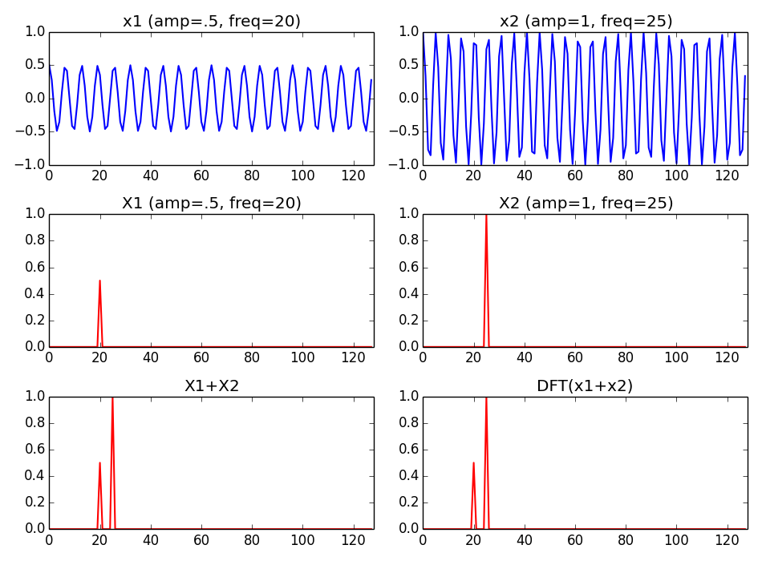

Slide 5
Shift:

Slide 6
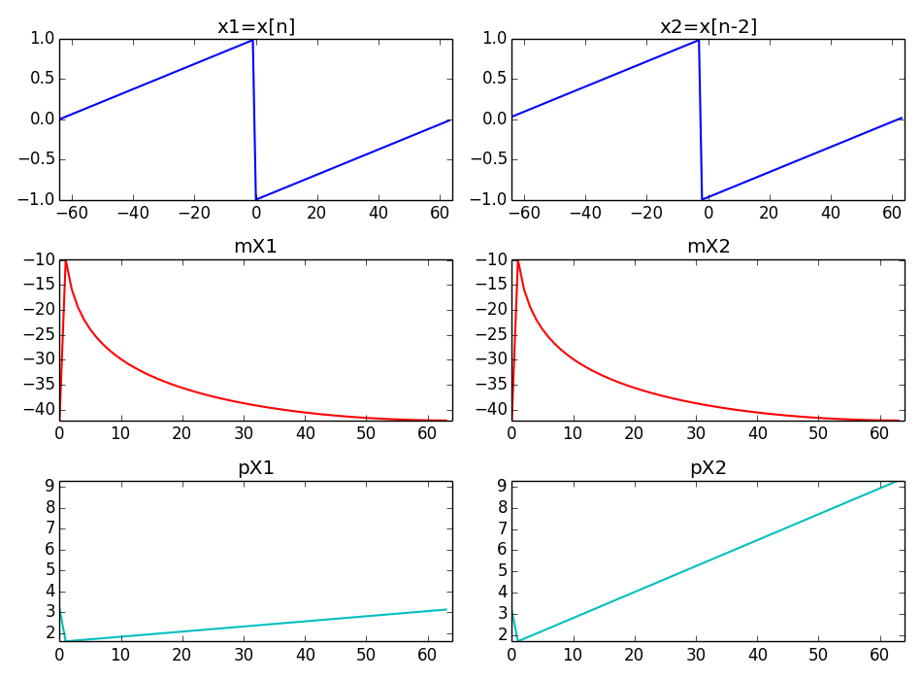

Slide 7
Evenness:

Slide 8
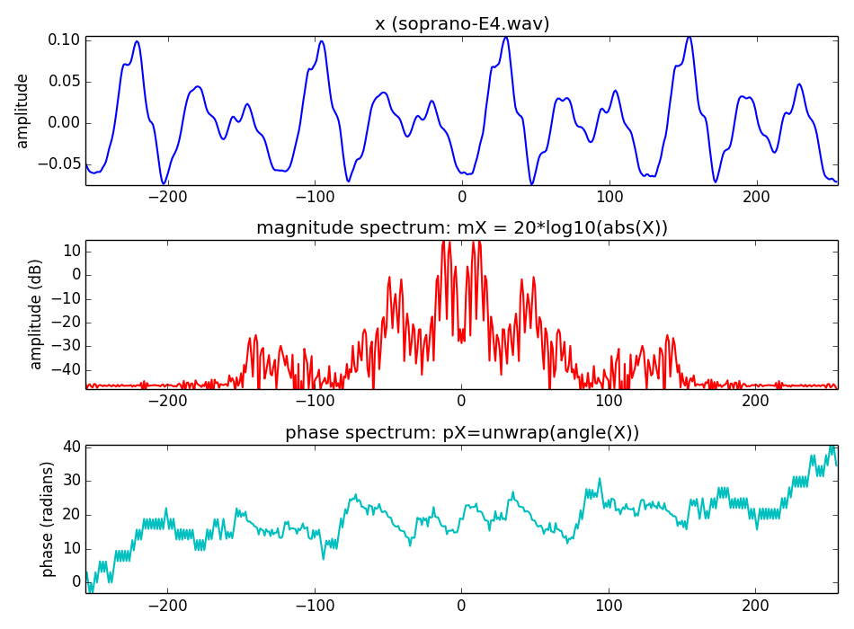

Slide 9
Convolution:

Slide 10
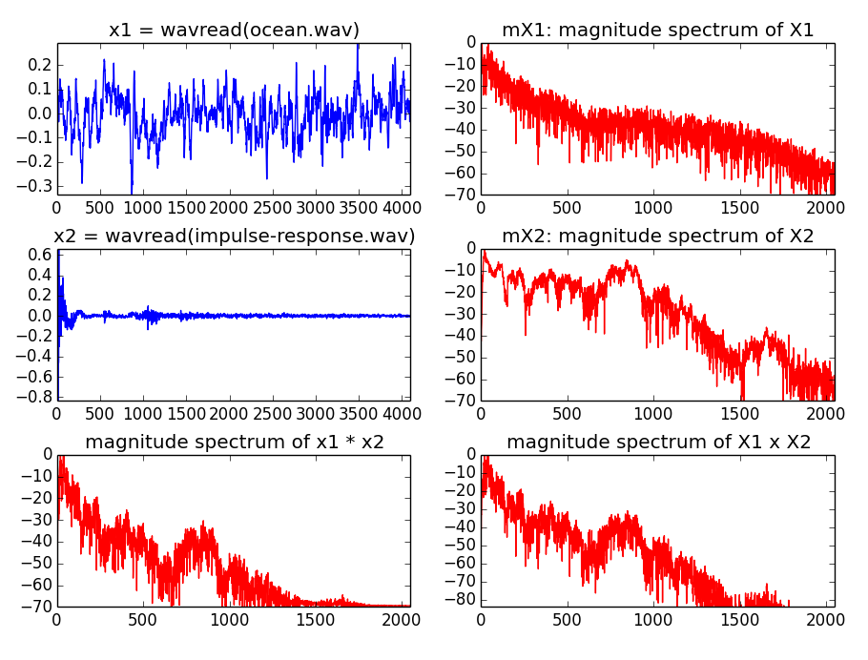

Slide 11
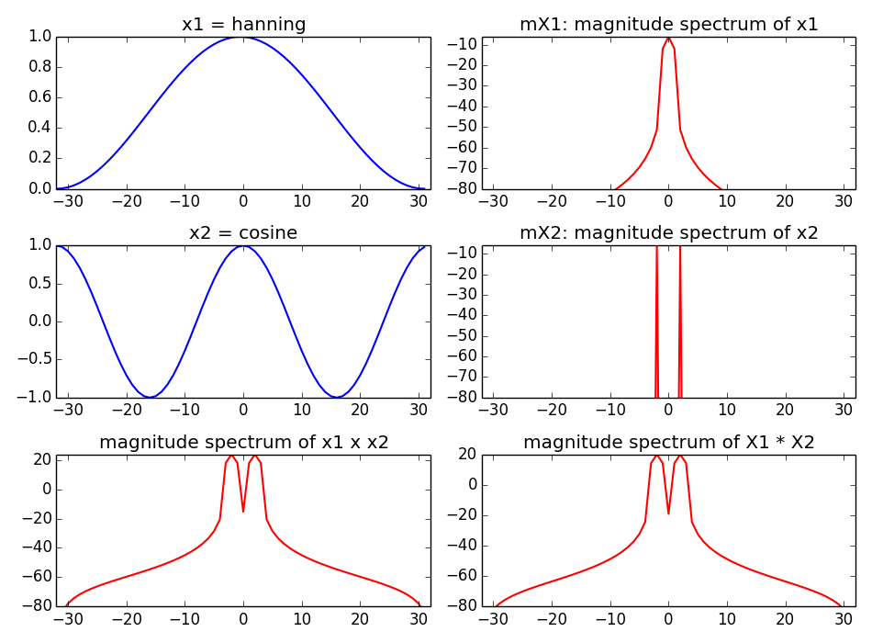

Slide 12
References and credits
More information on this topic:https://en.wikipedia.org/wiki/Fast_Fourier_transform
Sounds used taken from Freesound: http://www.freesound.org/people/xserra/packs/13038/
Reference for the DFT by Julius O. Smith: https://ccrma.stanford.edu/~jos/mdft/
All slides and code produced for this course are released using the CC Attribution-Noncommercial-Share Alike license or the Affero GPL license and available from https://github.com/MTG/sms-tools

Slide 13
Fourier Transform theorems and properties
(1 of 2)
Xavier Serra
Universitat Pompeu Fabra, Barcelona

