Slide 1
Spectral-based sound transformations
Xavier Serra
Universitat Pompeu Fabra, Barcelona

Slide 2
Index
Short-time Fourier transform
  Filtering; morphing
Sinusoidal plus residual model
  Frequency scaling
Harmonic plus residual model
  Pitch transposition; morphing
Harmonic plus stochastic model
  Time stretching; expressive transformations

Slide 3
Short-time Fourier transform
w[n]
x[n]
|X[k]|
|Y[k]|
yw[n]
FFT
y[n]
Transf
IFFT
Overlap-add
xw[n]
<X[k]
<Y[k]

Slide 4
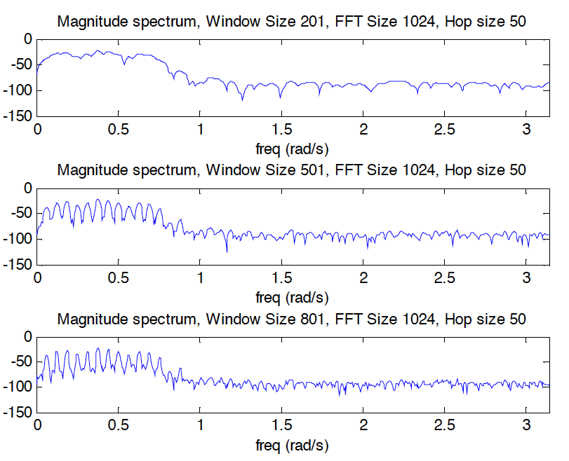
Filtering: frequency resolution

Slide 5
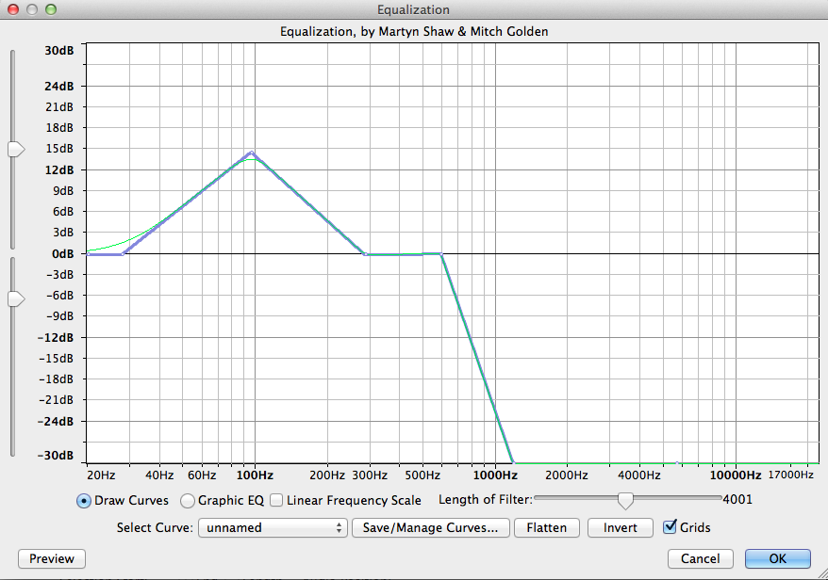
Filtering: Equalization

Slide 6
Morphing with STFT
w2[n]
x2[n]
|X2[k]|
X
FFT
x2w[n]
smoothing
w1[n]
|X1[k]|
|Y[k]|
x1[n]
yw[n]
y[n]
X
FFT
X
IFFT
Overlap-add
x1w[n]
<X1[k]

Slide 7
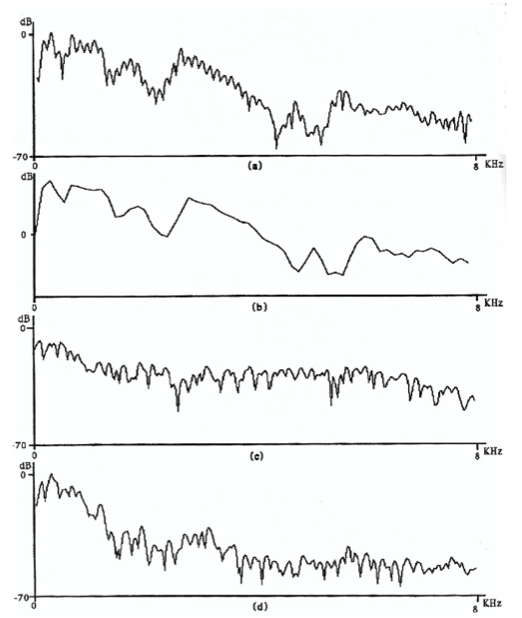
Morphing

Slide 8
Harmonic plus residual model
wh[n]
x[n]
|X[k]|
A_{r}
f_{r}
p_{r}
X
FFT
Peak detection
F0
detection
xwh[n]
<X[k]
p_{h}
f_{h}
p_{h}
A_{h}
xwr[n]
X[k]
-
X
FFT
+
Sine spectral
synthesis
Yh[k]
wr[n]
Transf.
f_{h}
p_{h}
A_{h}
Sine spectral
synthesis
Yr[k]
Yh[k]
+
Y[k]
IFFT
yw[n]
Overlap-add
y[n]

Slide 9
Filtering sine waves
Hz = np.array([0, 2099, 2100, 3000, 3001, fs/2]) # Hz
dB = np.array([-200, -200, 0, 0, -200, -200]) # dB
Filter = np.asarray((Hz, dB))
ysmag += np.interp(ysloc/Ns*fs, Filter[0,:],Filter[1,:])

Slide 10
Frequency shifting of sine waves
fshift = 100.0
ysloc = (ysloc>0) * (ysloc + fshift/fs*Ns)

Slide 11
Frequency stretching of sine waves
fstretch = 1.1
ysloc = ysloc * (fstretch**np.arange(0, ysloc.size))

Slide 12
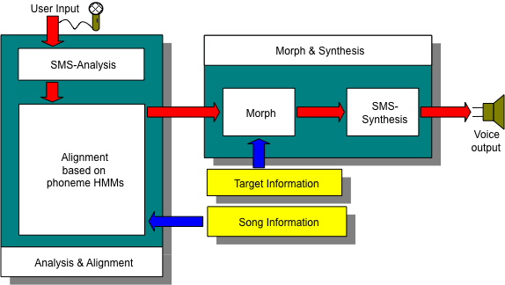
Morphing

Slide 13
Harmonic plus stochastic model
wh[n]
x[n]
|X[k]|
A_{r}
f_{r}
p_{r}
X
FFT
Peak detection
F0
detection
xwh[n]
<X[k]
p_{h}
f_{h}
p_{h}
A_{h}
xwr[n]
X[k]
Yh[k]
X
FFT
+
Sine spectral
synthesis
-
wr[n]
Yr[k]
Transf.
Stochastic approximation
f_{h}
p_{h}
A_{h}
|Ys[k]|
Sine spectral
synthesis
Transf.
Stochastic
spec. synthesis
Yh[k]
+
Random phase generation
Y[k]
<Ys[k]
IFFT
yw[n]
Overlap-add
y[n]

Slide 14
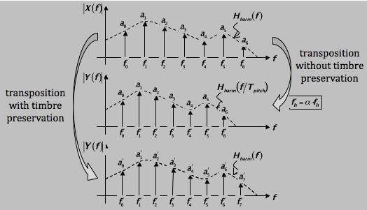
Pitch transposition with timbre preservation

Slide 15
Time scaling
Analysis frames
Used twice!
TS>1
Synthesis frames
Analysis frames
Not used!
TS<1
Synthesis frames

Slide 16
Time scaling: phase preservation
Phase
Z⁻¹
Spectrum Phase Generation
Phase
AF_{n}
Peak
Detection
Z⁻¹
Peak
Continuation
SF_{m}
Peak
Detection
Amplitude
Amplitude
Notes:
-Dynamic: The spectral characteristics of a voiced sound change with the loudness.

Slide 17
Phase preservation around each peak
Amplitude
f₁
Amplitude
f₁
f₂
f₂
Phase
Phase
AF_{n}
SF_{m}
Notes:
-Vibrato: Two types of vibrato exist in singing. The classical vibrato in opera music corresponds to periodic modulation of the phonation frequency, and in popular music the vibrato implies an added amplitude modulation of the voice source. In speech, no vibrato exists.

Slide 18
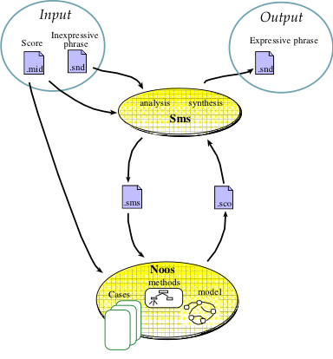
Expressive transformations

Slide 19
References
http://en.wikipedia.org/wiki/Sound_effects
http://en.wikipedia.org/wiki/Equalization_filter
http://en.wikipedia.org/wiki/Audio_timescale-pitch_modification

Slide 20
Credits
All the slides of this presentation are released under an Attribution-Noncommercial-Share Alike license.

