Slide 1
Some basic mathematics
Xavier Serra
Universitat Pompeu Fabra, Barcelona
Notes:
Welcome again to the Audio Signal Processing for Music Applications course!!
In this lecture I go over some of the basic mathematics that are required to understand the equations and concepts that we will introduce during in the course and that are the basis for the signal processing techniques to be developed and used in practice.

Slide 2
Index
Sinusoidal functions
Complex numbers
Euler’s formula
Complex sinusoids
Scalar product of sequences
Even and odd functions
Convolution
Notes:
We will deal with discrete signals and discrete systems, thus we will require some background on discrete mathematics.
The good news is that no calculus is required to follow this course.
We need to be familiar with sinusoidal functions, understand complex numbers, and know about some linear algebra. Not much more. The rest we will cover and explain in the course.
So let me now overview what you should already know about these concepts or, if you do not know about them, let me identify what you should learn by yourself before continuing in this course.

Slide 3
Sinusoidal functions (sinewaves)
Notes:
Let's start with sinewaves.
A sinewave, or sinusoid, is a mathematical curve that describes a smooth repetitive oscillation. It occurs often in physics, engineering and many other fields.
For us the sinewave is the basic building block that makes up all sounds and it is of fundamental importance for Fourier analysis, which is the core of this course.

Slide 4
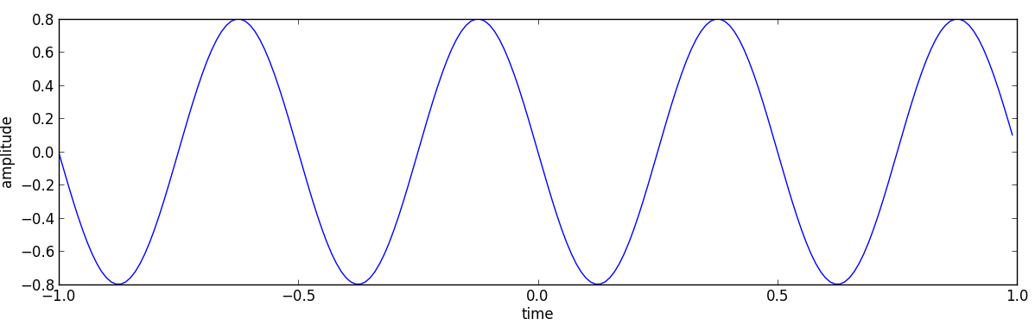
Sinewave plot
A = .8
f = 2
phi = pi/2
fs = 100
t = arange(-1, 1, 1.0/fs)
x = A * cos(2*np.pi*f*t+phi)
Notes:
The most common visual representation of a sinusoid is this one, in which we plot the value of the sinusoid along time.
For all our example calculations and plots done during the course, also for the assignments, we will be using the programing language Python. Here is the code to compute this particular sinewave.
In the theory lectures we will not show much code, just the plots and results, but we will have dedicated lectures for introducing the programming view to all what we explain here.
In this course we will try to explain all the relevant concepts by showing equations and figures, in the theory lectures, writing code, in the programming lectures, and by listening to sounds and showing examples, in the demo lectures.

Slide 5
Complex numbers
a, b are real numbers
, imaginary unit
Im
Complex plane:
Re (real axis)
Im (imaginary axis)
Re
Notes:
Let's go to a more basic concept, complex numbers.

Slide 6
Im
Rectangular form:
a
x
b
Re
Polar form:
Im
A
x
φ
Re
Notes:
A complex number can be expressed in two ways, in what we call rectangular form or in what we call polar form.
The polar form representation makes the sum and multiplications operations of complex numbers more intuitive. For us that will be a great advantage and we will use the polar form representation of complex numbers and functions whenever possible.

Slide 7
Euler's formula
Im
x
Re
Notes:
Now lets combine sines and complex numbers.
Euler's equation is a mathematical formula that establishes the fundamental relationship between the trigonometric functions and the complex exponential function.
....
It is a really nice looking formula. The physicist Richard Feynman called the equation "the most remarkable formula in mathematics”.
Basically it is a way to go from polar to rectangular forms of a complex number.
....
This formula will be fundamental to understand the Discrete Fourier Transform.

Slide 8
Complex sinusoid
Real sinusoid:
Notes:
Now that we know about sinusoids, about complex numbers and about Euler's formula, we can introduce complex sinusoids.
A complex sinusoid can be expressed by this equation, either in polar form or rectangular form, using Euler's formula to go from one to the other.
We will normally be working with real signals, thus real sinusoids, and we will have to go from the complex sinusoids, the ones that the Fourier transform works with, to real sinusoids. For this we will be using these equations, which are derived from the inverse Euler's formula.
This basically says that by summing two complex sinusoids we can cancel the imaginary components of the sinusoids and keep only their real part.

Slide 9
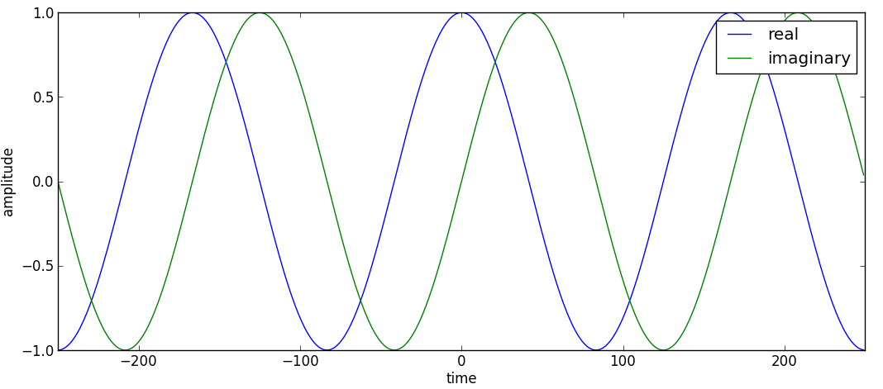
Complex sinewave
Notes:
To plot a complex sinusoid is not easy, we would need to show it in a 3D space. A common alternative is to plot the real and imaginary components as two separate functions, like in this plot.
The complex sinusoids are the basis functions used in Fourier analysis and thus it is important to be familiar with them.

Slide 10
Scalar (dot) product of sequences
Example:
Notes:
Now let's talk about the scalar, or dot, product, a common algebraic operation between sequences.
This is an operation that takes two equal-length sequences of numbers and returns a single value.
This operation can be defined either algebraically or geometrically.
Algebraically, it is the sum of the products of the corresponding entries of the two sequences of numbers, as this equation shows.
Geometrically, it is the product of the magnitudes of the two vectors and the cosine of the angle between them.

Slide 11
Orthogonality of sequences
Example:
2
x=(2,2)
1
1
2
3
4
-1
-2
y=(2,-2)
Notes:
An important property of the scalar product is that when two sequences are orthogonal their scalar product is equal to 0.
Geometrically it can be understood as the projection of one sequence into the other.
This is the basic operation that is performed by the Discrete Fourier Transform.

Slide 12
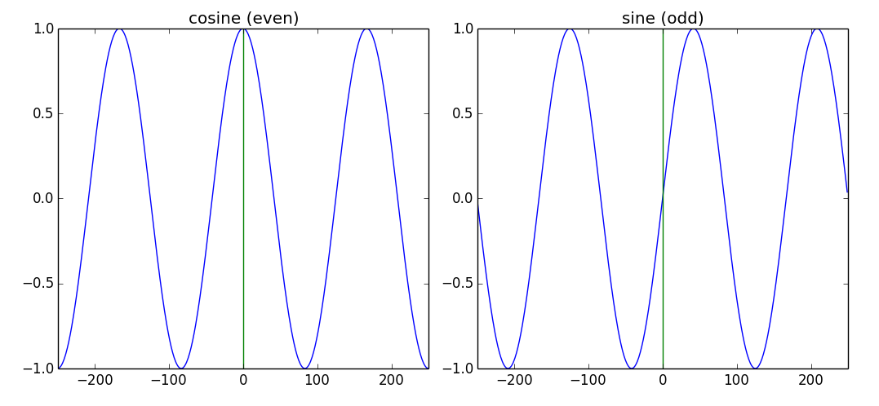
Even and odd functions
f(a) is even if f(-a) = f(a) [symmetric]
f(a) is odd if f(-a) = -f(a) [antisymmetric]
Notes:
Another mathematical concept that will appear in our signal analysis operations is the concept of even and odd functions.
The cosine function is even and the sine function is odd. This can be shown in these plots.

Slide 13
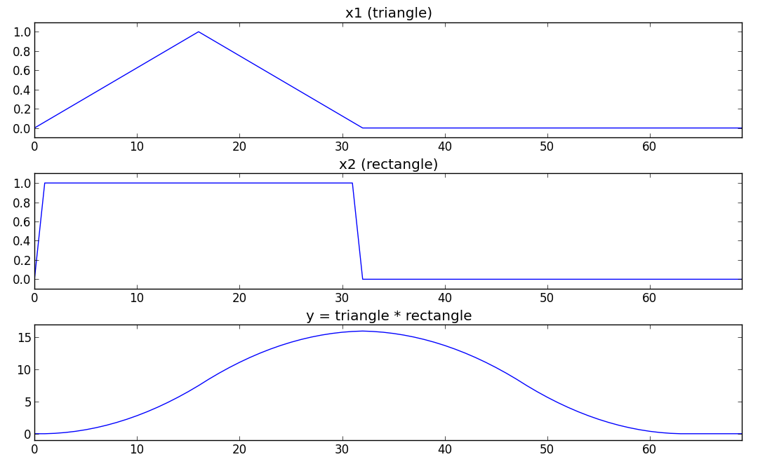
Convolution
Notes:
The last basic math operation I want to mention is the convolution of sequences.
This is a mathematical operation on two sequences, producing a third sequence that can be viewed as a modified version of one of the original sequences.
It gives the overlap area between the two sequences as a function of the amount that one of the original sequences is translated.
Convolution is similar to cross-correlation.
Convolution is a common operation used to implement filtering of sounds and it is also very useful to understand several of the properties of the Fourier transform.

Slide 14
References and credits
More information on this topic in Wikipedia:
  https://en.wikipedia.org/wiki/Sinusoid
  https://en.wikipedia.org/wiki/Complex_numbers
  https://en.wikipedia.org/wiki/Euler_formula
  http://en.wikipedia.org/wiki/Dot_product
  https://en.wikipedia.org/wiki/Convolution
Good reference for the mathematics of the DFT by Julius O. Smith: https://ccrma.stanford.edu/~jos/mdft/
All slides and code produced for this course are released using the CC Attribution-Noncommercial-Share Alike license or the Affero GPL license and available from https://github.com/MTG/sms-tools
Notes:
The topics I presented in this lecture are extensively covered in many text books.
Most of the text references I used come from Wikipedia and from the website of Julius Smith on the Mathematics of the Discrete Fourier Transform, reference that I will use extensively in this course.

Slide 15
Some basic mathematics
Xavier Serra
Universitat Pompeu Fabra, Barcelona
Notes:
This is all for this lecture.
We have done a very quick overview of some math concepts that will be very much needed throughout the course. Please make sure that you get a grasp of them before starting all the Fourier topics.
Thanks for your attention!!

