Slide 1
The Discrete Fourier Transform
(1 of 2)
Xavier Serra
Music Technology Group
Universitat Pompeu Fabra, Barcelona
http://mtg.upf.edu

Slide 2
Index
DFT equation
Complex exponentials
Inner product

Slide 3
Discrete Fourier Transform
n: discrete time index in samples (normalized time, T=1)
k: discrete frequency index in bins
frequency in radians
frequency in Hz, where fs is the sampling rate

Slide 4
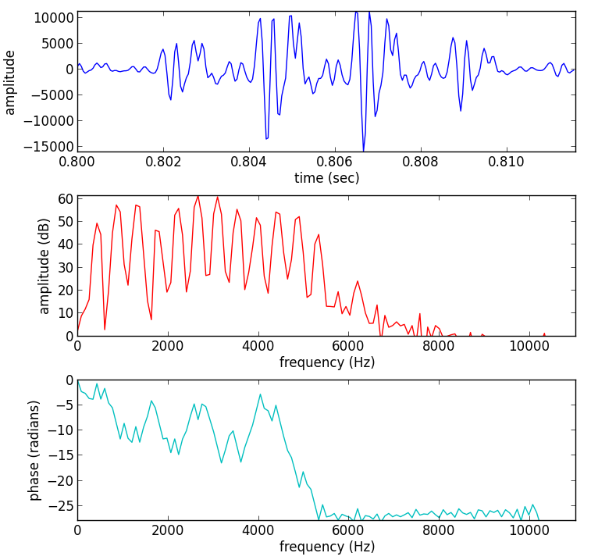
sound fragment
x[n]
magnitude
spectrum
phase
spectrum

Slide 5
(fs, x) = read('oboe.wav')
size = 256
start = .8*fs
xw = x[start:start+size] * np.hamming(size)
plt.plot(np.arange(start, (start+size), 1.0)/fs, xw)
X = fft(xw)
mX = 20 * np.log10(abs(X)/size)
pX = np.unwrap(np.angle(X))
plt.plot(np.arange(0,fs/2.0,float(fs)/size),mX[0:size/2])
plt.plot(np.arange(0,fs/2.0,float(fs)/size),pX[:size/2])

Slide 6
Complex exponentials

Slide 7
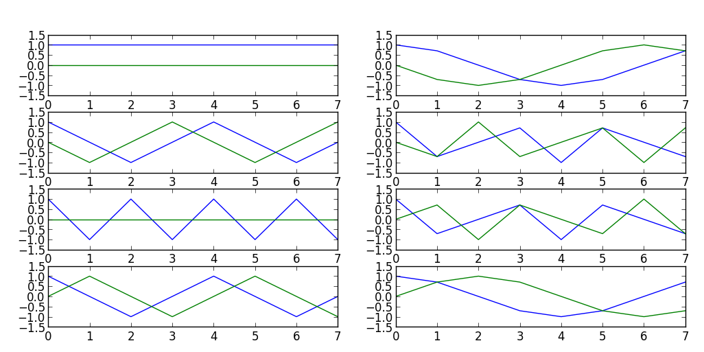
Complex exponentials
N = 8
for k in range(N):
s = np.exp(-1j*2*np.pi*k/N*np.arange(N))
plt.subplot(N/2, 2, k+1)
plt.plot(np.real(s))
plt.subplot(N/2, 2, k+1)
plt.plot(np.imag(s))

Slide 8
Inner product - DFT
Example:

Slide 9
Inner product - DFT
x = np.array([1,-1,1,-1])
print 'x = {}'.format(x)
N = 4
for k in range(N):
s = np.exp(1j*2*np.pi*k/N*np.arange(N))
print 's{0} = {1}'.format(k, s)
X = sum(x*np.conjugate(s))
print '<x,s{0}> = {1}'.format(k,X)
Output:
x = [ 1 -1 1 -1]
s0 = [ 1.+0.j 1.+0.j 1.+0.j 1.+0.j]
<x,s0> = 0.0
s1 = [ 1.+0.j 0.+1.j -1.+0.j -0.-1.j]
<x,s1> = 1.32693504719e-16
s2 = [ 1.+0.j -1.+0.j 1.-0.j -1.+0.j]
<x,s2> = 4.0
s3 = [ 1.+0.j -0.-1.j -1.+0.j 0.+1.j]
<x,s3> = 5.52708599219e-16

Slide 10
References
https://ccrma.stanford.edu/~jos/mdft/
Full code of plots and accompanying labs available at:https://github.com/MTG/sms-tools

Slide 11
Credits
All the slides of this presentation are released under an Attribution-Noncommercial-Share Alike license.

