Slide 1
The Discrete Fourier Transform
(2 of 2)
Xavier Serra
Music Technology Group
Universitat Pompeu Fabra, Barcelona
http://mtg.upf.edu

Slide 2
Index
DFT equation
DFT of complex sinusoids
DFT of real sinusoids
Inverse-DFT

Slide 3
Discrete Fourier Transform
n: discrete time index in samples (normalized time, T=1)
k: discrete frequency index in bins
frequency in radians
frequency in Hz, where fs is the sampling rate

Slide 4
DFT of complex sinusoid

Slide 5
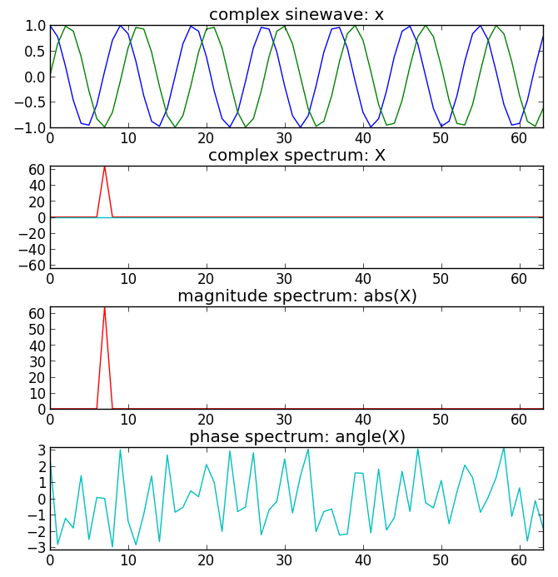
N = 64
k0 = 7
x=exp(1j*2*pi*k0/N*arange(N))
plt.plot(arange(N),real(x))
plt.plot(arange(N),imag(x))
for k in range(N):
s=exp(1j*2*pi*k/N*arange(N))
X=append(X,sum(x*conjugate(s)))
plt.plot(arange(N),real(X))
plt.plot(arange(N),imag(X))
plt.plot(arange(N),abs(X))
plt.plot(arange(N),angle(X))

Slide 6
DFT of complex sinusoid

Slide 7
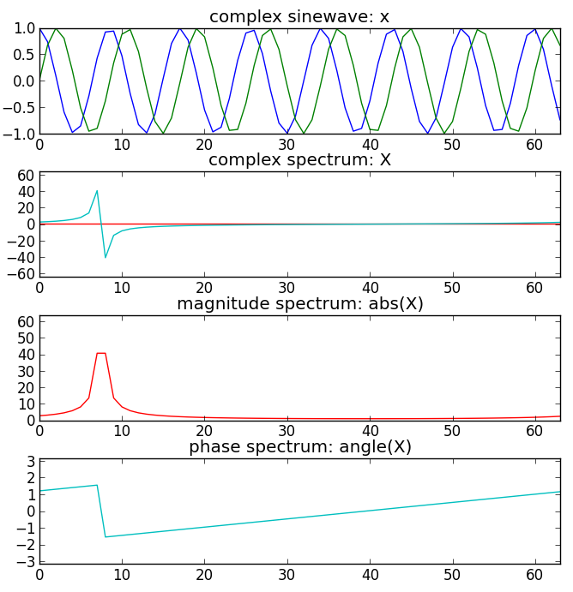
N = 64
f0 = 7.5/N
x = exp(1j*2*pi*f0/N*arange(N))
plt.subplot(411)
plt.plot(arange(N), real(x))
plt.plot(arange(N), imag(x))
for k in range(N):
s = exp(1j*2*pi*k/N*arange(N))
X = append(X, sum(x*conjugate(s)))
plt.subplot(412)
plt.plot(arange(N), real(X))
plt.plot(arange(N), imag(X))
plt.subplot(413)
plt.plot(arange(N),abs(X))
plt.subplot(414)
plt.plot(arange(N),angle(X))

Slide 8
DFT of real sinusoids

Slide 9
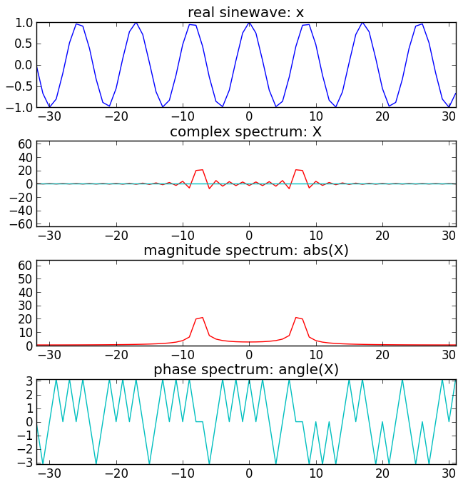
N = 64
k0 = 7.5
nv = arange(-N/2, N/2)
kv = arange(-N/2, N/2)
x = cos(2*np.pi*k0/N*nv)
plt.subplot(411)
plt.plot(nv, real(x))
for k in kv:
s=exp(1j*2*pi*k/N*nv)
X=append(X,sum(x*conj(s)))
plt.subplot(412)
plt.plot(kv, real(X))
plt.plot(kv, imag(X))
plt.subplot(413)
plt.plot(kv, abs(X))
plt.subplot(414)
plt.plot(kv, angle(X))

Slide 10
Inverse DFT
Example:

Slide 11
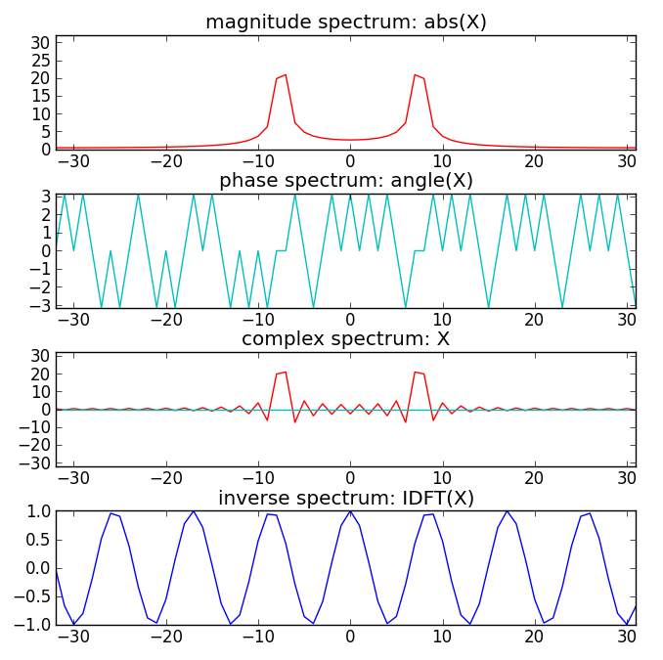
Inverse DFT example
N = 64
k0 = 7.5
x = cos(2*pi*k0/N*arange(-N/2, N/2))
for k in np.arange(-N/2, N/2):
s=exp((-1j*2*pi*k/N)*arange(-N/2,N/2))
X=append(X, sum(x*conjugate(s)))
plt.subplot(411)
plt.plot(arange(-N/2,N/2), abs(X))
plt.subplot(412)
plt.plot(arange(-N/2,N/2), angle(X))
plt.subplot(413)
plt.plot(np.arange(-N/2,N/2), real(X))
plt.plot(np.arange(-N/2,N/2), imag(X))
for k in arange(-N/2,N/2):
s=exp((1j*2*pi*k/N)*arange(-N/2,N/2))
y=append(y, sum(X*s)/N)
plt.subplot(414)
plt.plot(arange(-N/2,N/2), y)

Slide 12
References
https://ccrma.stanford.edu/~jos/mdft/
Full code of plots and accompanying labs available at:https://github.com/MTG/sms-tools

Slide 13
Credits
All the slides of this presentation are released under an Attribution-Noncommercial-Share Alike license.

