Slide 1
The Short-Time Fourier Transform
(1 of 2)
Xavier Serra
Music Technology Group
Universitat Pompeu Fabra, Barcelona
http://mtg.upf.edu

Slide 2
Index
Short-time Fourier Transform equation
Window size
FFT size
Hop size
Time-frequency compromise
Inverse STFT
STFT implementation

Slide 3
Short-time Fourier Transform
w: real window
l: number of frame
H: time advance of window (hop-size)

Slide 4
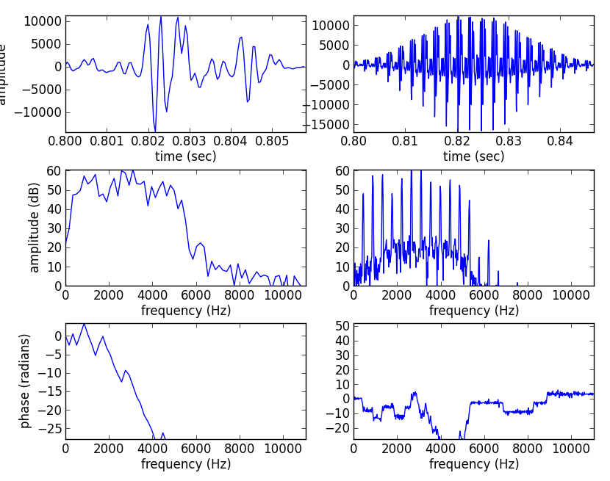
Window size
Affects the time versus frequency resolution
M = 128
M = 1024

Slide 5
(fs, x) = read('oboe.wav')
N = 128
start = .8*fs
xw = x[start:start+N] * np.hamming(N)
plt.plot(np.arange(start, (start+N), 1.0)/fs, xw)
X = fft(xw)
mX = 20 * np.log10(abs(X)/N)
pX = np.unwrap(np.angle(X))
plt.plot(np.arange(0, fs/2.0, float(fs)/N), mX[0:N/2])
plt.plot(np.arange(0, fs/2.0, float(fs)/N), pX[:N/2])
N = 1024
start = .8*fs
xw = x[start:start+N] * np.hamming(N)
plt.plot(np.arange(start, (start+N), 1.0)/fs, xw)
X = fft(xw)
mX = 20 * np.log10(abs(X)/N)
pX = np.unwrap(np.angle(X))
plt.plot(np.arange(0, fs/2.0, float(fs)/N), mX[0:N/2])
plt.plot(np.arange(0, fs/2.0, float(fs)/N), pX[:N/2])

Slide 6
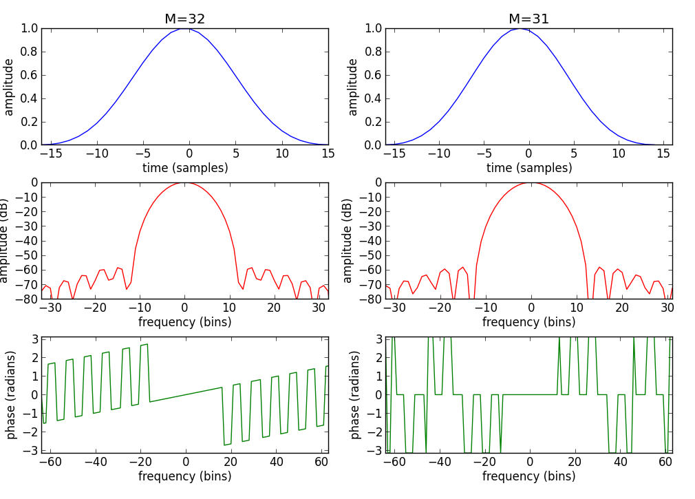
Even-Odd size Window

Slide 7
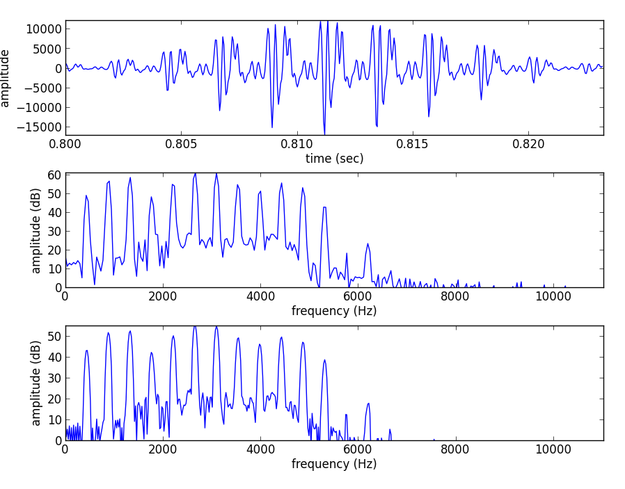
FFT size
FFT size, N, should be equal or larger than the window size, M

Slide 8
(fs, x) = read('oboe.wav')
M = 512
N = 512
start = .8*fs
xw = x[start:start+M] * np.hamming(M)
plt.subplot(311)
plt.plot(np.arange(start, (start+M), 1.0)/fs, xw)
X = fft(xw, N)
mX = 20 * np.log10(abs(X)/N)
pX = np.unwrap(np.angle(X))
plt.subplot(312)
plt.plot(np.arange(0, fs/2.0, float(fs)/N), mX[0:N/2])
M = 512
N = 1024
start = .8*fs
xw = x[start:start+M] * np.hamming(M)
X = fft(xw, N)
mX = 20 * np.log10(abs(X)/N)
plt.subplot(313)
plt.plot(np.arange(0, fs/2.0, float(fs)/N), mX[0:N/2])

Slide 9
Hop size
Successive frames should overlap in time in such a
way that all the data are weighted equally.
For certain windows exists perfect overlap factors.
Rectangular: M/j, Hanning and Hamming: (M/2)/j,
where j = 0, 1, ....
The overlap factor can be expressed by:

Slide 10
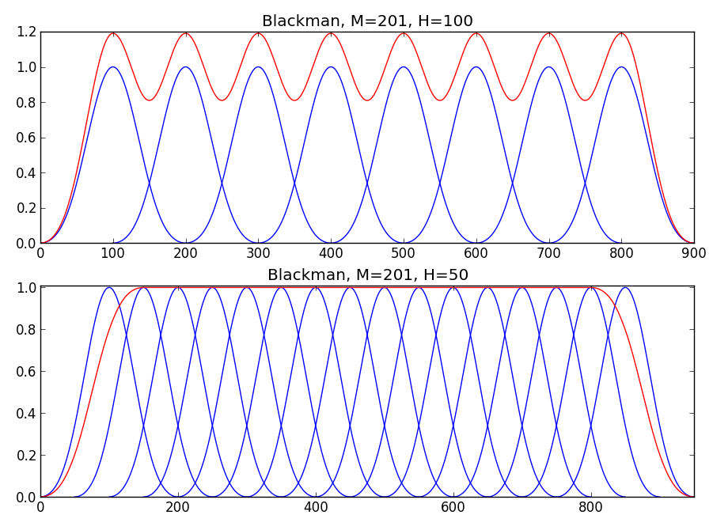

Slide 11
N= 1000
M = 201
w = signal.blackman(M)
w1 = w/sum(w)
H = 100
pin = 0
pend = N - M
plt.subplot(211)
while pin<pend:
y [pin:pin+M] += w1*H
plt.plot(np.arange(pin, pin+M), w, 'b')
pin += H
plt.plot(np.arange(0, N), y, 'r')
H = 50
pin = 0
pend = N - M
plt.subplot(212)
while pin<pend:
y [pin:pin+M] += w1*H
plt.plot(np.arange(pin, pin+M), w, 'b')
pin += H
plt.plot(np.arange(0, N), y, 'r')

Slide 12
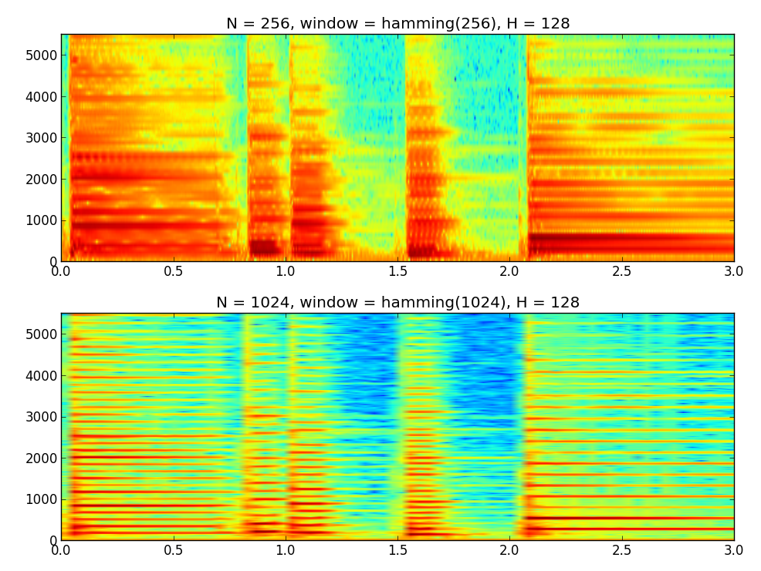
Time-frequency compromise

Slide 13
from pylab import *
from scipy.io.wavfile import read
(fs, x) = read('piano.wav')
subplot(2,1,1)
specgram(x,NFFT=256,window=hamming(256),Fs=fs,noverlap=128)
subplot(2,1,2)
specgram(x,NFFT=1024,window=hamming(1024),Fs=fs,noverlap=128)

Slide 14
Inverse STFT
each synthesized frame is:
and the synthesized sound is:

Slide 15


Slide 16
STFT implementation diagram
w[n]
x[n]
|X[k]|
yw[n]
y[n]
FFT
IFFT
Overlap-add
xw[n]
<X[k]

Slide 17
def stft(x, fs, w, N, H) :
hN = N/2
hM1 = int(math.floor((w.size+1)/2))
hM2 = int(math.floor(w.size/2))
pin = hM1
pend = x.size-hM1
w = w / sum(w)
while pin<pend:
#-----analysis-----
xw = x[pin-hM1:pin+hM2]*w
fftbuffer[:hM1] = xw[hM2:]
fftbuffer[N-hM2:] = xw[:hM2]
X = fft(fftbuffer)
mX = 20 * np.log10( abs(X[:hN]) )
pX = np.unwrap( np.angle(X[:hN]) )
#----synthesis-----
Y[:hN] = 10**(mX/20) * np.exp(1j*pX)
Y[hN+1:]=10**(mX[:0:-1]/20)*np.exp(-1j*pX[:0:-1])
fftbuffer = np.real( ifft(Y) )
yw[:hM2] = fftbuffer[N-hM2:]
yw[hM2:] = fftbuffer[:hM1]
y[pin-hM1:pin+hM2] += H*yw
pin += H
return y

Slide 18
References
https://ccrma.stanford.edu/~jos/sasp/
https://en.wikipedia.org/wiki/STFT
https://en.wikipedia.org/wiki/Window_function
Full code of plots and accompanying labs available at: https://github.com/MTG/sms-tools

Slide 19
Credits
All the slides of this presentation are released under an Attribution-Noncommercial-Share Alike license.

