Slide 1
Sinusoidal Modeling
Xavier Serra
Music Technology Group
Universitat Pompeu Fabra, Barcelona
http://mtg.upf.edu

Slide 2
Index
Sinusoidal model
Sinewave spectrum
Sinusoidal detection
  Peak detection
  Peak interpolation
Sinusoidal synthesis
Implementation

Slide 3
Sinusoidal model

Slide 4
Sinewave spectrum

Slide 5
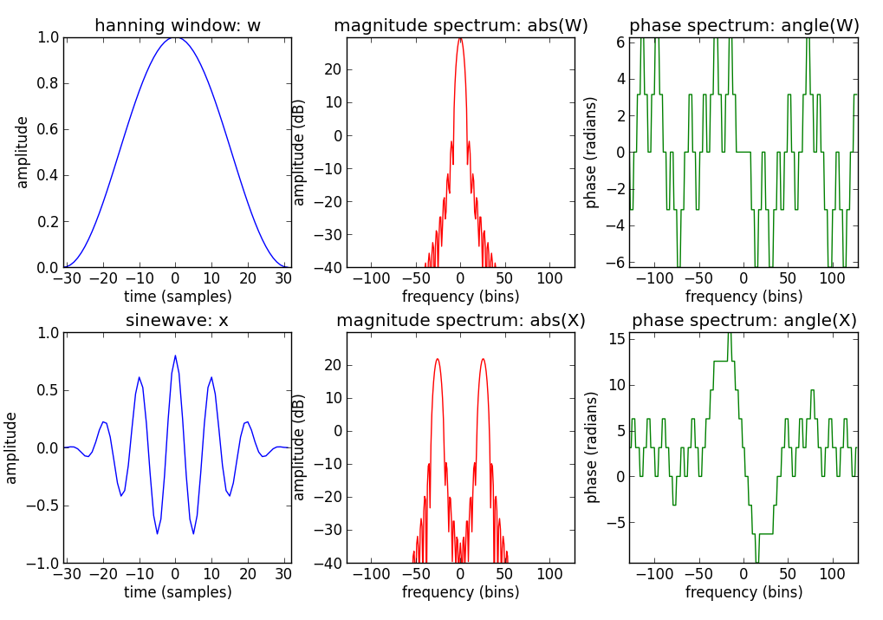
Sinewave spectrum

Slide 6
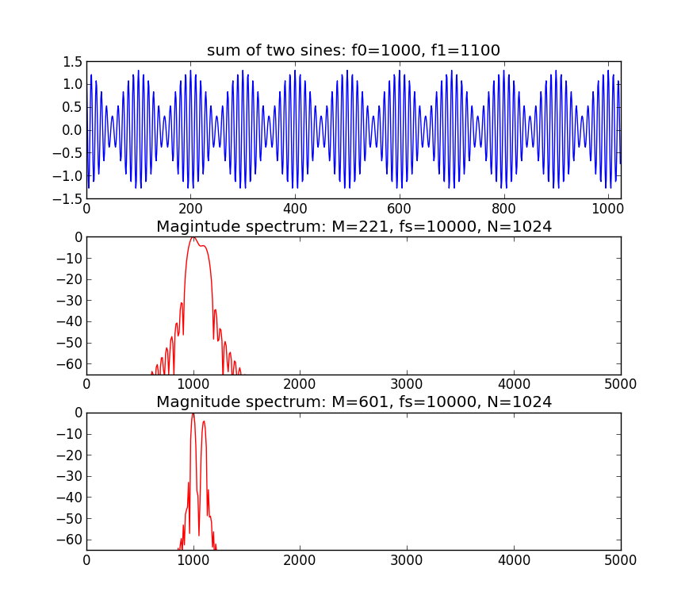
Sinusoidal detection – freq. resolution

Slide 7
N = 1024
M1 = 221
M2 = 601
f0 = 1000
f1 = 1100
fs = 10000
A0 = .8
A1 = .5
hN = N/2
w1 = np.hanning(M1)
w2 = np.hanning(M2)
x = A0*np.cos(2*np.pi*f0/fs*np.arange(N))+
A1*np.cos(2*np.pi*f1/fs*np.arange(N))
plt.subplot(3,1,1)
plt.plot(np.arange(N), x, 'b')
X = fft(x[0:M1]*w1, N)
mX = 20*np.log10(abs(X[0:hN]))
plt.subplot(3,1,2)
plt.plot((np.arange(hN)/float(N))*fs, mX-max(mX), 'r')
X = fft(x[0:M2]*w2, N)
mX = 20*np.log10(abs(X[0:hN]))
plt.subplot(3,1,3)
plt.plot((np.arange(hN)/float(N))*fs, mX-max(mX), 'r')

Slide 8
Peak detection
A peak is defined as a local maximum in the magnitude spectrum.
Each peak location is accurate only to within half a sample.
Zero-padding increases the number of DFT samples (bins) per Hz and thus increases the accuracy of peak detection.
A better peak detection strategy is based on combining zero-padding with some spectral interpolation.

Slide 9
Peak detection and window-size
To resolve two sinusoids separated in frequency by ∆Hz we require main-lobe bandwidth Bf <= ∆
If
and
where main-lobe bandwidth in bins, sampling rate,
M: window length, and frequencies of the sinusoids.
If and are successive harmonics of a fundamental frequency ,
Then . Harmonic resolution requires and
Since the period in samples is , then

Slide 10
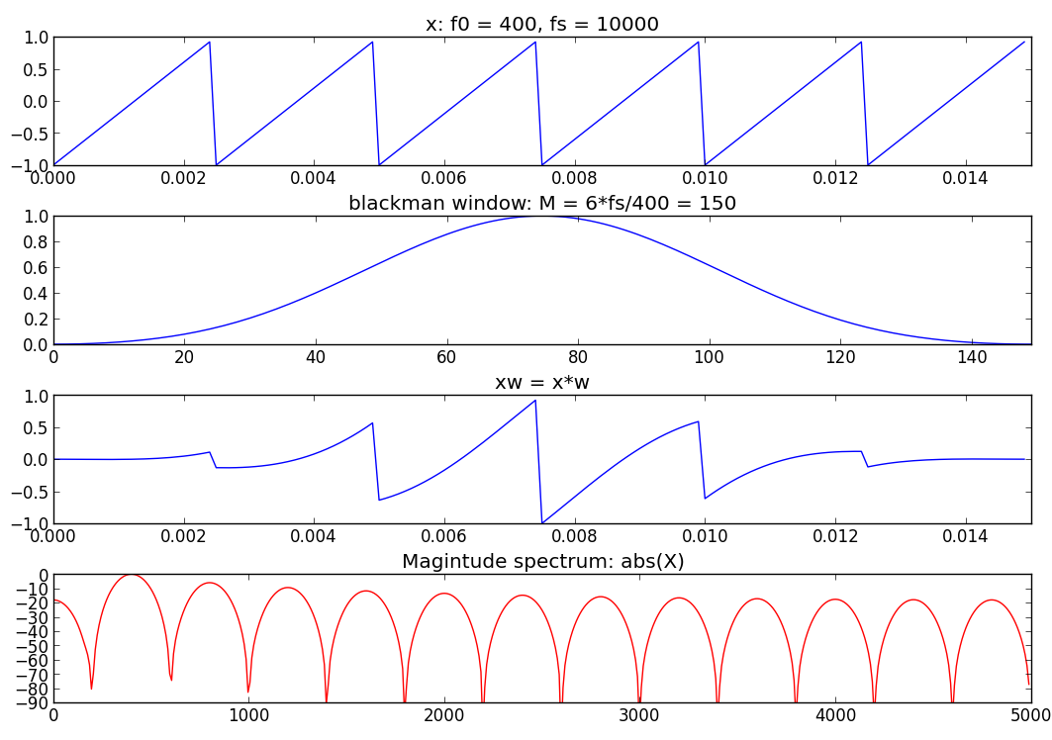

Slide 11
N = 1024
hN = N/2
f0 = 400.0
fs = 10000.0
M = 6 * fs / f0
w = np.blackman(M)
x = signal.sawtooth(2 * np.pi * (f0/fs) * np.arange(M))
plt.figure(1)
plt.subplot(4,1,1)
plt.plot(np.arange(M)/fs, x, 'b')
plt.subplot(4,1,2)
plt.plot(np.arange(M), w, 'b')
xw = x * w
plt.subplot(4,1,3)
plt.plot(np.arange(M)/fs, xw, 'b')
X = fft(xw, N)
mX = 20*np.log10(abs(X[0:hN]))
plt.subplot(4,1,4)
plt.plot(fs*np.arange(hN)/N,mX-max(mX), 'r')

Slide 12
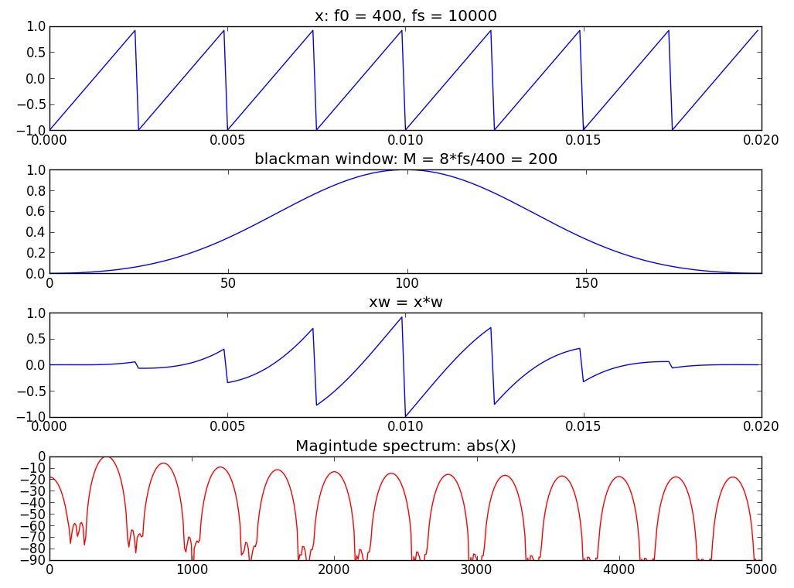

Slide 13
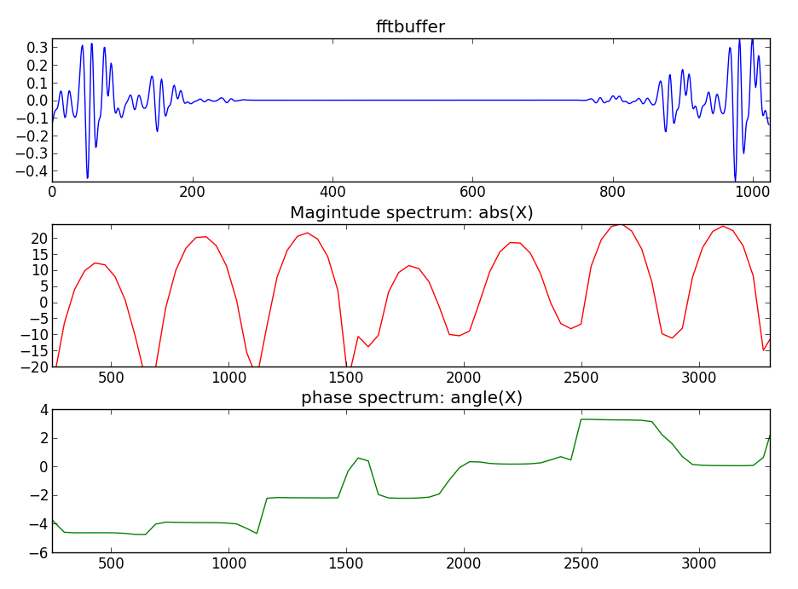
Peak phase

Slide 14
N = 1024
hN = N/2
M = 601
hM = (M+1)/2
w = np.blackman(M)
(fs, x) = wp.wavread('oboe.wav')
xw = x[40000:40000+M] * w
fftbuffer = np.zeros(N)
fftbuffer[:hM] = xw[hM-1:]
fftbuffer[N-hM+1:] = xw[:hM-1]
plt.subplot(3,1,1)
plt.plot(np.arange(N), fftbuffer, 'b')
X = fft(fftbuffer)
mX = 20*np.log10(abs(X[:hN]))
plt.subplot(3,1,2)
plt.plot(fs*np.arange(hN)/float(N),mX, 'r')
pX = np.unwrap(np.angle(X[0:hN]))
plt.subplot(3,1,3)
plt.plot(fs*np.arange(hN)/float(N),pX, 'g')

Slide 15
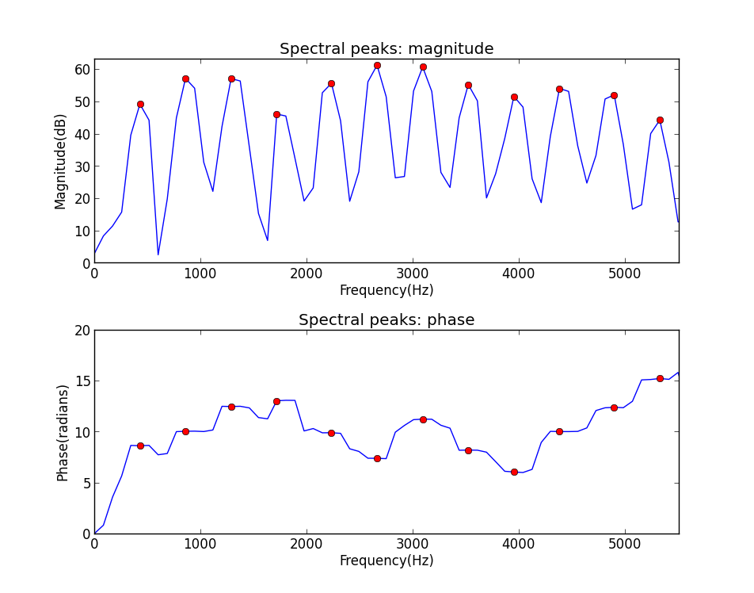
Peak detection

Slide 16
Peak detection
def peak_detection(mX, hN, t):
# mX: magnitude spectrum, hN: size of positive spectrum,
# t: threshold
thresh=np.where(mX[1:hN-1]>t, mX[1:hN-1],0)
next_minor=np.where(mX[1:hN-1]>mX[2:], mX[1:hN-1],0)
prev_minor=np.where(mX[1:hN-1]>mX[:hN-2], mX[1:hN-1],0)
ploc=thresh * next_minor * prev_minor
ploc=ploc.nonzero()[0] + 1
return ploc

Slide 17
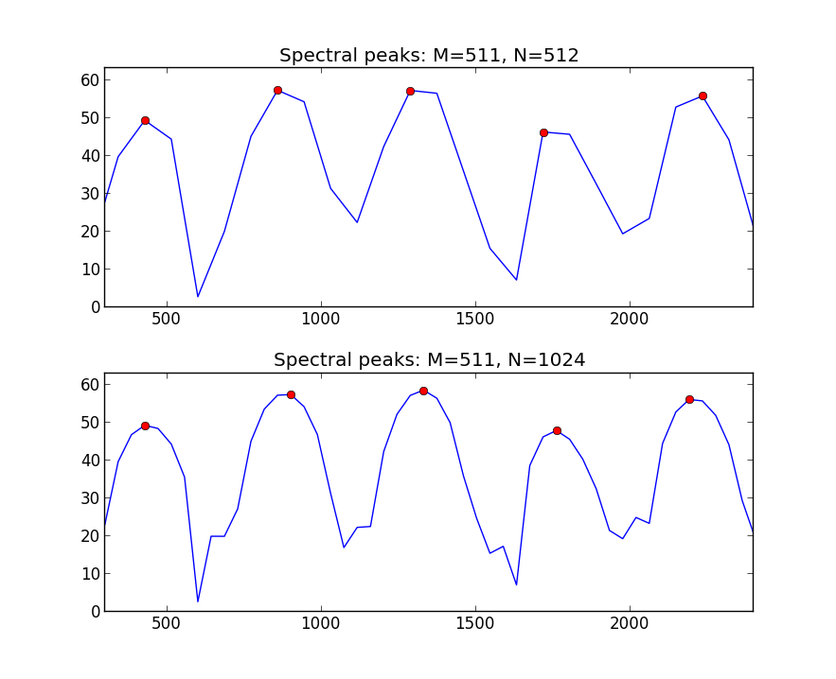
Peak detection with zero-padding

Slide 18
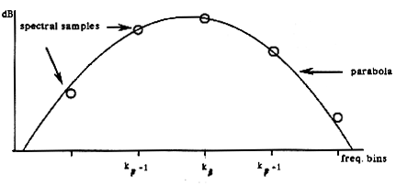
Parabola
p: center of the parabola
a: measure of concavity
b: offset

Slide 19
Peak interpolation
o
o
o
-1
0
+1
Center of the parabola:
Amplitude:

Slide 20
Peak interpolation
def peak_interp(mX, pX, ploc):
# mX: magnitude spectrum, pX: phase spectrum,
# ploc: locations of peaks
# iploc, ipmag, ipphase: interpolated values
val = mX[ploc]
lval = mX[ploc-1]
rval = mX[ploc+1]
iploc = ploc + 0.5*(lval-rval)/(lval-2*val+rval)
ipmag = val - 0.25*(lval-rval)*(iploc-ploc)
ipphase = np.interp(iploc, np.arange(0, pX.size), pX)
return iploc, ipmag, ipphase

Slide 21
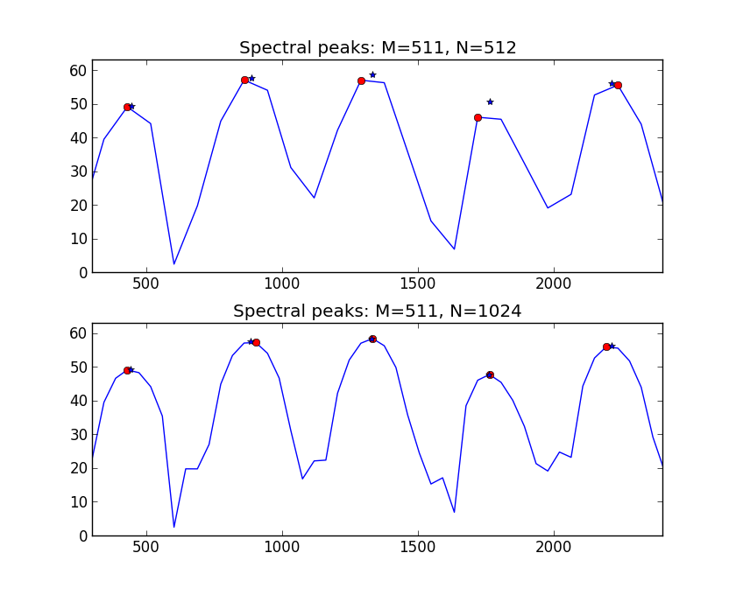
Peak detection with interpolation

Slide 22
Sinusoidal parameters from peaks

Slide 23
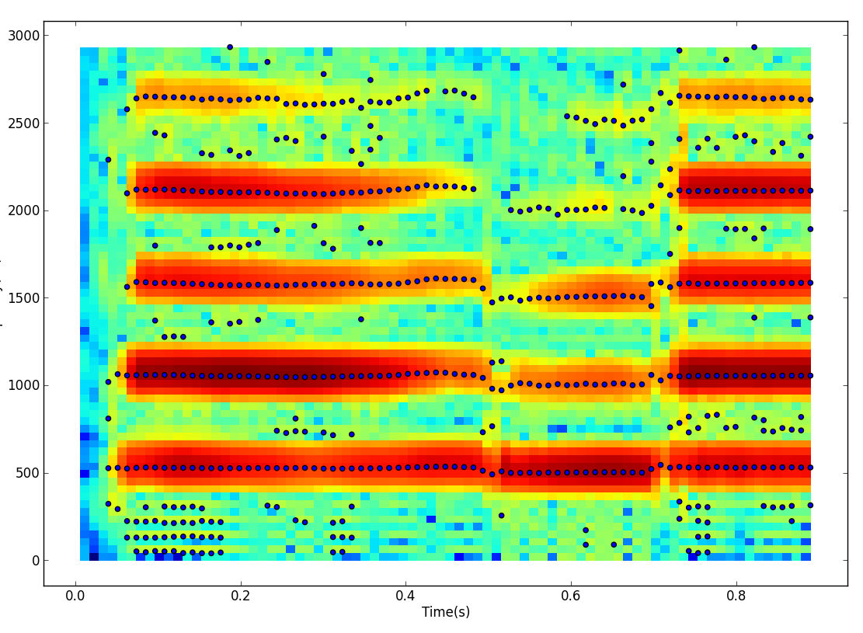

Slide 24
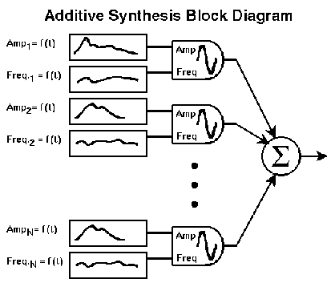
Sinusoidal synthesis

Slide 25
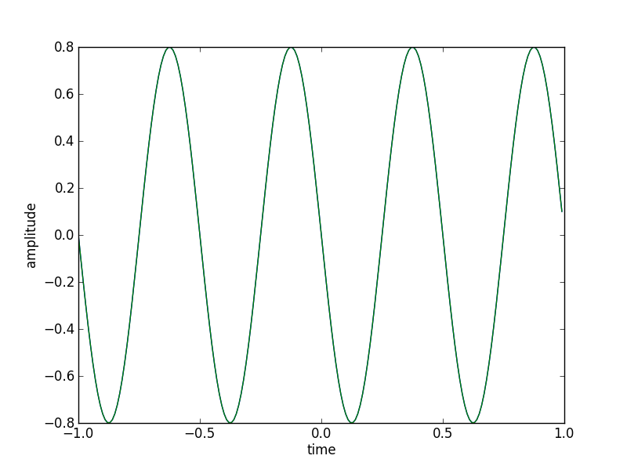
Sinusoidal synthesis
Ar = .8
Fr = 2.0
phi = np.pi/2
fs = 100
t = np.arange(-1, 1, 1.0/fs)
x = Ar * np.cos(2*np.pi*fr*t+phi)
plt.plot(t, x)

Slide 26
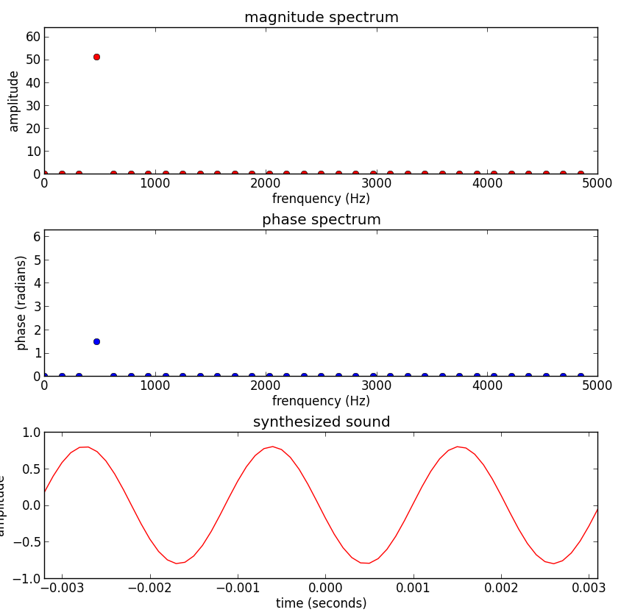
Spectral-based sinusoidal synthesis
fr = 500.0
Fs = 10000.0
Ar = .8
pr = 1.5
Ns = 64
hNs = Ns/2
k = np.int(np.round(Ns*fr/fs))
mY[k] = Ar * Ns
pY[k] = pr
Y[:hNs] = .5*mY*np.exp(1j*pY)
Y[hNs+1:]=Y[hNs-1:0:-1].conjugate()
plt.subplot(3,1,1)
plt.plot(mY, 'ro')
plt.subplot(3,1,2)
plt.plot(pY, 'bo')
y = np.real(ifft(Y))
yw[:hNs-1] = y[hNs+1:]
yw[hNs-1:] = y[:hNs+1]
plt.subplot(3,1,3)
plt.plot(yw, 'r')

Slide 27
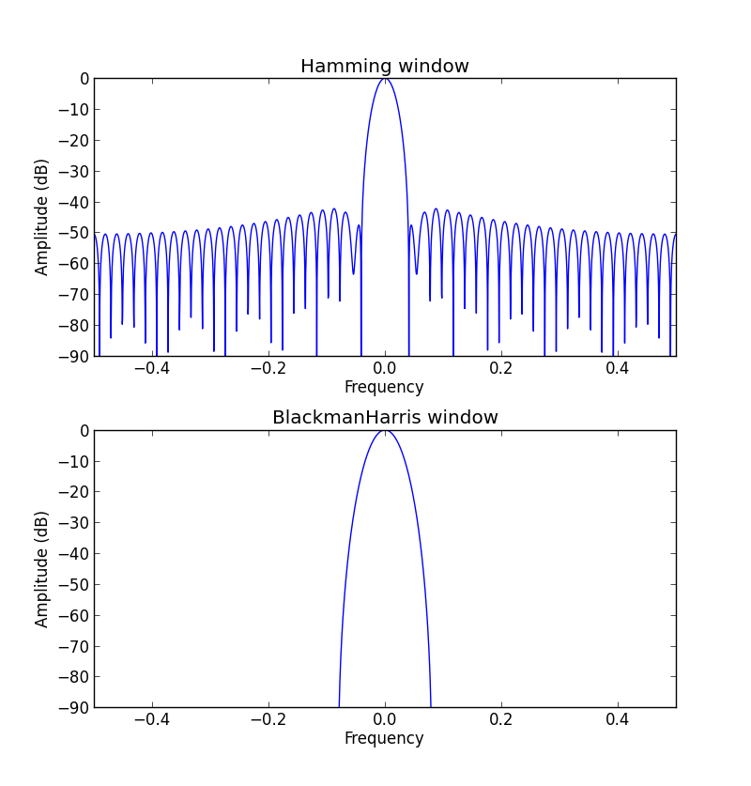
Sinusoids in spectrum

Slide 28
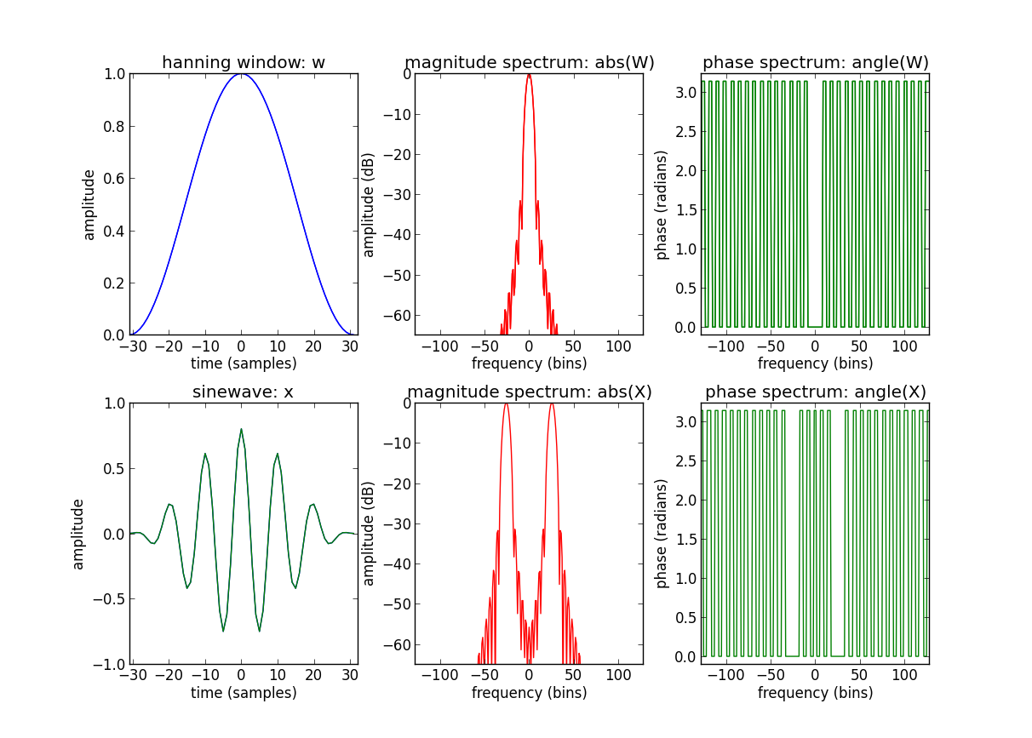
Sinewave spectrum

Slide 29
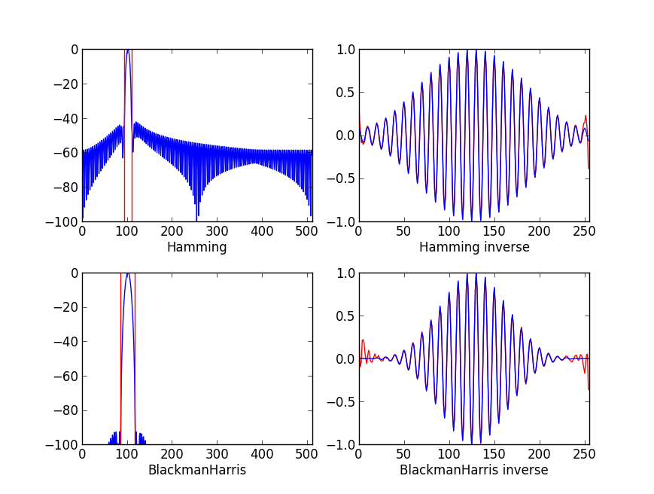
Inverse of spectral sinusoid

Slide 30
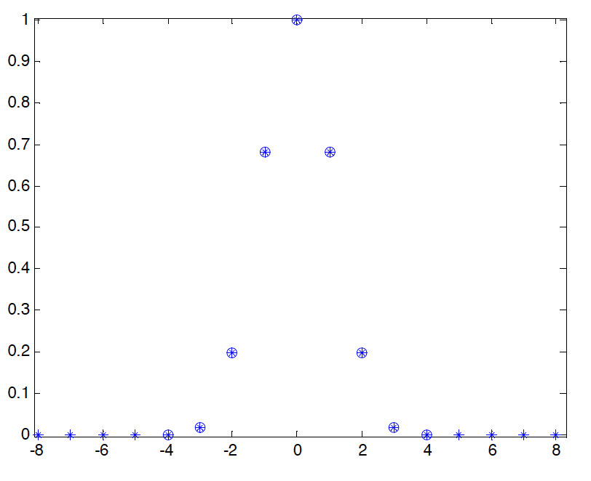
Blackman-Harris main-lobe

Slide 31
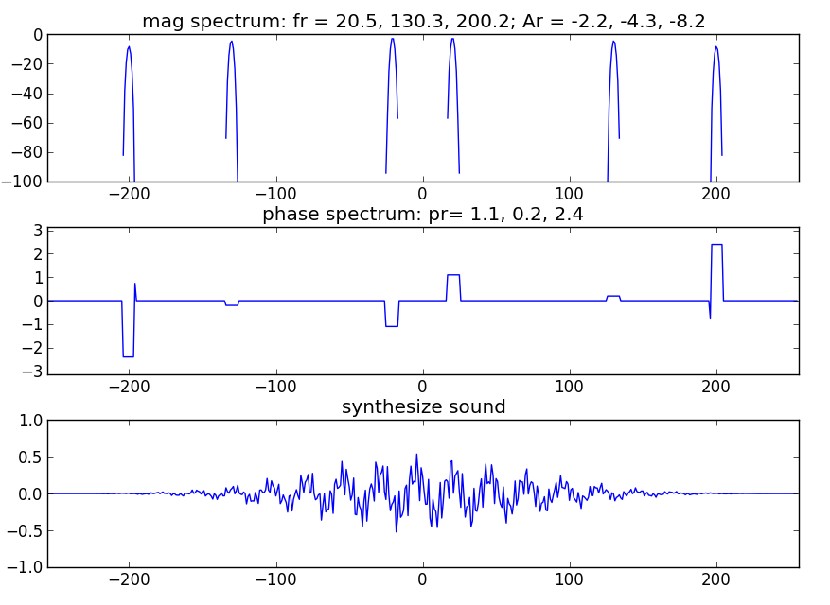
Synthesized spectrum and signal

Slide 32
def genspecsines(iploc, ipmag, ipphase, N):
Y = np.zeros(N, dtype = complex)
hN = N/2
for i in range(0, iploc.size):
loc = iploc[i]
if loc<1 or loc>hN-1: continue
binremainder = round(loc)-loc;
lb = np.arange(binremainder-4, binremainder+5)
lmag = uf.genbh92lobe(lb) * 10**(ipmag[i]/20)
b = np.arange(round(loc)-4, round(loc)+5)
for m in range(0, 9):
if b[m] < 0:
Y[-b[m]]+=lmag[m]*np.exp(-1j*ipphase[i])
elif b[m] > hN:
Y[b[m]]+=lmag[m]*np.exp(-1j*ipphase[i])
elif b[m]==0 or b[m]==hN:
Y[b[m]]+=lmag[m]*np.exp(1j*ipphase[i])+lmag[m]*np.exp(-1j*ipphase[i])
else:
Y[b[m]]+=lmag[m]*np.exp(1j*ipphase[i])
Y[hN+1:] = Y[hN-1:0:-1].conjugate()

Slide 33
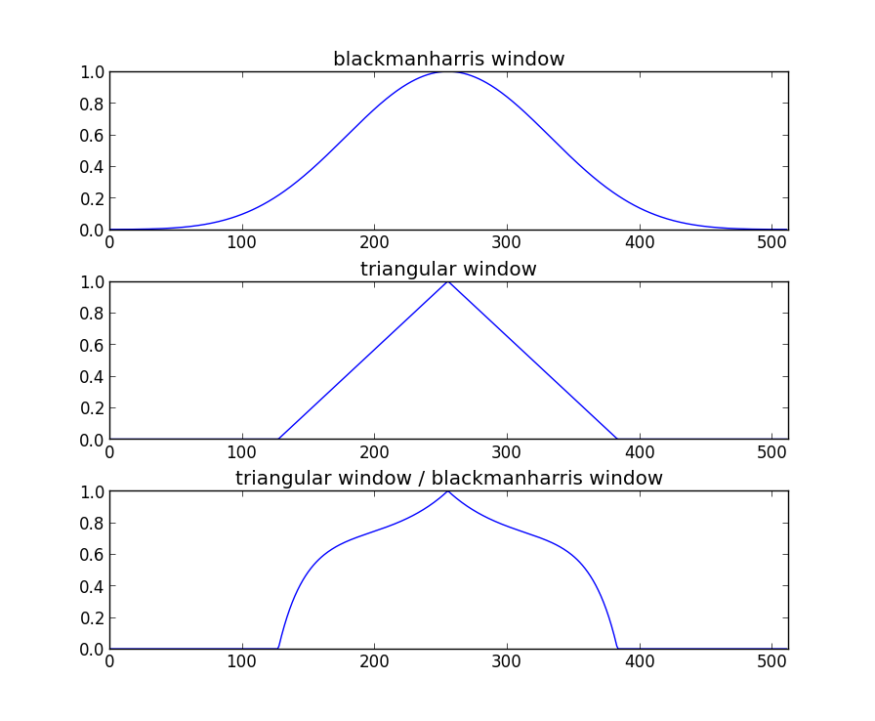
Synthesis window

Slide 34
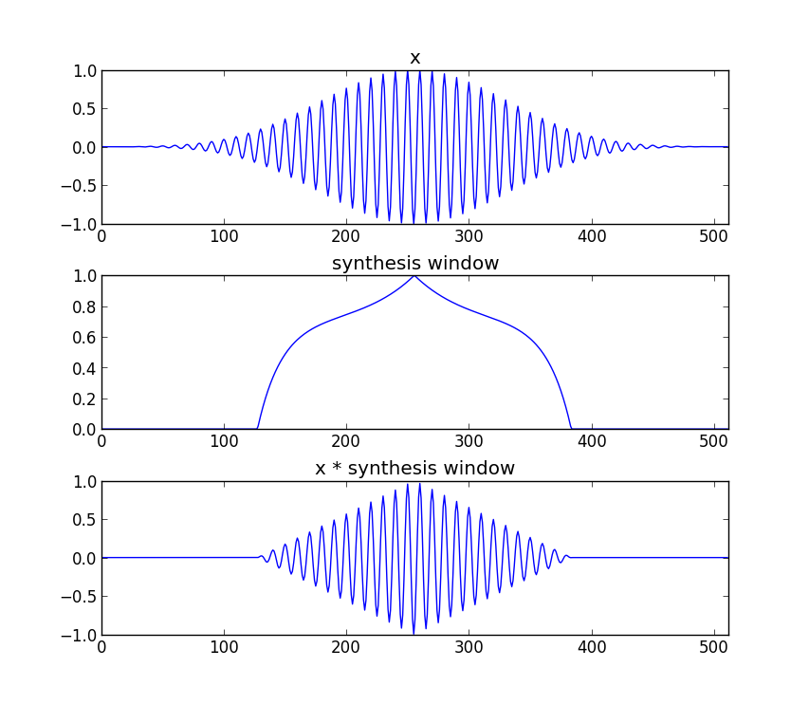
Synthesis window

Slide 35
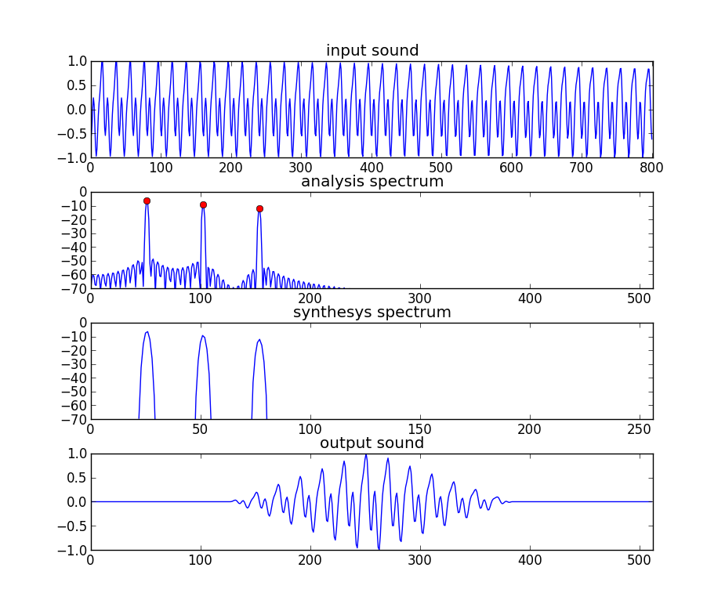
Analysis / Synthesis
M = 801
window = hamming(M)
N = 1024
t = -40
fr = 100.2, 200.3, 300.2
Ar = .99, .7, .5
fs = 2000
Ns = 512

Slide 36
Implementation
Analysis
Synthesis
w[n]
|X[k]|
Peak detection
A_{r}
Sine spectral
synthesis
x[n]
FFT
f_{r}
xw[n]
<X[k]
p_{r}
Y[k]
IFFT
yw[n]
Overlap-add
y[n]

Slide 37
def sine_model(x, fs, w, N, t):
hN = N/2
hM = (w.size+1)/2
Ns = 512
H = Ns/4
hNs = Ns/2
pin = max(hNs, hM)
pend = x.size - max(hNs, hM)
w = w / sum(w)
ow = triang(2*H);
sw[hNs-H:hNs+H] = ow
bh = blackmanharris(Ns)
bh = bh / sum(bh)
sw[hNs-H:hNs+H] = sw[hNs-H:hNs+H] / bh[hNs-H:hNs+H]
while pin<pend:
xw = x[pin-hM:pin+hM-1] * w fftbuffer[:hM] = xw[hM-1:]
fftbuffer[N-hM+1:] = xw[:hM-1]
X = fft(fftbuffer)
mX = 20 * np.log10( abs(X[:hN]) )
ploc = peak_detection(mX, hN, t)
pmag = mX[ploc]
pX = np.unwrap( np.angle(X[:hN]) )
iploc, ipmag, ipphase = peak_interp(mX, pX, ploc)
plocs = iploc*Ns/N;
Y = genspecsines(plocs, ipmag, ipphase, Ns)
fftbuffer = np.real( ifft(Y) )
yw[:hNs-1] = fftbuffer[hNs+1:]
yw[hNs-1:] = fftbuffer[:hNs+1]
y[pin-hNs:pin+hNs] += sw*yw
pin += H
return y

Slide 38
References
https://ccrma.stanford.edu/~jos/sasp/Spectrum_Analysis_Sinusoids.html
http://en.wikipedia.org/wiki/Additive_synthesis

Slide 39
Credits
All the slides of this presentation are released under an Attribution-Noncommercial-Share Alike license.

