Slide 1
The Discrete Fourier Transform
(1 of 2)
Xavier Serra
Universitat Pompeu Fabra, Barcelona

Slide 2
Index
DFT equation
Complex exponentials
Scalar product in DFT

Slide 3
Discrete Fourier Transform

Slide 4
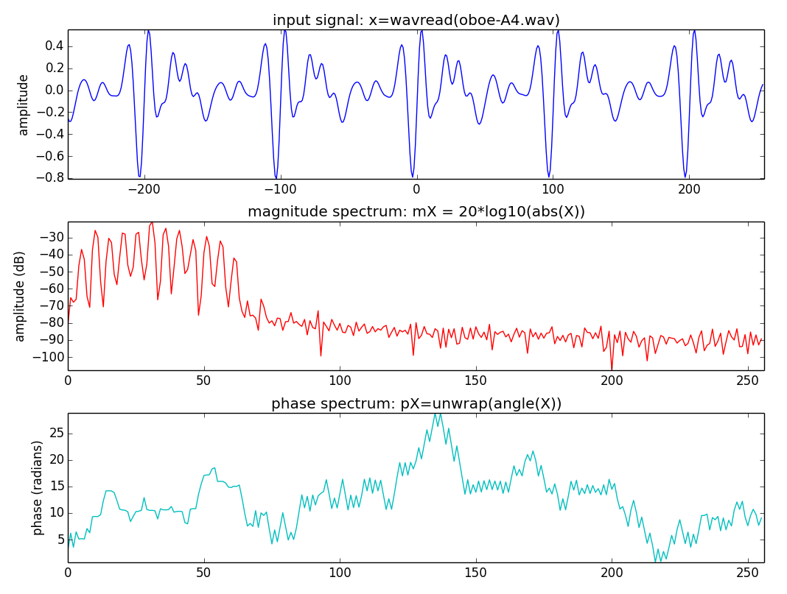

Slide 5
Complex exponentials

Slide 6
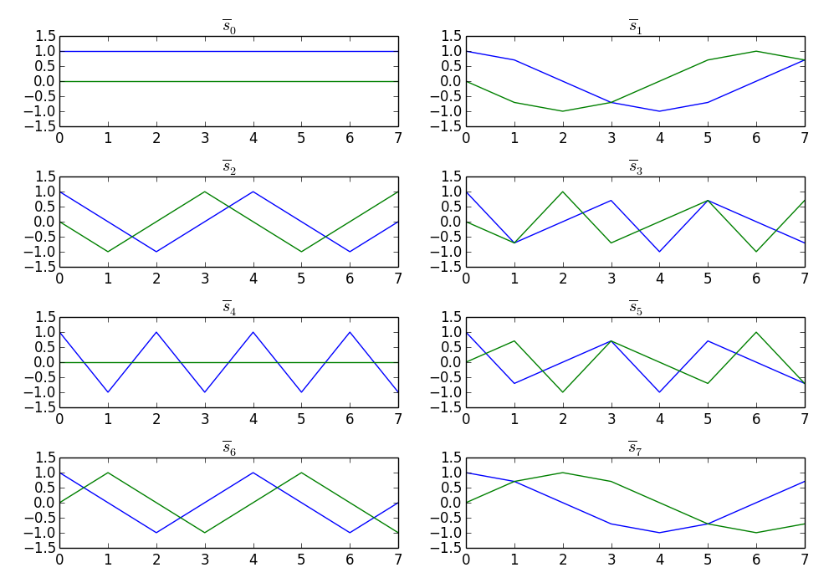
Complex exponentials

Slide 7
Scalar product - DFT
Example:

Slide 8
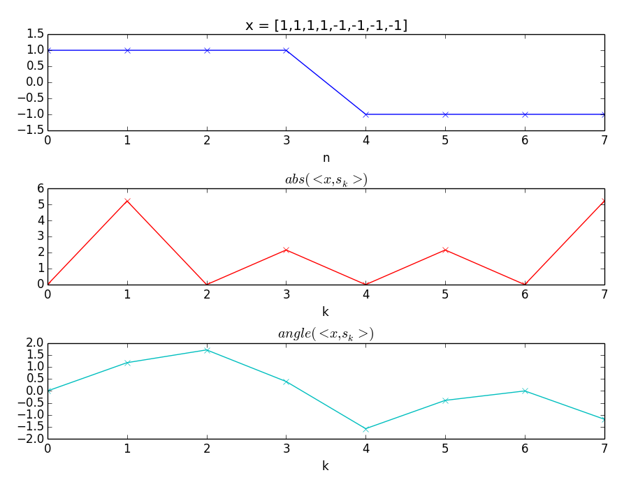
Scalar product - DFT

Slide 9
References and credits
Information in Wikipedia:
  https://en.wikipedia.org/wiki/Discrete_Fourier_transform
Reference on the mathematics of the DFT from Julius O. Smith: https://ccrma.stanford.edu/~jos/mdft/
Sounds from Freesound: http://www.freesound.org/people/xserra/packs/13038/
All slides and code produced for this course are released using the CC Attribution-Noncommercial-Share Alike license or the Affero GPL license and available from https://github.com/MTG/sms-tools

Slide 10
The Discrete Fourier Transform
(1 of 2)
Xavier Serra
Universitat Pompeu Fabra, Barcelona

